Slide 1
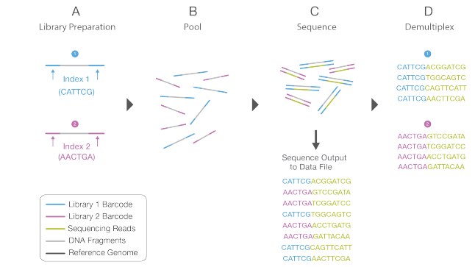
Demultiplexing overview

Slide 2



Problems:
Primers are not found at reads extremity
mutation/sequencing error on primer
Multiple primer 00
Cropped reads (14-mers missing)
Primer from different mid on same reads pair (hybrid reads pair)
a lot of intra library cross-talk / few cross library contamination

Slide 3
Diagnostic method:
Adapt code of standart demultipexing tool (https://github.com/jfjlaros/demultiplex)
For each barcode, check R1 AND R2 for presence. (New code: https://github.com/johrollin/demultiplexing/tree/main)
Count and classified reads in each category:
No tag (nb reads with no tag in the pair)
One tag (nb reads with one tag on the two paired reads)
Both same tag (nb reads with same tag for both read of the pair)
Both different tag (nb reads with different tag for each read of the pair)

Slide 4
One
Demultiplexeur method:
Sample 1
Same
Library x:
Mid 1
Mid 2
Mid 3
One
Sample 2
No tag
Same
Both different tag
one tag found on the two paired reads
Library x Unknown
reads with no tag in the pair
Sample 3
One
Library x Hybrid
reads with different tag for each read of the pair
Same
same tag for both read of the pair

Slide 5
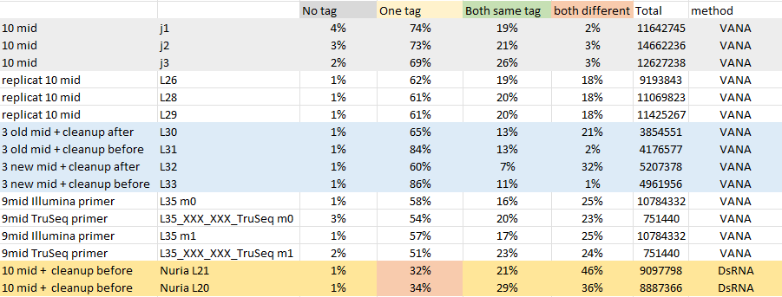
Demultiplex results:

Slide 6
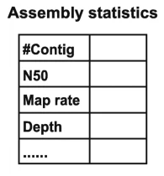
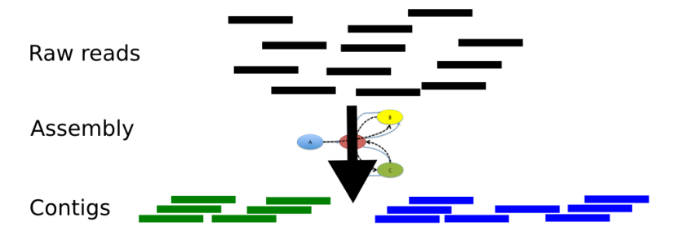
Producing contig:

Slide 7
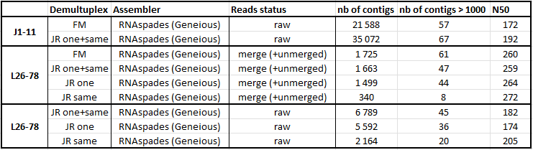
Demultiplexing effect on contig:
More selected are the reads (fewer there is) less short contigs are produced
On the tested cases the all the virus present where detected (blast) in all case => but with less background noise with the “same” only reads.
The most complete contig are produced in the one+same scenario ( ! not enough case tested)

Slide 8
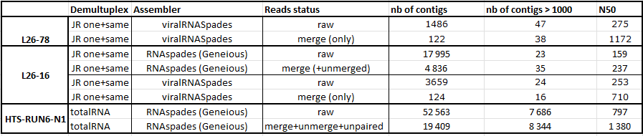
Read merging effect on contig:
Merging the reads allow to obtain longer contigs.

Slide 9
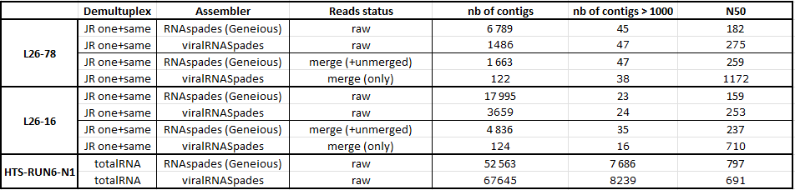
Assembly algo effect on contig:
viralRNAspades tend to obtain longer contig than RNAspades.
Viruses are still found with viralRNAspades with less false positive (blast)
Not tested on satellite/viroid !

