Slide 2
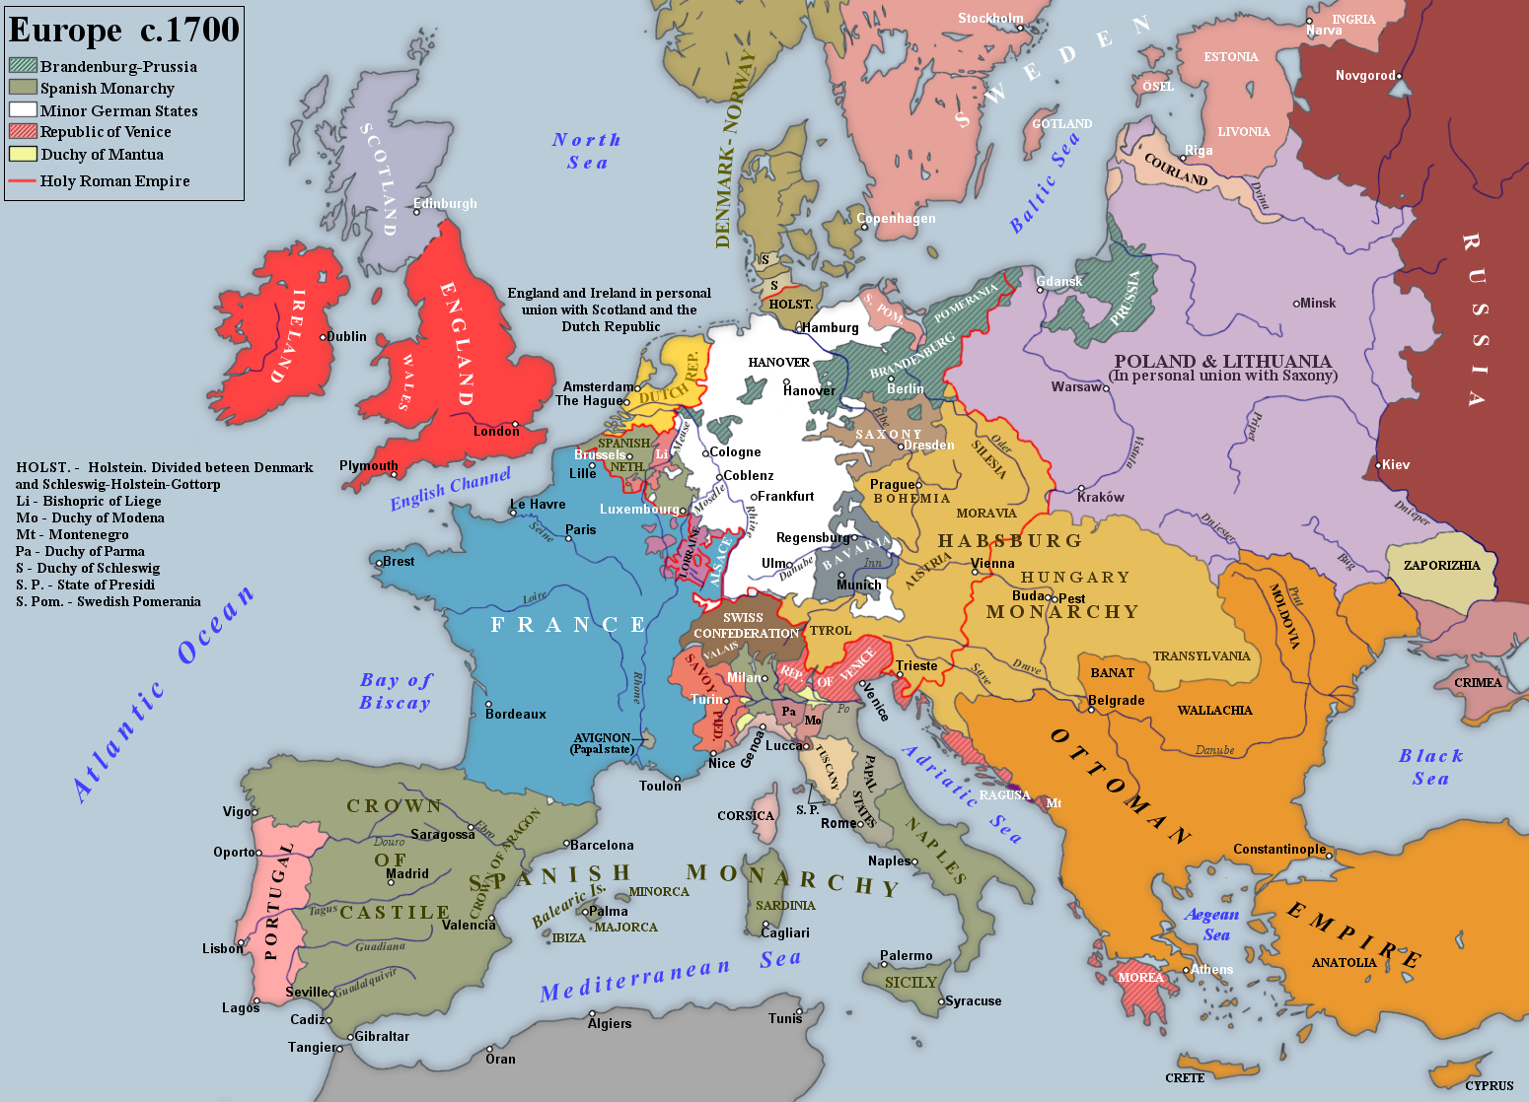

Slide 3
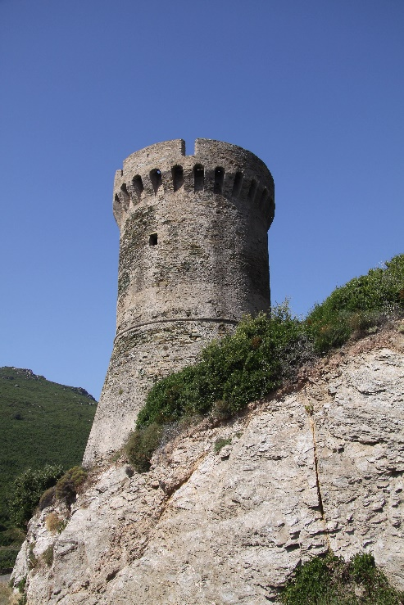
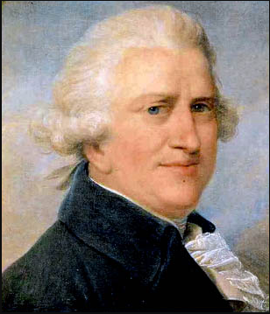
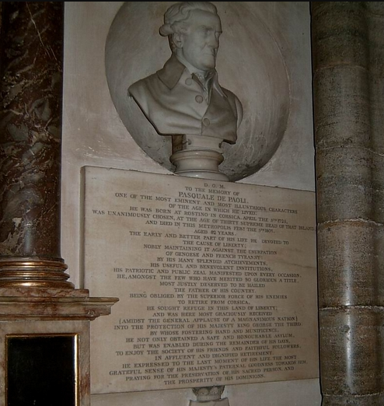
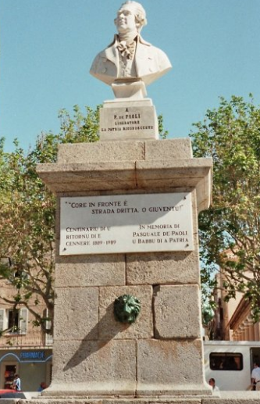
The Corsican Republic
Genoese Rule 1559 – 1755
The Genoese built 85 towers all around the island
They provided some protection against the pirates
Uprisings since 1729
Corsican Republic 1755 -- 1769
First democratic constitution in the world, written mainly by Pasquale Paoli, based on Locke’s ideas.
Universal suffrage for all male over 25
Restricted suffrage for women
French rule (1769 – today)
The French surrender Corsica
Corsica part of France since 1769
Napoleon born in Ajaccio in 1769
Pasquale Paoli (1725 – 1807)
Exile in Britain from 1769 till 1790
Returned to France to support the revolution
Got into troubles with the revolutionaries and went into a second exile in Britain.
Now in Corsica considered a saint.
Cenotaph of Pasquale Paoli,
at Westminster Abbey
Paoli all over the place in
Corsica
(here: Ile Rousse, Corsica)

Slide 4
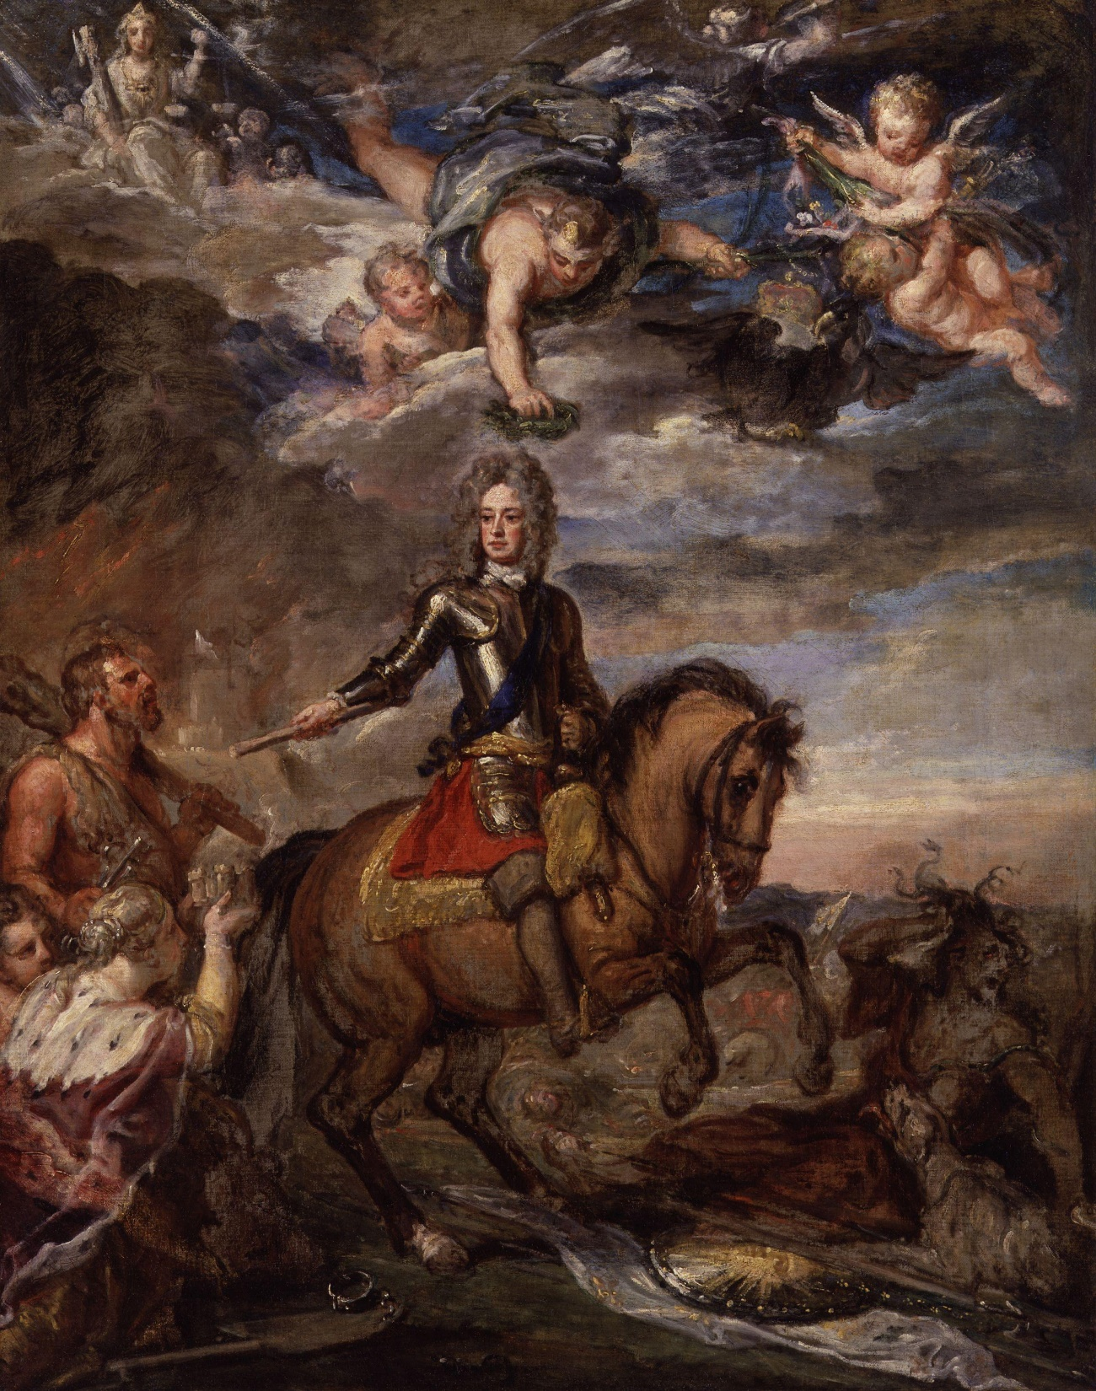
John Churchill (1650 – 1722)
1st Duke of Marlborough
in triumph (about 1704)
OR
Monsieur Marlbrouck,
Louis XIV‘s nightmare

Slide 5
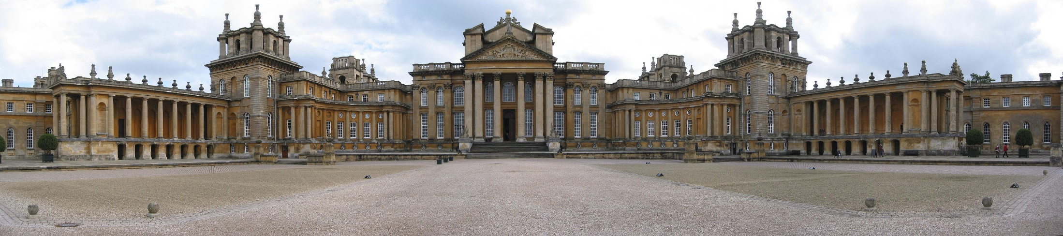
Blenheim Palace

Slide 6
Charles XII 1697 – 1718
Peter I 1682 – 1725
Charles II 1660 – 1685
James II 1685 – 1688
William III, Mary II 1688– 1694
William III 1688 – 1702
Anne 1702 – 1714
George I 1714 -- 1727
(William III 1672 – 1702)
(William IV 1711 – 1722)
Frederick William 1640 – 1688
Frederick I 1688 – 1713
Leopold I 1657 – 1705
Joseph I 1705 – 1711
Charles VI 1711-- 1740
Louis XIII 1610 – 1643
Louis XIV 1643 -- 1715
Philipp IV 1621 – 1665
Charles II 1665 – 1700
Philipp V 1700 – 1724
Notes:
The south of Europe was catholic, the north protestant.
France was by far the largest and most powerful country of Europe.
Louis XIV was an absolute ruler with huge resources. He was an expansionist.
There were the Spanish Hapsburgs and the Austrian ones.
The Austrian Hapsburgs ruled Austria and the Holy Roman Empire, a heterogeneous entity.
They were threatened by France and by the Ottomans, however on the wane.
The Spanish showed clear symptoms of incest; Charles II was called the bewitched. He was completely unfit for his job and had no heir.
Bone of contention: Spanish succession
Philipp V was grandson of Louis XIV. Nightmare of the Allies: France and Spain united.

Slide 7
Europe Almost Continually at War
Churchill’s
apprenticeship
Churchill’s
first feats
Churchill as
Chief Commander
Dutch War
1672 – 1678
(England opting
out in 1674)
Nine Years War
1688 – 1697
War of the Spanish
Succession
1702 – 1715
War of the
Austrian
Succession
1740 – 1748
Seven Years War
1756 – 1763
War of the Polish
Succession
1733 – 1738
(Britain not involved)
Notes:
The age of enlightenment saw an almost uninterrupted chain of wars. Had they nothing better to do?

Slide 8
Containing France
France
(Jacobites)
France
Spain
Bavaria (from 1703)
Nine Years War
1688 – 1697
Treaty of Ryswick (20 Sep 1697)
War of Spanish Succession
1702 – 1715
Treaty of Utrecht (March 1713)
England, Scotland
Dutch Republic
Prussia
Austria
Spain
Great Britain
Dutch Republic
Prussia
Austria
Bavaria (until 1703)
Notes:
A common pattern: The next in line unite against the first in order to prevent him from becoming to powerful.
The first in line was no doubt France.
Austria and Spain were supporting a Protestant usurper against a rightful Catholic king.
France was to be cut down to size, its growing power, its arrogance restrained.
The wars were long drawn-out and expensive.
Threat: James II as French puppet king, France and England one huge political entity, France extending into Germany, the Netherlands and Spain
Main outcome of the Nine Years War: Louis XIV recognised William II as legitimate king of England and promised not to help any of England’s enemies
The allies were held together by William, the enemy was Louis XIV. One huge army is an advantage over an alliance of several armies often in disaccord with each other.
Threat: France and Spain one huge political entity, to be united later on by family links as was England and Scotland; France extending into Germany and the Netherlands.
Main outcome of the War of the Spanish Succession: Phillip V, Louis XIV’s grandson was recognized as legitimate King of Spain, but renounced forever on any claim to the French throne
The allies were held together by Marlborough, the enemy was again Louis XIV. Again, France had the advantage of being one big entity.

Slide 9
Marlborough's Life in Five Stages
Early Life (1650 – 1678)
Page to James, Duke of York, several military expeditions
Lover of Barbara Villiers, marriage with Sarah Jennings
Serving the Duke of York/James II (1678 – 1688)
Accompanies the Duke of York into exile (1682 – 1684)
Defeats Monmouth in the Battle of Sedgemoor (6 July 1685)
Deserts James II (24 November 1688)
Serving William III and Mary (1688 – 1702)
Rocky relationship with William and Mary, with Sarah in between, persisting contact with James.
Some military feats during the Nine Years War, but little reward, then sacked.
At least four probably forged accusations of high treason, five weeks in the Tower, but finally returned in office.
Serving Queen Anne (1702 - 1711)
Commander in Chief of the Allies; many brilliant victories (Blenheim, Ramillies, Oudenaarde, Buchain)
Permanent charges from the Tories as soon as military success is on the wane.
Relation between Anne and Sarah deteriorating; Marlborough finally sacked for ominous reasons.
Old Age (1712 - 1722)
Two years in exile; reappointment to several titles by George I
Defeating the 1715 Jacobite rising.
Death on 16 June 1722 after several strokes.

Slide 10
Early Life (1650 – 1678)
Churchill’s father was Sir Winston Churchill, a former Royalist Captain, noble but poor. John is brought up a protestant
John Churchill lives in Dublin from 1661 till 1664 when his father, Sir Winston Churchill, is appointed as a Commissioner for Irish Land Claims in Dublin.
At 15, John becomes page to James, Duke of York, husband of Anne Hyde, whose Maid of Honour was John’s sister.
In 1670 he goes to the Mediterranean (and possibly to Tangier) under the orders of Sir Thomas Allen.
He becomes a lover of Barbara Villiers and (very likely) fathered a child, Barbara FitzRoy, who would become a Benedictine nun.
Churchill fought as a lieutenant in the Battle of Solebay (28 May 1672) alongside the French against the Dutch. He promoted to a captaincy in the Duke of York’s Admiralty Regiment.
He gained a commendation at the siege of Maastricht (June 1673, surrender of the Dutch) and is credited with saving the Duke of Monmouth’s life. For that, he was praised by the House of Stuart and the House of Bourbon.
He participated in Franco-Dutch war in 1674, serving with and learning from the French Marshal Henri de Turenne. Battles fought: Sinsheim (June 1674), Enzheim (October 1674), Sasbach (July 1675).
Churchill returned in 1675, met Sarah Jennings and married her in the winter of 1677/1678. They had seven children (two boys and five girls).

Slide 11
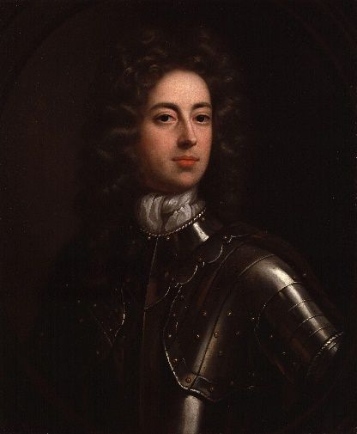
John Churchill,
in 1685

Slide 12
Serving the Duke of York/James (1678 – 1688)
In April 1678 John Churchill and Sidney Godolphin negotiate a convention about the deployment of English troops in Flanders. They meet William, Prince of Orange, who is highly impressed by Churchill.
After the Popish Plot in 1678, the Duke of York was exiled until 1682. Churchill was asked (or obliged?) to accompany him to the Hague, then to Brussels and Edinburgh. In return Churchill was made Lord Churchill of Eyemouth and appointed colonel of the King’s own Regiment of Dragoons. He had now a decent income and could afford a comfortable country life.
On James’s succession in 1685, Churchill was appointed governor of the Hudson Bay Company and got a seat in the House of Lords as Baron Churchill of Sandridge.
The Battle of Sedgemoor (6 July 1685) against Monmouth’s troops was not his most spectacular victory, but his first. Much of the praise went to the official leader Earl of Faversham, loyal but limited. Subsequent ferocities against Monmouth and his followers instigated by judge Jeffreys set in train a process of disillusion.
Churchill’s stance was this: If the King should attempt to change our religion, I will instantly quit his services.
Churchill deserted James on 24 November 1688, leaving behind a letter of apology and self-justification. It was the death-blow for the Royal Cause.
But James II was the man to whom Churchill owed virtually everything in his life and career.

Slide 13
Serving William III and Mary (1688 – 1702)
William entertained reservations about Churchill, now earl of Marlborough, the man who had deserted James.
William and Mary distrusted Marlborough's and his wife’s influence on Princess Anne. Mary disgusted him.
Churchill saw only three years in the field of the Nine Years War. After the Battle of the Boyne (1 July 1690) Marlborough left himself for Ireland and took Cork (27 September) and Kinsale (15 October), thus disrupting James’s supply routes.
But William who favored Dutch commanders failed to award Marlborough the Order of the Garter nor was he appointed Master-General of the Ordonnance. William and Marlborough were on bad terms, also due to Marlborough’s contact with James. Marlborough was anxious to obtain pardon for his desertion.
In January 1692, Mary ordered her sister Anne to dismiss Sarah from her household, and Marlborough was sacked and forbidden the court.
Young’s letters, inviting James to come back and purporting the seizure of William. They turned out to be a forgery, but Marlborough spend five weeks in the Tower (4 May – 15 June 1692).
The landing at the Camaret Bay (18 June 1694) was a complete disaster for the English and Dutch; Marlborough was accused of having warned the French by the Camaret letter. New accusations came up in 1696 (John Fenwick)
Marlborough represented the sick William in The Hague, negotiating the Treaty of the Second Great Alliance (7 September 1701) against France, signed by England, Austria and the Dutch Republic.

Slide 14
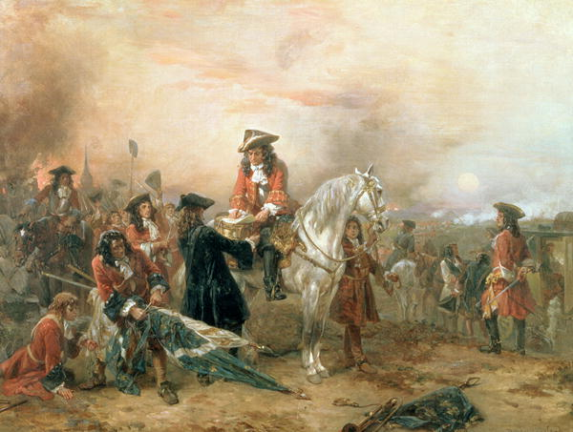
Marlborough writing a dispatch to his wife after the battle of Blenheim

Slide 15
Serving Queen Anne (1702 – 1707)
Marlborough and his wife were lavished with titles, had 60.000 pounds per year and unrivalled influence.
The War of the Spanish Succession began (4 May 1702). Marlborough was commander in chief of the allied forces. Some early successes (e.g. Venlo, Roermond, Stevenswert, Liege, Bonn).
Limited success in 1703, defeat at the battle of Eckeren (30 June 1703). Dispute between Tories (emphasizing the role of the Navy) and Marlborough/Whigs (Continental strategy). Thanks to the Whigs (Godolphin) Marlborough had plenty of money.
Marlborough won the Battle of Blenheim (14 August 1704) after an logistic feat (march over 300 mls), duping the Dutch. The French were frustrated; Marlborough was awarded the royal manor of Woodstock, to become Blenheim Palace.
But in 1705 things didn’t go well. A planned invasion of France didn’t take place, Marlborough’s success was considered a lucky strike. Relations between Anne (Tories) and Sarah (Whigs) deteriorated.
1706 saw the victory of Ramillies (23 May 1706) and the French defeat at Turin (September 1706) by Prince Eugene. This was grist to the mill of the Whigs, with the earl of Sunderland made Secretary of State. Abigal Masham effectively replaced Sarah, Richard Harley became Anne’s adviser.
1707 was again a bad year: setbacks in Spain at Alanza and along the Rhine, Prince Eugene retreated from Toulon. Even so Henry Boyle (Whig) replaced Harley, Robert Walpole (Whig) became Secretary at War, much to the displeasure of the Queen.

Slide 16
Serving Queen Anne (1708 – 1711)
The victory of Oudenaarde (11 July 1708) demoralised the French who were driven out of almost all the Spanish Netherlands. The Whigs were rising, the Queen distracted by Sarah.
Early in 1709, France was on the brink of collapse. Peace talks in The Hague (April 1709) didn’t succeed: No peace without Spain. The ensuing battle of Malplaquet (9 September 1709) was a Pyrrhic victory with over 24.000 casualties on the side of the Allies. The Tories were quick to criticise Marlborough, much to the pleasure of Queen Anne.
In 1710, the Tories won a landslide victory, England was weary. Sunderland and Godolphin were dismissed, Marlborough requested to remain in office until the new government had made their own arrangements for peace.
In 1711, Sarah fell into final disgrace. Marlborough’s last feat was the siege of the fortress of Buchain (12 September 1711). On 29 December 1711 he was dismissed on dubious grounds of having taken money.

Slide 17
Old Age (1711 – 1722)
He went into exile on 1 December 1712, his fortune in peril, Blenheim Palace unfinished, running out of money.
He remained in contact with both the Elector of Hanover and with James. The Queen still retained a personal attachment to him.
He returned to England the day the Queen died (1 August 1714). He was reappointed by George I as Captain-General and was returned several other titles.
He presided over the defeat of the 1715 Jacobite rising
After 1716 he suffered several strikes. He died on 16 June 1722

Slide 18
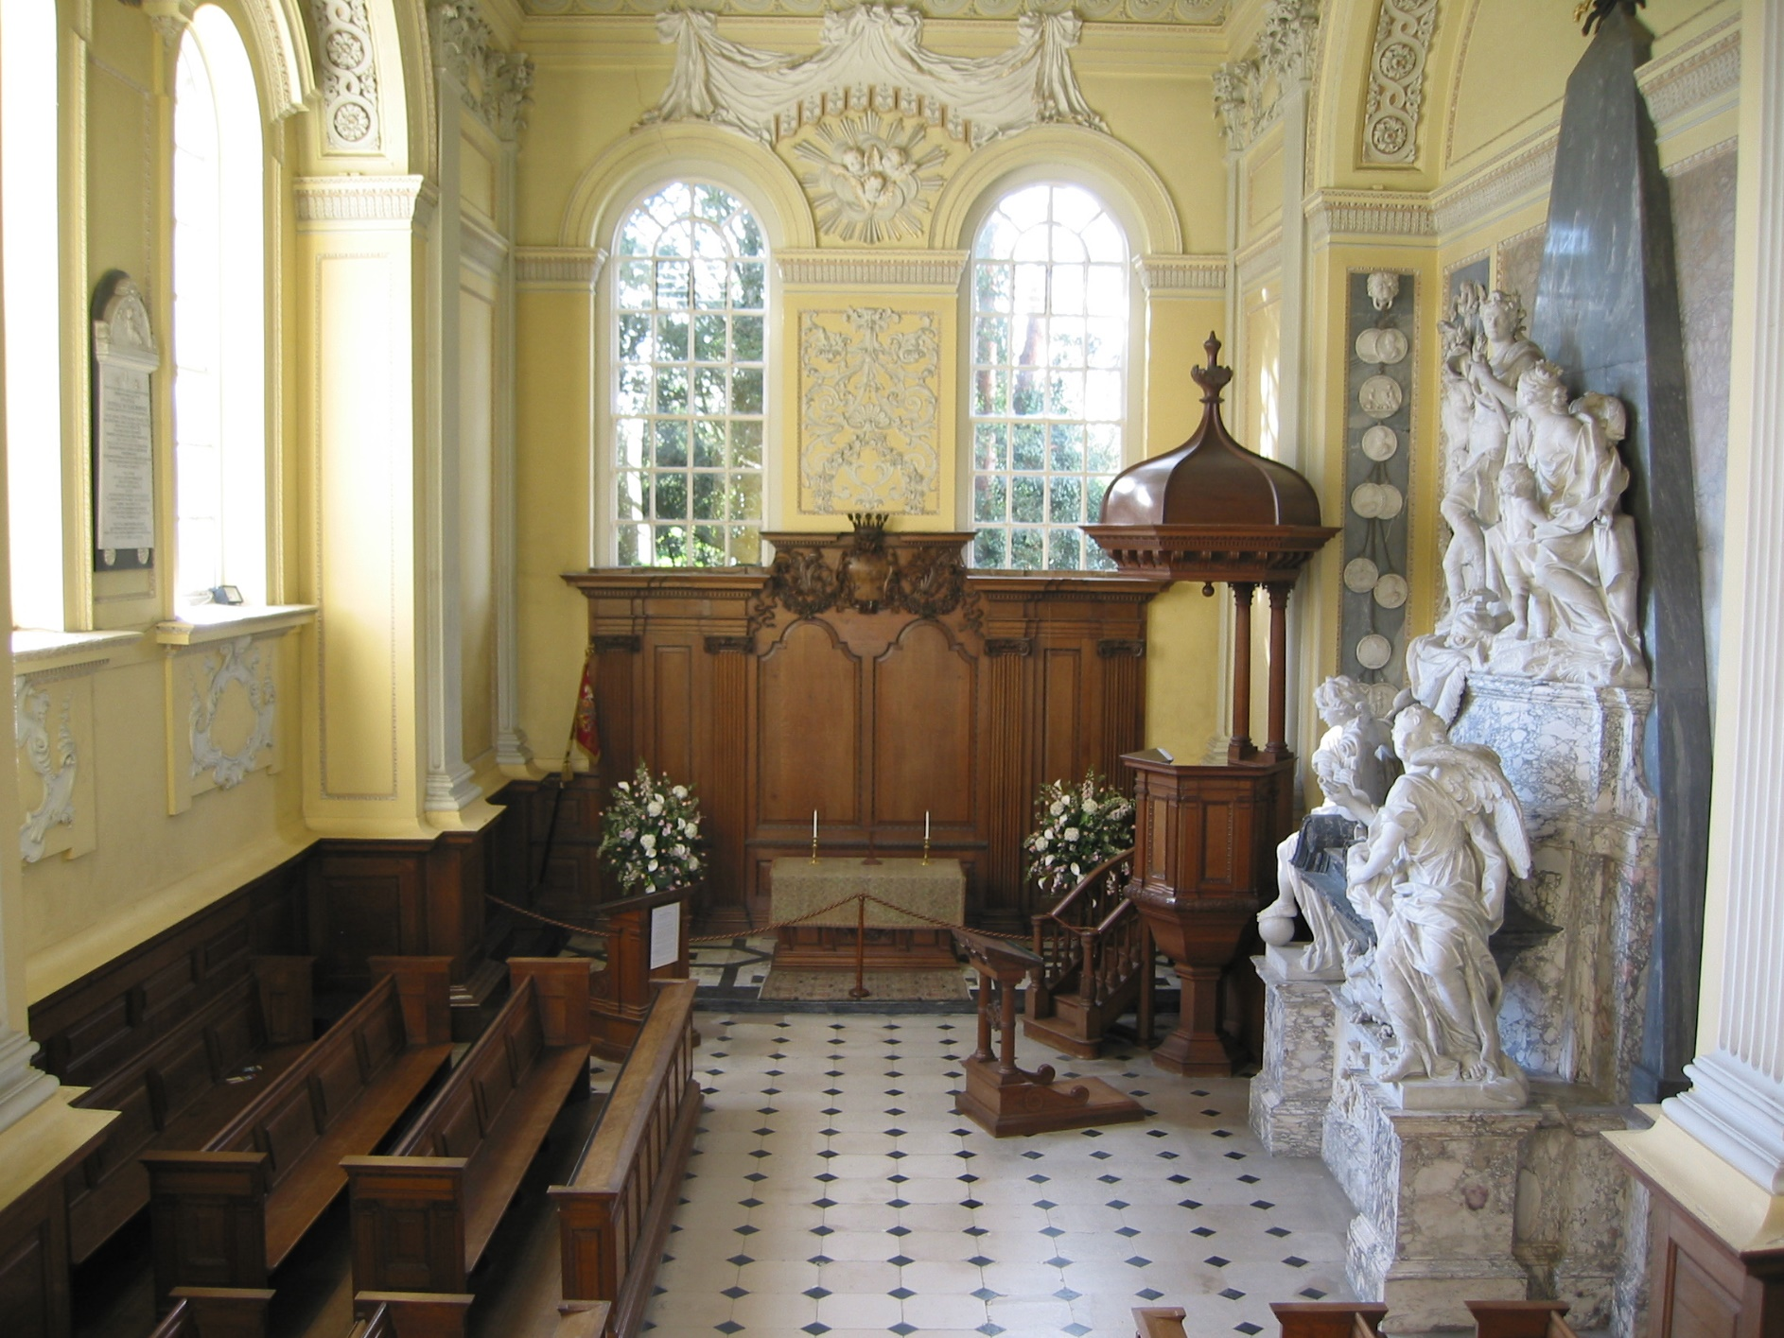
Resting place of the Duke and Duchess in the chapel at Blenheim Palace

