Slide 1
GSoC 2026 · Intel OpenVINO Toolkit
Agentic AI for
Predictive Maintenance
“What should I inspect next?”
Extending the Intel Metro AI Suite Blueprint
Contributor | : Hyeongseob Jo
Mentors | : Hassnaa Moustafa, Anand Bodas, Rohit Verma

Slide 2
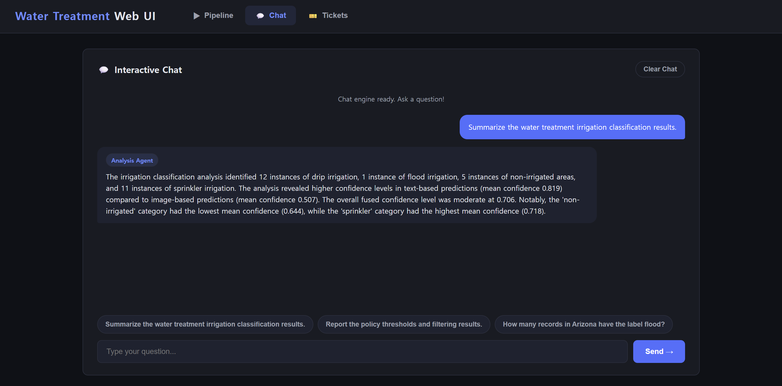
1. Core Pipeline Improvements
Unified AI chat, structured data queries, and a modular OpenVINO inference pipeline

Slide 3
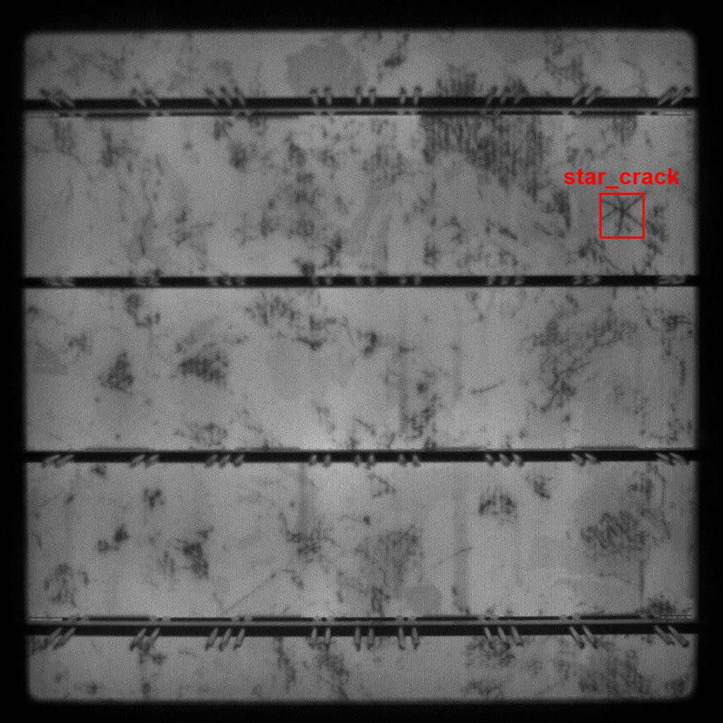

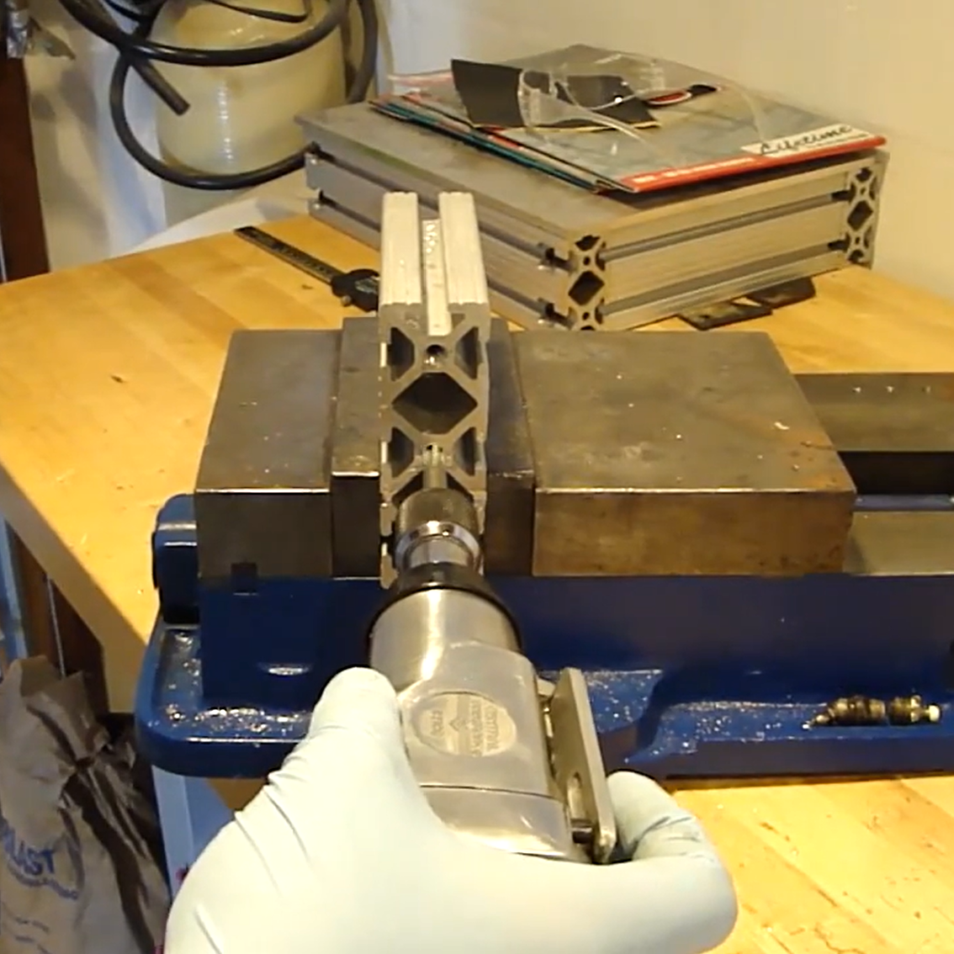
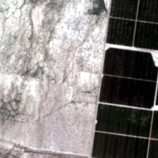
2. New Use Cases, One Shared Pipeline
Use Cases
Inference
w/ OpenVINO
Results
AI Agents
Chat System
Multimodal inputs
Model execution
JSONL + SQLite
Analysis + evidence
Queries
Solar Panel
Power Transmission
Manufacturing
Irrigation
Reference: github.com/johyeongseob/gsoc-2026

