Slide 1
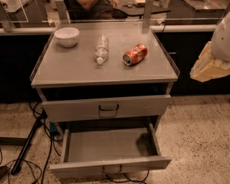
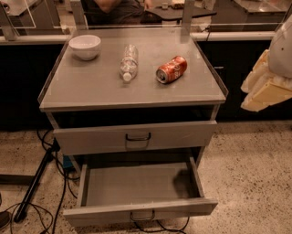
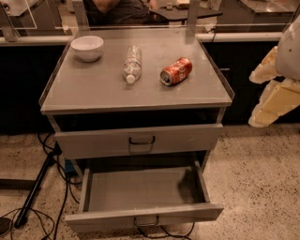
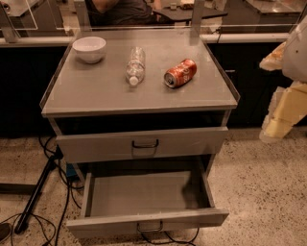
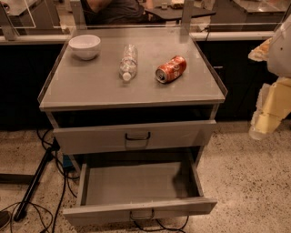



Text Emb. $v∈ℝ^{512}$
Action slots [B,6,11,512]
USE-L/5
Add
"close middle drawer"
Arm(7), Base(3), Mode(1)
[B,6,81,512]
[B,6,8,512]
[B,114,512]
FiLM
FiLM
MBConv
…
…
MBConv
Linear 1$×$1 Conv
TokenLeraner
Self-Attention
[B, 6, 300, 300, 3]
Self-Attention
Normalize + Resize
FiLM-EfficientNet-B3
Transformer
Action
Historical images

