Slide 1




Exqutor: Extended Query Optimizer for Vector-augmented Analytical Queries
Hyunjoon Kim¹, Chaerim Lim¹, Hyeonjun An¹, Rathijit Sen², Kwanghyun Park¹
1
2
Notes:
Hello everyone. I am so glad to be here today as the first speaker of this session. My name is chaerim lim, from yonsei university studying for a master degree. Today I’m gonna present our research work called ‘Exqutor: Extended Optimizer for Vector-augmented analytical queries’.

Slide 2






Summary
Check Exqutor
on our GitHub!
Existing Database Management Systems
,
,
,
, etc.
Exqutor
Existing systems rely on “blind” heuristic cardinality estimation for vector similarity search.
Exqutor achieves up to four orders of magnitude speedup for vector-augmented analytical queries.
Notes:
Let me start with vector similarity search, often referred to as VSS. It measures the distance between multi-dimensional data points to determine how similar they are.
For example, suppose we have dogs, cats, apples, and bananas.
We can transform these images into multi-dimensional vectors using embedding models, which we refer to as embedding vectors.

Slide 3
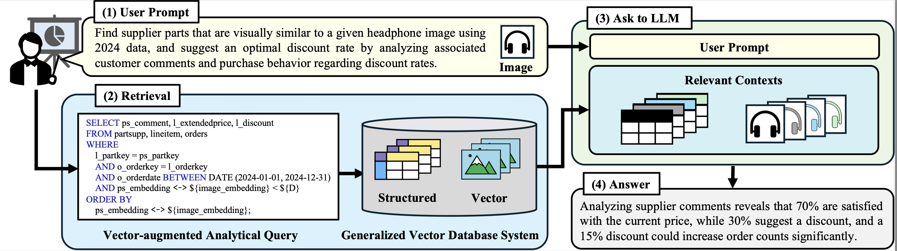
VAQ in RAG Scenario
Given supplier parts similar to this headphone image, analyze customer comments from 2024 data and
determine an appropriate discount rate.
Analyst
Notes:
Let me start with vector similarity search, often referred to as VSS. It measures the distance between multi-dimensional data points to determine how similar they are.
For example, suppose we have dogs, cats, apples, and bananas.
We can transform these images into multi-dimensional vectors using embedding models, which we refer to as embedding vectors.

Slide 4

VAQ in RAG Scenario
Given supplier parts similar to this headphone image, analyze customer comments from 2024 data and
determine an appropriate discount rate.
Analyst
Notes:
Let me start with vector similarity search, often referred to as VSS. It measures the distance between multi-dimensional data points to determine how similar they are.
For example, suppose we have dogs, cats, apples, and bananas.
We can transform these images into multi-dimensional vectors using embedding models, which we refer to as embedding vectors.

Slide 5
VAQ in RAG Scenario
Given supplier parts similar to this headphone image, analyze customer comments from 2024 data and
determine an appropriate discount rate.
Analyst
Notes:
Let me start with vector similarity search, often referred to as VSS. It measures the distance between multi-dimensional data points to determine how similar they are.
For example, suppose we have dogs, cats, apples, and bananas.
We can transform these images into multi-dimensional vectors using embedding models, which we refer to as embedding vectors.

Slide 6
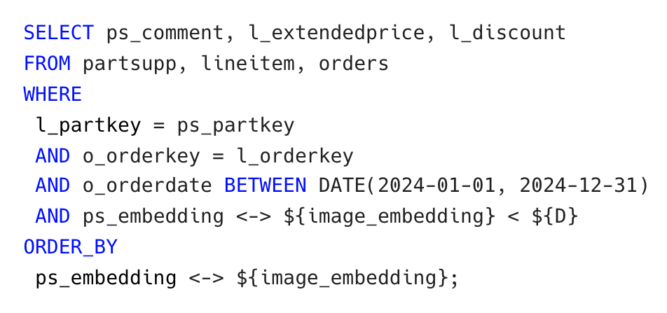

VAQ in RAG Scenario
Given supplier parts similar to this image, analyze customer comments from 2024 data and determine an appropriate discount rate.
Analyst
Notes:
Let me start with vector similarity search, often referred to as VSS. It measures the distance between multi-dimensional data points to determine how similar they are.
For example, suppose we have dogs, cats, apples, and bananas.
We can transform these images into multi-dimensional vectors using embedding models, which we refer to as embedding vectors.

Slide 7
Vector-augmented Analytical Queries
Given supplier parts similar to this image, analyze customer comments from 2024 data and determine an appropriate discount rate.
Analyst
Relational filters and joins
Notes:
Let me start with vector similarity search, often referred to as VSS. It measures the distance between multi-dimensional data points to determine how similar they are.
For example, suppose we have dogs, cats, apples, and bananas.
We can transform these images into multi-dimensional vectors using embedding models, which we refer to as embedding vectors.

Slide 8
Vector-augmented Analytical Queries
Given supplier parts similar to this image, analyze customer comments from 2024 data and determine an appropriate discount rate.
Analyst
Relational filters and joins
Vector Similarity Search
To find semantically related items
by calculating their distance
Notes:
Let me start with vector similarity search, often referred to as VSS. It measures the distance between multi-dimensional data points to determine how similar they are.
For example, suppose we have dogs, cats, apples, and bananas.
We can transform these images into multi-dimensional vectors using embedding models, which we refer to as embedding vectors.

Slide 9

Vector-augmented Analytical Queries
Given supplier parts similar to this image, analyze customer comments from 2024 data and determine an appropriate discount rate.
Analyst
Relational filters and joins
Vector Similarity Search
Vector-augmented Analytical Queries (VAQs)
Check VAQs
on our GitHub!
Notes:
Let me start with vector similarity search, often referred to as VSS. It measures the distance between multi-dimensional data points to determine how similar they are.
For example, suppose we have dogs, cats, apples, and bananas.
We can transform these images into multi-dimensional vectors using embedding models, which we refer to as embedding vectors.

Slide 10
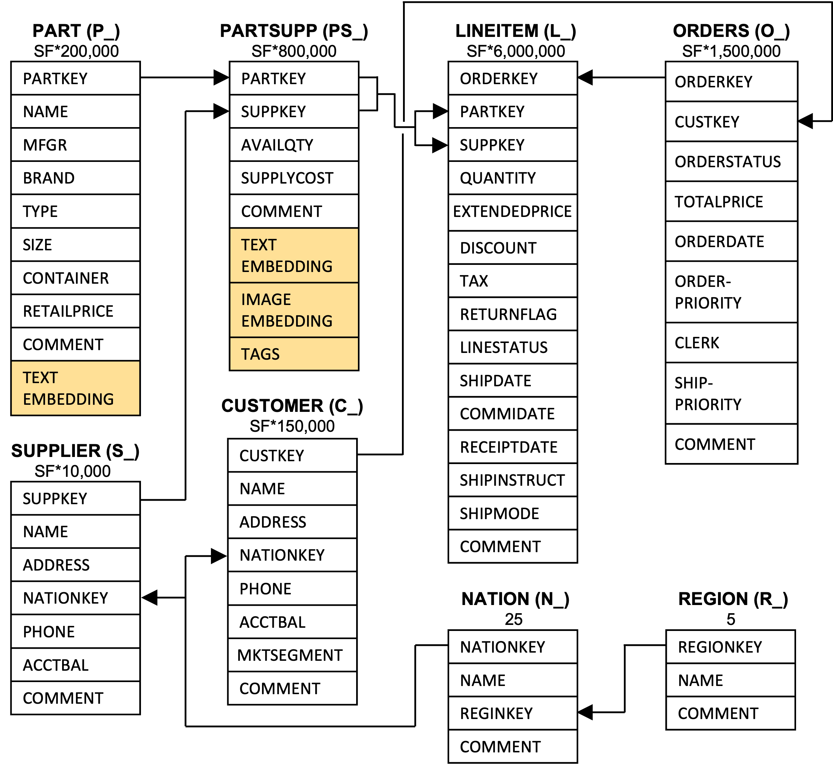
Vector-augmented SQL Analytics
TPC-H and TPC-DS benchmark (SF100) are extended with vector datasets: DEEP (96 dim), SIFT (128 dim), and SimSearchNet (256 dim)
New vector columns (yellow) in TPC-H benchmark
VAQ derived from TPC-H Query 12
Check benchmark
on our GitHub!
Notes:
To evaluate the performance of VAQs, we designed a benchmark called Vector-augmented SQL Analytics. This benchmark extends two well-established analytical workloads, TPC-H and TPC-DS; by adding a realistic vector data column to the schema.
For example, in the tpc-h based benchmark, we add an image_embedding column to the partsupp table. This column contains realistic vector data. In the case of the DEEP dataset, for instance, it consists of 96 dimensional vectors obtained by embedding image data.
To evaluate our method under diverse settings, we also conducted experiments using other vector datasets, including 128 dimensional SIFT and 256-dimensional SimSearchNet.

Slide 11


Poor Performance of VAQs on Existing Systems
Vector-augmented Analytical Queries (VAQs)
pgvector
(PostgreSQL)
duckdb-vss
(DuckDB)
Notes:
Let me start with vector similarity search, often referred to as VSS. It measures the distance between multi-dimensional data points to determine how similar they are.
For example, suppose we have dogs, cats, apples, and bananas.
We can transform these images into multi-dimensional vectors using embedding models, which we refer to as embedding vectors.

Slide 12
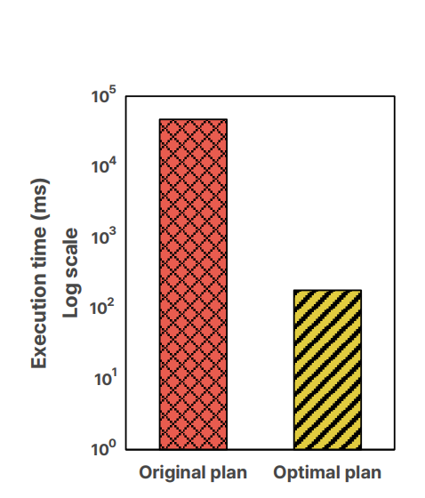
Poor Performance of VAQs on Existing Systems
Vector-augmented Analytical Queries (VAQs)
End-to-end execution time of VAQ (TPC-H based Query 12 with DEEP dataset, SF100)
~300x
speedup
pgvector
(PostgreSQL)
duckdb-vss
(DuckDB)
pgvector
pgvector with Exqutor
*Experiment Setup
Intel Xeon Gold 6530 with 128 vCPUs and 1.0 TB of RAM.
Notes:
Let me start with vector similarity search, often referred to as VSS. It measures the distance between multi-dimensional data points to determine how similar they are.
For example, suppose we have dogs, cats, apples, and bananas.
We can transform these images into multi-dimensional vectors using embedding models, which we refer to as embedding vectors.

Slide 13
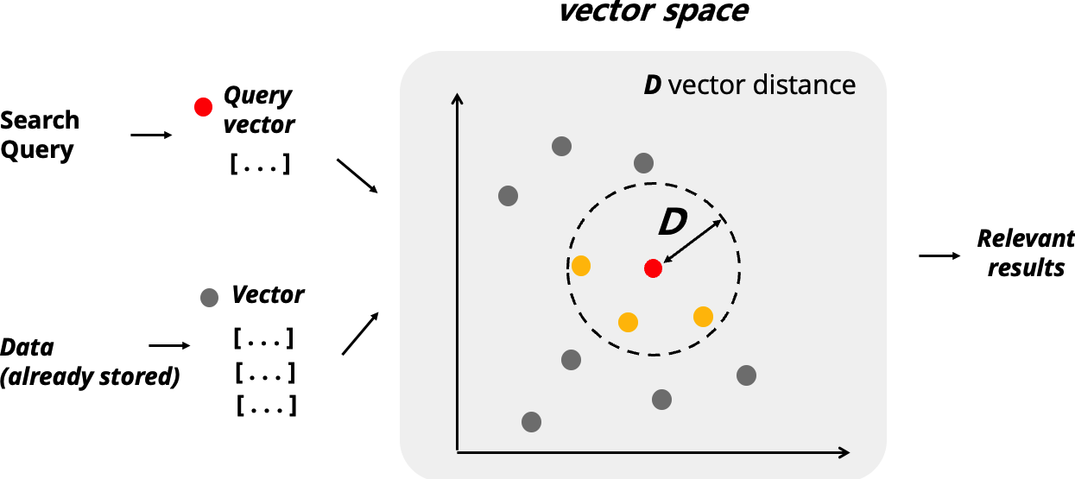
Wrong VSS Cardinality
Existing systems use fixed heuristic cardinality of VSS.
VAQ
${user-defined parameter}
A small D implies high similarity
Notes:
Let me start with vector similarity search, often referred to as VSS. It measures the distance between multi-dimensional data points to determine how similar they are.
For example, suppose we have dogs, cats, apples, and bananas.
We can transform these images into multi-dimensional vectors using embedding models, which we refer to as embedding vectors.

Slide 14
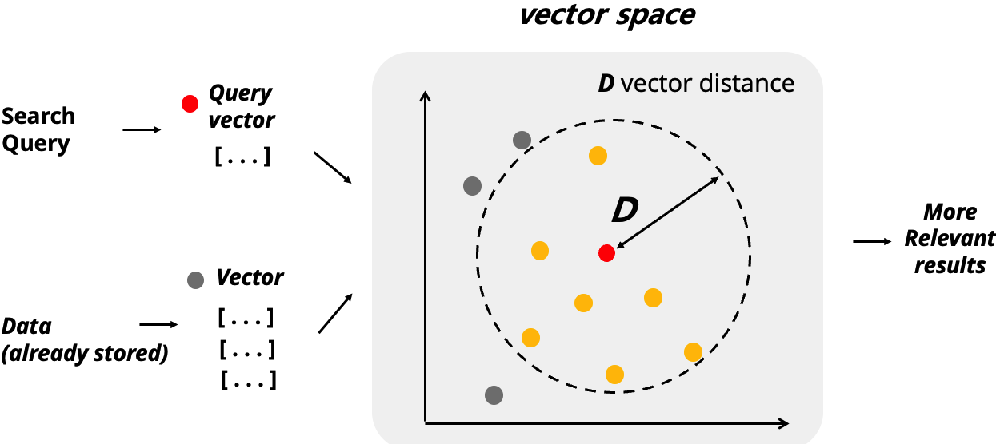
Wrong VSS Cardinality
Existing systems use fixed heuristic cardinality of VSS.
VAQ
${user-defined parameter}
However, the cardinality of VSS can be changed by vector distance threshold D
Notes:
Let me start with vector similarity search, often referred to as VSS. It measures the distance between multi-dimensional data points to determine how similar they are.
For example, suppose we have dogs, cats, apples, and bananas.
We can transform these images into multi-dimensional vectors using embedding models, which we refer to as embedding vectors.

Slide 15
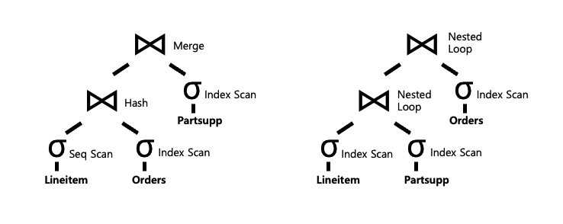
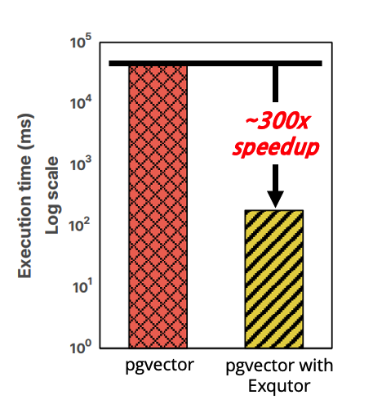
Wrong VSS Cardinality
VAQ
query plan from pgvector
contains
vectors
Set D to a small value
Existing systems
pgvector
duckdb-vss
Fixed VSS selectivity 0.333
Fixed VSS selectivity 1.0
Notes:
Let me start with vector similarity search, often referred to as VSS. It measures the distance between multi-dimensional data points to determine how similar they are.
For example, suppose we have dogs, cats, apples, and bananas.
We can transform these images into multi-dimensional vectors using embedding models, which we refer to as embedding vectors.

Slide 16
Wrong VSS Cardinality
VAQ
query plan from pgvector
contains
vectors
Set D to a small value
Existing systems
query plan from pgvector with Exqutor
pgvector
duckdb-vss
Exqutor
Check Exqutor
on our GitHub!
Notes:
Let me start with vector similarity search, often referred to as VSS. It measures the distance between multi-dimensional data points to determine how similar they are.
For example, suppose we have dogs, cats, apples, and bananas.
We can transform these images into multi-dimensional vectors using embedding models, which we refer to as embedding vectors.

Slide 17
Wrong VSS Cardinality
VAQ
query plan from pgvector
contains
vectors
Set D to a small value
Accurate VSS cardinality estimation is the key of the performance VAQ!!
Existing systems
query plan from pgvector with Exqutor
pgvector
duckdb-vss
Exqutor
Notes:
Let me start with vector similarity search, often referred to as VSS. It measures the distance between multi-dimensional data points to determine how similar they are.
For example, suppose we have dogs, cats, apples, and bananas.
We can transform these images into multi-dimensional vectors using embedding models, which we refer to as embedding vectors.

Slide 18
Exqutor
An open-source, pluggable framework for improving VSS cardinality estimation in existing DBMSs
DBMS
,
,
,
, etc.
Check Exqutor
on our GitHub!
Notes:
To address this limitation, we propose Exqutor, an open-source framework for improving VSS cardinality estimation in relational DBMSs.
When VAQ enters into the DBMS, Exqutor recognizes the queries and, during the query planning phase, provides more accurate cardinality estimates for VSS to the query optimizer. This allows the optimizer to generate more efficient query plans.
In the system overview, we show two complementary mechanisms for estimating VSS cardinality. Since VSS is executed in DBMSs in two main scenarios, each mechanism in Exuqtor is designed for one of these scenarios.

Slide 19
Exqutor
An open-source, pluggable framework for improving VSS cardinality estimation in existing DBMSs
DBMS
,
,
,
, etc.
Two complementary mechanisms
Check Exqutor
on our GitHub!
Notes:
To address this limitation, we propose Exqutor, an open-source framework for improving VSS cardinality estimation in relational DBMSs.
When VAQ enters into the DBMS, Exqutor recognizes the queries and, during the query planning phase, provides more accurate cardinality estimates for VSS to the query optimizer. This allows the optimizer to generate more efficient query plans.
In the system overview, we show two complementary mechanisms for estimating VSS cardinality. Since VSS is executed in DBMSs in two main scenarios, each mechanism in Exuqtor is designed for one of these scenarios.

Slide 20
Exqutor
(1) Vector Index-based Exact Cardinality Query Optimization (ECQO)
Exqutor runs only the vector index portion of the query during the query planning phase
Query planning phase
Execution phase
1. Identify the VSS part
Notes:
First of all, when an index is available, Exuqtor performs exact-cardinality-query-optimization or ECQO.
In this method, Exqutor executes only the vector index portion of the query during the query planning phase, obtains the actual result, and uses it as the estimated cardinality for query optimization.
The key advantage is that, since Exqutor runs the actual vector search in advance, it can provide the optimizer with the true cardinality rather than a heuristic estimate.
One natural concern is the overhead introduced by this approach. However, we keep this overhead below 0.01% of the performance gain.
This is possible for two reasons.
First, vector ANN indexes are inherently lightweight, so invoking them during the query planning phase incurs very little cost.
Second, the result is cached and reused during the actual execution phase.

Slide 21
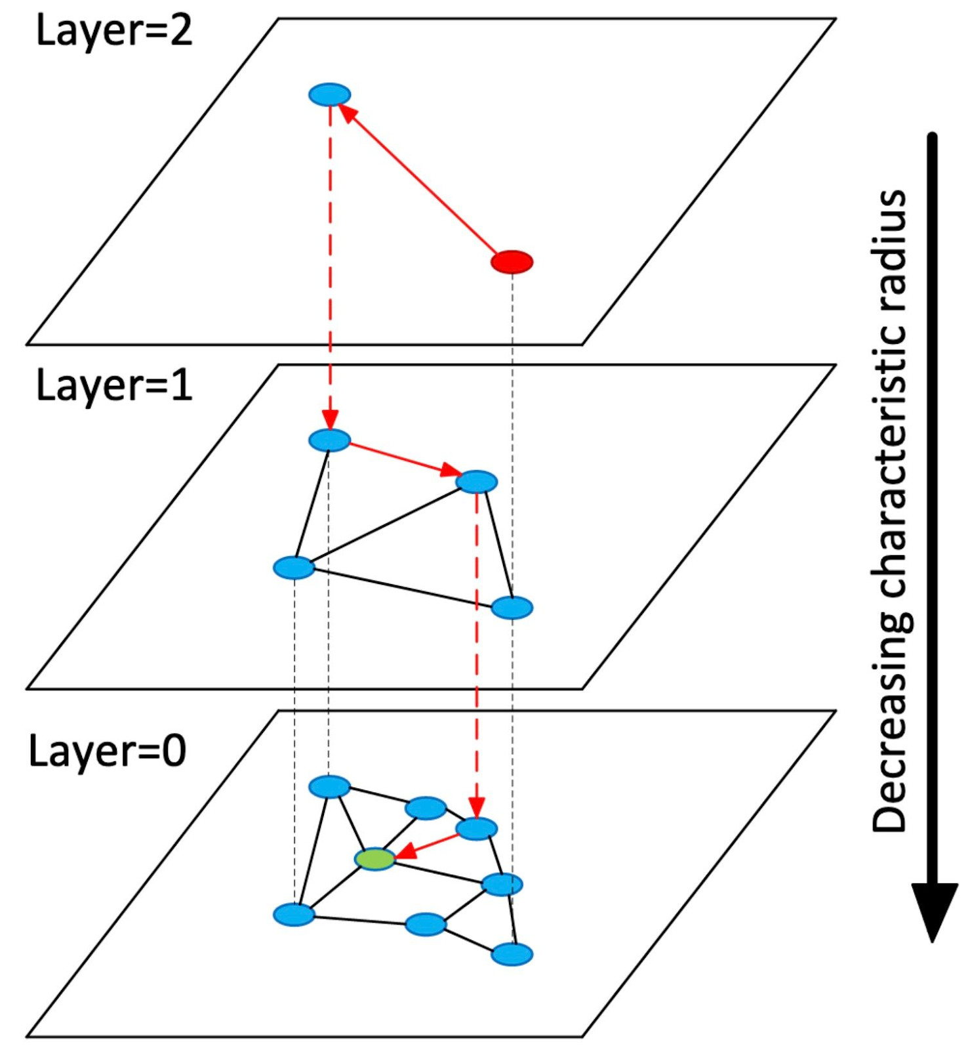
Exqutor
(1) Vector Index-based Exact Cardinality Query Optimization (ECQO)
Exqutor runs only the vector index portion of the query during the query planning phase
Query planning phase
Execution phase
1. Identify the VSS part
2. Execute with the vector index (e.g., HNSW)
Notes:
First of all, when an index is available, Exuqtor performs exact-cardinality-query-optimization or ECQO.
In this method, Exqutor executes only the vector index portion of the query during the query planning phase, obtains the actual result, and uses it as the estimated cardinality for query optimization.
The key advantage is that, since Exqutor runs the actual vector search in advance, it can provide the optimizer with the true cardinality rather than a heuristic estimate.
One natural concern is the overhead introduced by this approach. However, we keep this overhead below 0.01% of the performance gain.
This is possible for two reasons.
First, vector ANN indexes are inherently lightweight, so invoking them during the query planning phase incurs very little cost.
Second, the result is cached and reused during the actual execution phase.

Slide 22
Exqutor
(1) Vector Index-based Exact Cardinality Query Optimization (ECQO)
Exqutor runs only the vector index portion of the query during the query planning phase
Query planning phase
Execution phase
1. Identify the VSS part
2. Execute with the vector index (e.g., HNSW)
3. Retrieve the actual result
Notes:
First of all, when an index is available, Exuqtor performs exact-cardinality-query-optimization or ECQO.
In this method, Exqutor executes only the vector index portion of the query during the query planning phase, obtains the actual result, and uses it as the estimated cardinality for query optimization.
The key advantage is that, since Exqutor runs the actual vector search in advance, it can provide the optimizer with the true cardinality rather than a heuristic estimate.
One natural concern is the overhead introduced by this approach. However, we keep this overhead below 0.01% of the performance gain.
This is possible for two reasons.
First, vector ANN indexes are inherently lightweight, so invoking them during the query planning phase incurs very little cost.
Second, the result is cached and reused during the actual execution phase.

Slide 23
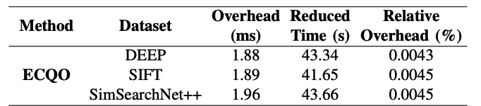
Exqutor
(1) Vector Index-based Exact Cardinality Query Optimization (ECQO)
Exqutor runs only the vector index portion of the query during the query planning phase
Query planning phase
Execution phase
1. Identify the VSS part
2. Execute with the vector index (e.g., HNSW)
3. Retrieve the actual result
Overhead below 0.01% of the performance gain!
Lightweight vector index & reusing the result
Notes:
First of all, when an index is available, Exuqtor performs exact-cardinality-query-optimization or ECQO.
In this method, Exqutor executes only the vector index portion of the query during the query planning phase, obtains the actual result, and uses it as the estimated cardinality for query optimization.
The key advantage is that, since Exqutor runs the actual vector search in advance, it can provide the optimizer with the true cardinality rather than a heuristic estimate.
One natural concern is the overhead introduced by this approach. However, we keep this overhead below 0.01% of the performance gain.
This is possible for two reasons.
First, vector ANN indexes are inherently lightweight, so invoking them during the query planning phase incurs very little cost.
Second, the result is cached and reused during the actual execution phase.

Slide 24
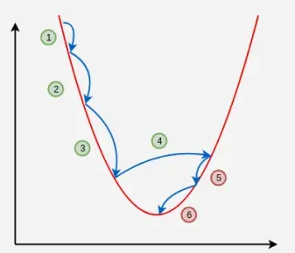
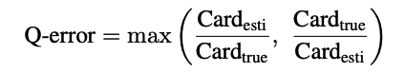
Exqutor
(2) Sampling-based Cardinality Estimation
When vector index is not available, Exqutor estimates VSS cardinality with sampling
Problem: Fixed sample size is not always sufficient
Momentum-based adjustment algorithm: Exqutor adaptively adjusts the sample size based on Q-error.
Q-error
Sampling size
Notes:
When no index is available, Exuqtor uses a sampling-based approach. However, simple random sampling is not always sufficient. We need to consider that vector data is high-dimensional, and in some cases, the data distribution itself may also be skewed.
To address these challenges, Exqutor adaptively adjusts the sample size. Specifically, it uses a momentum-based adjustment algorithm. This algorithm uses q-error, which captures the gap between the sampling-based estimate and the true cardinality. Based on this value, the sample size is increased or decreased accordingly.

Slide 25
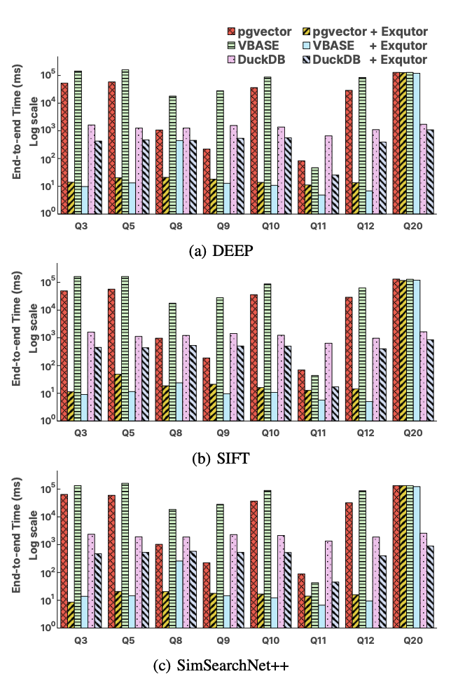
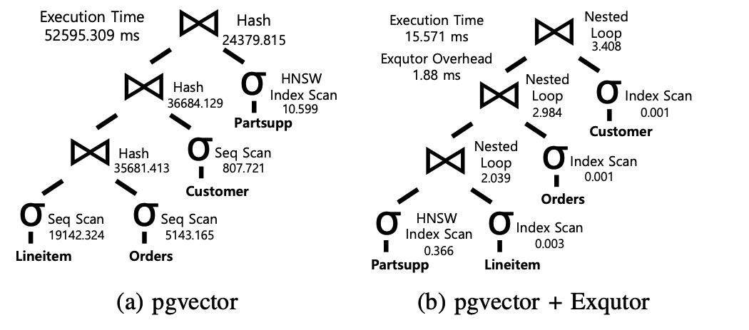

Evaluation
(1) Vector Index-based Exact Cardinality Query Optimization
Exqutor achieves performance gains up to four orders of magnitude.
*Intel Xeon Gold 6530 configured with 128 vCPUs and 1.0 TB of RAM.
Hash to Nested Loop Join
(96 dim)
Check all query plans of VAQs on our GitHub!
Table including vector is pushed down
(128 dim)
Query execution time for TPC-H VAQs (SF100)
Query plan comparison for TPC-H Q3 based VAQ on DEEP dataset
Notes:
Next, we show the performance improvement by Exqutor over existing systems.
When an index is available, Exqutor achieves performance gains of up to four orders of magnitude. The main reason for this improvement is that better cardinality estimation for tables containing vector data leads the optimizer to choose a better query plan overall.
We illustrate this using Query 3. In the original pgvector plan on the left, the Partsupp table containing the vectors is placed at the far right of the join order. With Exqutor, however, it moves to the bottom of the plan. This change also affects other operators in the plan. Sequential scans become index scans, and a hash join is replaced by a nested loop join.
Moreover, this performance improvement remains consistent even for higher-dimensional vectors, as demonstrated by the results on the SIFT and SimSearchNet datasets.

Slide 26
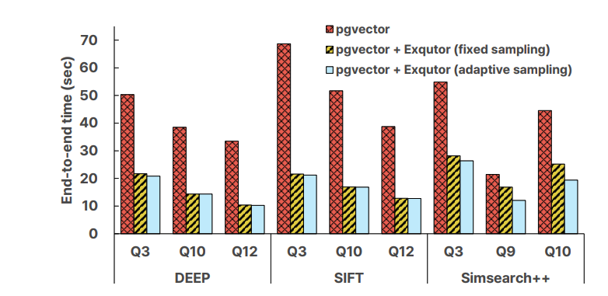
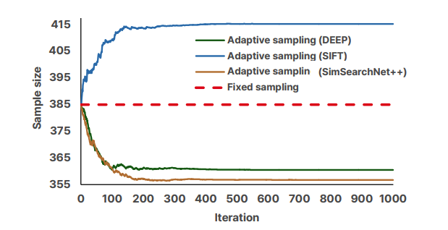

Evaluation
(2) Sampling-based Cardinality Estimation
With adaptive sampling, Exqutor achieves up to 3.2x speedup.
Skewed vector dataset needs more samples for estimating cardinality.
*Intel Xeon Gold 6530 configured with 128 vCPUs and 1.0 TB of RAM.
Skewed distribution
Query execution time on pgvector for TPC-H VAQs without vector index (SF100)
Convergence of adaptive sample size over time on the DEEP, SIFT, and SimSearchNet (SF100)
Notes:
When no index is available, Exqutor uses adaptive sampling, and it still archives performance improvements for the overall query execution.
A particularly interesting observation is that skewed and high-dimensional vector datasets require a larger sample size for accurate cardinality estimation. For example, the blue curve in the figure represents the SIFT dataset, which has a much more skewed distribution than the others, and therefore requires more samples.
In contrast, the DEEP dataset has relatively more regular distribution, so a smaller sample size is sufficient.

Slide 27

Conclusion
Exqutor: Extended Query Optimizer for Vector-augmented Analytical Queries
VAQs and Vector-augmented SQL analytics benchmark
Fixed VSS cardinality degrades VAQ performance on existing systems
An open-source, pluggable framework Exqutor for improving VSS cardinality estimation
Thank You!
chaerim.lim@yonsei.ac.kr bdai.research@gmail.com
https://bdai.yonsei.ac.kr/
GitHub
Presenter LinkedIn
Notes:
Finally, let me summarize the main contributions of our work.
First, we introduced Vector-augmented Analytical Queries, and showed how VSS can be used together with relational operators in real-world scenarios.
Second, we designed the Vector-augmented SQL Analytics benchmark to evaluate VAQ performance and shared it with the community.
Third, we proposed Exqutor, a framework that improves VAQ performance by replacing heuristic selectivity with computed cardinalities in the cost model, without modifying the execution engine or SQL interface.

