Slide 1





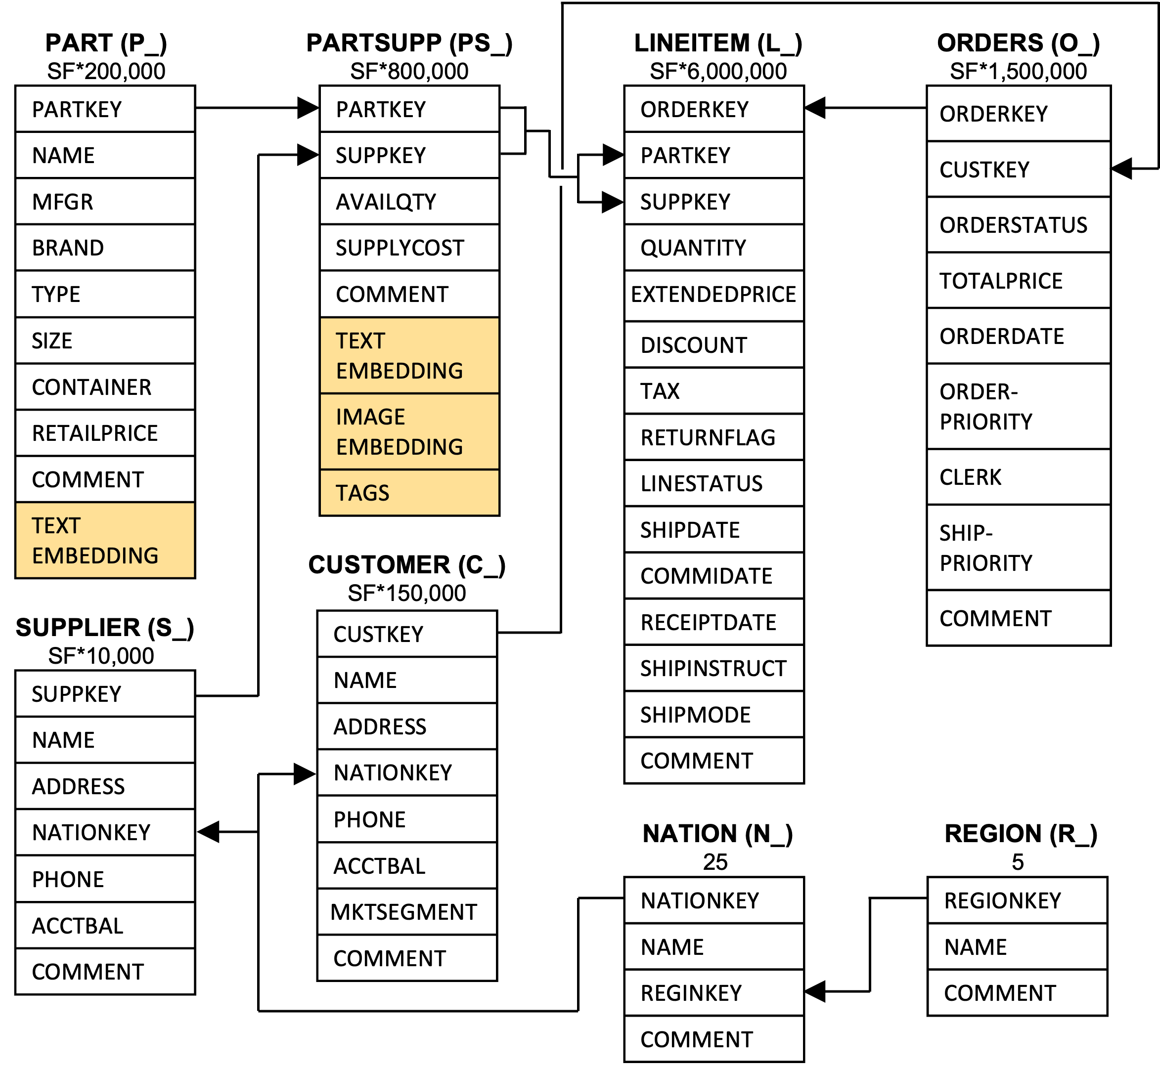

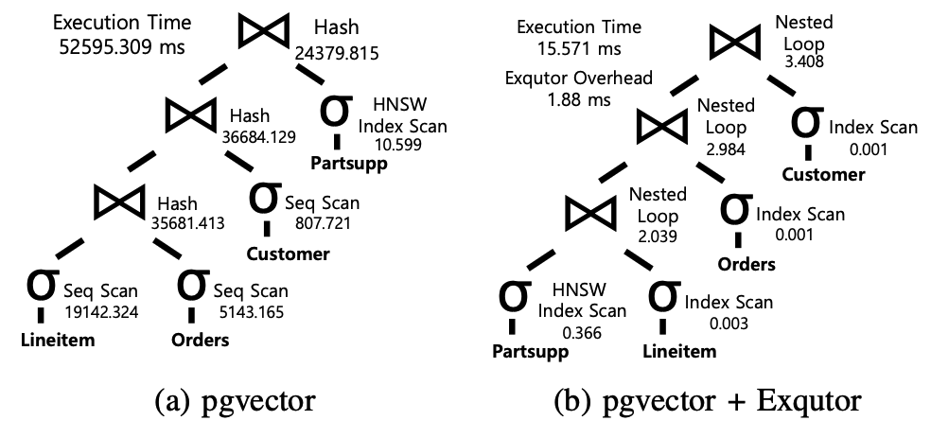
Exqutor: Extended Query Optimizer for Vector-augmented Analytical Queries
Contact
Chaerim Lim
Hyunjoon Kim*, Chaerim Lim*, Hyeonjun An*, Rathijit Sen#, Kwanghyun Park*
*Yonsei University, #Microsoft Gray Systems Lab
Paper
Exqutor
Research
Paper 31
The Rise of Vector-augmented Analytical Queries (VAQs)
Retrieval-Augmented Generation (RAG) workflows increasingly require vector-augmented analytical queries (VAQs) that combine vector similarity search (VSS) with relational operators such as joins and filters, as generalized vector databases support VSS.
Github
Vector-augmented SQL Analytics
Proposed Solution: Exqutor
To evaluate the performance of VAQs, we designed a new benchmark by extending analytical workload (TPC-H and TPC-DS) with vector embedding columns derived from three realistic vector datasets*. We also extended queries from the TPC-H and TPC-DS.
* DEEP, SIFT, and SimSearchNet++
Exqutor is an open-source, pluggable framework designed to improve cardinality estimation for VAQs. It seamlessly integrates into existing query optimizer pipelines. Exqutor employs two mechanisms depending on the execution scenario of VSS, whether vector indexes are available.
(A) Exact Cardinality Query Optimization (ECQO)
When vector indexes are available, Exqutor executes lightweight vector index searches (e.g., HNSW) during the query planning phase to obtain the exact number of qualifying tuples.
(B) Sampling-based Cardinality Estimation
Exqutor estimates selectivity by evaluating similarity over a subset of data when no vector indexes exist. The sample size is adjusted using a momentum-based algorithm leveraging Q-error.
The Problem: Cardinality Estimation of VSS
Existing systems often suffer from performance degradation due to inaccurate cardinality estimation for vector predicates, as query optimizers treat VSS as a black-box operator and rely on heuristic selectivity. By injecting true cardinalities, we achieved over two orders of magnitude reduction in query execution time.
Evaluation
Exqutor achieves significant performance gains up to four orders of magnitude speedups on pgvector and VBASE and 1.5×–37.2× on DuckDB using TPC-H based Vector-augmented SQL Analytics (SF100). The planning overhead remains minimal in comparison to the achieved performance gains. Exqutor also maintains high accuracy (Q-error < 1.2) for sampling-based cardinality estimation.
TPC-H Q3 based VAQ on DEEP dataset

