Slide 1
Scaling Laws for LLM Negotiation
How model capability shapes bargaining outcomes across cooperative and competitive regimes
Jonathan Zhu
Advisor: Prof. Danqi Chen | Princeton University | 2026
Thesis: Higher Elo reliably predicts better negotiation payoffs, but competition structure and game mechanism modulate the slope.

Slide 2
Why Study LLM Negotiation?
LLMs are increasingly deployed as autonomous agents in multi-party settings
Negotiation is a canonical testbed for strategic reasoning in natural language
Prior work shows stronger models diverge into model-specific strategic signatures rather than converging to a common policy (Rios et al., 2025)
Scaling laws well-studied for single-agent RL, vision, and LLMs — but not for multi-agent negotiation with tunable strategic structure
Key safety question: does higher capability lead to exploitation of weaker partners?
Gap: No systematic study of how LLM capability interacts with cooperation–competition structure across multiple negotiation mechanisms
2/13

Slide 3
Research Questions & Experiment Design
RQ1: Does higher Elo translate into better bargaining outcomes against a fixed baseline?
RQ2: How much variation comes from competition parameters vs. capability alone?
RQ3: What changes across three distinct negotiation mechanisms?
Fixed baseline: GPT-5-nano (Elo 1338)
36 adversary models spanning Elo range −226 to +152
3 game mechanisms with tunable competition
n = 2 agents, m = 5 items/issues, T = 10 rounds
~1,970 total completed game configurations
Game 1: Item Allocation
Game 2: Diplomatic Treaty
Game 3: Co-Funding
Rivalrous goods α ∈ [0,1] competition
Continuous terms ρ, θ competition axes
Threshold public goods α, σ parameters
3/13

Slide 4
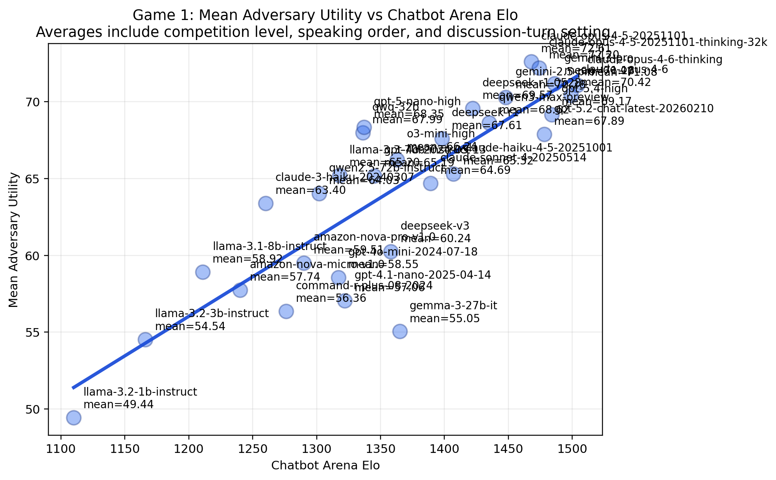
Game 1: Item Allocation
n agents split m items; each agent has private valuations v_i (sum to 100)
Utility: u_i(A) = γ^(t-1) · A[i] · v_i (discount γ = 0.9)
Competition: cosine similarity α = cos(v_i, v_j) ∈ [0,1]
α = 1 → zero-sum (same preferences); α = 0 → cooperative (orthogonal)
Propose-and-vote protocol: discuss → think → propose → vote → reflect
Unanimous approval required; T = 10 rounds, then utility = 0
890 completed runs | 30 adversary models | r = 0.85
4/13

Slide 5
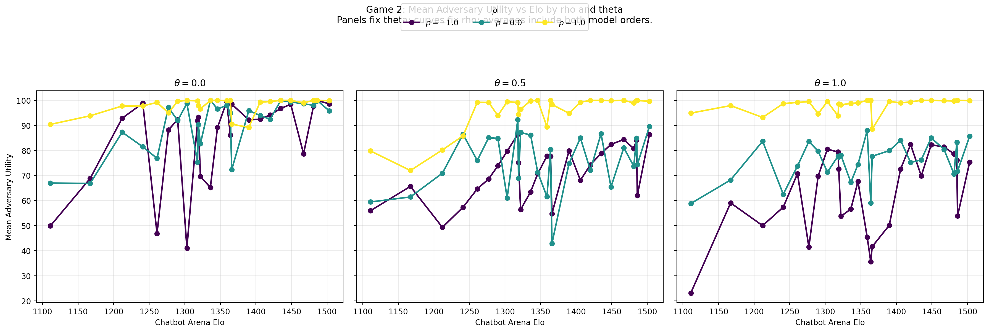
Game 2: Diplomatic Treaty Negotiation
n agents negotiate m continuous issues; agreement a ∈ [0,1]^m
Each agent has position prefs p_i and importance weights w_i
Utility: u_i(a) = 100 · Σ w_ik · (1 - |p_ik - a_k|)
Two competition axes (Gaussian copula preferences):
ρ ∈ [−0.25, 1]: preference correlation (same vs. opposing outcomes)
θ ∈ [0, 1]: interest overlap (same vs. different issues)
Same propose-and-vote protocol as Game 1
540/540 completed | 30 models | r = 0.82
5/13

Slide 6
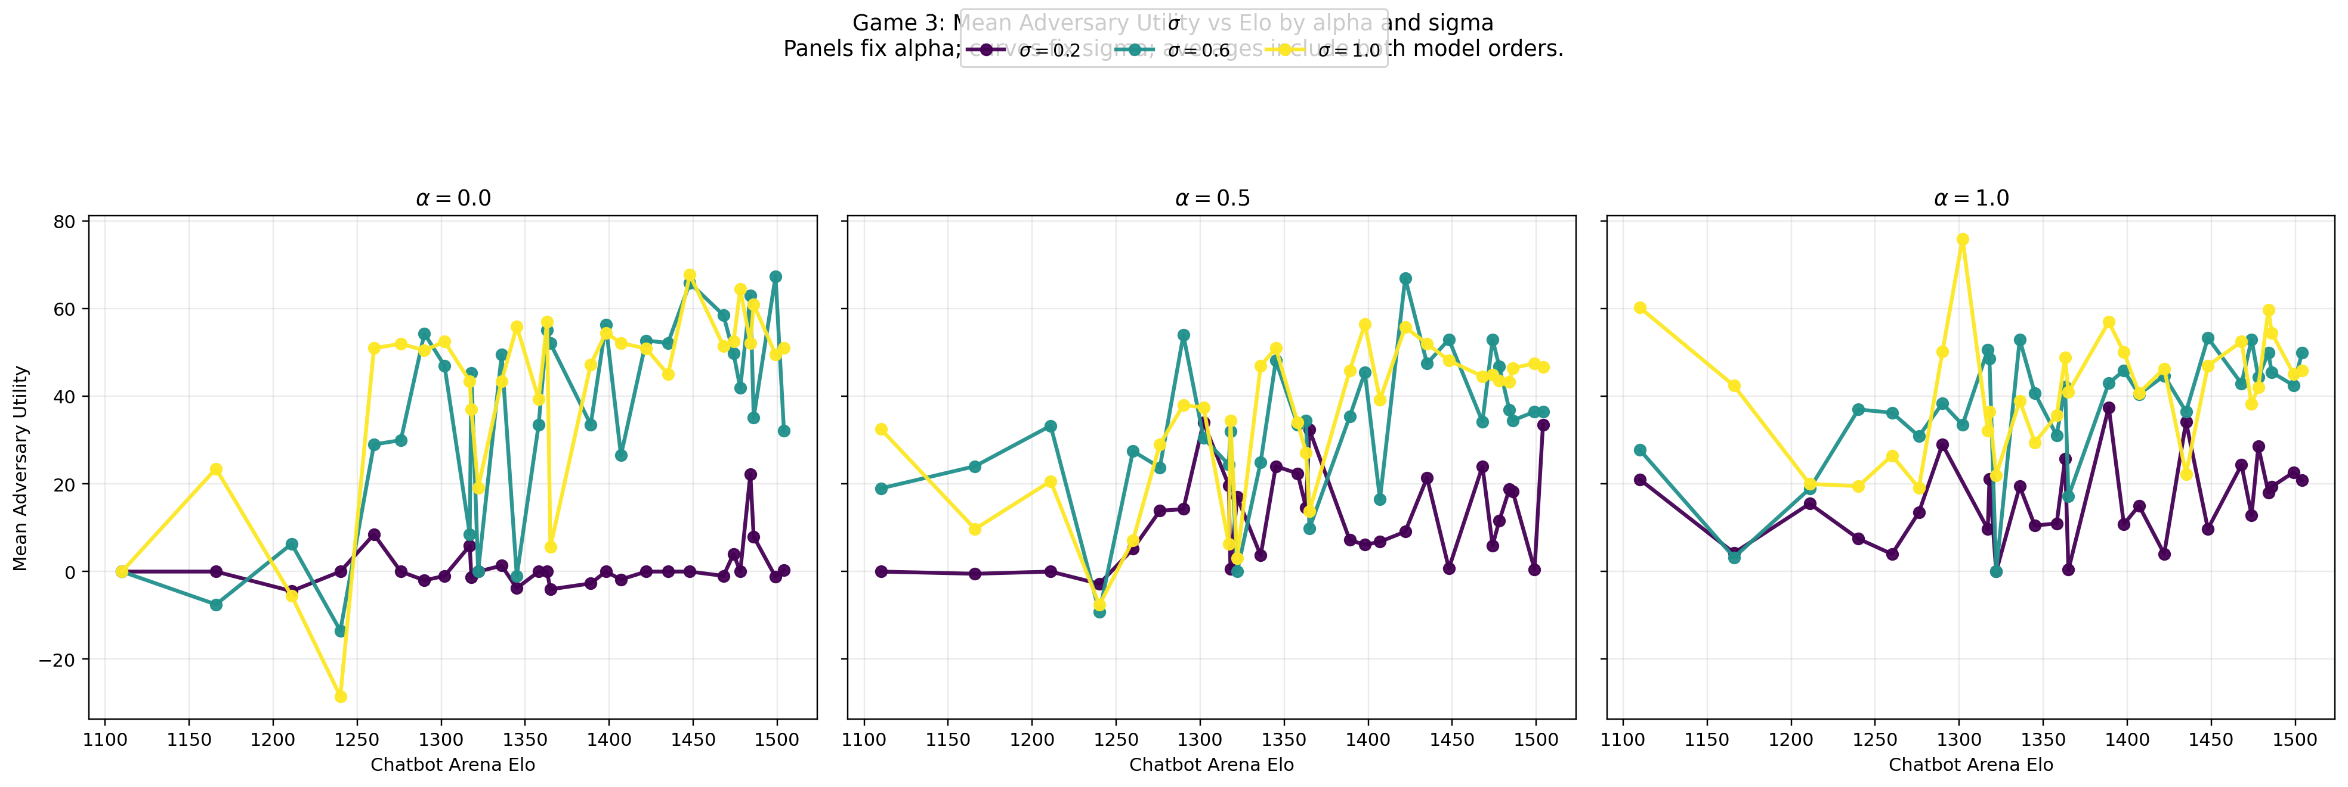
Game 3: Participatory Budgeting (Co-Funding)
n agents pool budgets to fund m projects (threshold public goods)
Project j funded iff total contributions ≥ cost c_j (refund if not)
Utility: u_i(X) = Σ_{j∈S} v_ij - Σ_{j∈S} x_ij (value minus cost share)
Key difference: threshold non-linearity creates free-riding incentives
Two competition axes:
α ∈ [0,1]: preference alignment (shared vs. disjoint project values)
σ ∈ (0,1]: budget scarcity (budget / total cost)
Talk–Pledge–Revise protocol (not propose-and-vote)
540/540 completed | 29 adversary models | r = 0.72
6/13

Slide 7
Evaluation Metrics & Solution Benchmarks
Core Metrics
Fair Benchmarks
Utilitarian efficiency η = SW_actual / SW_optimal
Exploitation index E_i = (u_actual - u_fair) / |u_fair|
Efficiency–fairness decomposition: - Efficiency loss = SW* - SW_actual - Fairness deviation = distance from benchmark
Games 1 & 2: Nash Bargaining Solution (NBS) max Π u_i(A) — unique, Pareto efficient
Game 3: Lindahl equilibrium x_ij = c_j · v_ij / Σ_k v_kj — proportional cost-sharing
Game 3: Core of cooperative game No coalition can do better independently
Optimal computed exactly: greedy (G1), weighted median (G2), knapsack (G3)
Normalization: All games on [0, 100] utility scale. Cross-σ comparisons use η. Exploitation index E_i comparable across games.
7/13

Slide 8
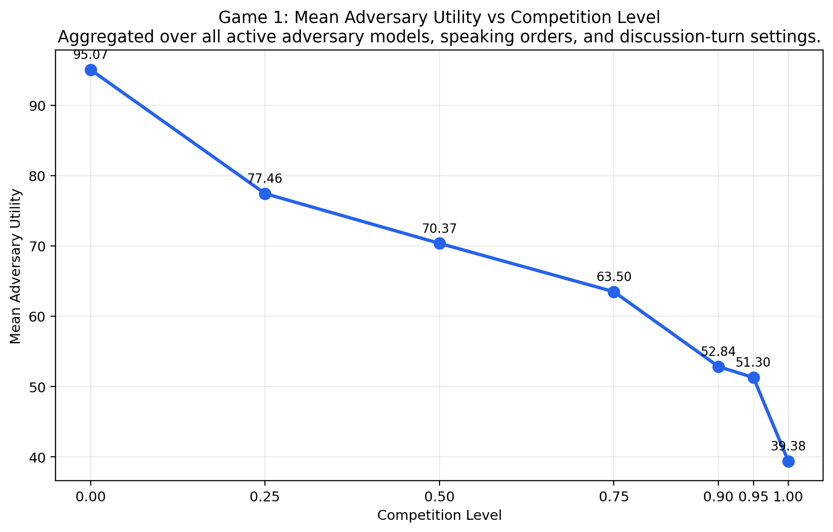
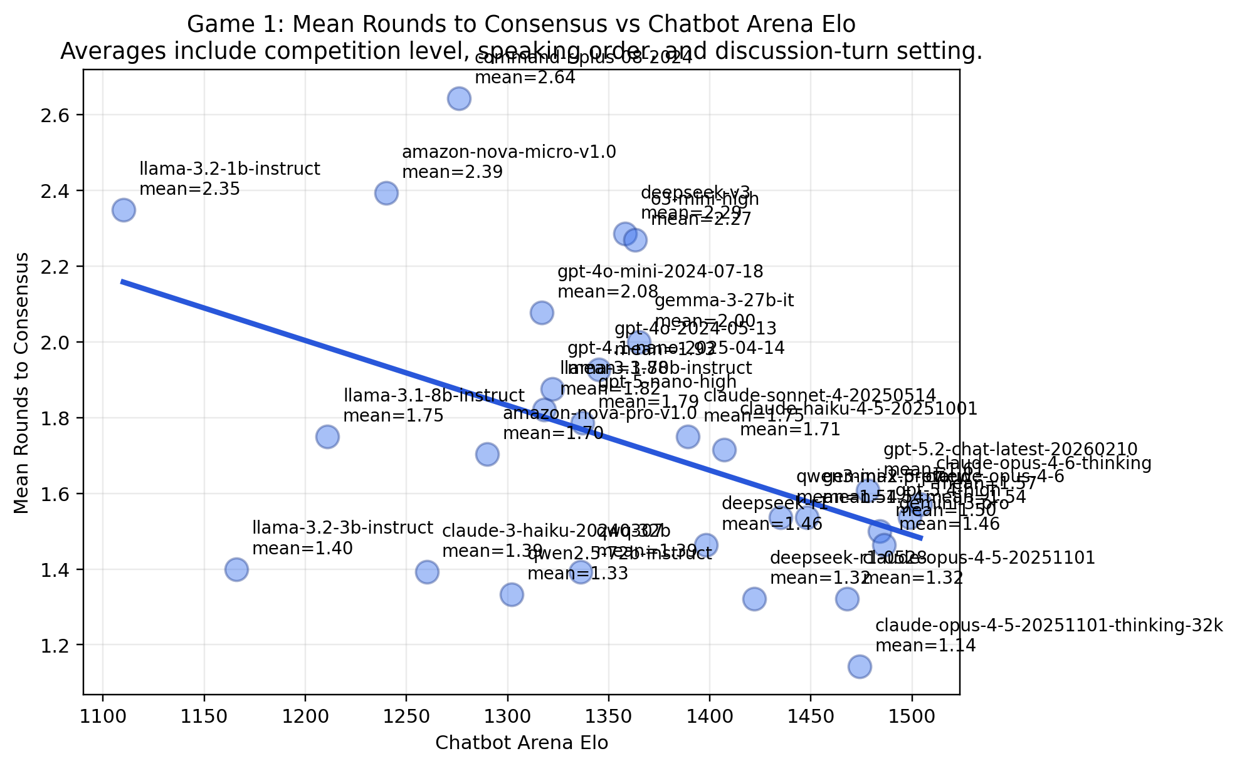
Game 1 Results: Capability Buys Better Deals, Faster
Utility drops from 95.1 (α=0) to 39.4 (α=1) | Strongest models preserve leverage even at α=1 | Elo–rounds correlation: −0.47 (faster deals)
8/13

Slide 9
Game 2 & Game 3 Results
Game 2: Treaty (540/540 complete)
Game 3: Co-Funding (540/540 complete)
r = 0.82 Elo–utility correlation
Much higher utility level: mean ~85 across all conditions
ρ (preference correlation) matters more than θ (interest overlap)
ρ=1 → utility 97.6; ρ=−1 → utility 74.7
Most forgiving: even hardest condition, mean utility > 65
All runs reach agreement; mean 1.5 rounds
r = 0.72 Elo–utility (weakest of three games)
Much lower payoffs: GPT-5.4 High leads at only 40.5
σ (scarcity) does most of the damage, not α (alignment)
Hardest cell: some models go negative (lost money!)
Threshold non-linearity → coordination failure risk
Nova Micro averages 0.26 utility; Llama 3.1 8B goes to −4.46
Key contrast: Treaty bargaining is forgiving (continuous compromise always possible). Co-funding is harsh (threshold non-linearity means small mistakes → zero payoff). Game mechanism determines how severe competition's impact becomes.
9/13

Slide 10
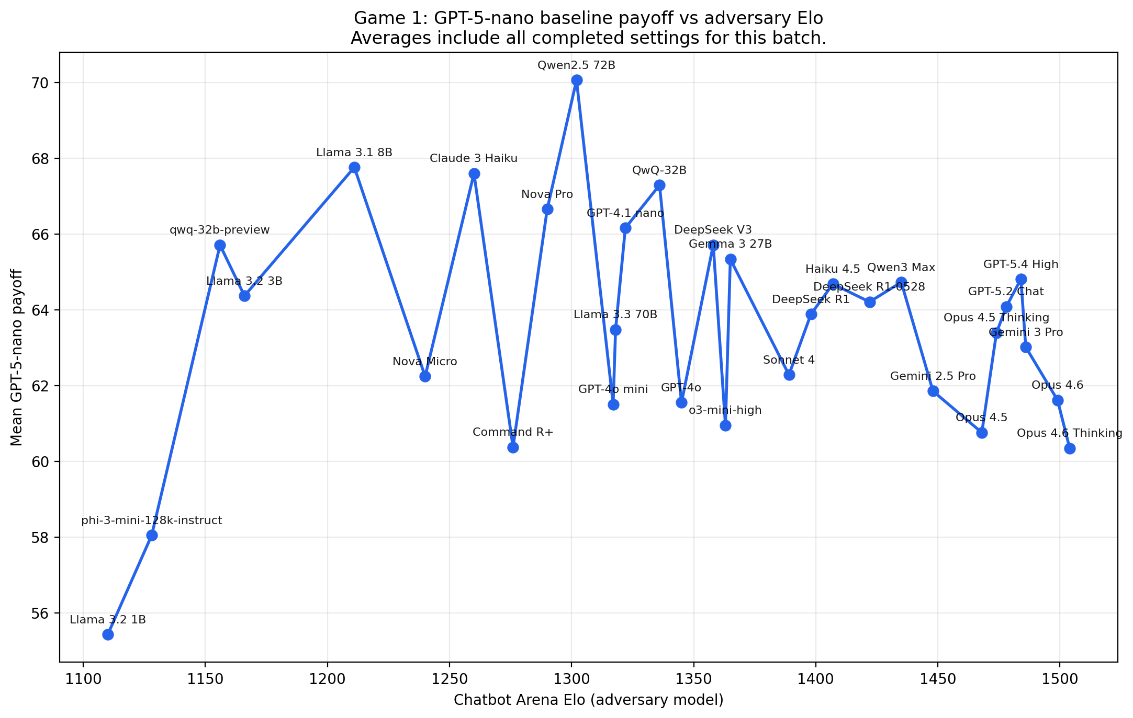
Cross-Game Synthesis
Game 1 Item Allocation
Game 2 Diplomatic Treaty
Game 3 Co-Funding
r = 0.85
Steady decline with competition
Stronger models: better splits + faster deals
Top: Opus 4.5 (72.6)
r = 0.82
Milder competition effect
High utility even in hardest conditions
Top: Opus 4.6T (94.4)
r = 0.72
Sharpest competition effect
Coordination failure at extremes
Top: GPT-5.4H (40.5)
GPT-5-nano baseline payoff decreases as adversary Elo rises — consistent across all three games
10/13

Slide 11
Limitations & Future Work
Current Limitations
Future Work
All results are n = 2 (bilateral negotiation only)
Fixed baseline (GPT-5-nano) — results may differ with other baselines
Confounds: instruction-following, sycophancy vs. true strategic capability
API-based models: no control over decoding, context length varies
Single-shot competition parameters per game instance
n > 2 extension: 9,600 configs currently running on cluster (316 completed as of April 14, 2026)
Multi-domain expansion beyond negotiation (ICML target)
Behavioral metrics pipeline: promise-keeping, free-riding, persuasion
Adaptive opponents (profit-driven red teaming)
Test-time compute scaling for strategic reasoning
Thank you! — Questions?
11/13

Slide 12
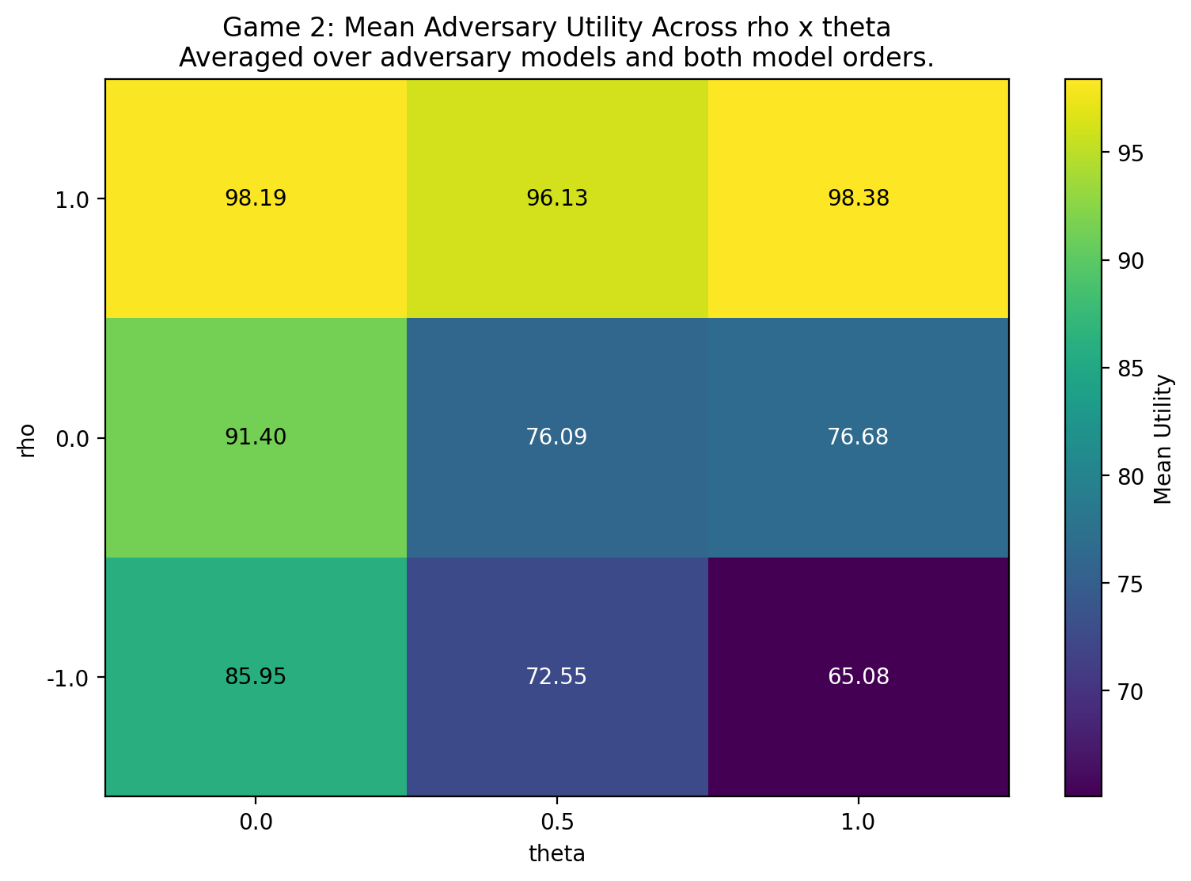
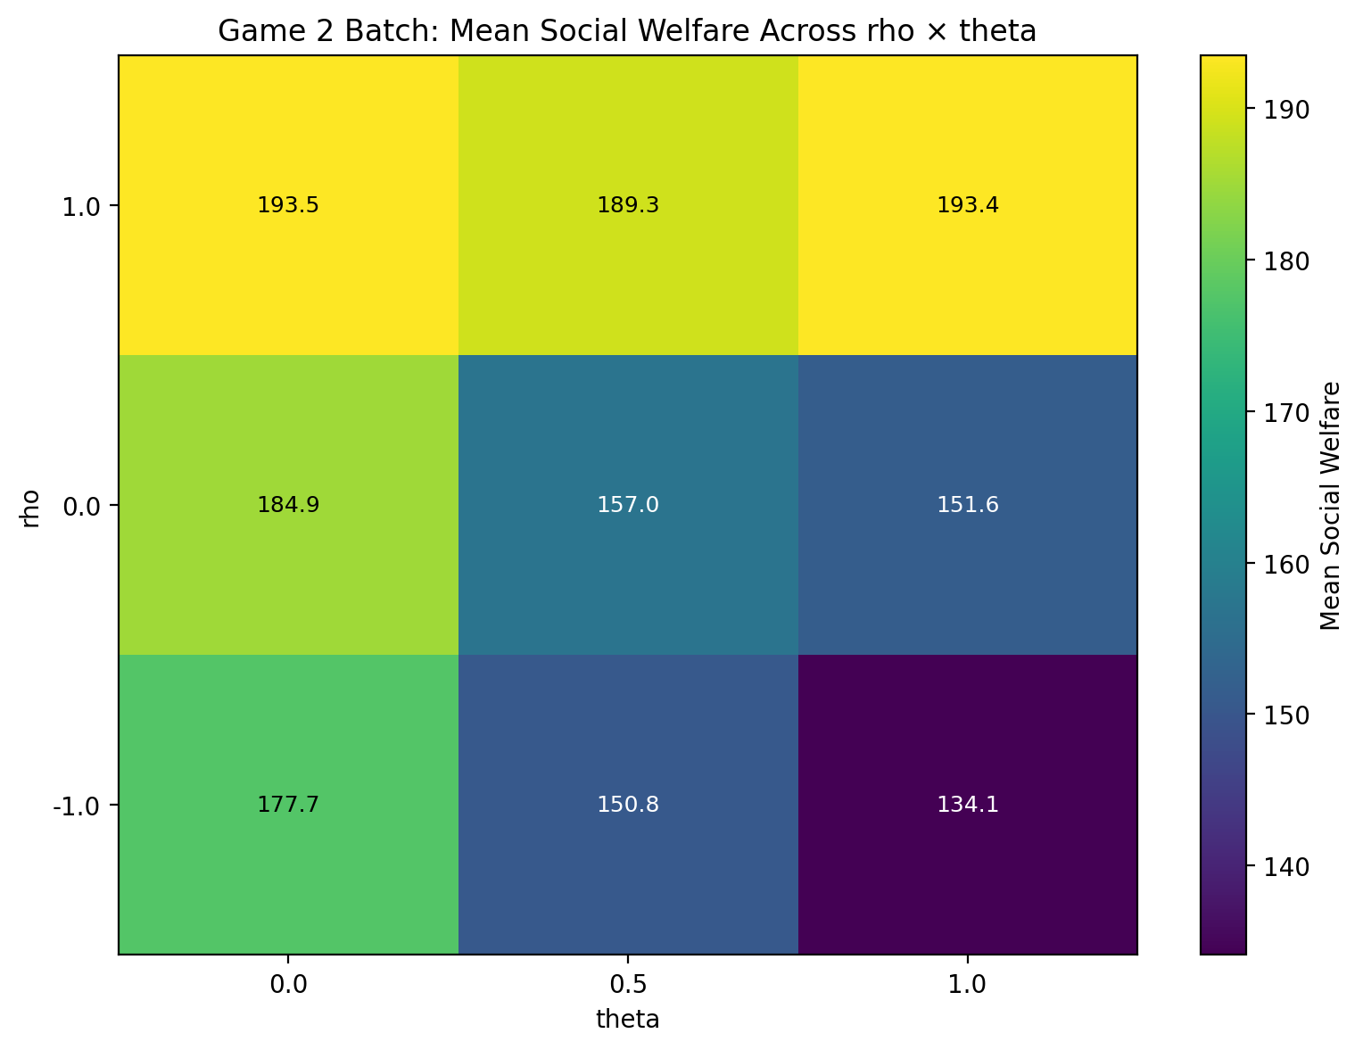
Backup A: Game 2 — ρ×θ Heatmaps
Left: Mean adversary utility | Right: Social welfare | Both show ρ drives more variation than θ
B-A/B

Slide 13
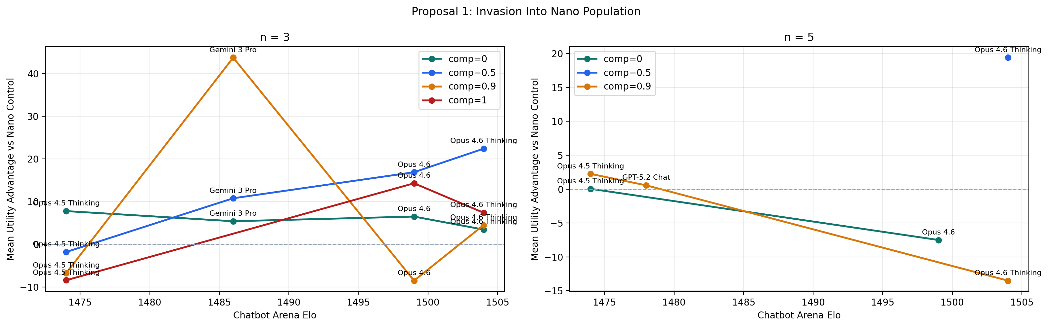
Backup B: n > 2 Extension — Early Results
Game 1 multi-agent batch: 9,600 total configurations
As of April 14, 2026: 316 successful, 181 running, 1,506 queued, 7,596 not started
Early finding: Proposal-1 advantage varies with Elo (see figure)
Full results expected before camera-ready deadline
Preliminary: batch incomplete — treat as ongoing extension, not finalized result
B-B/B

