Slide 1
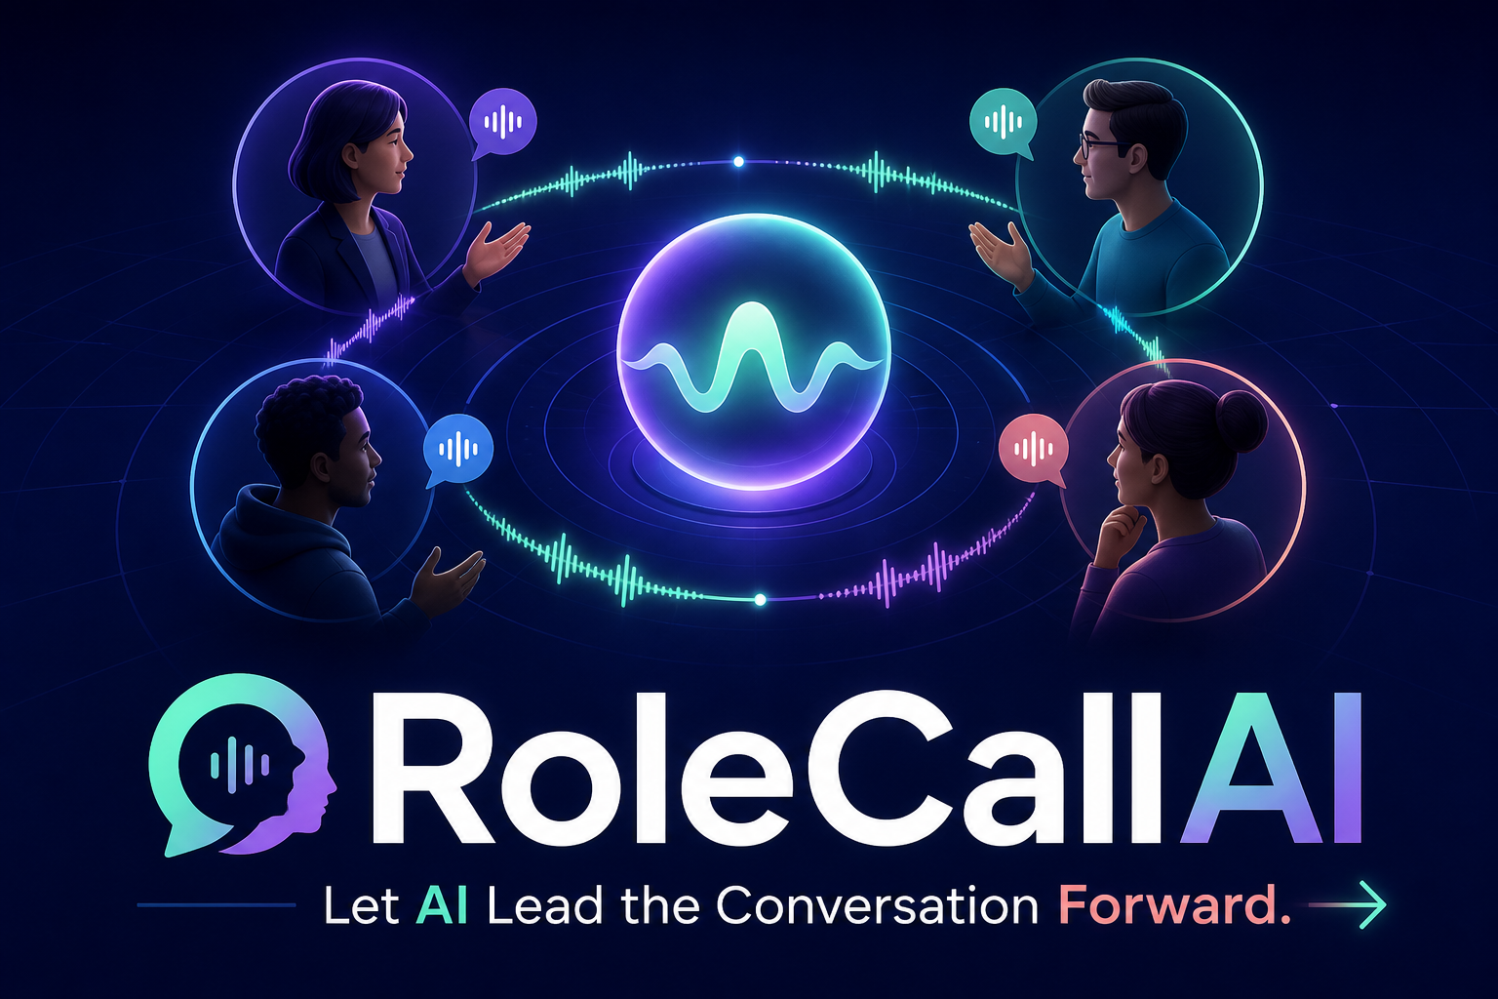
ALL THINGS AGENTIC HACKATHON
COLLABORATIVE PARTNER
- Arun Kumar Mani
Notes:
Hi my name is Arun Kumar. My project is called RoleCall AI
Open on the collaboration problem: RoleCallAI is a meeting participant that can lead, remember and act. [Sources] - README.md - https://allthingsagentichackathon.devpost.com/ [/Sources]

Slide 2
THE FRICTION
Most voice AI agents are designed for one-to-one conversations
Meetings often need structure, guidance, moderation, teaching, or evaluation.
Human lead meetings deviate
Most human lead meetings either miss the direction or take too long to achieve the goal
Scattered context
Owners, blockers, and decisions fade between recurring meetings.
Manual follow-through
Someone must run the room, take notes, and chase the next action.
RoleCallAI
02
Notes:
In normal meeting there are deviations from the core topic, participation becomes uneven, context gets lost between sessions, and follow-through becomes another manual chore.
Is there an AI Voice Agent which can solve this ?
Most voice AI agents are designed for one-to-one conversations. There is no Voice AI agent in the market which interacts in a group meeting.
Most voice agents optimize one-to-one dialogue; meetings additionally need fair participation, time control and follow-through. [Sources] - README.md [/Sources]

Slide 3
RoleCallAI
- a flexible meeting participant whose behavior can be defined by its role
Focused
The AI listens to the discussion, identifies relevant participants, responds in context, asks useful follow-up questions, and helps keep the meeting focused.
It remembers past meetings context and responds accurately in the ongoing meeting.
Remember
Action
It produces a structured summary containing key discussion points, decisions, blockers, and action items.
RoleCallAI
03
Notes:
Meet RoleCallAI: a real-time voice agent that does more than an 1:1 chat agent. It leads the meeting, gives every person the floor, remembers prior commitments, and turns the conversation into clear next step action items.
The product promise is focused facilitation, cross-meeting continuity and structured action—not open-ended conversation. [Sources] - README.md - docs/ARCHITECTURE.md [/Sources]

Slide 4
LIVE DEMO
Watch the agent take control
01
Create a room and choose the facilitator
≋
02
Hear soft Lyria lobby music in two browsers
03
Hear the agent rotate the floor by name
04
See live captions and natural follow-ups
CREATE → LOBBY → SPEAK → RECAP
05
End with a spoken recap and persistent summary
RoleCallAI
04
Notes:
During the live demo, call out the soft lobby track, then show that it stops before the agent rotates the floor by name. [Sources] - docs/REPRODUCIBLE_TESTING.md - docs/LYRIA.md - https://docs.cloud.google.com/gemini-enterprise-agent-platform/models/lyria/lyria-3 [/Sources]

Slide 5
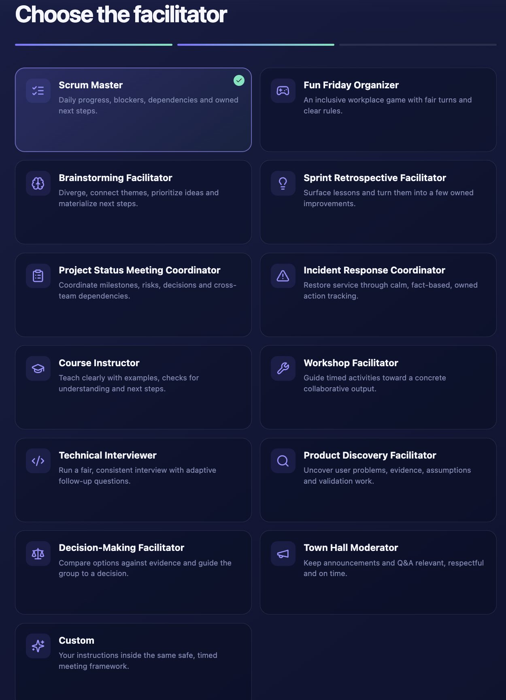
03
Notes:
In the demo we saw how the AI Voice agent started the conversation , gave each participants a turn to speak , it acknowledged what the said, it even corelated the blockers and summarized the entire meeting with action items. Later a meeting summary was posted a text with meeting analytics and info. This is just one small example , the host of the meeting can choose the role of the AI agent from the given templates or can create a new one based on his requirement.
There are 12 ready made templates available to name a few: Scrum master, Fun Friday organizer , Brainstorming Facilitator , Town Hall moderator , Incident Response Coordinator and so on.
The same controller supports twelve professional presets plus custom instructions while preserving one safety and timing framework. [Sources] - README.md [/Sources]

Slide 6
ARCHITECTURE
Deterministic control keeps a live agent reliable.
Browser clients
Cloud Run
GKE + LiveKit
ADK voice worker
Vertex AI
Admin + 2–10 participants
React UI + FastAPI control plane
WebRTC audio and server-enforced floor
Bounded audio bridge + validated tools
Gemini Live native-audio
Firestore
Memory Bank
Async + build assets
Rooms, transcript, outcomes
Cross-meeting commitments
Gemini 3.7 recap Static Lyria MP3
Runtime: Gemini proposes language and tools; the controller owns floor and lifecycle. Build: one fixed Lyria prompt → static MP3, with no meeting data or runtime call.
RoleCallAI
05
Notes:
I built rolecall AI for this hackathon under the Collaborative Partner track using Gemini Live native-audio model, Google ADK, and several other Google Cloud services.
The architecture separates judgment from control. Browser audio flows through LiveKit on GKE to an ADK worker and Gemini Live. Gemini can propose what to say or which tool to call, but it cannot decide who may publish, change room scope, or bypass the meeting lifecycle. Cloud Run serves the web and API, Firestore stores finalized meeting data, Memory Bank preserves selected cross-session facts, and Pub/Sub triggers post-processing.
The architecture combines deterministic floor control with Gemini judgment. Lyria appears only as a one-time build asset; it never receives meeting data. [Sources] - docs/ARCHITECTURE.md - docs/LYRIA.md - https://docs.cloud.google.com/gemini-enterprise-agent-platform/models/music/generate-music [/Sources]

Slide 7
PRODUCTION DISCIPLINE
Built for real meetings, not a staged chatbot.
The dev deployment combines product breadth with strict operational boundaries.
12 + Custom
2–10
0
facilitator roles
human participants
raw audio persisted
1 Lyria request · static lobby soundtrack · ~$0.08 once · 0 runtime music calls · no meeting data
RoleCallAI
06
Notes:
This is a working development deployment, not a prototype screen. It supports twelve facilitator presets plus custom instructions, from stand-ups and retrospectives to workshops and incident response. Rooms support two to ten people, mobile browsers, reconnect recovery, delegated end controls, and ninety-day recap retention. Raw audio remains memory-only, so the useful output is retained without turning every meeting into an audio archive.
Production discipline includes no raw-audio persistence and an explicit creative-model cost boundary: one Lyria request, then static serving. [Sources] - docs/DEPLOYMENT.md - docs/LYRIA.md - infra/terraform/COST_ESTIMATE.md [/Sources]

Slide 8
Future
RoleCallAI can grow into a complete meeting platform with:
MCP tools for Jira, Calendar, Gmail, and Drive
Meeting integrations for Google Meet, Webex, and Zoom
Connected task management and collaboration
Automated decision, risk, blocker, and action tracking
Multilingual voice support
Custom voices and communication styles
Post-meeting analytics and coaching
Enterprise identity, privacy, and governance
Notes:
The next step is integration depth—tools, meeting platforms, multilingual voice and enterprise governance—without weakening deterministic control. [Sources] - docs/HACKATHON.md [/Sources]

Slide 9
Let AI lead the conversation forward.
Notes:
Close by resolving the opening tension: AI can lead a group conversation forward when judgment and control are deliberately separated. [Sources] - README.md [/Sources]

