Slide 1



House Prices in Ames, Iowa
Correlation of Garage Finishes on House Prices

Slide 2


About - Ames, Iowa
College Town (Iowa State University)
Population: 65,000 people
Transportation: 69% of people drive

Slide 3
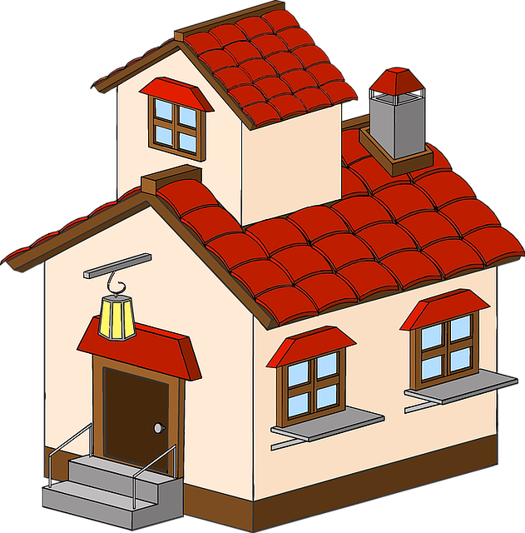
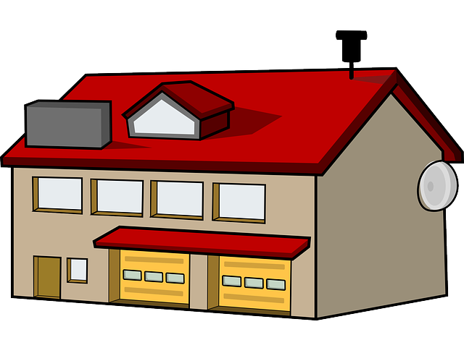
How does having or not having a garage impact the sale price of a home?

Slide 4
Defining “Garage”
“Finished Garage”
“No Garage”
Newly and completely renovated garage
Not having a garage

Slide 5
Null Hypothesis: μ₁₌μ₂
There IS NO sale price difference between houses with
finished garages (μ₁) and no garages (μ₂).

Slide 6
Alternate Hypothesis: μ₁≠μ₂
There IS a sale price difference between houses with
finished garages (μ₁) and no garages (μ₂).

Slide 7
Here is what I found

Slide 8
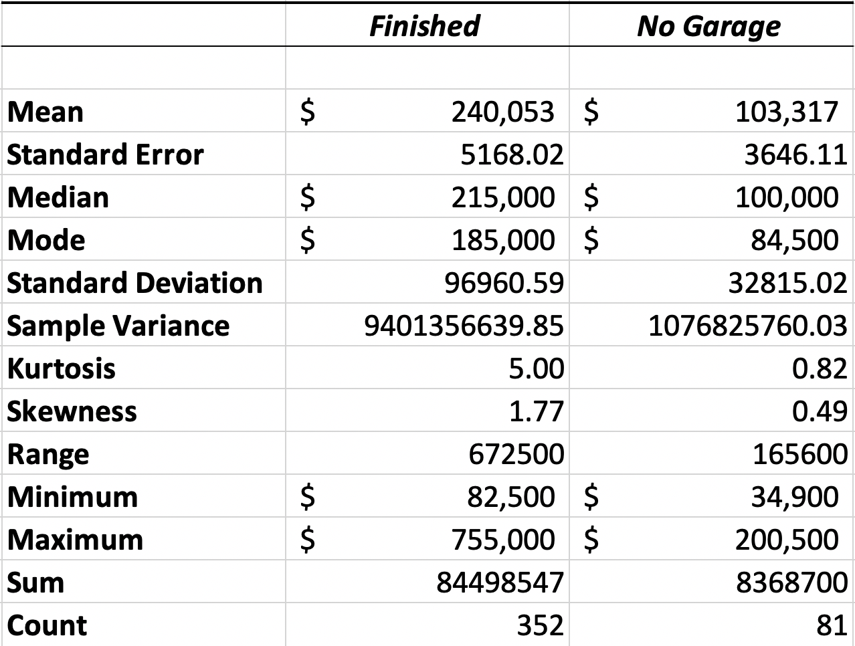
Finished Garage VS No Garage

Slide 9
Finished Garage VS No Garage
$240 K
$103 K

Slide 10
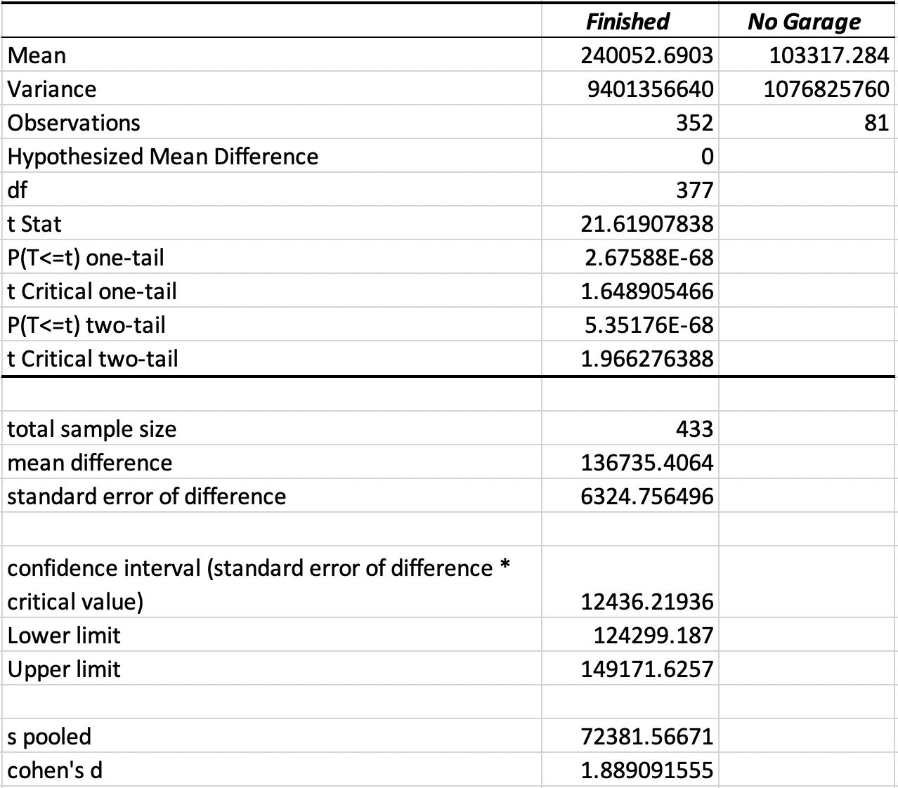
t-test results
Critical value: < 0.05
We find that at a 95% confidence, there is a difference between our lower and upper limit means.

Slide 11
Conclusion
Fail to
reject
Alternative Hypothesis
Null Hypothesis
There IS NO sale price difference between houses with finished garages (μ₁) and no garages (μ₂).
There IS a sale price difference between houses with finished garages (μ₁) and no garages (μ₂).

Slide 12
Let’s explore
Average price per square footage

Slide 13
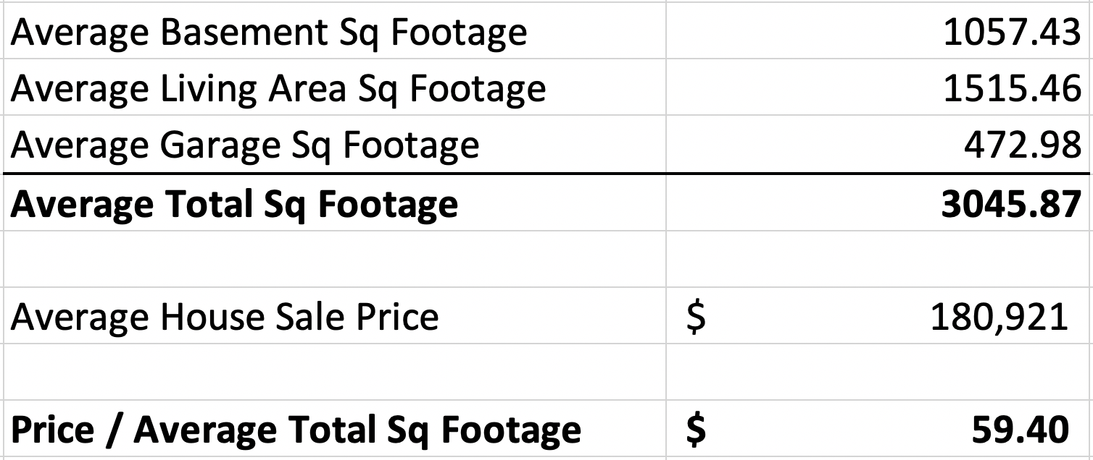
Price Per Square Foot
$60 / Sqft

Slide 14
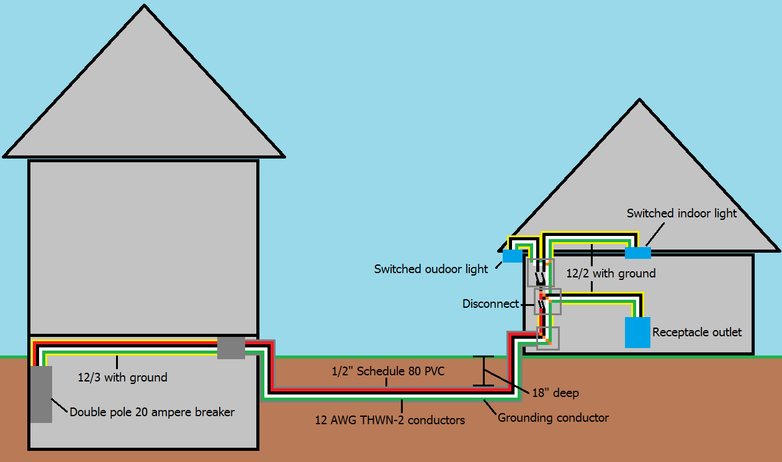
How much to build a garage from scratch?
Background Research
Ideal Garage
Attached Garages: $40/sqft
Detached Garages: $70/sqft
Size: Fitting 1 or 2 cars ($18,000 to $47,000)
Detached
Holds 475 sqft of space
Ames, Iowa Average: $60/sqft
Total: ~$29K

Slide 15
What property should I invest in in Ames, Iowa?

Slide 16
Purchasing a home with NO garage
Average Cost of a home with no garage: $103K
Average Cost of a garage: $29K
TOTAL SALE PRICE: $132K
Average Price Home with Garage: $240K
You save: $108K

Slide 17
Questions or comments?

Slide 18
References
https://livability.com/ia/ames
https://www.angieslist.com/articles/how-much-does-it-cost-build-garage.htm

