Slide 1
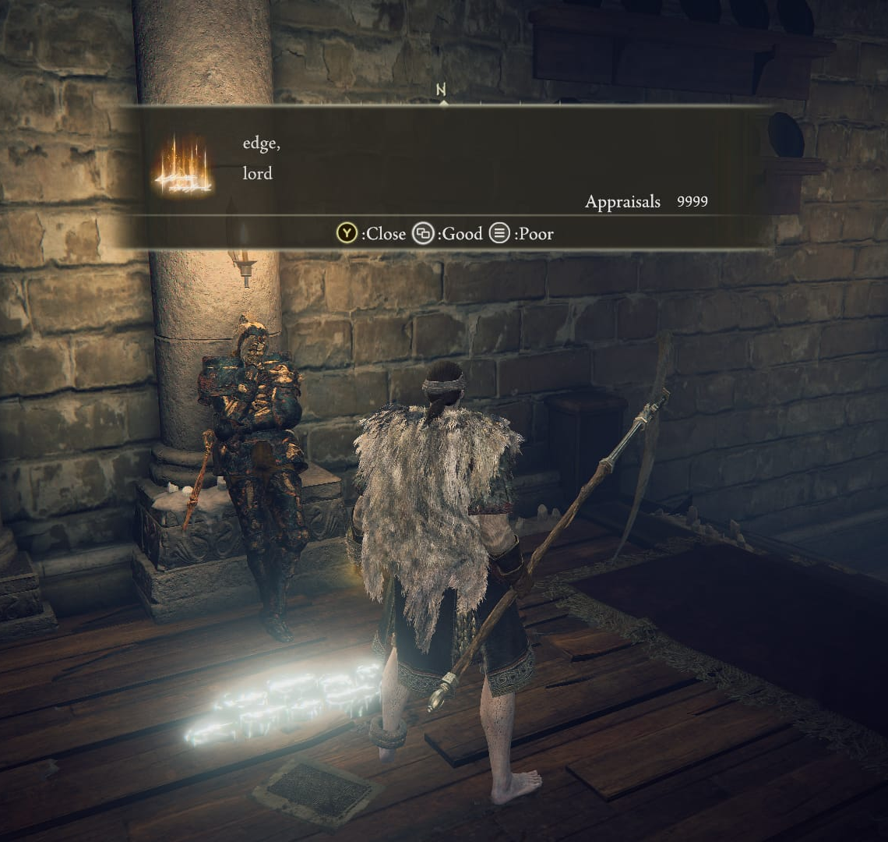
THE PLAYER
MESSAGE SYSTEM
IN ELDEN RING
Multimodal Cultural Artifact Analysis
Mario Ojeda
ENC 1102
How limited language creates shared meaning
Notes:
Image: Windows Central, screenshot credited to Elden Ring / FromSoftware. https://www.windowscentral.com/elden-ring-messages-reveal-helpfulness-hilarity-horniness

Slide 2
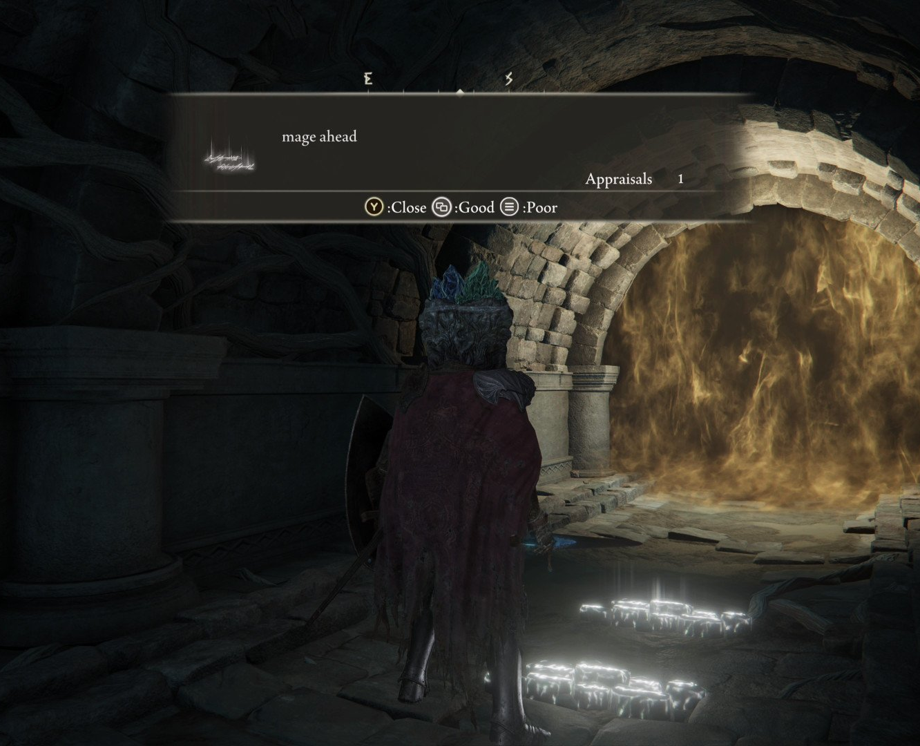
Artifact and community
02
A writing system embedded inside a shared game world
The artifact
Players leave short messages that appear in other players’ worlds. Readers can interpret and rate them while exploring.
The community
The audience consists of Elden Ring players who share warnings, advice, jokes, and misleading messages without speaking directly.
My connection
I began playing a few weeks after release. My experience with Dark Souls III also helped me recognize communication practices from the Souls community.
Notes:
Content adapted from Mario Ojeda's course activities. Image: Windows Central, screenshot credited to Elden Ring / FromSoftware. https://www.windowscentral.com/elden-ring-messages-reveal-helpfulness-hilarity-horniness

Slide 3
How the message system works
03
Meaning develops through both words and the surrounding situation
1
2
3
4
Compose
›
Place
›
Interpret
›
Respond
Choose a template and words from a limited list.
Leave the message at a specific location in the game world.
Other players combine the phrase with what they see nearby.
Readers rate the message or change their next action.
The same phrase can help, warn, joke, or deceive because location and community knowledge complete its meaning.
Notes:
Content adapted from Mario Ojeda's Alvarez, Wan, and Lee activity and MA1 planning notes.

Slide 4
Research question
04
How does the limited vocabulary in Elden Ring’s message system affect how players communicate and interpret meaning?
This question requires other players’ perspectives because identical words can produce different meanings in different locations.
Primary research: two semi-structured interviews with experienced players
Notes:
Research question from Mario Ojeda's UWC Online Writing Group Activity #2.

Slide 5
How players construct meaning
05
Four elements work together each time a player reads a message
01
WORDS
Preset phrases establish the basic idea.
02
LOCATION
A boss door, cliff, wall, or character changes the likely meaning.
03
RATINGS
Community feedback helps readers judge whether a message seems reliable.
04
EXPERIENCE
Players learn recurring jokes and patterns over time.
The message does not carry meaning alone. Players actively reconstruct it from the full situation.
Notes:
Analysis synthesized from Mario Ojeda's course activities and interview-theme reflection.

Slide 6
Interview evidence: Carlos Checa
06
Context changes meaning, while feedback shapes trust
“Even if the warning is false, it makes you more alert.”
Carlos considers whether a message seems plausible and how much risk comes from believing it.
Messages such as “enemy ahead” or “be wary of right” prepare players for danger before they can verify the warning.
Ratings make a message feel more trustworthy, while nearby replies such as “liar ahead” can challenge it.
He would keep the preset system because its limits encourage creativity and reduce insults or spoilers.
Notes:
Primary research interview conducted by Mario Ojeda. The displayed quotation is translated and lightly edited from Carlos Checa's Spanish response for clarity.

Slide 7
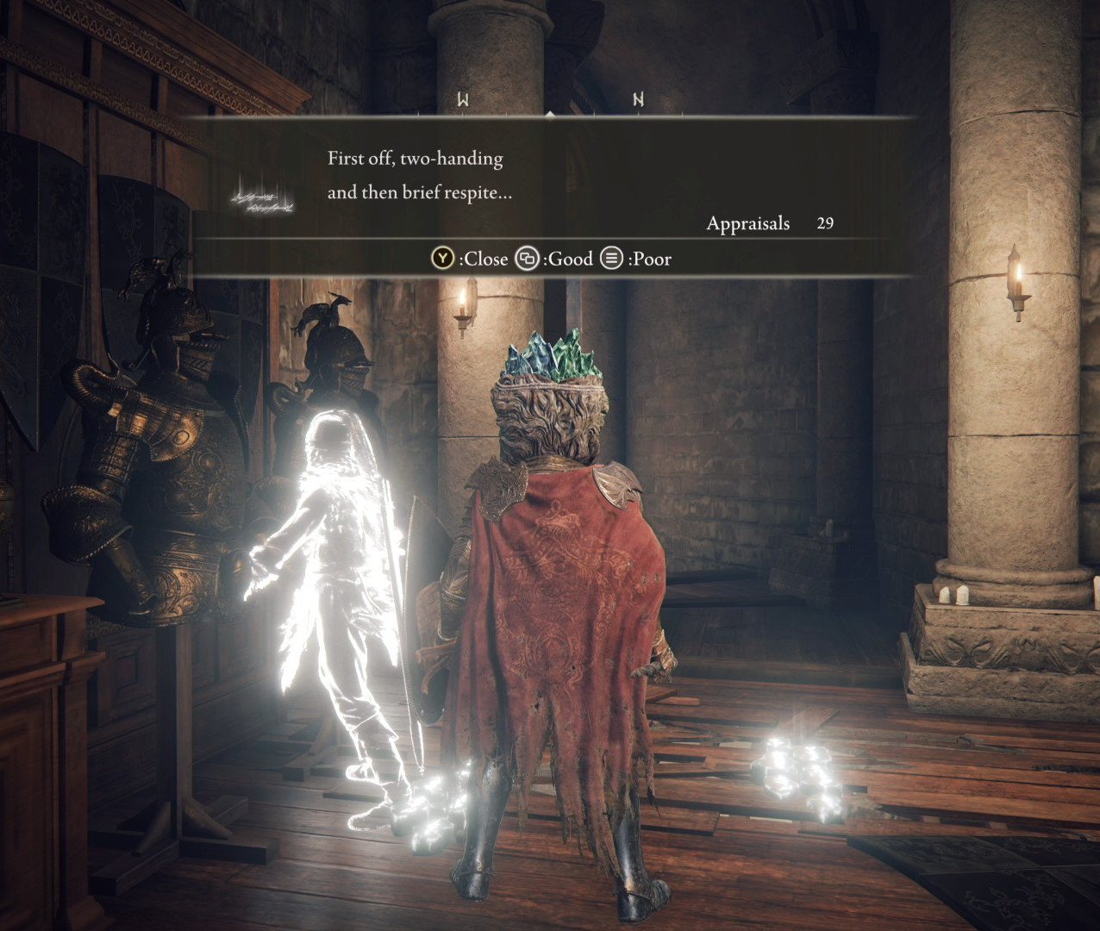
Interview evidence: Fabio García
07
The game world supplies information that the short phrase cannot contain
Fabio’s perspective
A message near Ranni or immediately before a boss fight probably refers to that nearby character or encounter.
He also uses ratings to decide whether to trust a message.
Fabio would keep the limited system because players become more creative and because the mechanic feels essential to the Souls series.
LOCATION + EXPERIENCE = INTERPRETATION
Notes:
Primary research interview conducted by Mario Ojeda. Image: Windows Central, screenshot credited to Elden Ring / FromSoftware. https://www.windowscentral.com/elden-ring-messages-reveal-helpfulness-hilarity-horniness

Slide 8
Roozen: writing is social and rhetorical
08
Assigned concept 1.0
AUDIENCE
Roozen explains that writers make meaning for “particular audiences and purposes” and always remain connected to other people.
Every message addresses another player who may eventually encounter it.
PURPOSE
Elden Ring makes this visible. Anonymous players still anticipate what a reader knows, needs, and may do next.
Writers choose phrases to help, warn, joke, or mislead, depending on the situation.
Roozen, “Writing Is a Social and Rhetorical Activity”
Notes:
Source: Kevin Roozen, 'Writing Is a Social and Rhetorical Activity,' Concept 1.0 in the assigned course PDF. Analysis adapted from Mario Ojeda's graded Roozen activity.

Slide 9
Russell: writing mediates activity
09
Assigned concept 1.5
STOP SIGN
ELDEN RING MESSAGE
Written marks coordinate what drivers do at an intersection.
⇄
A short message can change whether a player advances, searches, attacks, or becomes cautious.
The text connects players across distance and time. A writer leaves a message now, and an unknown reader may act on it later.
Russell, “Writing Mediates Activity”
Notes:
Source: David R. Russell, 'Writing Mediates Activity,' Concept 1.5 in the assigned course PDF. Analysis adapted from Mario Ojeda's graded Russell activity.

Slide 10
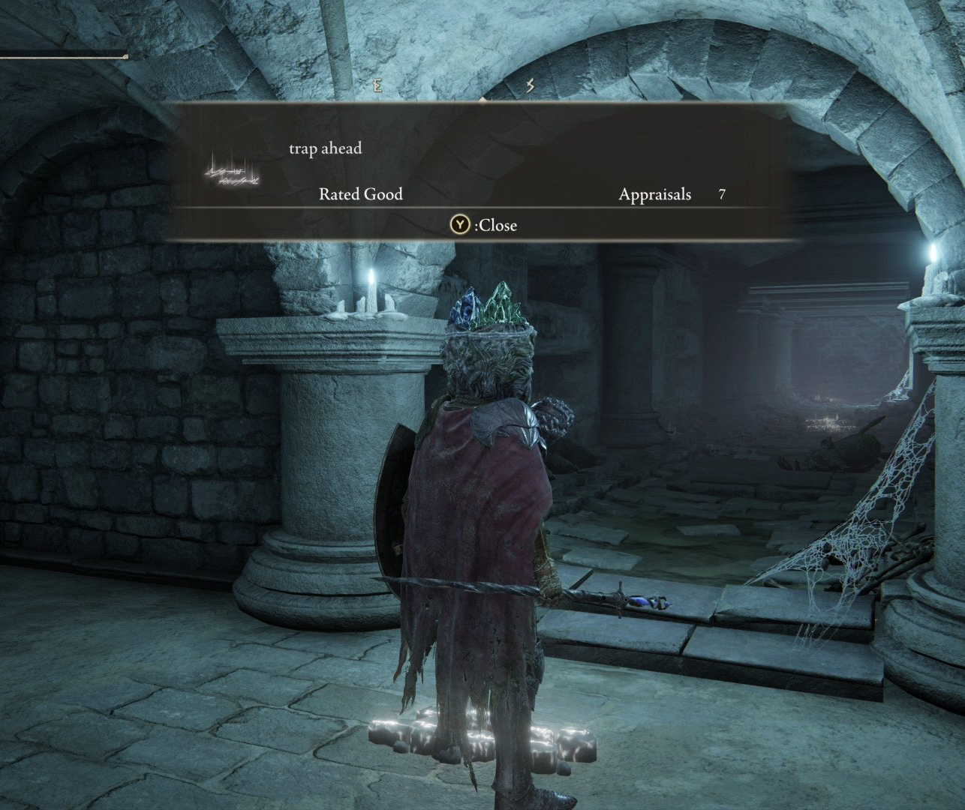
Conclusion
10
Limited language produces a richer form of shared interpretation
What the artifact shows
The preset vocabulary does not prevent meaningful communication. It moves part of the meaning into location, ratings, and shared experience.
Players turn constraints into creativity. They develop recognizable warnings, jokes, and ways to challenge misleading messages.
The system demonstrates that writing can build community and shape action even when writers and readers never meet.
Notes:
Conclusion based on Mario Ojeda's interview-theme reflection and course activities. Image: Windows Central, screenshot credited to Elden Ring / FromSoftware. https://www.windowscentral.com/elden-ring-messages-reveal-helpfulness-hilarity-horniness

