Slide 1
DES Instrument Cluster
SEA:ME 2025
Team 2
Aakash Som, Donghyun Kim and Jojeong Min

Slide 2
Objective
To design and implement a Qt-based graphical user interface (GUI) for the instrument cluster.
To integrate an Arduino based speed sensor system with the Raspberry Pi using the CAN bus protocol.
To display real-time speed data on the instrument cluster GUI.
To test the functionality of the instrument cluster using realistic driving scenarios.
To document the project in a comprehensive manner, including a detailed explanation of the system architecture, software design, implementation, results, and conclusions.
BONUS Part:
To display battery level of PiRacer on Instrument Cluster.

Slide 3
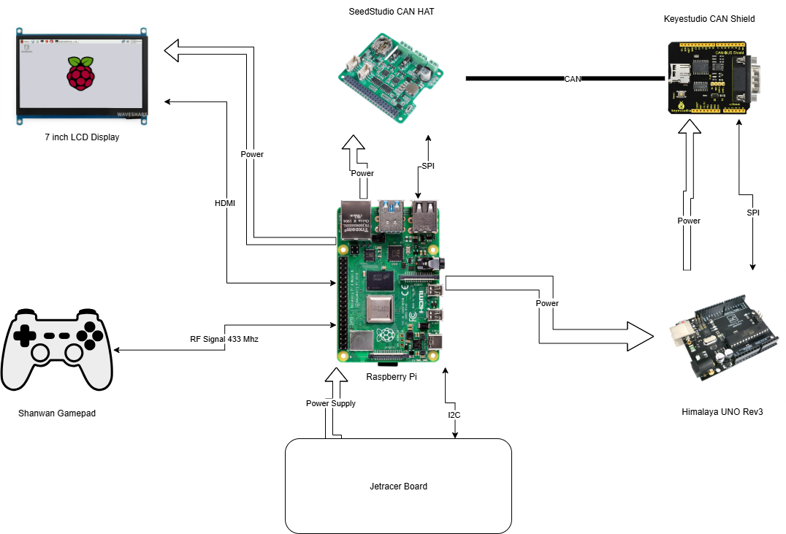
Physical Architecture

Slide 4
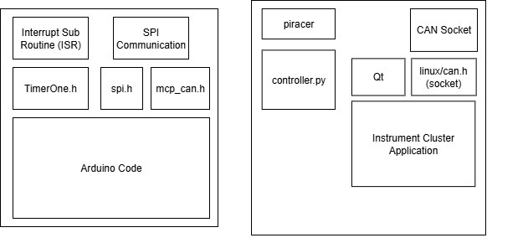
Code Structure

