Slide 1

Feature Engineering and Preprocessing
Dr. Shailesh S shaileshsivan@gmail.com

Slide 2
Overview
Machine Learning
Dimensionality Reduction
Components of Dimensionality Reduction
Methods of Dimensionality Reduction
Feature Reduction Iris Dataset
Preprocessing

Slide 3
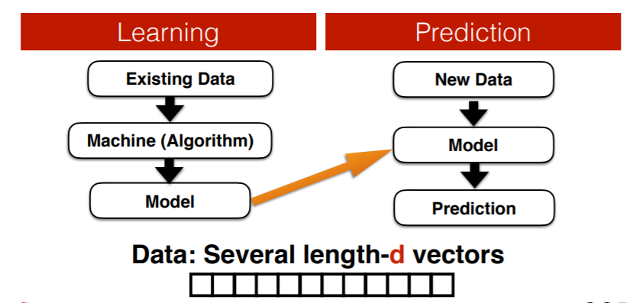
What Does Machine Learning do?

Slide 4
Some Facts
Expectation :
We have good enough data
Do focus on designing better algorithms
Reality :
We have large amount of data but not good enough
How to transform your data into learning compactable ?

Slide 5
What is a Feature in ML
A feature is a measurable property of the object you’re trying to analyze. In datasets, features appear as columns
Feature engineering is the process of transforming raw data into features that better represent the underlying problem to the predictive models, resulting in improved model accuracy on unseen data.
Feature engineering turn your inputs into things the algorithm can understand

Slide 6
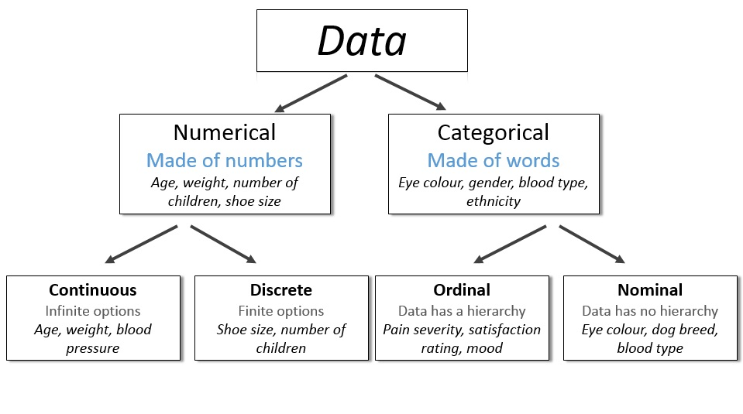
Types of Features
Features

Slide 7
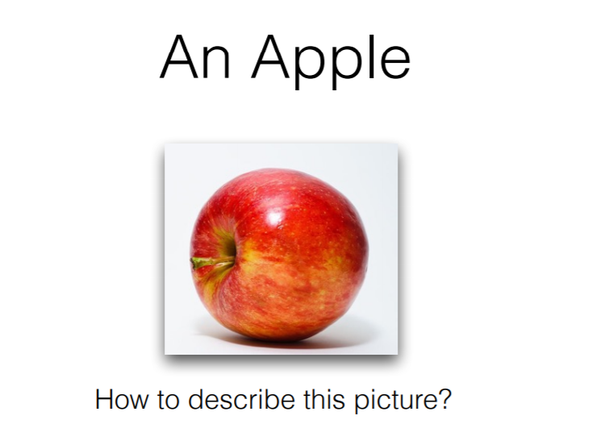
Features from observation

Slide 8
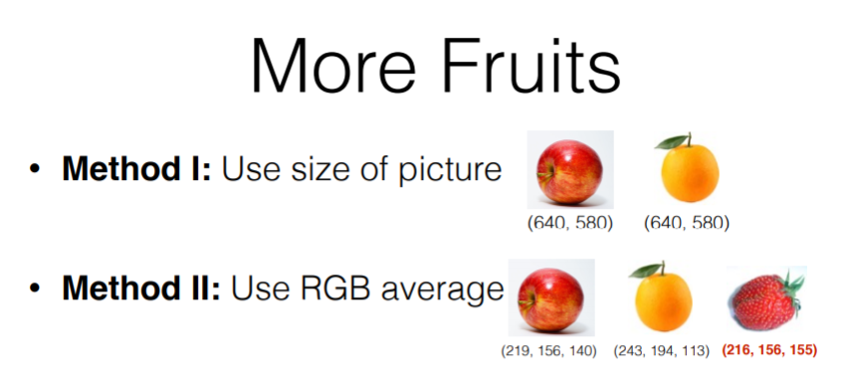
Features from observation

Slide 9
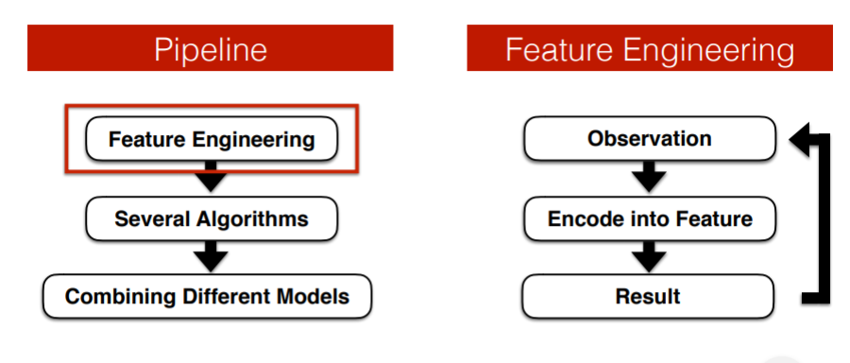
Feature Engineering

Slide 10
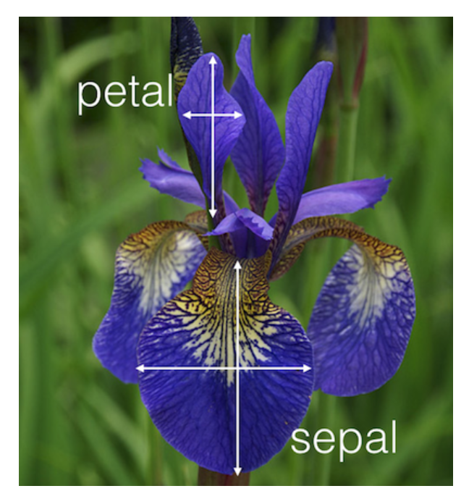
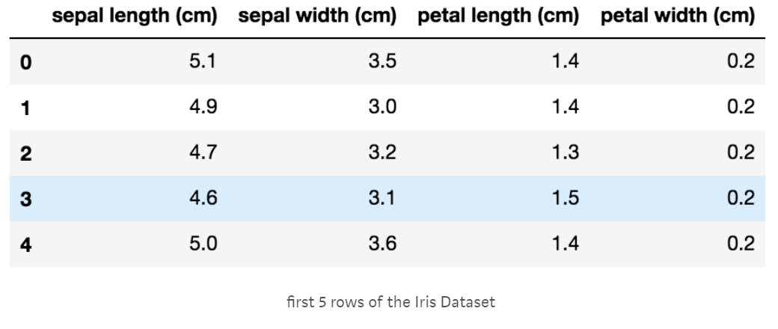
Features in iris data set
Source : Kaggle
https://www.kaggle.com/uciml/iris

Slide 11
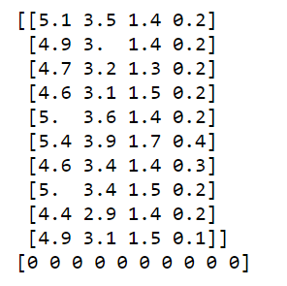
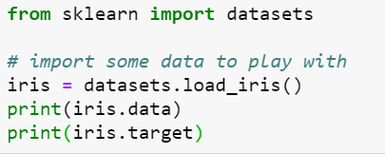
Iris dataset in scikit-learn
scikit-learn – machine learning in python
Simple and efficient tools for data mining and data analysis
several machine learning algorithms
Machine Learning in Python

Slide 12
Synthetic Data
Synthetic data is artificially generated data used for:
- Testing algorithms
- Learning concepts
- Simulating real-world scenarios
- Handling privacy issues
Key idea: Generate data with known properties.

Slide 13
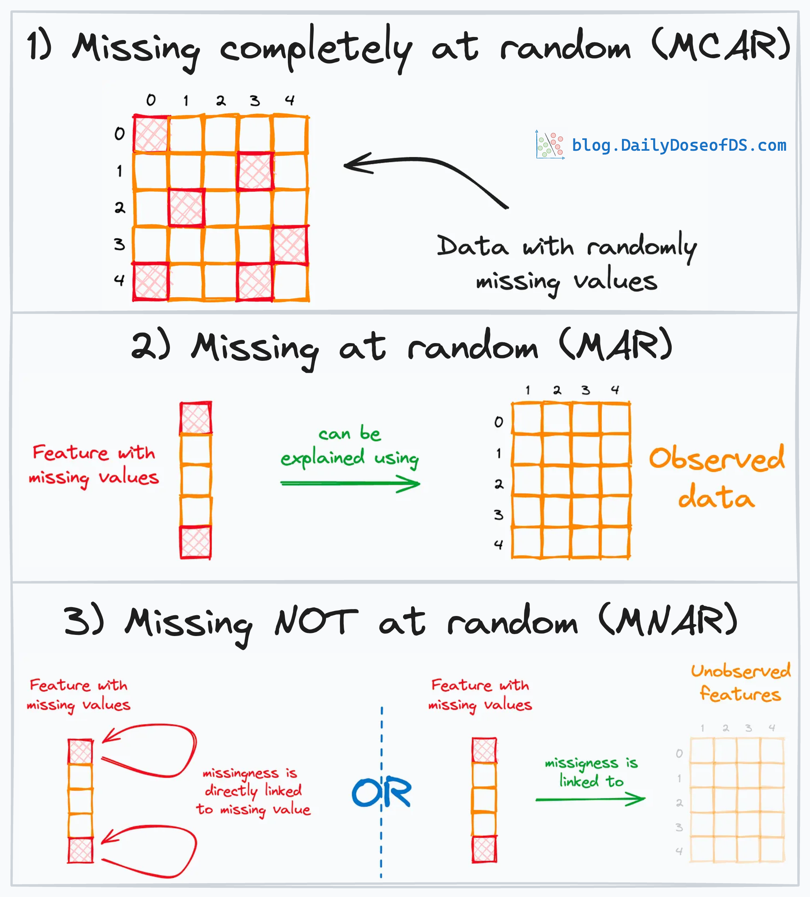
Missing Data Handling
Types of Missing Data:
- MCAR – Missing Completely at Random
- MAR – Missing At Random
- MNAR – Missing Not At Random

Slide 14
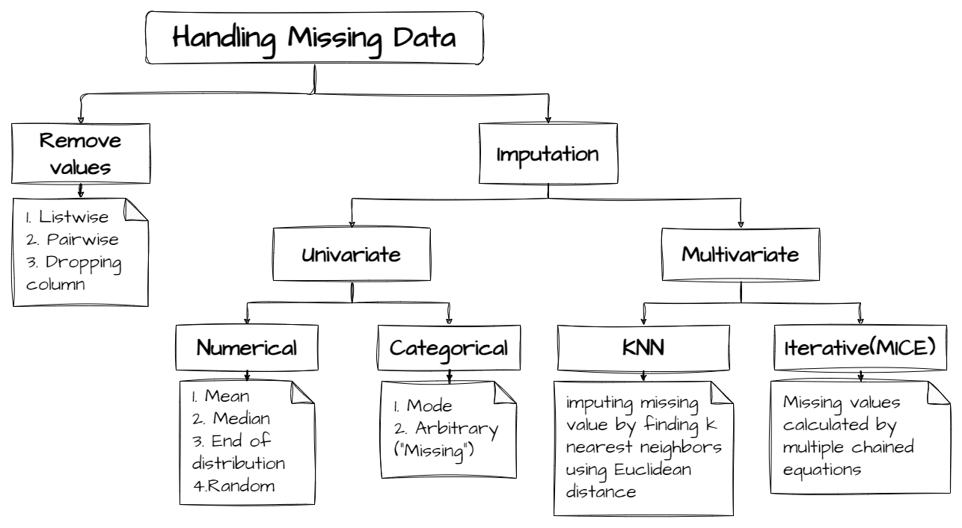
Missing Data Handling
Handling Techniques:
- Remove rows/columns
- Mean/Median/Mode imputation
- Forward/Backward fill
- Predict using ML models

Slide 15
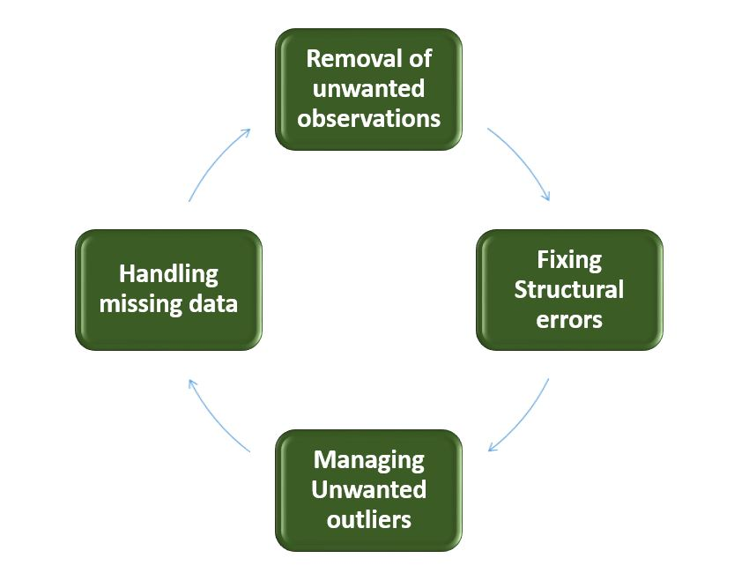
Data Cleaning
Data cleaning fixes:
- Duplicate data
- Incorrect values
- Outliers
- Inconsistent formats
Goal: Improve data quality and consistency.

Slide 16
Normalization and Scaling
Scaling is important for distance-based algorithms.
Methods:
- Min-Max Normalization
- Standardization (Z-score)
- Robust Scaling
Ensures all features are on similar scale.

Slide 17
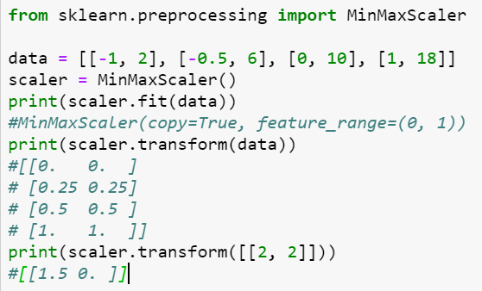
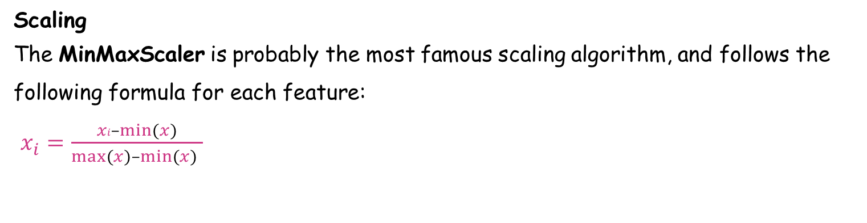
Preprocessing
Scaling
The MinMaxScaler is probably the most famous scaling algorithm, and follows the following formula for each feature:
$x_{i}=\frac{xi–min⁡(x)}{max⁡(x)–min⁡(x) }$
Shrinks the range such that the range is now between 0 and 1 (or -1 to 1 if there are negative values).

Slide 18
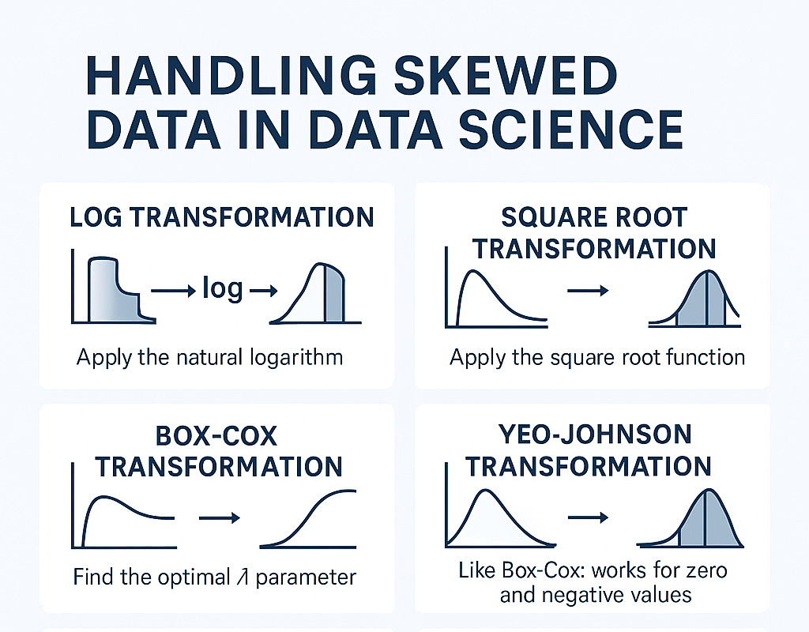
Data Transformation
Used to change distribution of data.
Common transformations:
- Log transformation
- Square root transformation
- Exponential transformation
- Box-Cox transformation
Used when data is skewed.

Slide 19
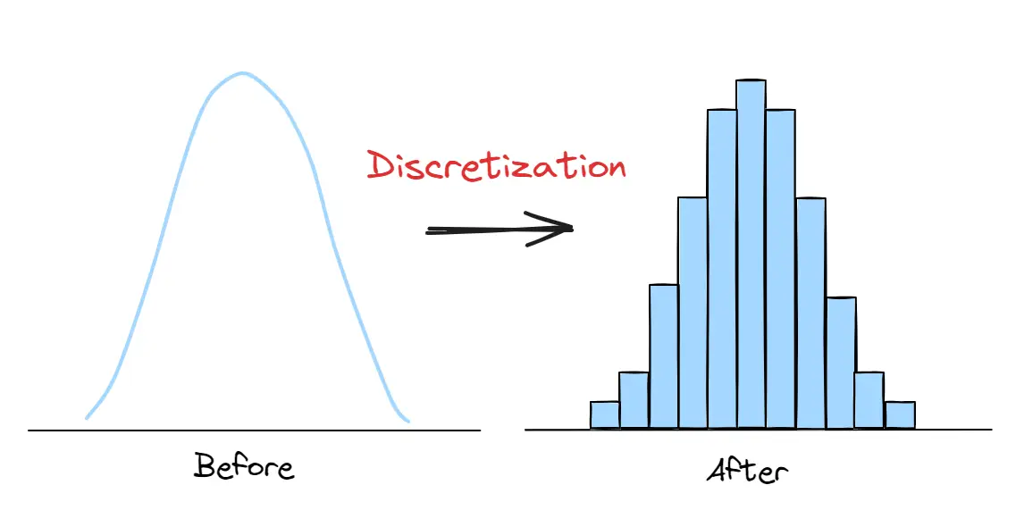
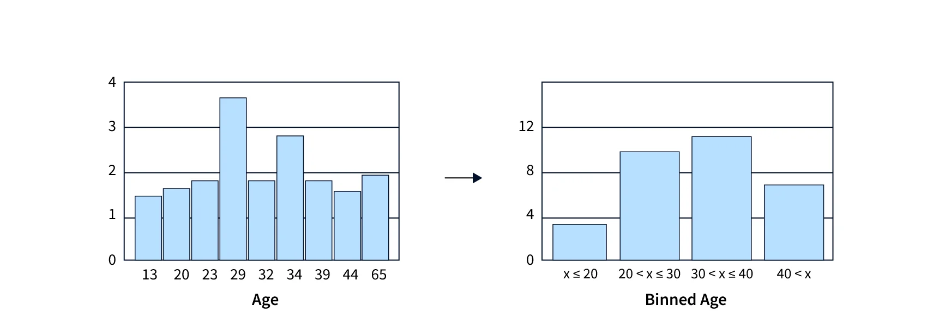
Discretization and Binning
Converts continuous data into categories.
Types:
- Equal-width binning
- Equal-frequency binning
- K-means binning
Useful for decision trees and noise reduction.

Slide 20
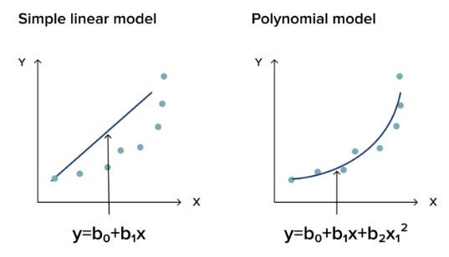
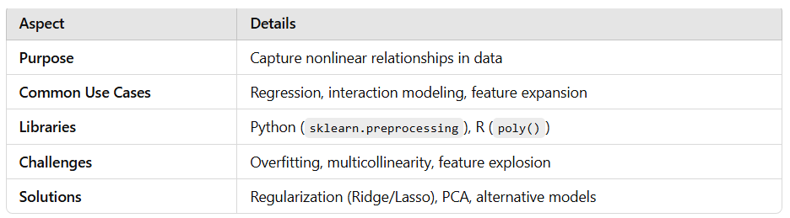

Polynomial Interaction Features
Used to model non-linear relationships.
Create new features:
- $x_{1}^{2},x_{2}^{2}$
- $x_{1}∗x_{2}$
Helps linear models learn non-linear patterns.

Slide 21
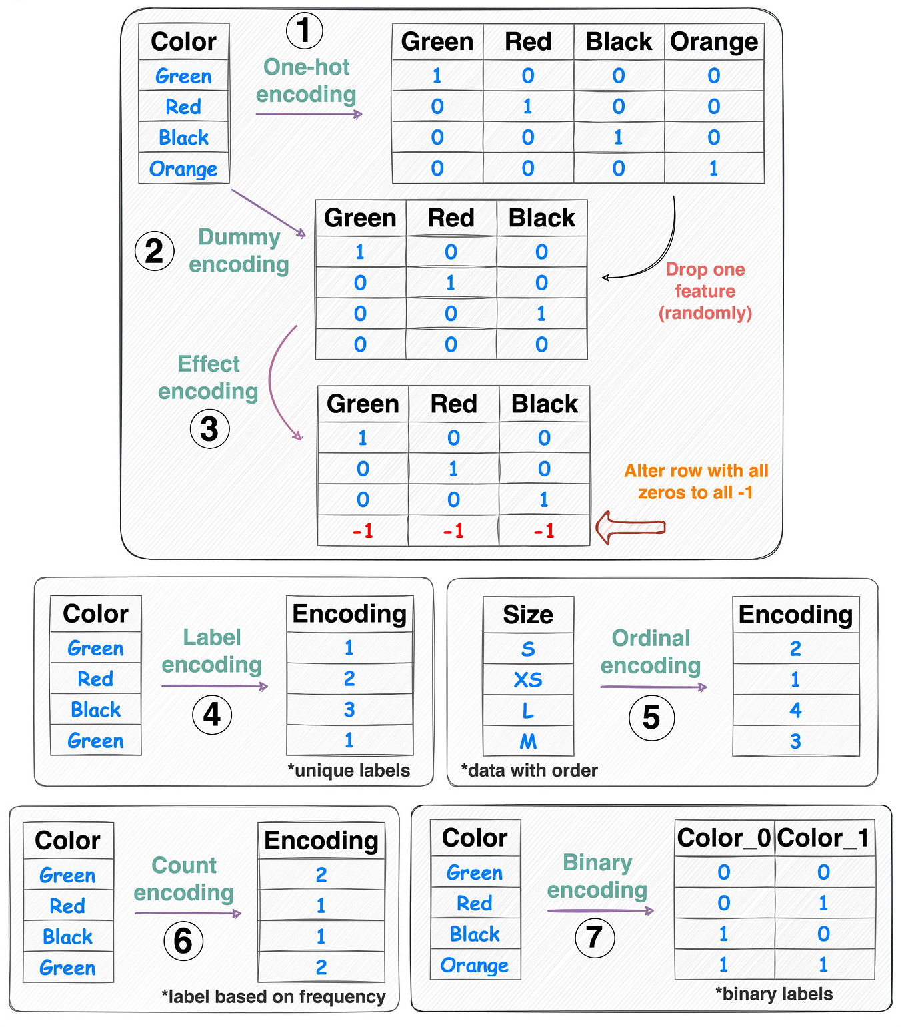
Encoding Techniques
Convert categorical data into numerical form.
Methods:
- Label Encoding
- One-Hot Encoding
- Ordinal Encoding
- Target Encoding
- Frequency Encoding

Slide 22
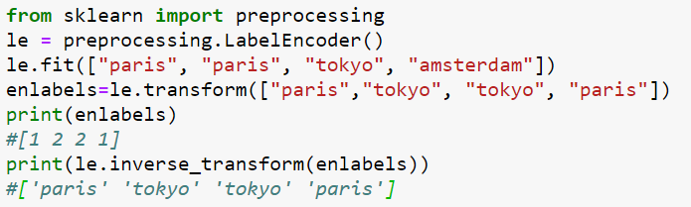
Preprocessing
Label Encoding
Used to transform non-numerical labels, that is, categorical values, to numerical labels.

Slide 23
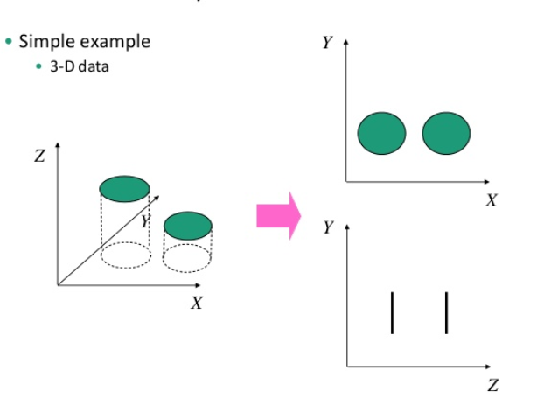
Dimensionality Reduction
Dimensionality reduction - Reducing the number of random variables to consider. Learning in Python

Slide 24
Dimensionality Reduction
‘Dimensionality’ - simply refers to the number of features (i.e. input variables) in your dataset.
When the number of features is very large relative to the number of observations in your dataset, certain algorithms struggle to train effective models.
This is called the “Curse of Dimensionality,”
It’s especially relevant for clustering algorithms that rely on distance calculations.

Slide 25
Components of Dimensionality Reduction
Feature selection: you select a subset of the original feature set.
Feature extraction: you build a new set of features from the original feature set.

Slide 26
Feature Selection
1️⃣ Filter Methods
Use statistical measures to rank and select features.
Independent of any machine learning model.
Examples:
  Correlation coefficient
  Chi-squared test
  ANOVA F-test
  Mutual Information

Slide 27
Feature Selection
2️⃣ Wrapper Methods
Use predictive models to evaluate feature subsets.
Computationally expensive but can provide better performance.
Examples:
  Forward Selection
  Backward Elimination
  Recursive Feature Elimination (RFE)

Slide 28
Feature Selection
3️⃣ Embedded Methods
Feature selection is performed during model training.
Less computationally expensive than wrappers, model-aware.
Examples:
  Lasso (L1 Regularization)
  Decision Tree feature importance
  Elastic Net
4️⃣ Hybrid Methods Combine filter and wrapper methods to leverage the advantages of both.
Example workflow: Apply filter to reduce features, then wrapper for fine selection.

Slide 29
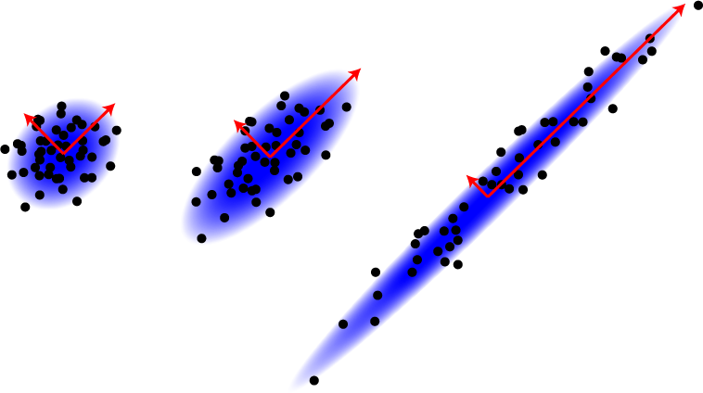
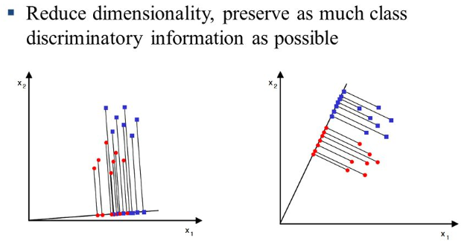
Feature Extraction
Linear Discriminant Analysis (LDA)
Principal Component Analysis (PCA)

Slide 30
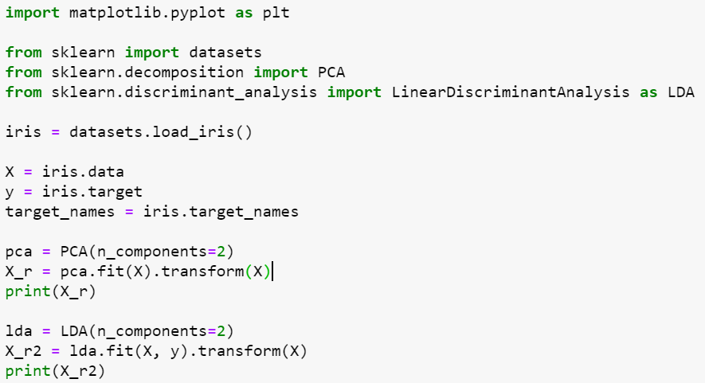
Feature Reduction Iris Dataset

Slide 31
Feature Reduction Iris Dataset
PCA OUTPUT
[[-2.68412563 0.31939725] [-2.71414169 -0.17700123] [-2.88899057 -0.14494943] [-2.74534286 -0.31829898] [-2.72871654 0.32675451] [-2.28085963 0.74133045] [-2.82053775 -0.08946138] [-2.62614497 0.16338496] [-2.88638273 -0.57831175] ------------------------------------------------------------------------------------------------------------------------------------------------------------------------------------------------------------------------------------------------------------------------------------------------------------------------------------------------------------- [ 1.16932634 -0.16499026] [ 2.10761114 0.37228787] [ 2.31415471 0.18365128] [ 1.9222678 0.40920347] [ 1.41523588 -0.57491635] [ 2.56301338 0.2778626 ] [ 2.41874618 0.3047982 ] [ 1.94410979 0.1875323 ] [ 1.52716661 -0.37531698] [ 1.76434572 0.07885885] [ 1.90094161 0.11662796] [ 1.39018886 -0.28266094]]
LDA OUTPUT
[[-8.06179978e+00 3.00420621e-01] [-7.12868772e+00 -7.86660426e-01] [-7.48982797e+00 -2.65384488e-01] [-6.81320057e+00 -6.70631068e-01] [-8.13230933e+00 5.14462530e-01] [-7.70194674e+00 1.46172097e+00] [-7.21261762e+00 3.55836209e-01] ------------------------------------------------------------------------------------------------------------------------------------------------------------------------------------------------------------------------------------------------[ 9.97610366e-01 -4.90530602e-01] [ 3.83525931e+00 -1.40595806e+00] [ 2.25741249e+00 -1.42679423e+00] [ 1.25571326e+00 -5.46424197e-01] [ 1.43755762e+00 -1.34424979e-01] [ 2.45906137e+00 -9.35277280e-01] [ 3.51848495e+00 1.60588866e-01] [ 2.58979871e+00 -1.74611728e-01] [-3.07487884e-01 -1.31887146e+00] [ 4.96774090e+00 8.21140550e-01] [ 5.88614539e+00 2.34509051e+00] [ 4.68315426e+00 3.32033811e-01]]

Slide 32
Preprocessing Pipeline
1. Data Collection
2. Data Cleaning
3. Missing Value Handling
4. Encoding
5. Scaling
6. Transformation
7. Feature Engineering
8. Feature Reduction
9. Train Model

Slide 33

Thank You

