Slide 1
Approach and Assumptions
I have chosen python, pandas and matplot to come with the solution, the client was mentioning about larger dataset in future, we may need to leverage bigdata solutions such as databricks and pyspark if the data volume is too huge.
For the classic car scenario, I had drawn the trend of sales against year_month to get a better visualization of the sales over the years. Hope it meets the clients expectation, let me know otherwise.
For the discount scenario, I have calculated the discounted amount for mentioned product line and plotted against year, it will provide how much discount they provide over the years for different product lines. Hope it serves the purpose.

Slide 2
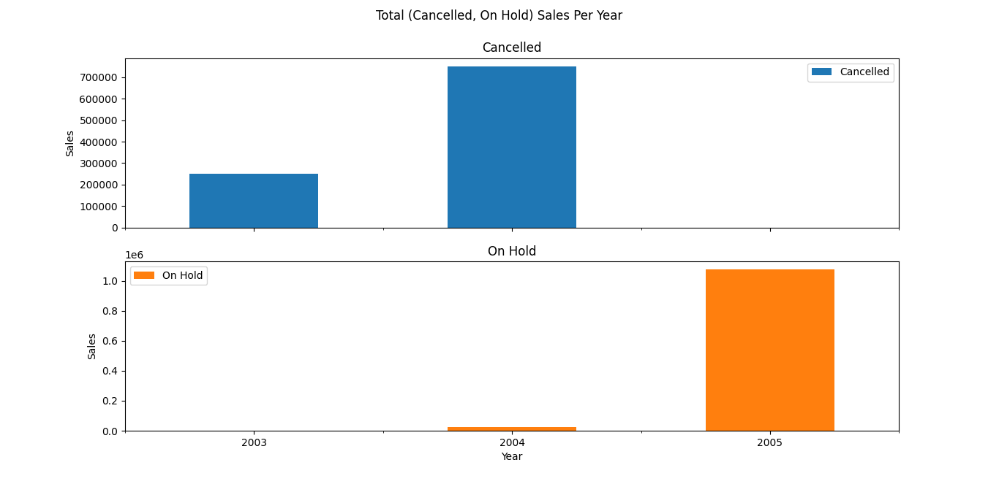
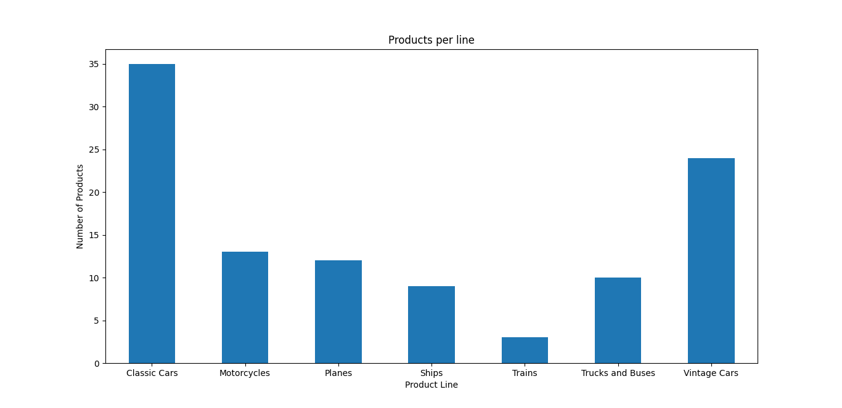
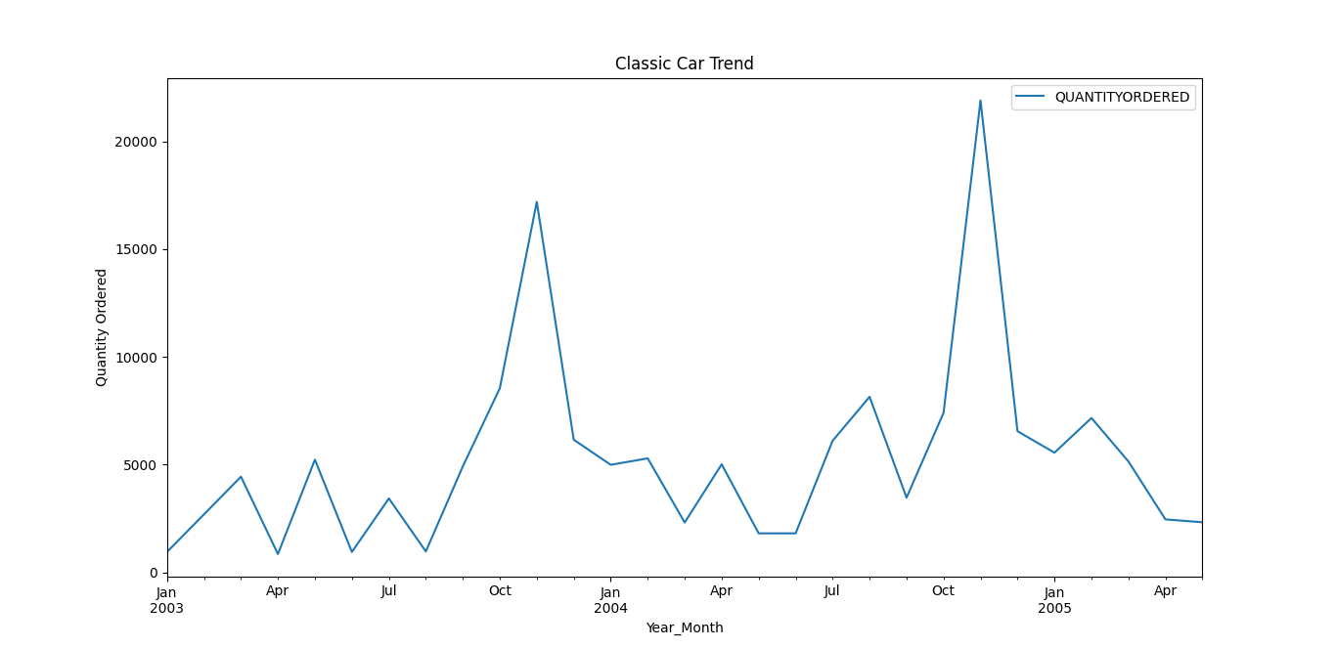
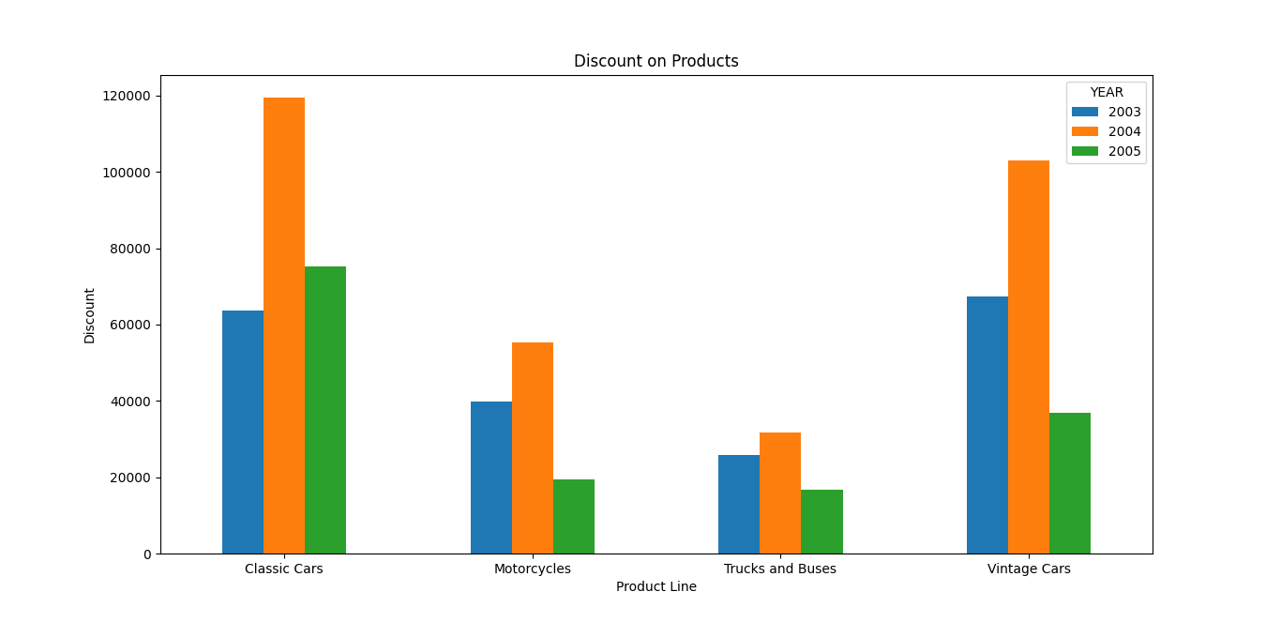
Results

