Slide 1

Insurance Premium Prediction

Slide 2
Project Objective:
Develop a Machine Learning model to predict insurance premiums based on individual factors such as age, sex, BMI, number of children, smoking status, and region.
Scope:
Provide accurate and personalized premium predictions for insurance applicants.
Explore opportunities for model enhancements and improvements over time.
Key Focus:
Deliver a reliable and user-friendly solution for insurance premium estimation.
Foster ongoing monitoring, user feedback integration, and adaptability to ensure sustained success.

Slide 3
Architecture
Data Ingestion
Data Preprocessing
EDA
Model Building
Model Testing
Flask Setup
Deployment

Slide 4
Data Collection and validation
Data Sources:
Dataset was obtained from the Machine Learning course website (Spring 2017) from Professor Eric Suess - CSU East Bay College of Science.
Data Validation:
Rigorous validation procedures to ensure accuracy and reliability.
Handling missing values, outliers, and maintaining data consistency.

Slide 5
Data Pre-processing
Objective
Ensure the preparedness of data for effective model training.
Steps
Handling missing values, outliers, and addressing data inconsistencies.
Normalizing numerical features and encoding categorical variables.

Slide 6
Exploratory Data Analysis (EDA)
Objective:
Gain insights into data distributions, relationships, and patterns.
Key Activities:
Visualizing age distribution, BMI variations, and regional trends.
Analyzing correlations between variables.
Visual Elements:
Incorporate visualizations such as histograms, scatter plots, and correlation matrices.

Slide 7
Model Building
Training Process
Data split into training and testing sets for iterative model training.
Optimization efforts for achieving optimal performance.
Algorithm Selection
Tried and tested multiple algorithms; GradientBoosting selected for its superior performance in regression tasks.
Algorithms Explored
Linear Regression, Decision Trees, Random Forest, Gradient Boosting, Extreme Gradient Boosting
Model Evaluation Metrics
RMSE (Root mean squared error) and r2_score (R-squared).

Slide 8
Predictions
All the trained models were used for validating test set.
The best RMSE and r2 score model were saved for developing API for prediction of premium.

Slide 9
Q & A
Q1) What is the source data?
Dataset was obtained from the Machine Learning course website (Spring 2017) conducted by Professor Eric Suess - CSU East Bay College of Science.
Q2) What was the type of the data?
The data was combination of categorical and numerical values.
Q3) What’s the complete flow you followed in this project?
Refer the 3rd slide for better understanding
Q4) What techniques were you using for data pre-processing?
Handling missing values, outliers, and addressing data inconsistencies.
Normalizing numerical features and encoding categorical variables.

Slide 10
Q5) How training was done or what models were used?
The dataset was split into training and testing sets.
Algorithm Selection:
Multiple algorithms were explored, including Linear Regression, Decision Trees, Random Forest, Gradient Boosting and XGBoost.
Model Training:
The Gradient Boosting algorithm was selected for its superior performance in regression tasks.
Iterative optimization was performed to achieve optimal model performance.
Model Evaluation Metrics:
Model performance was evaluated using key metrics such as accuracy, precision, recall, and F1-score.

Slide 11
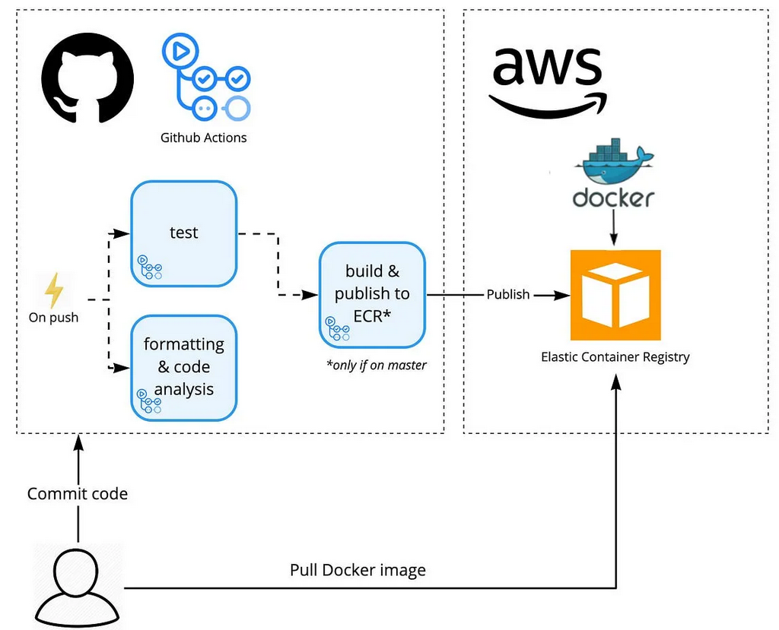
Q6) How prediction was done?
On the basis of trained model, the prediction was performed. We also created API interface for estimating cost of premium on the basis of personal health information/status.
Q7) What are the different stages of deployment?

