Slide 1
INDIAN TAX SYSTEM AND GST

Slide 2
TAX
Tax is a mandatory financial charge imposed upon a taxpayer (an individual or other legal entity) by government, in order to fund various public expenditures.

Slide 3
Public Expenditures
Public expenditures include expenditures on economic infrastructure (roads, public transportation, sanitation, legal systems, public safety, education, health-care systems), military, scientific research, culture and the arts, distribution,, and the operation of government itself

Slide 4
TAX
INDIRECT TAX
DIRECT TAX

Slide 5
DIRECT TAX
A direct tax is paid directly by an individual or organization to an imposing entity.
In direct tax the impact and incidence falls on same person
Impact means immediate burden and incidence means ultimate burden

Slide 6
EXAMPLES OF DIRECT TAX
INCOME TAX
CORPORATE TAX
GIFT TAX etc…

Slide 7
INCOME TAX
Income tax is an annual tax on income
Income of previous year is taxable in the next following assessment year

Slide 8
HEADS OF INCOME
SALARIES
INCOME FROM HOUSE PROPERTY
PROFIT AND GAINS OF BUSINESS OR PROFESSION
CAPITAL GAINS
INCOME FROM OTHER SOURCE

Slide 9
AY 2018-2019 FY 2017-2018
Up to Rs. 2,50,000 Nil
2,50,000- 5,00,000 5%
5,00,000- 10,00,000 20%
Above 10,00,000 30%

Slide 10
INDIRECT TAX
When the impact and incidence falls on different person, then it is known as indirect tax.

Slide 11
EXAMPLES OF INDIRECT TAX
SERVICE TAX
SALES TAX
VALUE ADDED TAX
GST etc…

Slide 12
Sales Tax(1938)
A sales tax is a consumption tax imposed by the government on the sale of goods and services. Sales tax is levied at the point of sale, collected by the retailer and passed on to the government.

Slide 13
Sales taxes are only charged to the end user of a good or service. Because the majority of goods in modern economies pass through a number of stages of manufacturing, often handled by different entities, a significant amount of documentation is necessary to prove who is ultimately liable for sales tax.

Slide 14
Value Added Tax
Value-added tax (VAT) is a type of consumption tax that is placed on a product whenever value is added at a stage of production and at the point of retail sale.

Slide 15
VAT is levied on the gross margin at each point in the manufacturing-distribution-sales process of an item. The tax is assessed and collected at each stage

Slide 16
GST
GST is an indirect tax levied on the supply of goods and services. “GST is a comprehensive, multi-stage, destination-based tax that will be levied on every value addition.”
The main objective of incorporating the GST is to eliminate tax on tax i.e. double taxation which cascades from the manufacturing level to the consumption level.

Slide 17
The Goods and Services Tax (GST) is a value-added tax levied on most goods and services sold for domestic consumption. The GST is paid by consumers, but it is remitted to the government by the businesses selling the goods and services.

Slide 18
France was the first country to implement the GST in 1954
Some of the countries with GST include Canada, Vietnam, Australia, Singapore, UK, Monaco, Spain, Italy, Nigeria, Brazil, and South Korea. India is set to join the GST group on July 1, 2017.

Slide 19
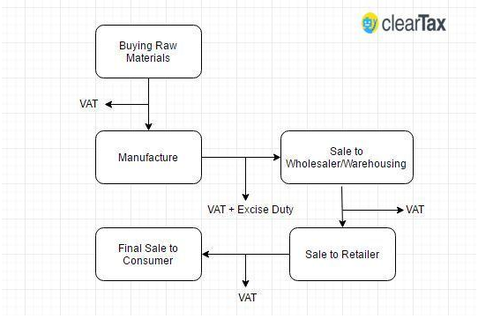

Slide 20
Destination-Based
Consider goods manufactured in Maharashtra and are sold to the final consumer in Karnataka. Since Goods & Service Tax (GST) is levied at the point of consumption, in this case, Karnataka, the entire tax revenue will go to Karnataka and not Maharashtra

Slide 21
Components of GST
There are 3 taxes applicable under GST:
CGST: Collected by the Central Government on an intra-state sale (Eg: Within Maharashtra)
SGST: Collected by the State Government on an intra-state sale (Eg: Within Mahaashtra)
IGST: Collected by the Central Government for inter-state sale (Eg: Maharashtra to Tamil Nadu)

Slide 22
Illustration:
Let us assume that a dealer in Gujrat had sold the goods to a dealer in Punjab worth Rs. 50,000. The GST rate is 18% comprising of only IGST.
In such case, the dealer has to charge Rs. 9,000 as IGST. This IGST revenue will go to the Central Government.
The same dealer sells goods to a consumer in Gujrat worth Rs. 50,000. The GST rate on the good is 12%. This rate comprises of CGST at 6% and SGST at 6%.
The dealer has to collect Rs. 6,000 as Goods and Service Tax. Rs. 3,000 will go to the Central Government and Rs. 3,000 will go to the Gujarat government as the sale is within the state

Slide 23
Tax calculations in Pre GST regime
Action | Cost | 10% Tax | Total
Manufacturer | 1,000 | 100 | 1,100
Warehouse adds label and repacks @ 300 | 1,400 | 140 | 1,540
Retailer advertises @ 500 | 2,040 | 204 | 2,244
Total | 1,800 | 444 | 2,244

Slide 24
Tax calculations in GST regime
Action | Cost | 10% Tax | Actual Liability | Total
Manufacturer | 1,000 | 100 | 100 | 1,100
Warehouse adds label and repacks @ 300 | 1,300 | 130 | 30 | 1,430
Retailer advertises @ 500 | 1,800 | 180 | 50 | 1,980
Total | 1,800 |  | 180 | 1,980

Slide 25
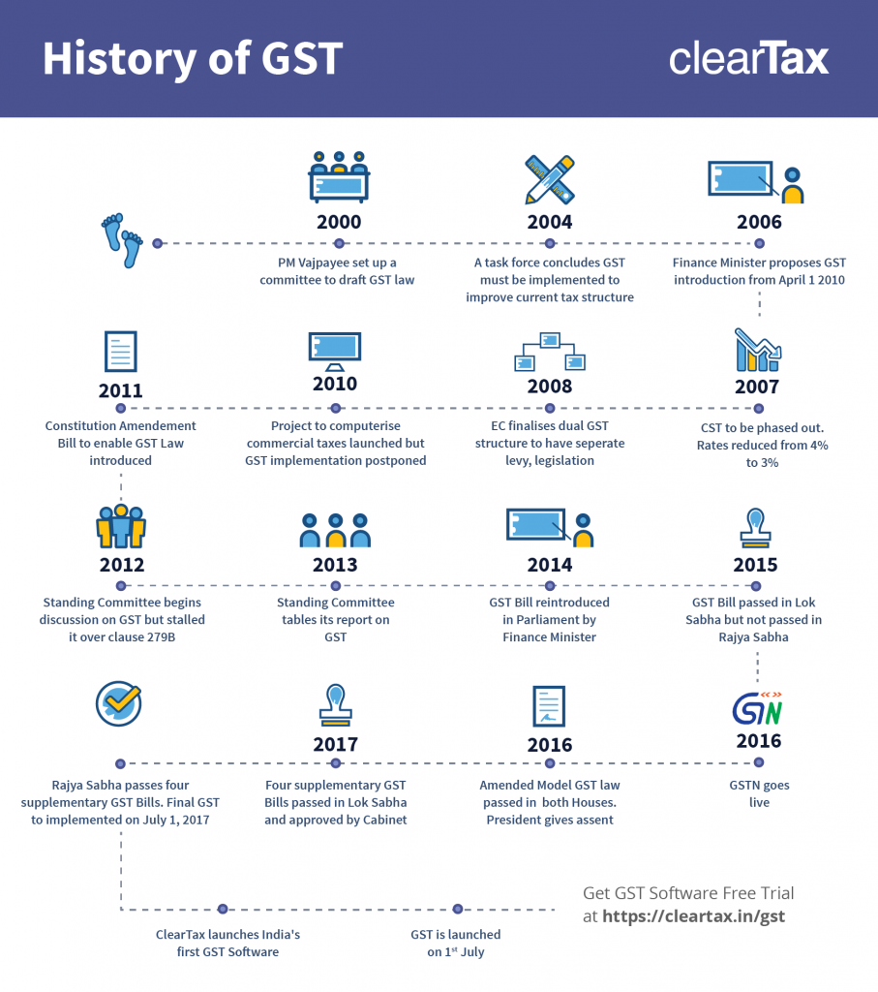

Slide 26
Advantages Of GST
Removing cascading effect of tax
Higher threshold for registration
Defined treatment for e-commerce
Increased efficiency in logistics

Slide 27
Disadvantages Of GST
Increased costs due to software purchase
Increase in operational cost
SME will have a higher tax burden

Slide 28


