Slide 1
cfdna-chromatin-xai
Fetal-Fraction XAI Module — Complete Method Walkthrough
Feature-agnostic explainer over a PCA -> linear-regression fetal-fraction model (seqFF++).
Every formula and code block is taken verbatim from the tool source.
Importance (SHAP) -> Explanation (cell of origin) -> Mechanism (PC decomposition).
SHAP
tissue enrichment
PC <-> tissue

Slide 2
OVERVIEW
What this tool is
A feature-agnostic explainer wrapped around a fetal-fraction predictor built as PCA -> linear regression. It reads ONLY the trained model's bin_loadings and beta. No per-patient data is required for the importance and mechanism tracks, and none ever leaves the instance — only per-feature aggregates do.
1 IMPORTANCE
2 EXPLANATION
3 MECHANISM
Which bins drive the FF prediction, and in which direction?
What cell types are those bins open in?
Which PCs build each FF direction, resembling which tissue?
SHAP, closed-form
enrichment vs null
PC <-> tissue

Slide 3
STEP 1 — THE FEATURE
Normalized coverage residual
The model never sees raw read counts. Raw coverage is confounded by GC bias and depth; the input feature is the RESIDUAL after regressing those out, so a non-zero value is biological signal, not artifact.
INPUT whole-genome cfDNA sequencing, binned into 50 kb windows on hg19 autosomes (~52,000 bins)
OUTPUT one corrected coverage residual x(i,b) per (sample, bin)
INTERPRET The key inversion: open chromatin fragments more readily -> fewer intact fragments span the bin -> LOWER coverage. So 'open chromatin => low coverage'. This is why a negative-weight bin later corresponds to HIGH placental openness.

Slide 4
STEP 2 — THE MODEL
PCA, then linear regression
With ~52k bins and far fewer samples, regressing FF directly on bins overfits. PCA compresses the bins into ~100 orthogonal components; the regression runs on those.
L[b,k] loadings — column k is a genome-wide spatial pattern (a 'meta-bin'): which bins move together.
beta_k coefficient — how strongly, and in which direction, PC k moves FF. Its SIGN is load-bearing downstream.
INTERPRET Because both maps are linear, they collapse EXACTLY into a single linear model in bin space — no approximation. That collapse is what makes SHAP closed-form.

Slide 5
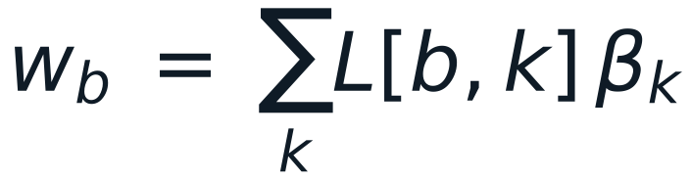
STEP 3 — EFFECTIVE PER-BIN WEIGHT
Collapsing PCA x beta into one weight per bin
Substitute the score into FF-hat and swap the order of summation: the two stacked linear maps become one signed weight per bin.
# extract_ff_shap.R — effective per-bin weight w = L %*% beta_pc
L <- obj$bin_loadings # data.table: bin_name + PC1..PCk
pc_cols <- grep("^PC[0-9]+$", names(L), value = TRUE)
Lmat <- as.matrix(as.data.frame(L)[, pc_cols]) # nbin x npc
beta <- obj$beta; bpc <- beta[pc_cols] # align to loadings' PCs
w <- as.numeric(Lmat %*% bpc) # <- one signed weight per bin
names(w) <- bin_name
# w_bin > 0 : more openness -> HIGHER predicted FF (fetal / placental-leaning)
# w_bin < 0 : more openness -> LOWER predicted FF (maternal-leaning)
signed_vec <- w # keeps DIRECTION of effect on FF
imp_vec <- abs(w) # magnitude
INTERPRET w_b needs only the trained model — the entire importance track is computable with NO patient data.

Slide 6
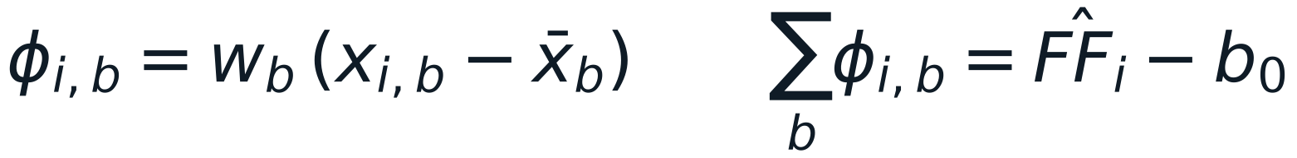
STEP 4 — SHAP
Closed-form importance
For a linear model the Shapley value has an exact closed form: weight x centered value. No sampling, no KernelExplainer.
# extract_ff_shap.R — exact linear-SHAP when the coverage matrix X is present
xbar <- colMeans(X[, common])
center <- sweep(X[, common], 2, xbar, "-")
mad_j <- colMeans(abs(center)) # mean_i |x_ij - xbar_j| (>= 0)
# signed exact linear-SHAP magnitude: SIGN is carried by w (mad_j >= 0)
signed_vec[common] <- w[common] * mad_j
imp_vec[common] <- abs(w[common]) * mad_j
imp_mode <- "pca_linear_shap_exact"
imp <- data.frame(feature = names(imp_vec),
mean_abs_shap = imp_vec, # magnitude
signed_shap = signed_vec) # direction
THE SIGN IDENTITY
mad_b >= 0 can never flip the sign, so
sign(signed_shap_b) = sign(w_b).
The aggregate track is anchored to the model weight — patient-independent.
TWO MODES
• model-only (no X): importance = |w_b|
• exact SHAP (X present): |w_b| x mad_b — weight scaled by that bin's coverage variability. Direction unchanged; the most-extreme bin gets reweighted.

Slide 7
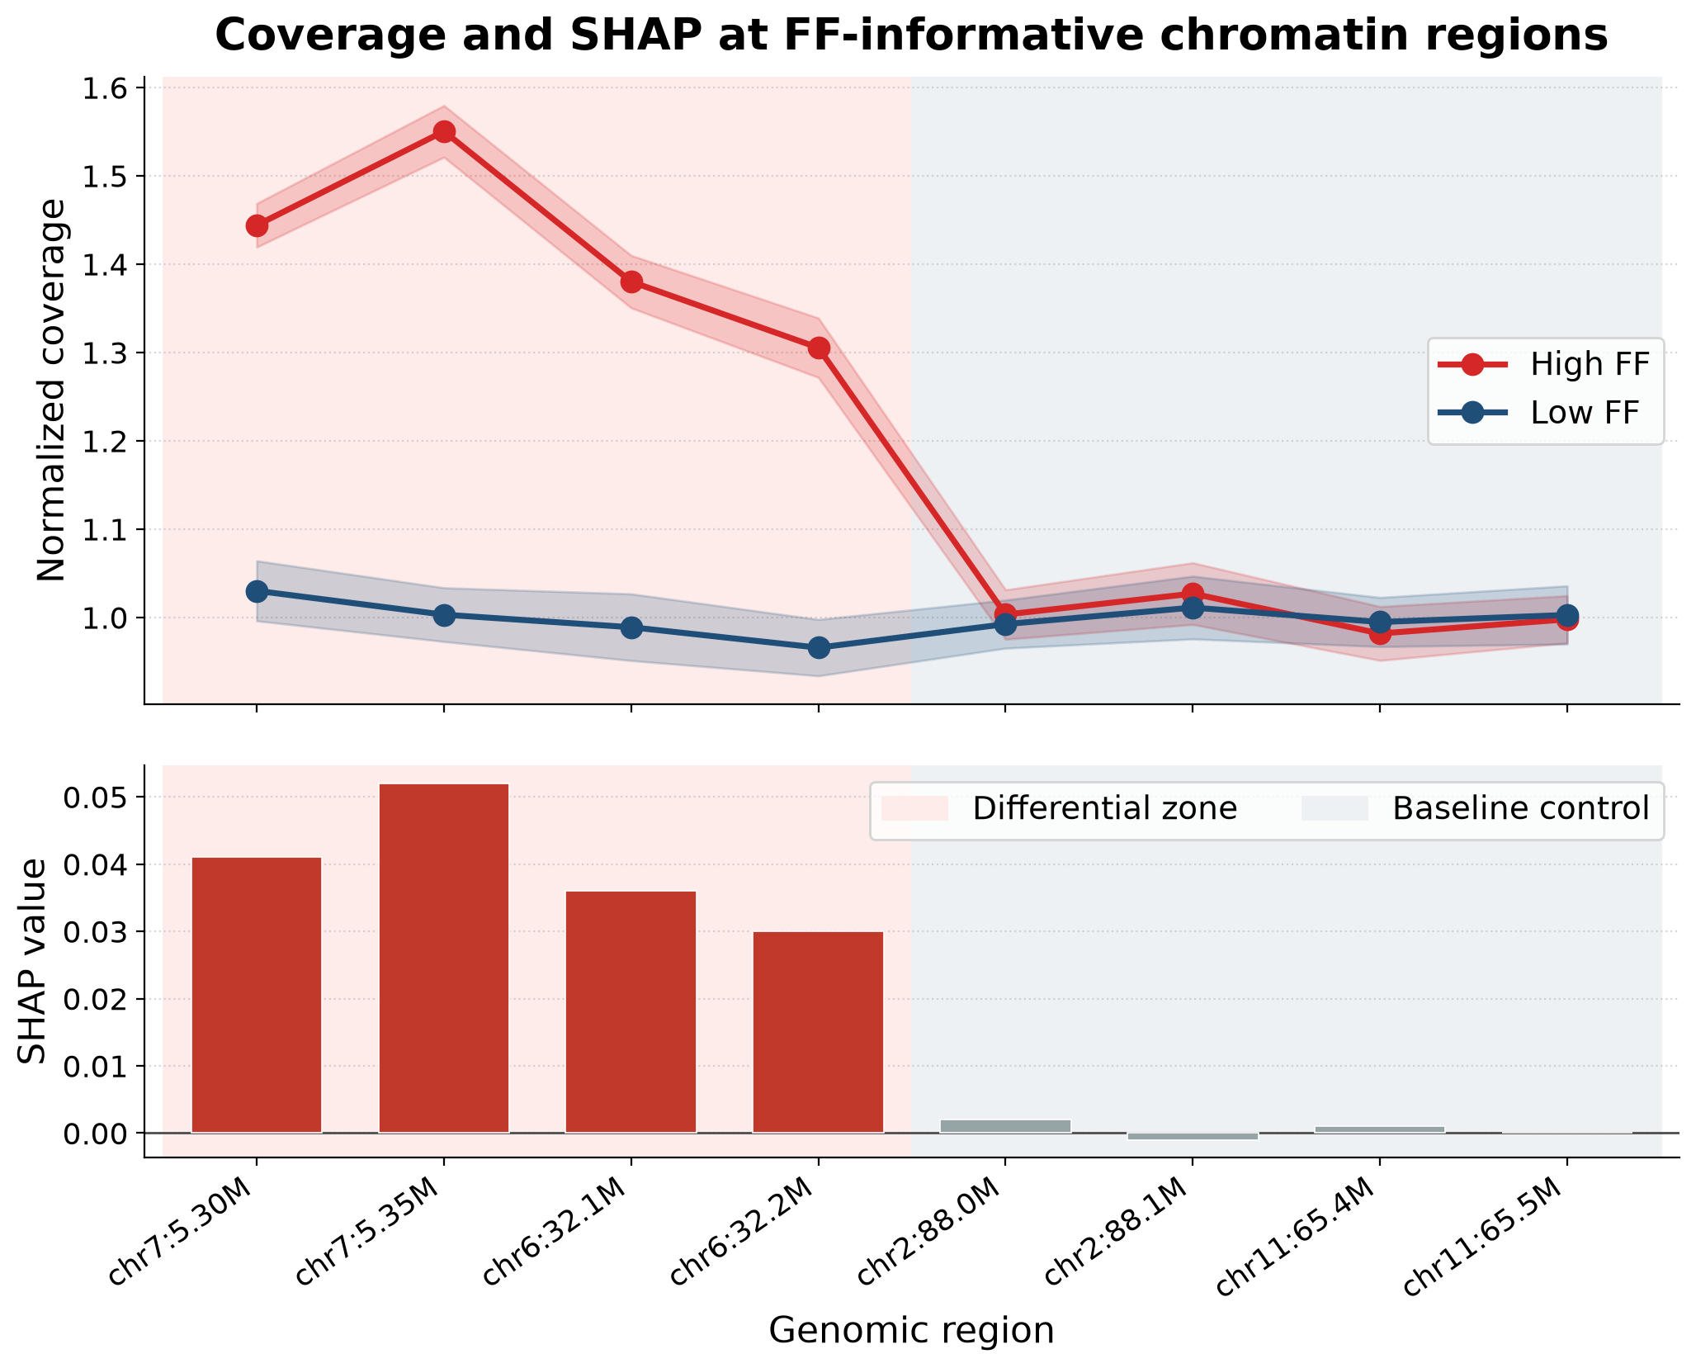
STEP 4 — SHAP, THE FIGURE
Coverage / SHAP track
Two stacked panels, shared x-axis.
x (both) genomic region, chr1 -> chr22
top y normalized coverage x(i,b) — the INPUT feature
bottom y SHAP value phi(i,b) — the signed contribution to FF-hat for that sample
READ a tall positive bar pushed this sample's FF up; a deep negative bar pushed it down. A bin earns large |phi| only when its coverage deviates from the mean AND it carries a non-trivial weight.

Slide 8
STEP 5 — PARTITION
FF-up vs FF-down bin sets
Split every bin by the sign of its weight, then take the top-N most extreme in each direction (defaults N = 500, 1000, 2000, 5000). These POS / NEG sets feed every downstream figure.
Why 'FF-up / FF-down' and not 'positive / negative SHAP' — same partition, clearer name:
naming
sign anchored to
ambiguous?
positive / negative SHAP
arithmetic sign — aggregate or per-sample phi?
YES — per-sample phi flips below the bin mean
FF-up / FF-down
sign(w_b) — sample-independent model weight
NO — names the biological direction

Slide 9
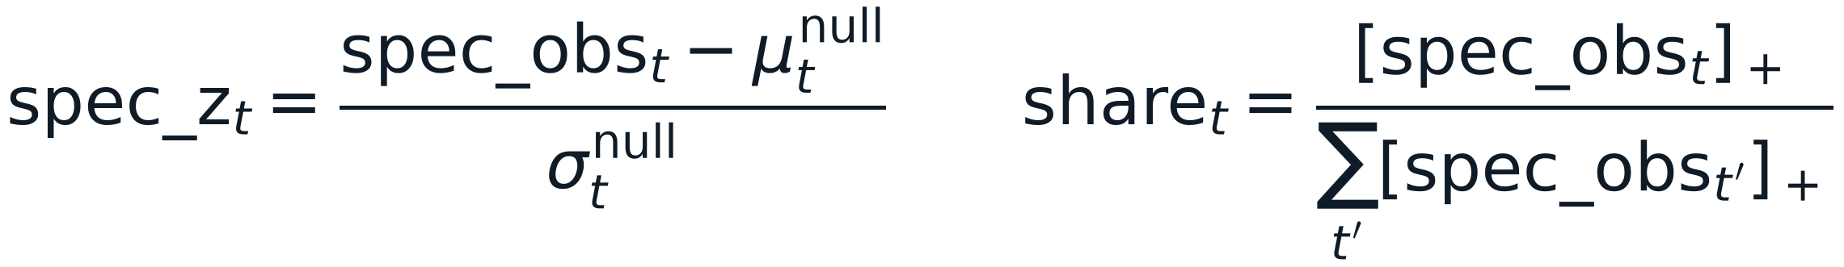
STEP 6 — EXPLANATION
Cell-of-origin enrichment vs a matched null
What cell types are the top SHAP bins open in? Calibrate against random genome so 'open everywhere' can't fake a signal.
# ff_tissue_proportion.py — spec_<t> = C_<t> - row-mean; matched random-region null
spec = C.sub(C.mean(axis=1), axis=0) # per-bin tissue specificity
spec_obs = np.nanmean(SP[sel], axis=0) # over the top-N bins
for b in range(n_perm): # n_perm = 2000
r = rng.choice(Ngrid, k, replace=False) # k random bins
spec_null[b] = np.nanmean(SP[r], axis=0)
spec_mu, spec_sd = spec_null.mean(0), spec_null.std(0) + 1e-12
spec_z = (spec_obs - spec_mu) / spec_sd # calibrated enrichment
spec_p = (np.abs(spec_null-spec_mu) >= np.abs(spec_obs-spec_mu)[None]).mean(0)
pos = np.clip(spec_obs, 0, None); props[topn] = pos / pos.sum() # composition share
INTERPRET spec_z = how many SD more tissue-specific-open than random genome (significance). share = tissue's slice of the positive origin signal (composition). Leading in both = a solid call.

Slide 10
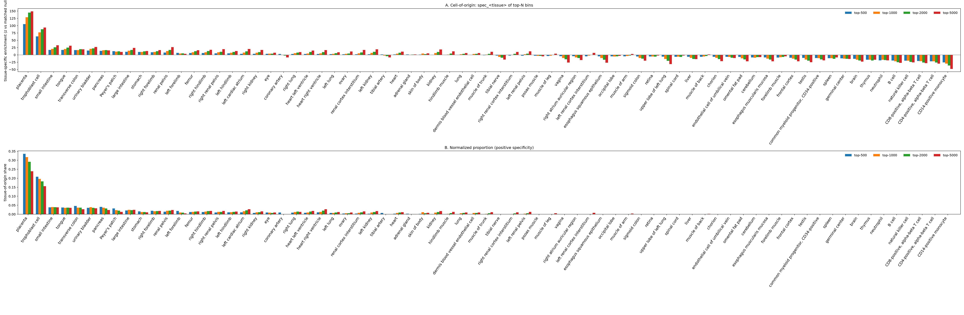
STEP 6 — THE FIGURE
Tissue track (grouped bars, default)
Panel A x = tissue, y = spec_z; grouped bars = the four top-N cutoffs.
Panel B x = tissue, y = share (normalized cell-of-origin proportion).
On the synthetic FF-up set, placenta dominates both (spec_z ~ 105) — the fetal-signal confirmation.

Slide 11
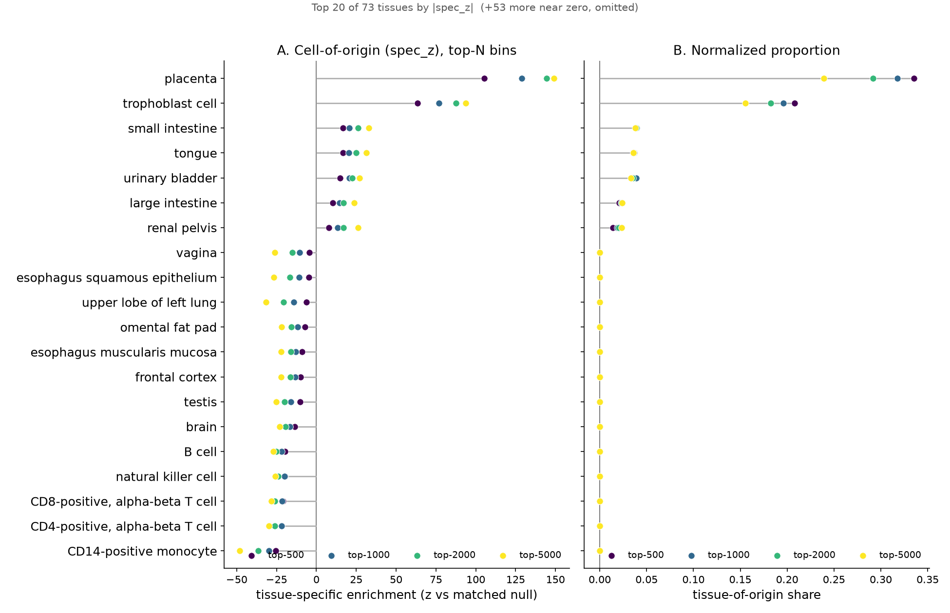
STEP 7 — NEW IN V0.6.2
Lollipop layout
Same statistic as the bars — transposed and sorted so 73 tissue names stay horizontal and legible.
y tissue (top-K by |spec_z|, labels horizontal)
x spec_z (A) / share (B)
One colored dot PER top-N cutoff, stem from zero; the near-zero tail collapses into a '+N more near zero' note.
READ dots for all cutoffs on one row show at a glance whether a tissue's enrichment is STABLE as the bin set widens — a robustness signal the bars don't surface.
CLI --style lollipop --top-k 20

Slide 12
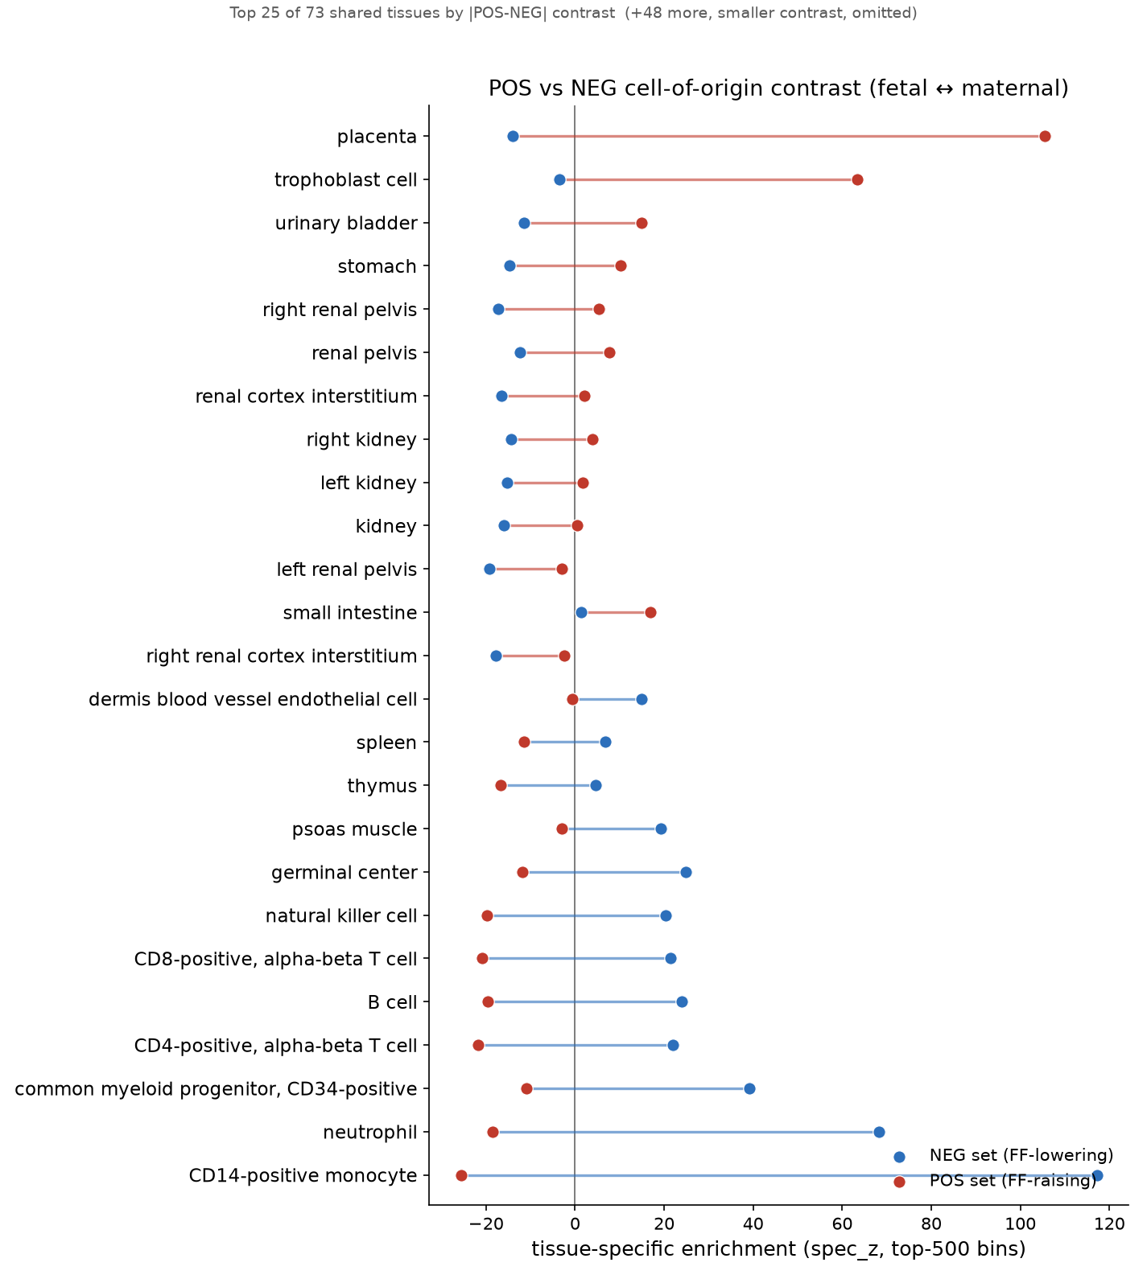
STEP 8 — NEW IN V0.6.2
POS-vs-NEG dumbbell
Both FF directions on one axis, so the fetal<->maternal contrast per tissue is directly visible.
y tissue (top-K by contrast)
x spec_z, TWO dots per tissue — FF-up (red) and FF-down (blue) — joined by a line.
The line LENGTH is the contrast: how strongly that tissue distinguishes fetal from maternal bins.
DEMO placenta contrast ~ +119 (fetal); CD14+ monocyte ~ -143 (maternal hematopoietic).
Reads the two ff_tissue_results.csv files — no recomputation, no atlas reload.

Slide 13
STEP 9 — MECHANISM
Opening the PCA black box: PC ↔ tissue
Each PC loading L[·,k] is a genome-wide spatial pattern. Correlate it with each tissue's openness, then flip by sign(βₖ) so red always means FF-up.
# pc_tissue_map.R — beta-oriented PC x tissue alignment
corr <- cor(Lc, Cc) # npc x ntissue: raw Pearson, loading vs openness
corr_or <- corr * sign(beta) # ORIENT: + => this PC's FF-up direction opens tissue t
best <- max.col(abs(corr_or)) # each PC's dominant tissue
# exact additive decomposition of the effective weight
w <- as.numeric(Lmat %*% beta) # w_bin = sum_k L[bin,k]*beta_k
contrib <- sweep(Lmat[pos_set,], 2, beta, '*') # Contrib[bin,k] = L[bin,k]*beta_k
pos_c <- colMeans(contrib) # mean PC contribution over FF-up bins
WHY THE FLIP A PC can enter the FF score with a negative β. Multiplying the correlation by sign(βₖ) re-expresses every cell in FF-direction terms, so one colorbar (red = FF-up) reads consistently across the whole matrix — the cell color IS the oriented value.

Slide 14
STEP 10 — MECHANISM
Per-PC contribution to FF-up / FF-down bins
Because w_bin decomposes exactly into per-PC terms, we can ask which PCs BUILD each origin signal:
• pos_contribₖ = mean over FF-up bins of L[b,k]·βₖ — how much PC k drives the fetal signal
• neg_contribₖ = mean over FF-down bins of L[b,k]·βₖ — how much PC k drives the maternal signal
• pos_fracₖ / neg_fracₖ = that PC's SHARE of the set's total signed weight
This closes the loop: bin → PC → tissue. A handful of PCs usually carry each direction, and each of those PCs maps to a dominant tissue via the alignment matrix — so the FF score becomes readable as 'PC3 = placental opening, PC7 = monocyte opening.'

Slide 15
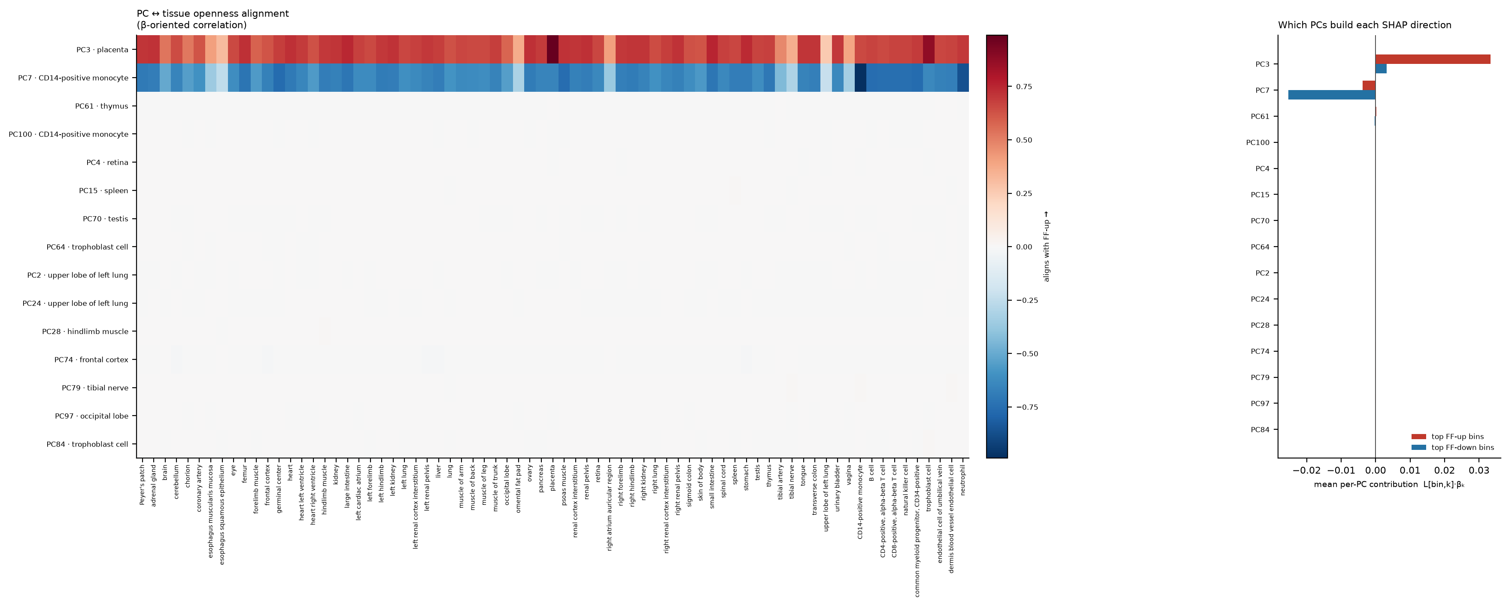
STEP 9–10 — THE FIGURE
PC × tissue heatmap + contribution bars
LEFT PC × tissue, color = β-oriented corr (RdBu_r). Rows labeled PC·best-tissue. Red = FF-up alignment, blue = FF-down. Colorbar carries the 'FF-up →' label.
RIGHT per-PC contribution bars (pos red / neg blue).
DEMO PC3·placenta lights red (fetal); PC7·CD14 monocyte lights blue (maternal) — exactly the seeded structure.

Slide 16
STAGE
WHAT
KEY QUANTITY
THE WHOLE PIPELINE IN ONE LINE
Bin → weight → SHAP → origin → mechanism
1 Feature
GC/NB-normalized coverage residual per 50 kb bin
x_{i,b}
2 Model
PCA → linear regression on PC scores
FF̂ = b₀ + Σ βₖ sₖ
3 Weight
back-project β through loadings
w_b = Σₖ L[b,k]·βₖ
4 SHAP
exact closed-form linear SHAP
φ_{i,b} = w_b·(x_{i,b}−x̄_b)
5 Partition
top-N by sign(w_b)
U_N (FF-up) / D_N (FF-down)
6 Enrichment
tissue specificity vs matched null
spec_z = (obs−μ)/σ
7–8 Layouts
lollipop (stability) + dumbbell (contrast)
Δ_t = zᵖᵒˢ − zⁿᵉᵍ
9 Alignment
PC ↔ tissue, β-oriented
align = corr·sign(β)
10 Contribution
which PCs build each origin
Contrib = L·β

