Slide 1
eHealth - Presentation
Johannes Jobst (1300563)
Marin-Petru Hincu (1268171)
Pascal Kautzmann (1320404)
Hania Anjum Chatha (1293609)
Faculty 2

Slide 2
Content
Introduction & Motivation
Delvelopment Timeline
Account creation
Admin view
Login & 2FA
JDatePicker
Password
Create an Appointment
Managing Appointments
H2 Embedded Database
Conclusion

Slide 3
Introduction & Motivation
Introduction
User doesn’t anymore need to call a doctor via the telephone
Able to create an account in the eHealth application
The Application suggested doctors for you
Able to make an appointment
Displays all upcoming appointments they have
Able to edit or delete a certain appointment
Motivation
Working on the same project simultaneously
Creating an Application which uses a database to store
The practical implementation of distance calculations between addresses
Motivated to learn more about encryption

Slide 4
Development Timeline
Started with a GitHub repository
Basic construct of the GUI
Implementation of the H2 database
Added password hashing
Convert to Maven
Finished login & sign up & admin view
Focused on main part of the application
Added all functionalities for creating or editing appointments
Added reminder
Added export functionality
Error Handling and Bug fixing

Slide 5
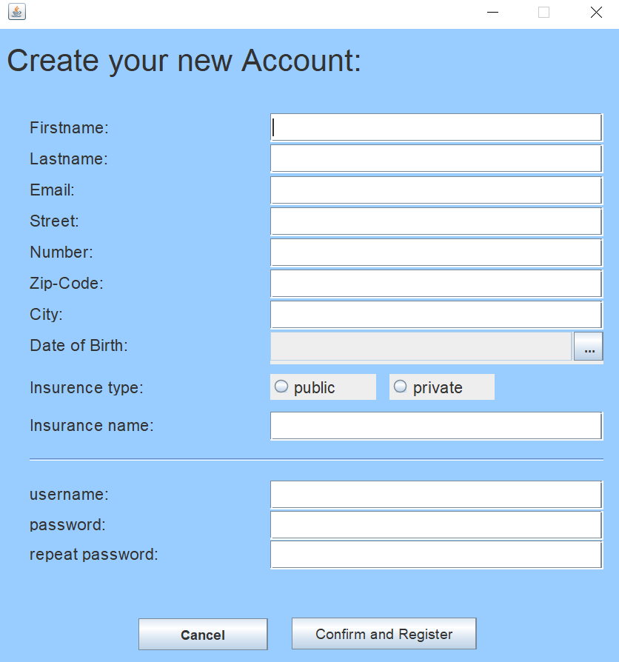
Account creation
Create a new eHealth account
The email must has the right format (max@mustermann.de)
The username must be unique in our database
The system checks that they aren’t empty and not longer than the capacity

Slide 6
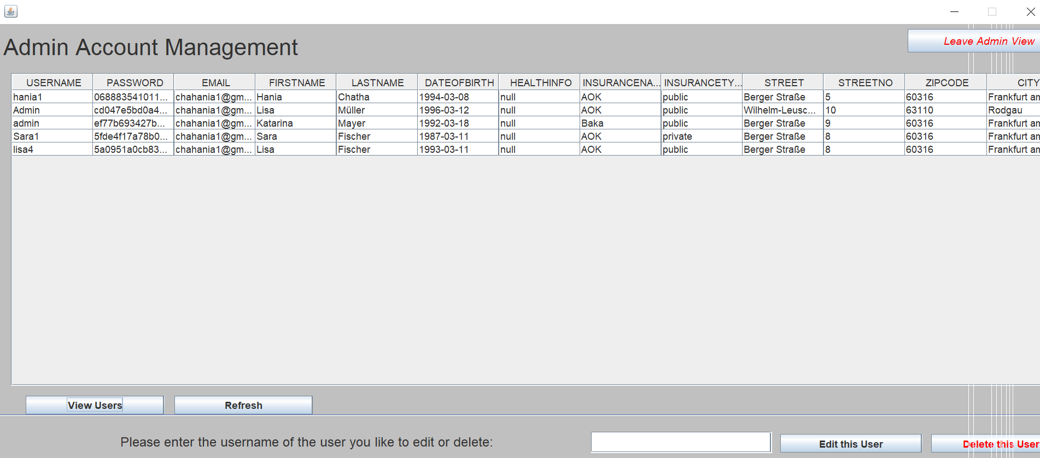
Admin view
The admin can view all users
This is implemented via an SQL query out of the user table in the database
Option to edit the personal informations of users

Slide 7
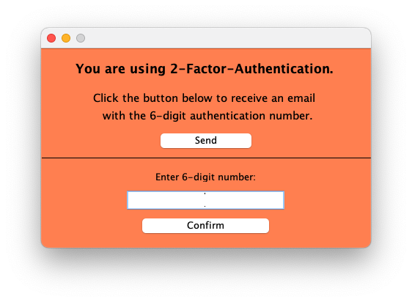
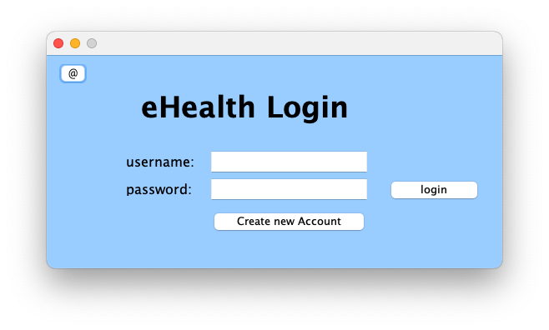
Login and 2-Factor-Authentication
One of the most important features to provide every user a unique view
Gives access to the program functionalities
2-Factor-Authentication to secure the sensible health information of every user
After login the user gets send a unique number code via email by using the javax.mail class
Necessary to login into eHealth

Slide 8
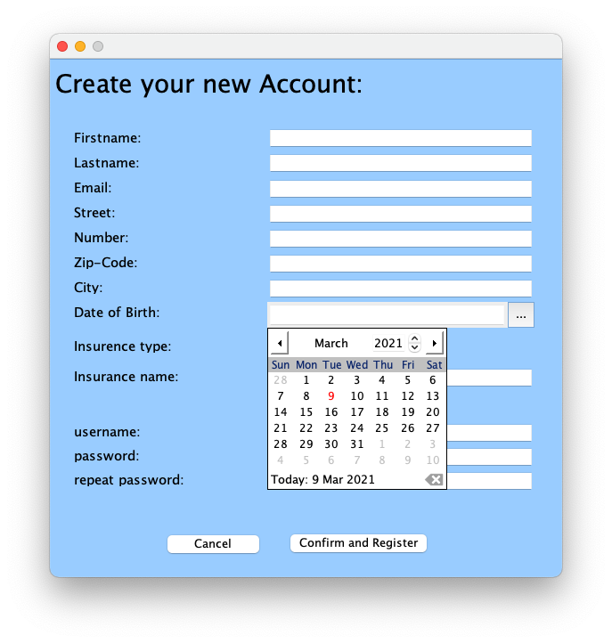
JDatePicker
Date picker control for Java Swing applications
Implemented in every dialog with a date input
Requires a date label formater to convert the chosen input to a date for our database
User friendly
Need to pick your date
No worries about wrong date format by the user
Error handling easier

Slide 9
Password
Passwords are hashed
One way function
PBKDF2(Password-based-Key-Derivative-Function)
Salt: no two passwords have the same hash
Notes:
[PBKDF2WithHmacSHA512]

Slide 10
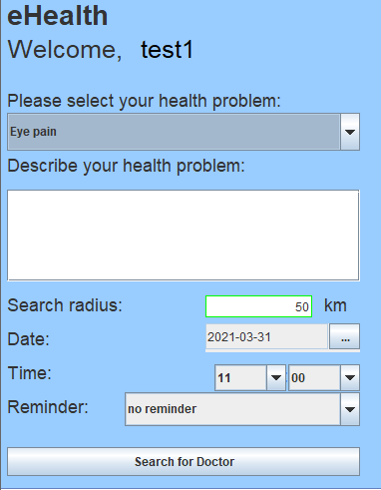
Create an appointment -search for a doctor
Select health problem from Dropdown list
Description field to better describe the problem
Search radius
Time and date
Reminder
Confirmation email

Slide 11
Create an appointment -distance of search
Need coordinates to calculate
Why OpenStreetMap:
No account – easy to use
Free (Open Database Licence (ODbL) 1.0)
With stored coordinates easy to calculate
dx = 111.3 * cos(lat) * (lon1 - lon2)
lat = (lat1 + lat2) / 2 * 0.01745
dy = 111.3 * (lat1 - lat2)
Notes:
OpenStreetAPI provides GET request support

Slide 12

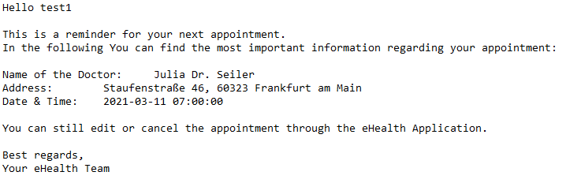
Create an appointment -reminder
Predefined time periods
separate thread
check every minute
Sends an email with the appointment details

Slide 13
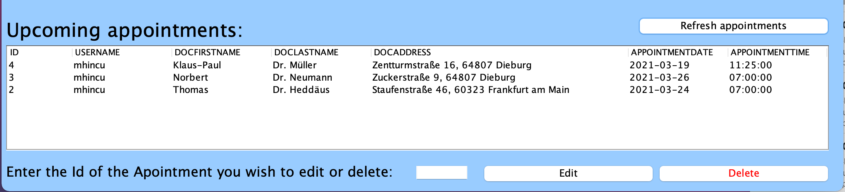
Managing Appointments
Displayed data is taken from the Appointments database table
"Refresh appointments" queries the database for the newest state
Appointments can be edited and deleted using their ID
For each edit/delete operation a confirmation e-mail is send out

Slide 14
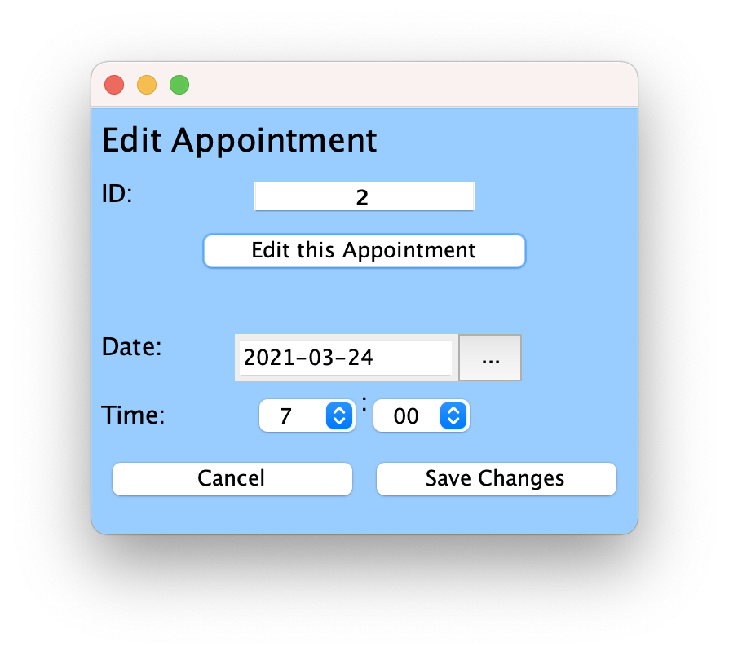
Editing an Appointment
Editing appointment with specified ID
Date and time of the appointment can be changed
An update query is executed against the database when saving the changes

Slide 15
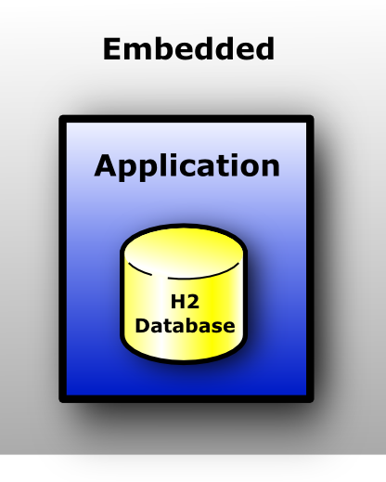
H2 Embedded Database
Java application contains database
JDBC (Java database connectivity) used for querying the database
Source: http://www.h2database.com/html/features.html

Slide 16
Conclusion – Accumulated Knowledge
JDBC (Java Database Connectivity)
Security
Encryption
JavaMail API
Threads
And other useful APIs

Slide 17
Thanks for your attention!

