Slide 1
Analysis of the Salary Prediction Dataset using R Visualizations
Bill Fitzpatrick Mihaela E. Sardiu, Ph.D. Data 824 Final Project July 2025

Slide 2
INTRODUCTION
In this presentation I will be performing an analysis of the Salary Prediction dataset using mostly visualizations. I downloaded the dataset from the Kaggle website. The dataset was generated from large language models and not collected from actual data sources.
Link to the Salary Prediction dataset on Kaggle: Salary Prediction dataset
Link to the Github Repository: View the project on Github

Slide 3
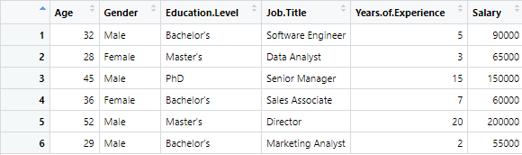
Here are the first 6 records of the Salary dataset The dataset contains information about the salaries of employees at a company. Each row represents a different employee, and the columns include information such as age, gender, education level, job title, years of experience, and salary. The dataset started 375 employees with two having N/A values so they were removed leaving 373 employees.
Columns:
Age: This column represents the age of each employee in years. The values are numeric.
Gender: This column contains the gender of each employee. The values in this column are categorical.
Education Level: This column contains the educational level of each employee, which can be high school, bachelor's degree, master's degree, or PhD. The values in this column are categorical.
Job Title: This column contains the job title of each employee. The job titles can vary depending on the company and may include positions such as manager, analyst, engineer, or administrator. The values in this column are categorical.
Years of Experience: This column represents the number of years of work experience of each employee. The values in this column are numeric.
Salary: This column represents the annual salary of each employee in US dollars. The values in this column are numeric and can vary depending on factors such as job title, years of experience, and education level.

Slide 4
Job Title Bar Graphs

Slide 5
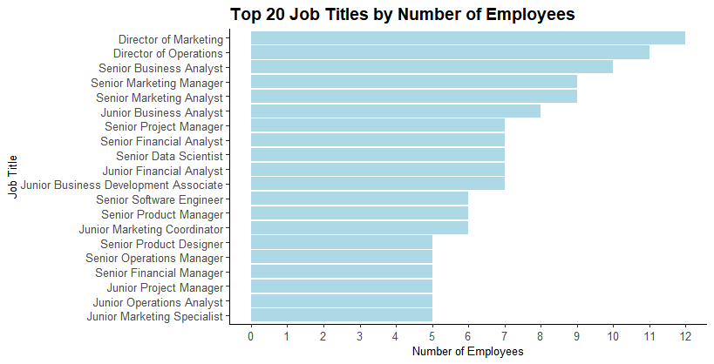
Here is a bar graph showing the top 20 job titles with the most employees. There are 174 different job titles which is too much to list.

Slide 6
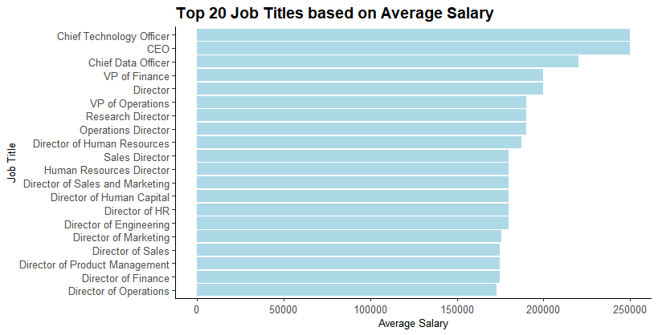
This bar graph shows the top 20 job titles by average salary. The highest paying jobs are the higher ranked positions as expected.

Slide 7
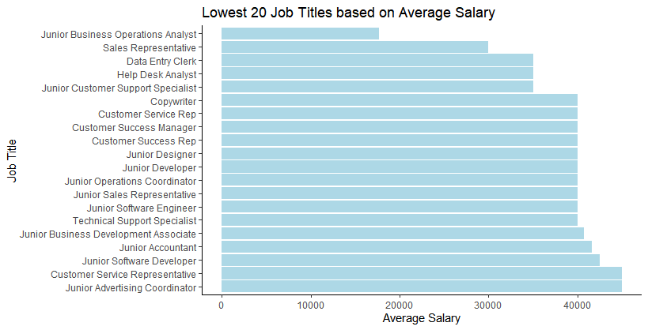
This bar graph shows the lowest 20 job titles based on average salary. Of course, most of these jobs are entry level.

Slide 8
Histograms - Pie Charts - Bar Graph of the remaining variables

Slide 9
Statistical Measures Summarized Below the Graphs and Charts
n mean sd median trimmed mad min max range skew kurtosis se
373 37.43 7.07 36 37.25 8.9 23 53 30 0.2 -1.03 0.37
n: represents the number of observations or sample size in a dataset.
mean: is a measure of central tendency that represents the typical value in a dataset.
sd: standard deviation of the x-axis variable values which is a statistical measure that describes how much the values in a dataset vary or spread out from the mean (average).
trimmed: refers to a trimmed mean, which is a way of calculating the average after removing a certain percentage of the lowest and highest values in a dataset.
mad: stands for mean absolute deviation. It’s a measure of how spread out the values in a dataset are — specifically, how far each value is from the mean, on average.
min: the minimum value of the x-axis variable.
max: the maximum value of the x-axis variable.
range: the difference between the maximum and minimum x-axis variable.
skew: refers to the asymmetry of a data distribution — how much it deviates from being perfectly symmetrical.
kurtosis: a statistical measure that describes the shape of a distribution’s tails — specifically, how often extreme values (outliers) occur compared to a normal distribution.
se: stands for standard error. It measures how much a sample statistic (like the sample mean) is expected to vary from the true population parameter.

Slide 10
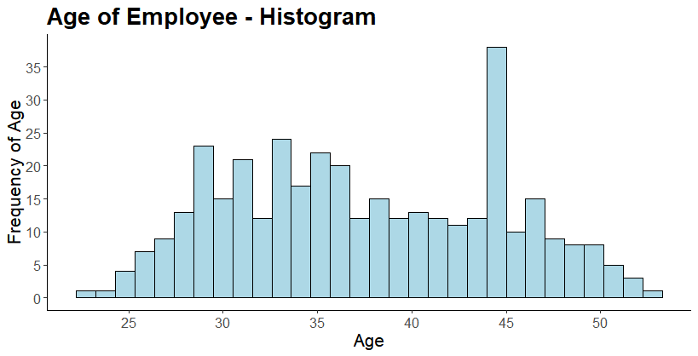
n mean sd median trimmed mad min max range skew kurtosis se
373 37.43 7.07 36 37.25 8.9 23 53 30 0.2 -1.03 0.37
This histogram shows the distribution of the employee ages. Below the histogram are summary statistics. Most of the employees are between the ages of 28 and 37 with an unusual spike around 44 years of age.

Slide 11
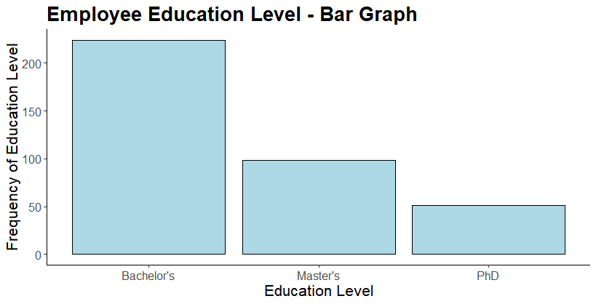
This bar chart shows the education levels of the employees. More than double of the employees have Bachelor’s Degrees than Master’s Degrees. The number of employees with Master’s Degrees double the amount of PhD degrees.

Slide 12
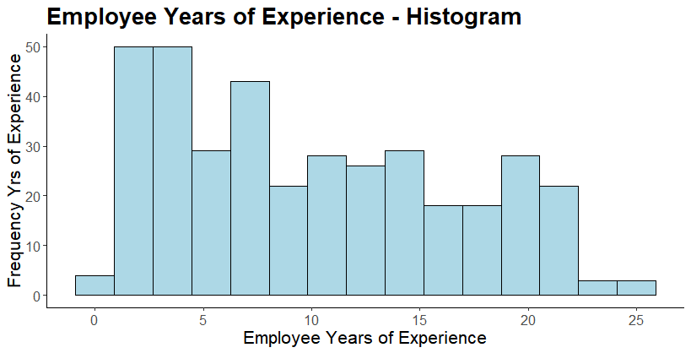
n mean sd median trimmed mad min max range skew kurtosis se
373 10.03 6.56 9 9.67 8.9 0 25 25 0.36 -1.06 0.34
Here is the distribution of the employee’s years of experience again with the summary statistics below it. The peak is around 2 -5 years of experience which declines in general as the years go up with a sharp decline after around 22 years.

Slide 13
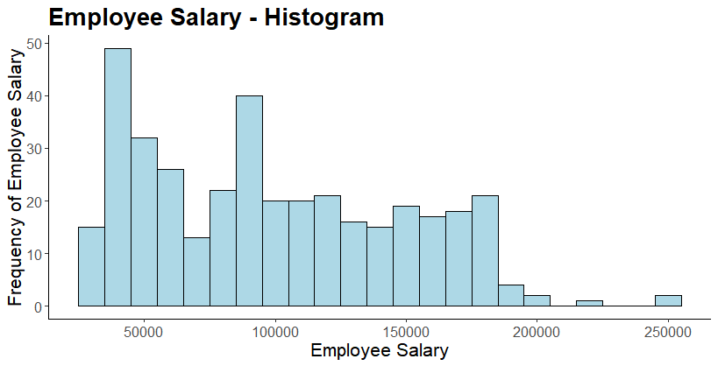
n mean sd median trimmed mad min max range skew kurtosis se
373 100670.2 48079.58 95000 97943.14 59304 30000 250000 220000 0.41 -0.77 2489.47
Most employees make between $25,000 to $60,000 with a spike around $90,000. Between $100,000 and $170,000, the number of employees having those salaries stays consistent.

Slide 14
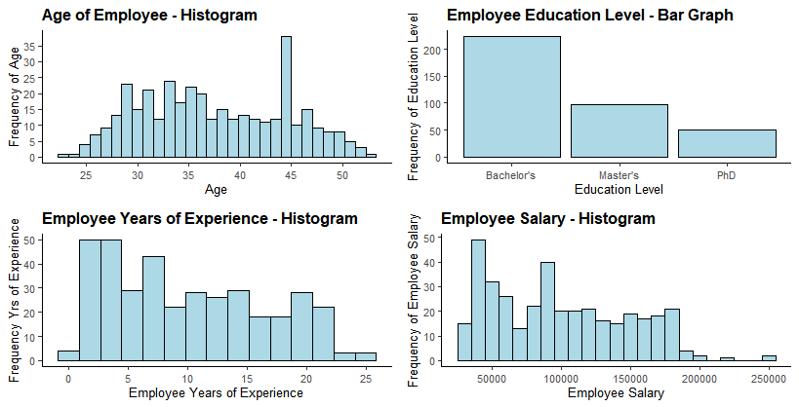
Here are all 4 graphs shown previously all on one page showing the frequency of employee age, education level, years of experience, salary.

Slide 15
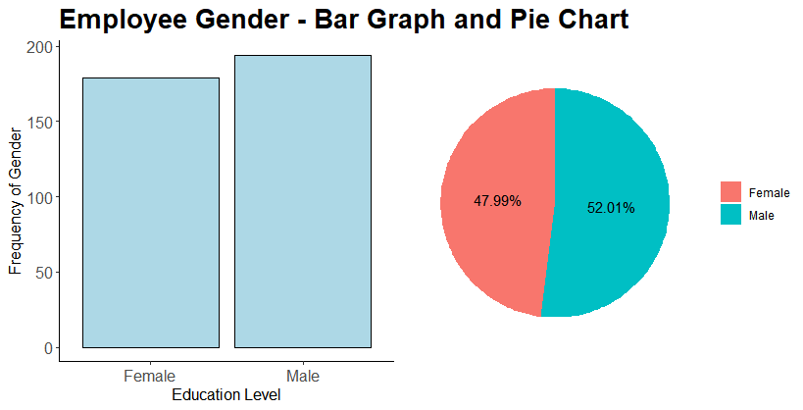
Here is the bar graph and pie chart side by side. The split between male and female employees is very close with male employees outnumbering female employees by a very narrow margin.

Slide 16
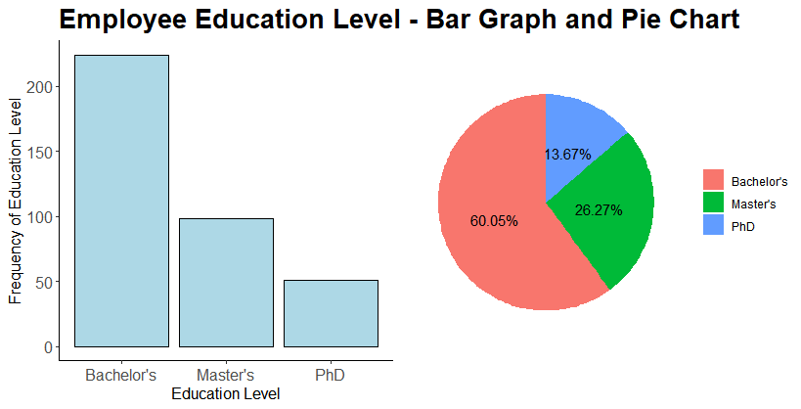
This visualization shows the bar graph and pie chart of employee education level side by side. The pie chart shows the exact percentages for the three education levels.

Slide 17
Scatter Plots

Slide 18
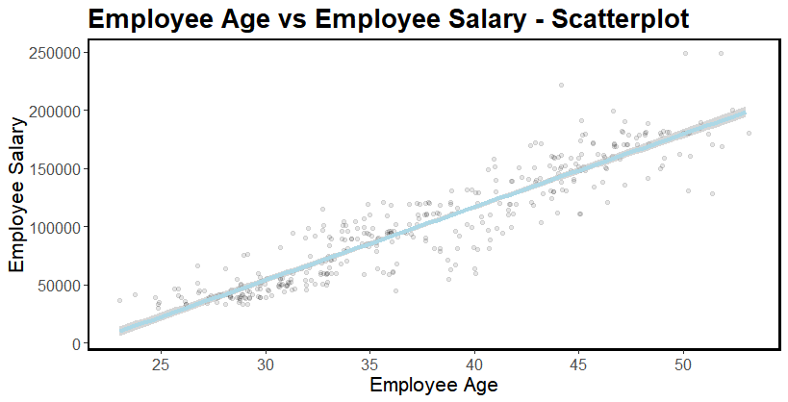
Here is a scatter plot of employee age vs employee salary with a linear regression line. These two variables are highly positively correlated which is not surprising. In general, the older the employee, the more experience an employee has. There are three possible outliers with one at $220,000 salary which is the Chief Data Officer and two at $250,000 salaries being the CEO and Chief Technology Officer. All three of these positions are held my male employees.

Slide 19
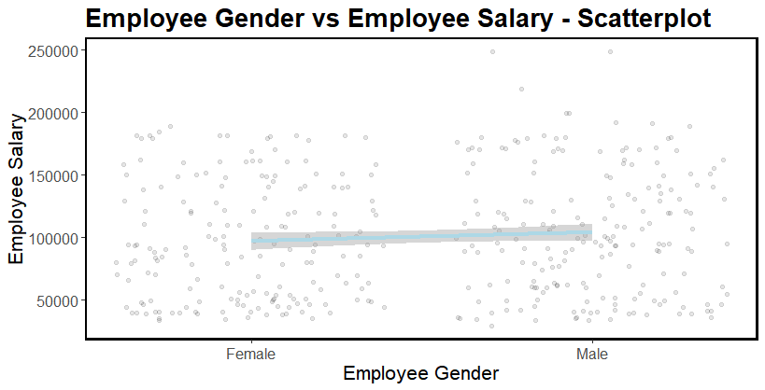
This scatterplot of gender vs. salary shows that the salaries for males and females are almost identical. The trend line has a slight upward slope probably because the three highest paid employees in the company are male with all three making over $200,000.

Slide 20
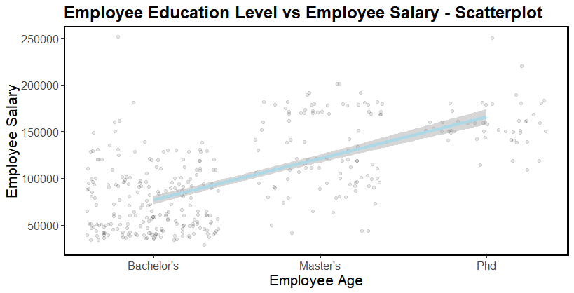
This visualization displays the level of employee education vs the employee salary. Again, there is a high positive correlation which is shown by the linear regression line. There are no surprises with the results of this scatter plot with higher employee levels of education receiving higher salaries.

Slide 21
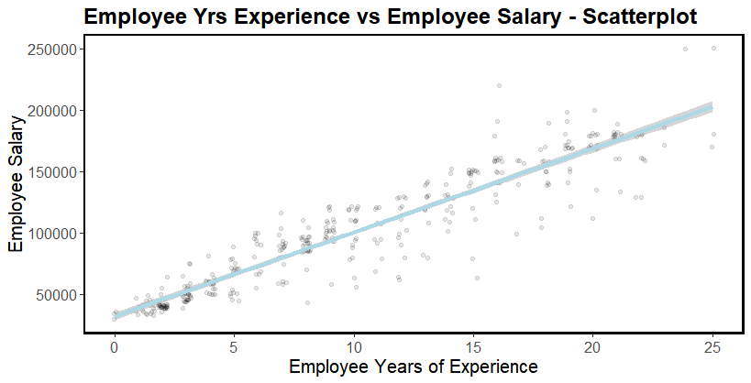
This scatter plot of employee years of experience vs salary shows a positive linear correlation which makes total sense. The data points do not look to be as tight around the linear regression line as age vs salary meaning there is more variation. The highest concentration of employees appears to be around 2.5 years of experience. The top two salaries with 23 and 25 years of experience correspond to the CEO and the Chief Technology Officer.

Slide 22
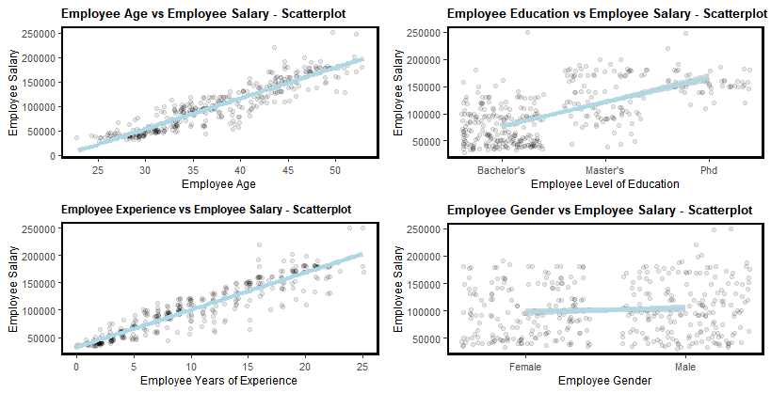
This shows all 4 scatter plots of employee salary vs age, salary vs education, salary vs experience, and salary vs gender. Salary has a positive correlation with all four variables but only slightly with gender. It appears that age and yrs of experience correlate to higher salaries more than level of education but not by much.

Slide 23
Box Plots

Slide 24
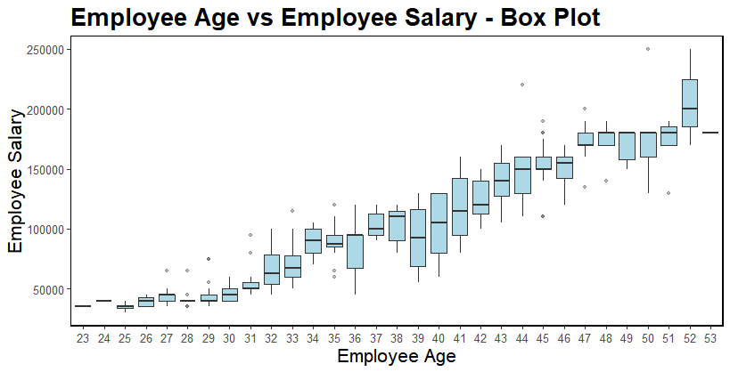
This box plot shows the same trend as the scatter plot but displays the distribution within each age. The box displays the interquartile range (middle 50% of the data) while the line inside the box shows the median value. The whiskers extending outside the box reach from Q1 to the minimum value and from Q3 to the maximum value within the range [Q1 - 1.5*IQR, Q3 + 1.5*IQR]. The dots outside the whiskers are data points considered outliers and are typically marked as individual points. The employees between ages 32 and 44 show a wider variance in their salaries than other employees.

Slide 25
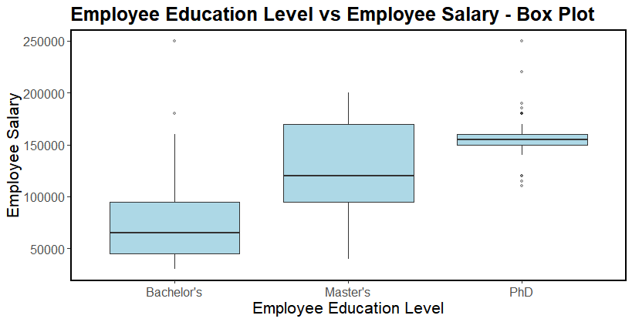
This shows some interesting observations. The CEO who is a male aged 50 who is tied for the highest salary at $250,000 only obtained a bachelor’s degree. The Sales Director who is a male aged 51 also has a bachelor’s degree with salary of $180,000. The salaries of PhD’s have a tight interquartile range with a salary between $150,000 and $160,000. The PhD employees have a very wide variability in their salaries which I find surprising.

Slide 26
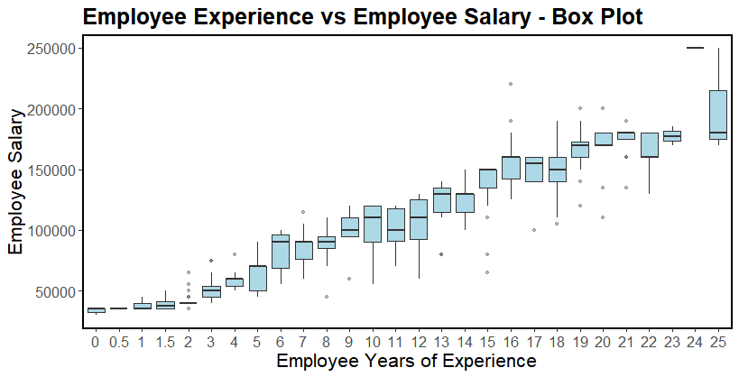
There is not much that stands out here. The range and amount of variability start to go up at around 5 years of experience. Employees at two years experience have a very small interquartile range with no whiskers with 4 possible outliers above and one below. Maybe the outliers above are employees with a PhD.

Slide 27
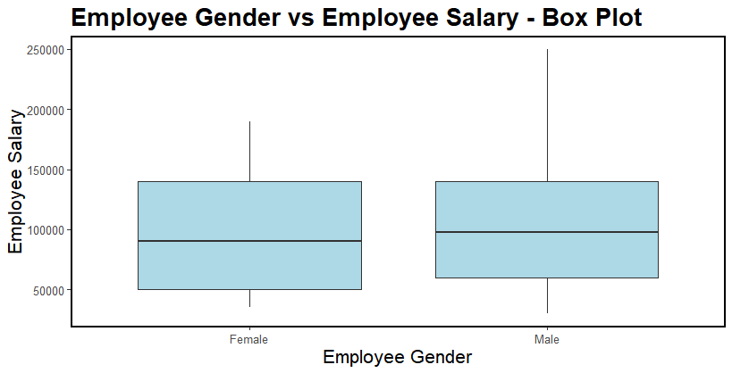
This box plot of gender shows that male and female salaries are very similar. There is a larger interquartile range for females, but upper whisker is longer because of those two males who make $250,000 representing the maximum value.

Slide 28
Box Plots with Scatter Plots

Slide 29
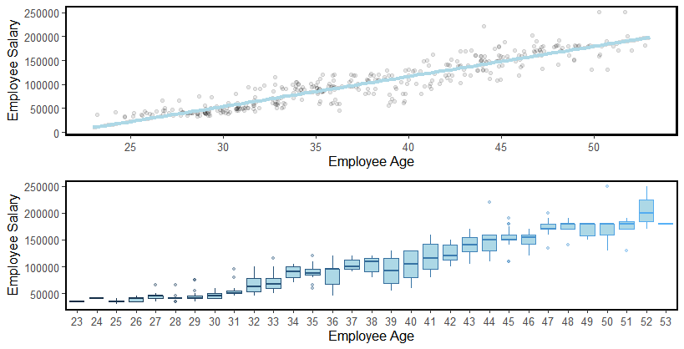
The next four pages show a scatter plot on top and a box plot on the bottom. We have already gone over these graphs and plots by themselves earlier in the presentation. The scatter plots show the data points, and the box plots show the distribution of those data points including the interquartile range (box), the median (line in box), whiskers (lines outside box), and the outliers.

Slide 30
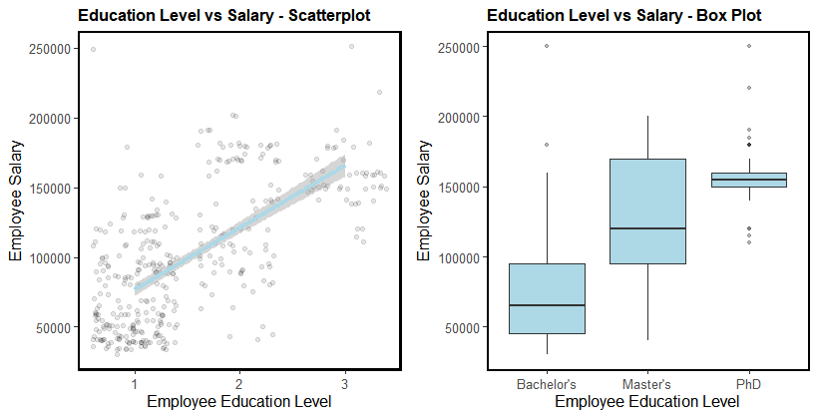
This scatter plot and box plot show salary by employee education level.

Slide 31
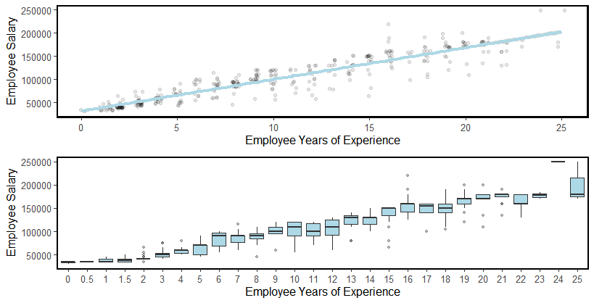
This scatter plot and box plot show salary by employee years of experience.

Slide 32
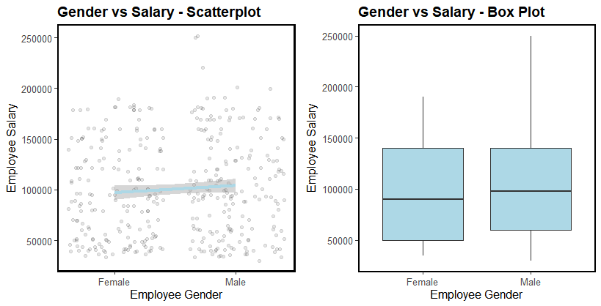
This scatter plot and box plot show salary by employee gender.

Slide 33
Correlation Heatmap and Scatter Plot Matrix

Slide 34
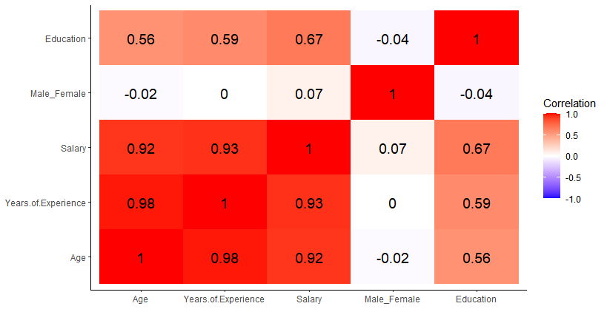
Here is a correlation heatmap that show the pairwise correlations of all the variables. As we have previously concluded, salary is highly correlated with age and years of experience. I am a little surprised that education is not more correlated with salary. I know that the CEO having only a bachelor’s degree and making $250,000 does bring this correlation value down. Gender does not have a correlation with any of the other variables.

Slide 35
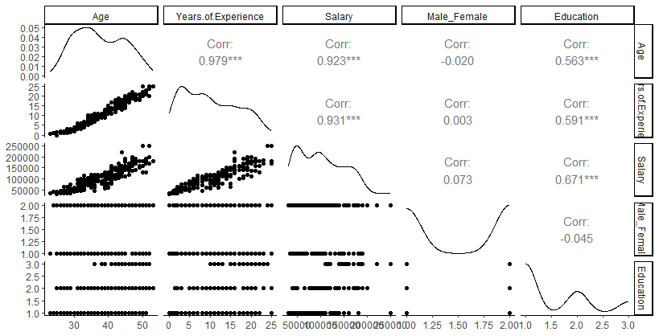
Here is a scatterplot matrix that shows the same thing as the correlation heatmap in a different way.

Slide 36
Conclusion
Most employees are between the ages of 28 and 37 with an unusual spike around 44 years of age. The employees between ages 32 and 44 show a wider variance in their salaries than other employees.
The split between male and female employees is close with male employees outnumbering female employees by a very small margin. Male and female employee salaries are nearly identical . The average salary is slightly higher for male employees which is mostly because the top three salaries are all male employees.
More than double of the employees with degrees have Bachelor’s Degrees rather than Master’s Degrees. The number of employees with Master’s Degrees double the amount of PhD degrees.
The CEO who is a male aged 50 and tied for the highest salary at $250,000 only obtained a bachelor’s degree. The Sales Director who is a male aged 51 also has a bachelor’s degree with salary of $180,000. The salaries of PhD’s have a tight interquartile range (middle 50%) with a salary between $150,000 and $160,000. Because of the tight interquartile range, there are a lot of PhD’s whose salaries are considered outliers both above and below the interquartile salaries.
The highest concentration of employees appears to have around 2.5 years of experience.

Slide 37
Conclusion – cont.
Most employees make between $25,000 to $60,000 with a spike around $90,000. The number of employees having salaries between $100,000 and $170,000 are similar.
Age and salary are highly positively correlated. In general, the older the employee, the more experience an employee has which typically means a higher salary.
There are three salary outliers with one having a salary of $220,000 (Chief Data Officer) and two with a salary of $250,000 (CEO , Chief Technology Officer). All three positions are held my male employees.
Salary has a positive correlation with all four variables but only slightly with gender. Age and yrs of experience are correlated to higher salaries more than level of education.
Education and salary are positively correlated with higher levels of education receiving higher salaries.

Slide 38
Thank you for watching ☺

