Slide 1

Telecom Churn Prediction

Slide 2

Approach

Slide 3
Objective
Reduce customer churn, particularly among high-value customers.
Predict churn in the ninth month using data from the previous three months.

Slide 4
Data Collection
Gather data on various factors including demographics, usage patterns, service quality, and complaints.
Focus on high-value customers for analysis.

Slide 5
Data Cleaning and Data Preprocessing
Identifying and dealing with missing data points.
Outlier Detection and Treatment
Data Transformation
Normalization and Scaling
Label Encoding
Splitting Data
Balancing Data

Slide 6
Predictive modeling
Build machine learning models for churn prediction based on the collected data..
The models will be designed to forecast whether a high-value customer is likely to churn in the near future.

Slide 7

Model Output
The models will provide a probability or likelihood score for each high-value customer, indicating the likelihood of them churning in the ninth month

Slide 8

Actionable Insights
Identify important variables (features) that strongly predict churn.
These variables will reveal the underlying reasons why customers decide to switch to other networks.

Slide 9
Proactive Customer Retention
Utilize the churn predictions to take proactive steps in retaining high-value customers.
Offer special plans, discounts, or personalized offers to incentivize them to stay.

Slide 10
Addressing Underlying Issues
Use insights from identified variables to understand the root causes of churn.
Implement corrective measures to improve customer satisfaction and loyalty.

Slide 11
Benefits
Minimize revenue loss associated with churn.
Enhance customer retention rates, particularly among high-value clients.
Improve overall customer satisfaction and loyalty.

Slide 12

Iterative Process
Continuously monitor and refine the predictive models based on new data and customer behavior patterns.

Slide 13
Performance Metrics & Classifications cost
Evaluate the best machine-learning model
Compute the misclassification cost of predicting a churn customer

Slide 14
Findings

Slide 15
Types of Data augmentation used
Random Under-sampling
Random Over-Sampling
No Balance Data

Slide 16
Machine Learning Models
Logistic Regression
Decision Tree
KNN
Random Forest

Slide 17

Important Metrics to Consider
Precision measures the accuracy of the positive predictions made by the model.
Recall (also known as sensitivity or true positive rate) measures the ability of the model to capture all the positive instances.
F1 Score combines precision and recall into a single value, providing a balanced assessment of a model's effectiveness in binary classification tasks.

Slide 18
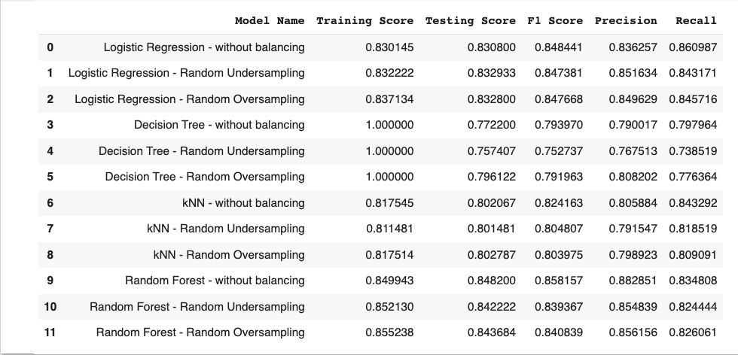
Results using Machine learning algorithm models

Slide 19
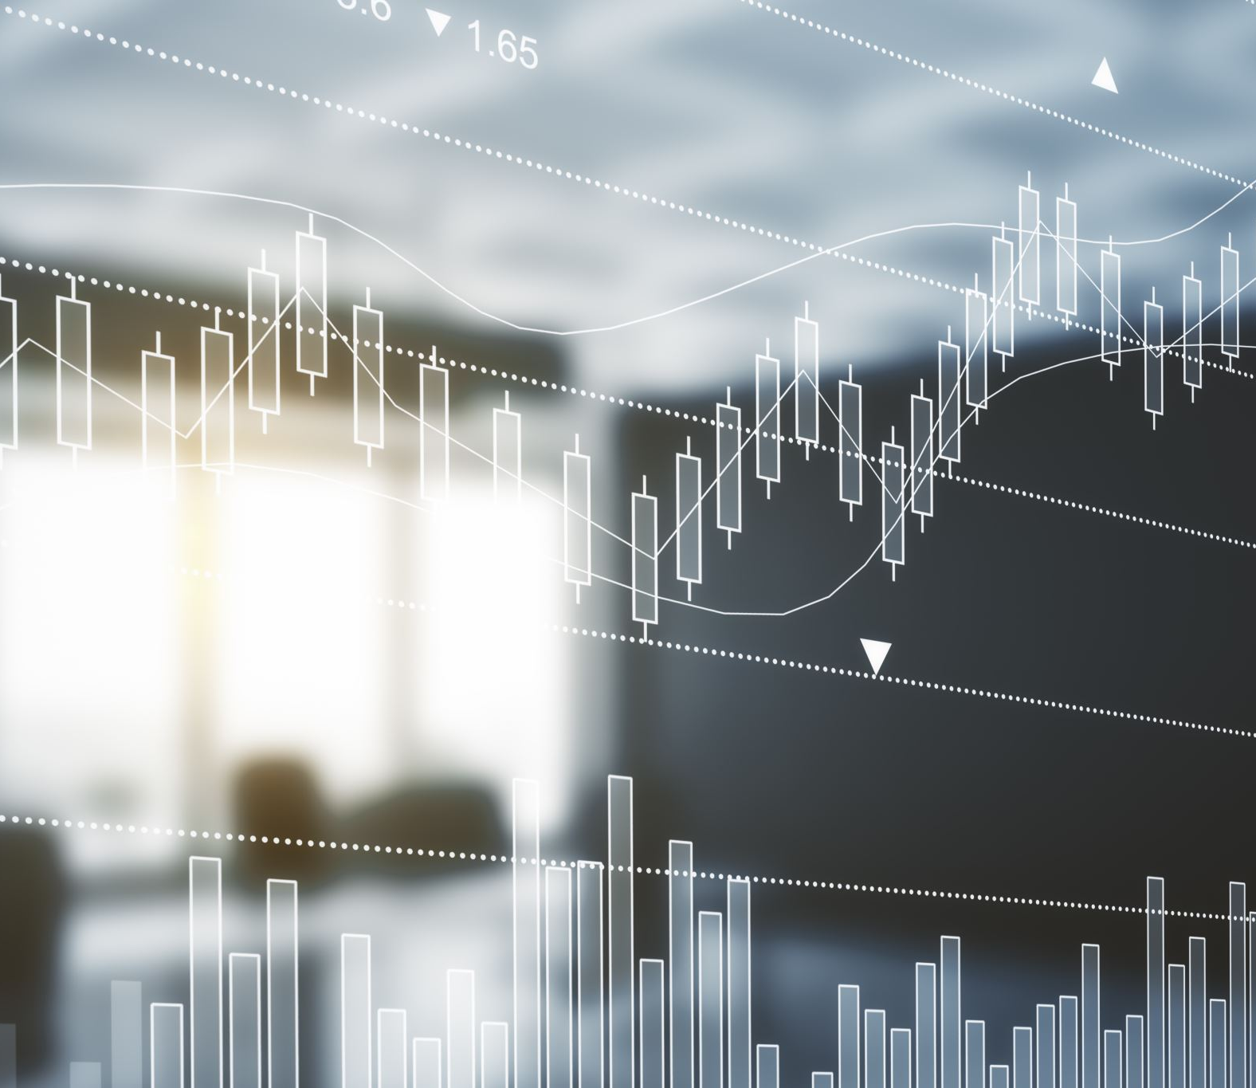
Decision
Logistic regression with unbalanced data was the best model to use in this case

Slide 20
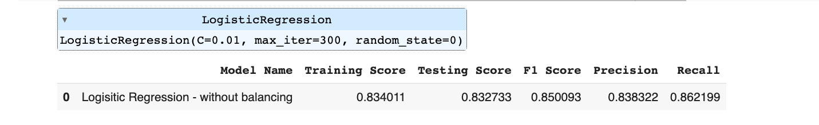
Improve Logistic model with tuning parameters

Slide 21

Deep Learning Model

Slide 22
Results

Slide 23

Logistic Regression vs Neural Network
Logistic Regression is a suitable model for predicting customer churn

Slide 24
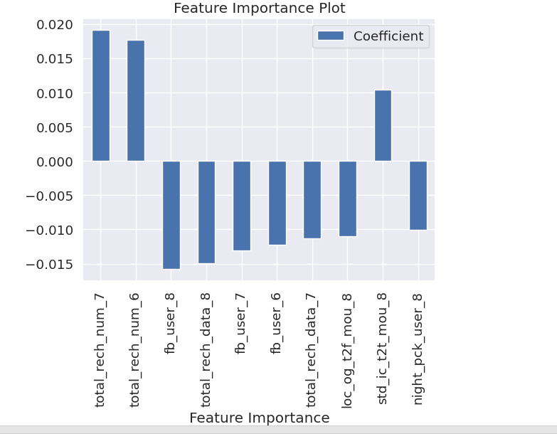
Variables
The strongest predictors for customer churn are:
The total recharge amount for June
The total recharge amount for July
The total recharge in mobile internet in August
Etc.

Slide 25
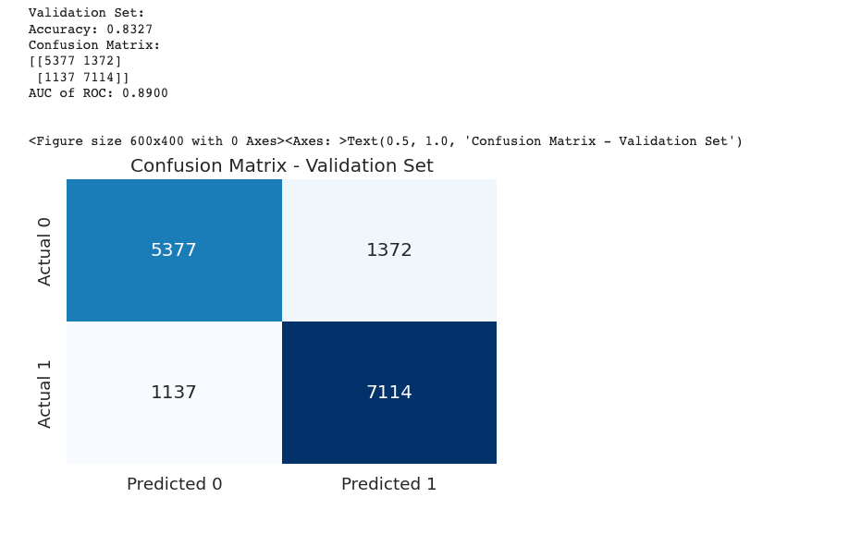
Model Performance

Slide 26
Recommendations

Slide 27

Enhance Customer Engagement
Increase interaction and communication with customers.

Slide 28

Improve Onboarding Process
Optimize the initial experience for new customers.

Slide 29

Proactive Customer Support
Address customer issues before they escalate

Slide 30

Personalization and Customization
Tailor offerings and recommendations to individual customer needs.

Slide 31

Feedback Loop and Surveys
Strengthen the feedback loop with customers.

Slide 32

Customer Loyalty Programs
Gain insights into competitors' strategies and customer experiences.

Slide 33

Data Security and Privacy
Strengthen data security and privacy measures

Slide 34

Customer Lifetime Value (CLV) Optimization
Maximize the long-term value of each customer.

