Slide 1

Project 4
Stroke Prediction using
Supervised Machine Learning
Group 2
Sophie Pribojac II Maliha Mukhtar II Jo Alva II Farheen Oomatia

Slide 2
Table of Content
Introduction
Data Cleaning – SQL
Visualization – Python Matplotlib & Pandas
Supervised Machine Learning Models
Model Optimizations
Result & Conclusion

Slide 3

1. Introduction
- stroke 2nd leading cause of death globally (11%)*
- 1/3rd of survivors are very often left with severe disability such as loss of vision &/or speech, paralysis and confusion**
- 4 out of 10 death could be prevented if risk factors are highlighted early on**
- supervised machine learning models may help predict high risk patients and aid in prevention efforts by health care providers
* https://www.who.int/news-room/fact-sheets/detail/the-top-10-causes-of-death
** https://www.emro.who.int/health-topics/stroke-cerebrovascular-accident/index.html

Slide 4

2. Data Cleaning
- rounded age present as decimals
- dropped gender ’other’ (1 row)
- dropped smoking_status column ( too many ‘unknown’)
Stats on dataset:
- total 5109 rows of data post cleaning
- average age 43 years across cohort
- 2994 female & 2115 male data rows
- 4400 employed, 22 never employed, 687 children
- 2596 Urban & 2513 Rural dwellers
- avg glucose level 106.14 mg/dL (optimal 70-100 mg/dL)
- 4860 never had stroke, 249 had stroke
Notes:
For the data cleaning, we started with rounding the ages present in decimals to the nearest age. These affected only ages between 0 and 2.
The gender ’Other’ was dropped as we only had one row of data for this gender.
Also, we decided to drop the column smoking_status for the second part of the analysis as we had too many rows where status showed ’Unknown’. According to the notes on Kaggle, ’Unknown’ means that the information is unavailable for this patient.

Slide 5
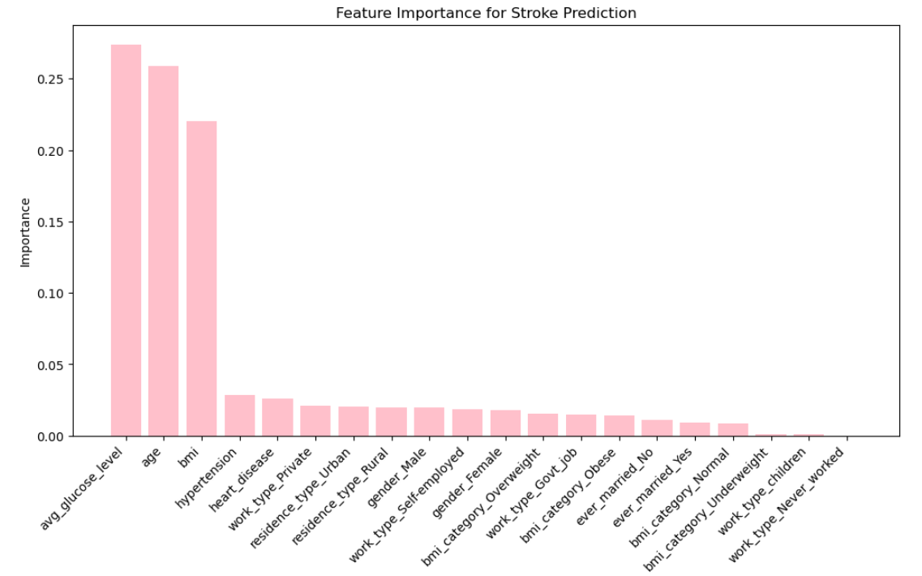
3. Visualizations
Feature Importance
Notes:
In terms of feature importance for the predictive model, 'avg_glucose_level,' 'age,' and 'bmi' are the most influential factors, contributing 27.40%, 25.91%, and 22.05%, respectively.
Health-related features such as 'hypertension' and 'heart_disease' play a smaller role.
Employment factors ('work_type_Private,' 'work_type_Self-employed,' 'work_type_Govt_job') and residence types ('residence_type_Urban' and 'residence_type_Rural') also contribute.
Gender and marital status have a lesser impact, and different BMI categories provide additional insights.
'work_type_Never_worked' has negligible importance.
Understanding these feature contributions helps interpret the model's decision-making process.

Slide 6
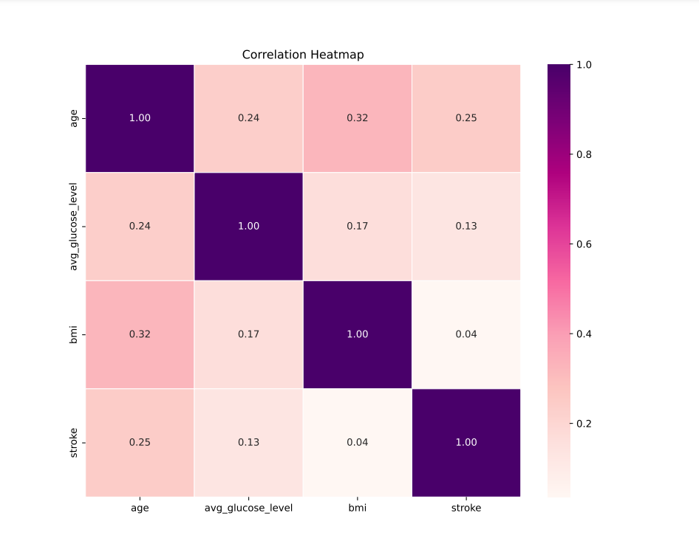
Correlation Heatmap
Notes:
In our analysis, we observed key correlations among age, average glucose level, BMI, and stroke risk. Age is positively correlated with both average glucose level (0.24) and BMI (0.32), indicating higher levels with increasing age. A positive correlation (0.25) between age and stroke risk suggests a link between age and a higher likelihood of stroke. Additionally, a modest positive correlation (0.13) between average glucose level and stroke risk hints at a potential association. These findings offer valuable insights into the interplay of these factors but remind us that correlation doesn't imply causation.
Overall it appears that age is a strong influential factor in stroke. So let’s explore this further

Slide 7
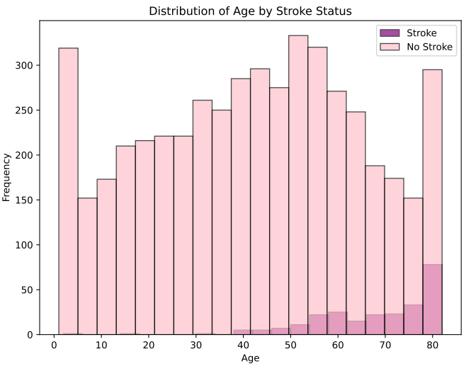
Age Distribution
Notes:
In our analysis, we observed key correlations among age, average glucose level, BMI, and stroke risk. Age is positively correlated with both average glucose level (0.24) and BMI (0.32), indicating higher levels with increasing age. A positive correlation (0.25) between age and stroke risk suggests a link between age and a higher likelihood of stroke. Additionally, a modest positive correlation (0.13) between average glucose level and stroke risk hints at a potential association. These findings offer valuable insights into the interplay of these factors but remind us that correlation doesn't imply causation.
Overall it appears that age is a strong influential factor in stroke. So let’s explore this further

Slide 8
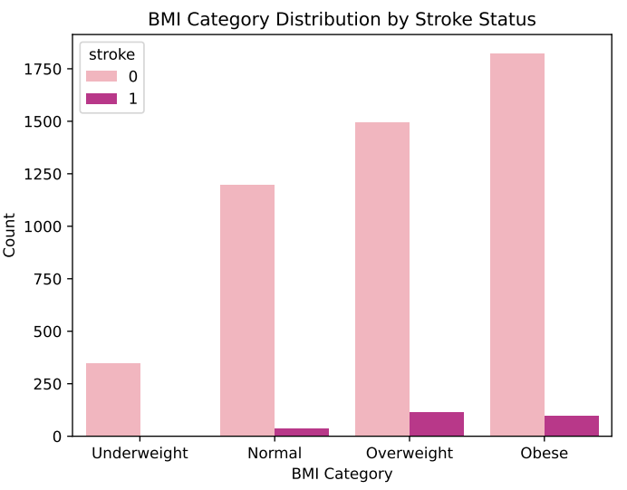
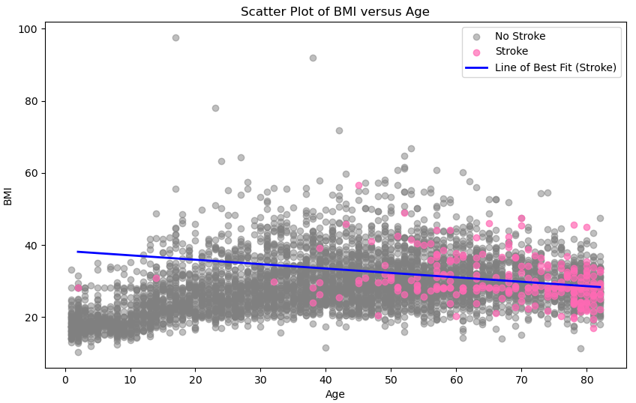
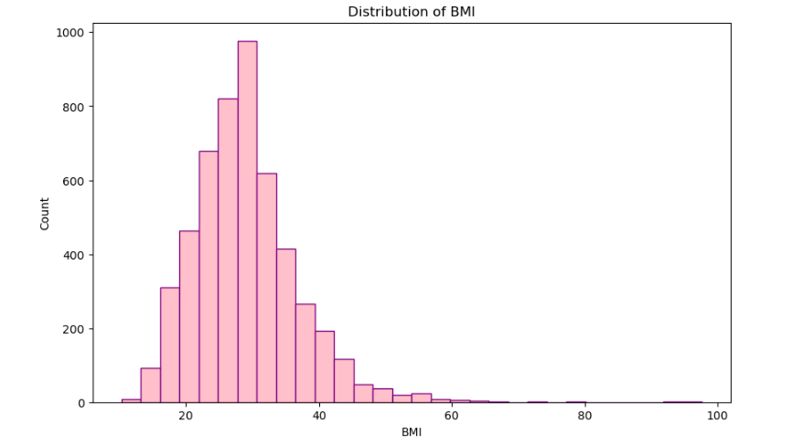
Age vs BMI
Notes:
In our analysis, we observed key correlations among age, average glucose level, BMI, and stroke risk. Age is positively correlated with both average glucose level (0.24) and BMI (0.32), indicating higher levels with increasing age. A positive correlation (0.25) between age and stroke risk suggests a link between age and a higher likelihood of stroke. Additionally, a modest positive correlation (0.13) between average glucose level and stroke risk hints at a potential association. These findings offer valuable insights into the interplay of these factors but remind us that correlation doesn't imply causation.
Overall it appears that age is a strong influential factor in stroke. So let’s explore this further

Slide 9
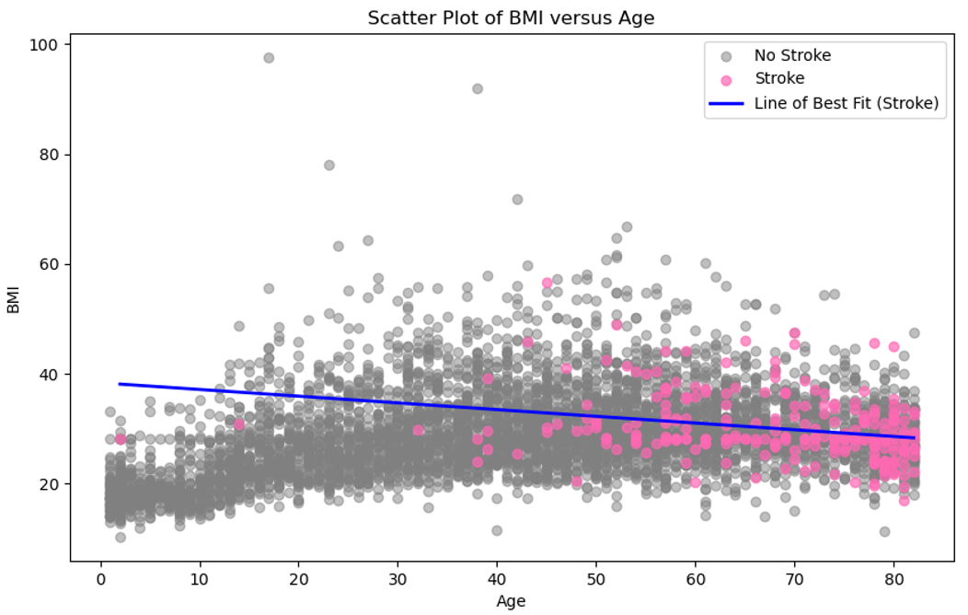
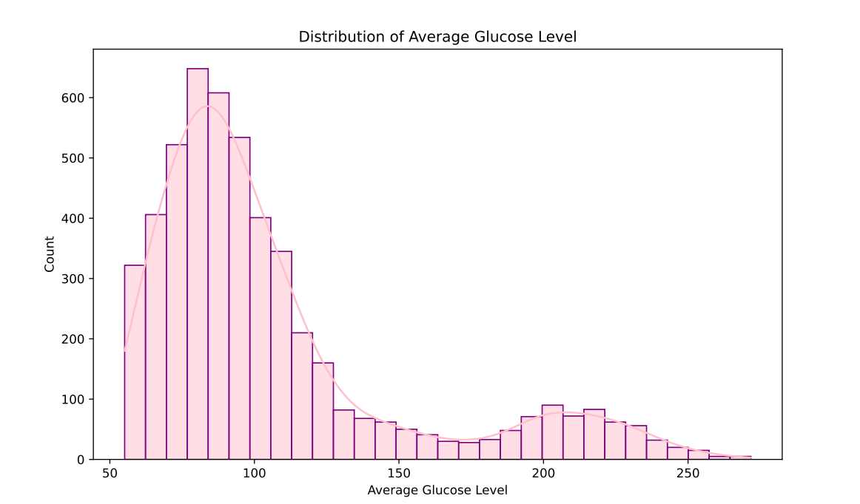
Age vs Blood Sugar
Notes:
In our analysis, we observed key correlations among age, average glucose level, BMI, and stroke risk. Age is positively correlated with both average glucose level (0.24) and BMI (0.32), indicating higher levels with increasing age. A positive correlation (0.25) between age and stroke risk suggests a link between age and a higher likelihood of stroke. Additionally, a modest positive correlation (0.13) between average glucose level and stroke risk hints at a potential association. These findings offer valuable insights into the interplay of these factors but remind us that correlation doesn't imply causation.
Overall it appears that age is a strong influential factor in stroke. So let’s explore this further

Slide 10
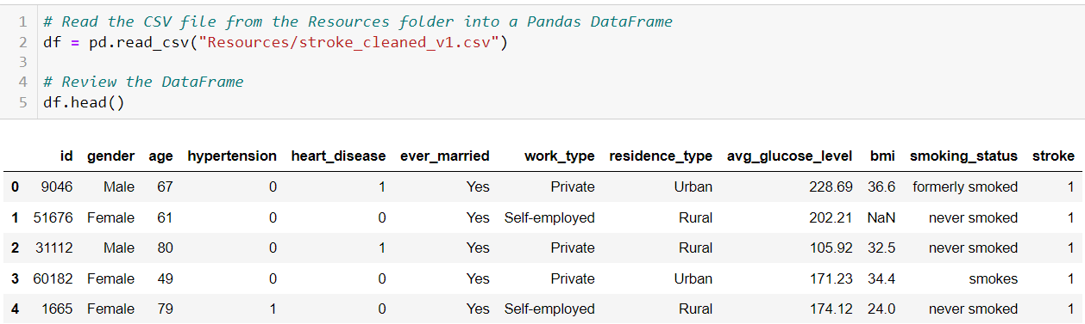
4. Supervised Machine Learning Models
Preprocessing for Models
Step 1: Filling the Null Values with Median:
median_bmi = df['bmi'].median()
df['bmi'] = df['bmi'].fillna(median_bmi)
Step 2: Dropping some columns
df = df.drop( ['id', 'work_type'], axis=1)

Slide 11
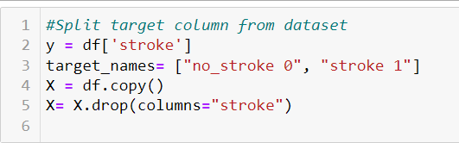
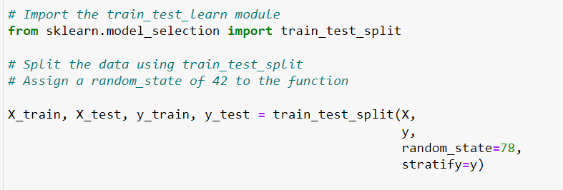

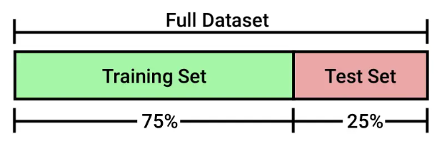
Splitting the data into Training and Testing Sets
Balance of our target values(y)

Slide 12
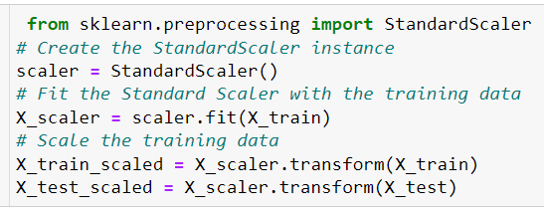


Standardize Data and Dummy encoding
Applies on Numeric columns
Transforms the data to have mean of ‘0’ and Standardization of ‘1’
Creates binary columns for each category

Slide 13
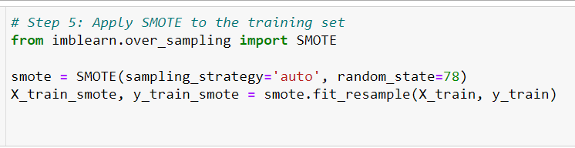

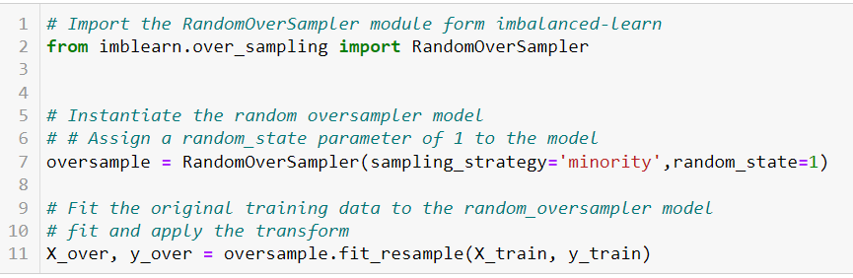

Handling Imbalanced Data
by Oversampling with SMOTE And RandomOverSampler
Smote
It creates synthetic, diverse samples.
Effective in handling class imbalance by introducing new information.
RandomOverSampler
No creation of synthetic samples
uses existing data, duplicates samples.

Slide 14
Supervised Machine Learning Models
Logistic Regression Model
Model_LR = LogisticRegression(solver='lbfgs’, max_iter=200,random_state=78)
K_nearest neighbors
Model_knn = KNeighborsClassifier(n_neighbors=5)
Descision Tree
model_DT = tree.DecisionTreeClassifier()
Random Forest
rf_model = RandomForestClassifier(n_estimators=500, random_state=78)
Support Vector Machine (SVM)
model_svm = SVC(kernel='linear')

Slide 15
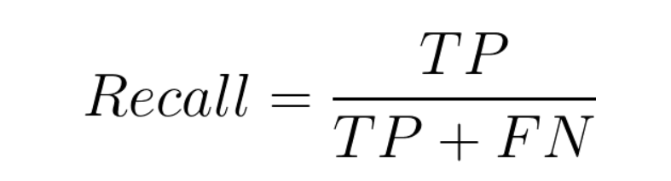
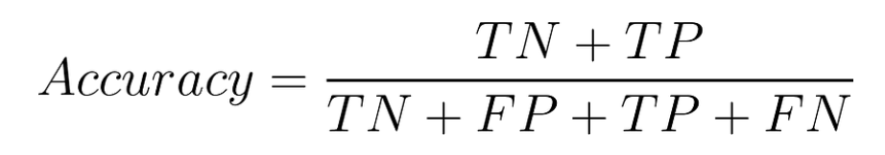
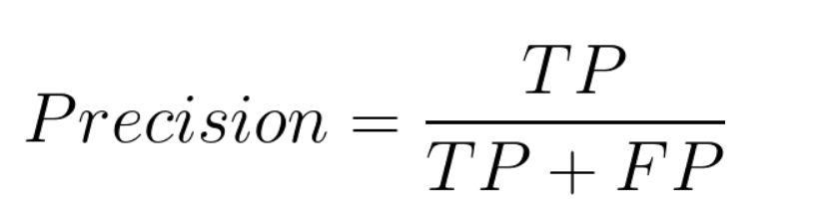
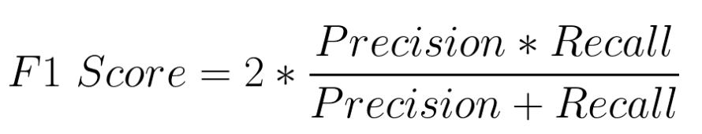
Evaluation Of Models
Evaluation of Models
Metrices to evaluate Models

Slide 16
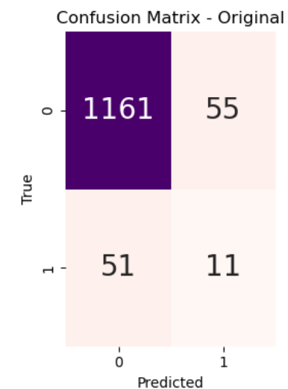
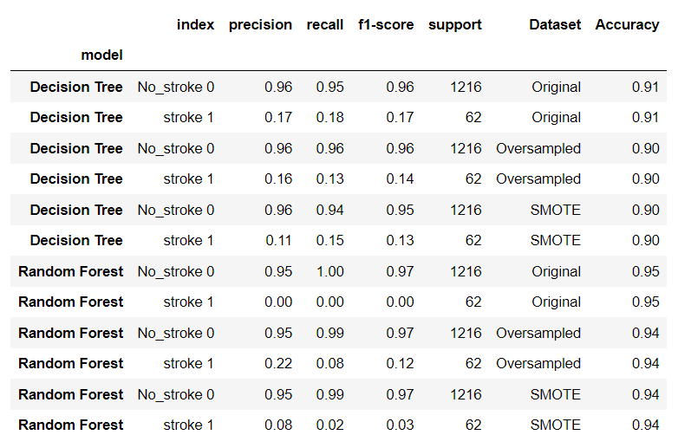
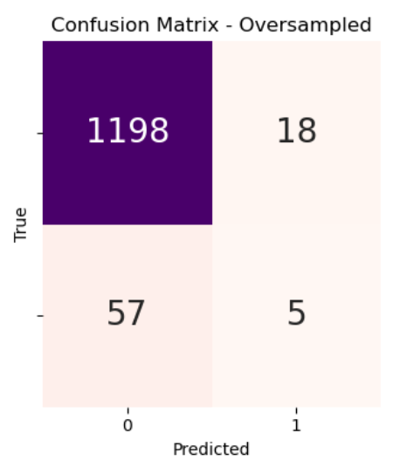
Decision Tree Model And Random Forest Model
In Decision Tree Model 51 people who actually have Stroke, model is predicting them as they don’t have stroke while 55 are those who actually do not have stroke and model is predicting them as they have stroke.
In Random Forest Model 57 people who actually have Stroke, model is predicting them as they don’t have stroke while 18 are those who actually do not have stroke and model is predicting them as they have stroke.

Slide 17
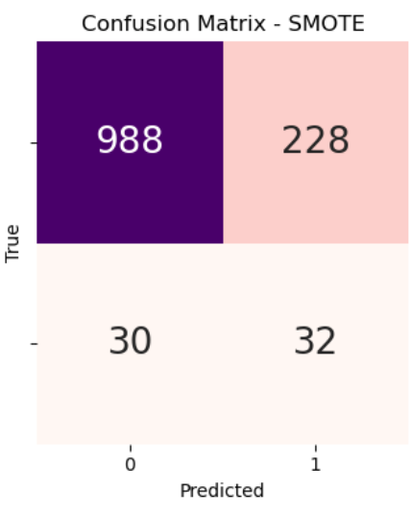
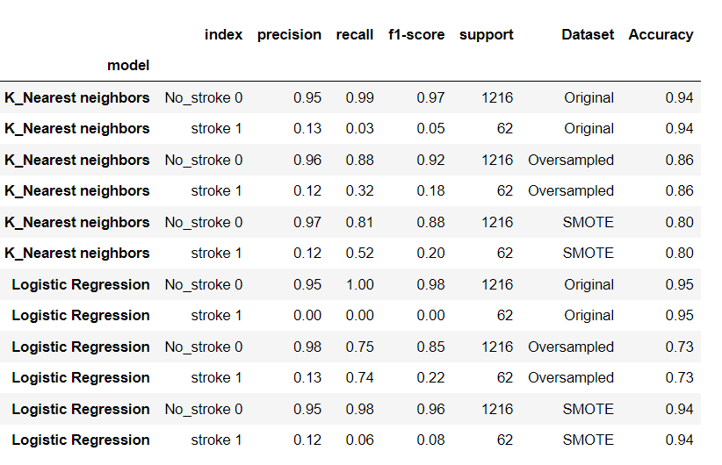
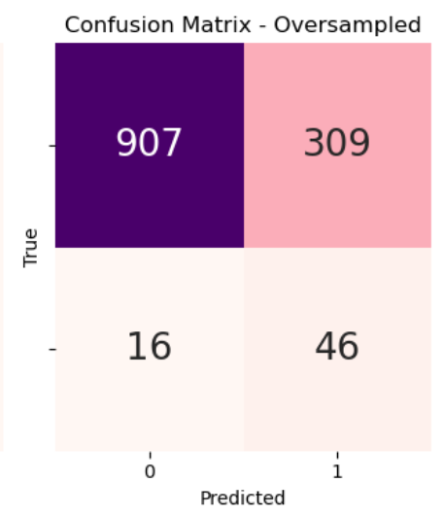
K_Nearest neighbors Model And Logistic Regression Model
KNN Model(Smote), with 30 people who actually have Stroke, model is predicting them as they don’t have stroke while 228 are those who actually do not have stroke and model is predicting them as they have stroke.
Logistic Regression Model (Oversampled): FN is 16 ,FP is 309

Slide 18
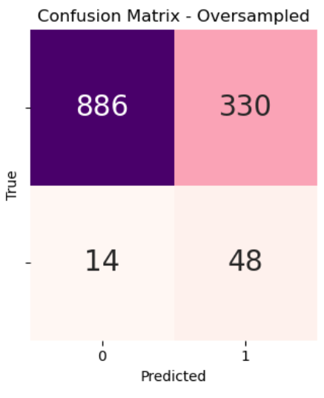
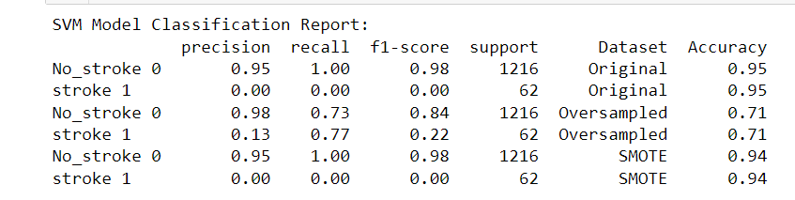
Support Vector Machine (SVM)
SVM with Oversampled Data shows some promising results with a recall for Stroke1 77% and with 14 FN. Though the number of FP is High.

Slide 19
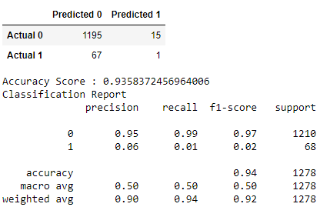
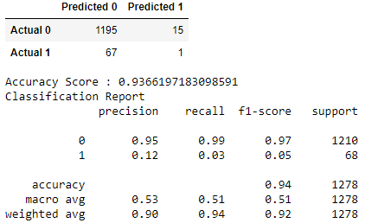
5. Model Optimizations
Part 1
1. Oversampling data and using
RandomForestClassifier
2. Oversampling data, dropping columns found less important, and using RandomForestClassifier
2. Oversampling data, dropping
columns found less important,
and using RandomForestClassifier

Slide 20
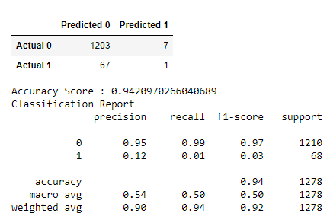
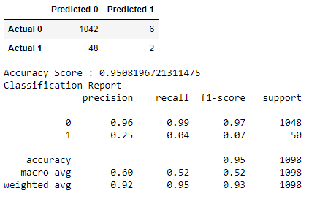
Optimization Part 2
3. Random Forest Classifier
optimised using GridSearchCV
4. Outliers removed from
original dataset, oversampled,
using RandomForestClassifier

Slide 21
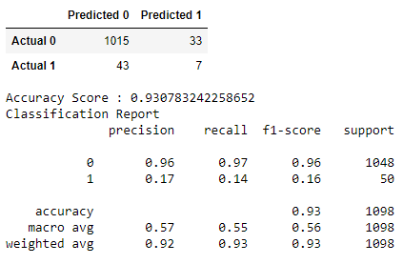
Optimization Part 3
7. Outliers removed, oversampled, using Decision Tree Model

Slide 22
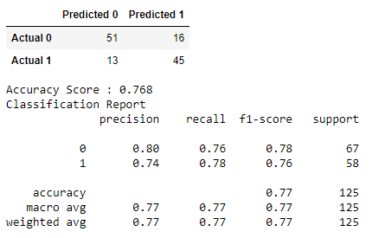
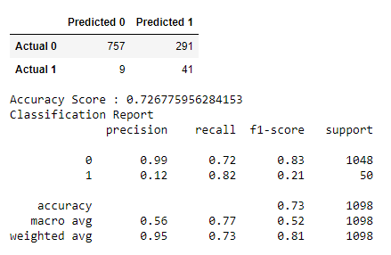
Optimization Part 4
5. Balancing no-stroke to match stroke, using RandomForestClassifier
6. Outliers removed, oversampled, using Support Vector Model

Slide 23
6. Results & Conclusion
The visualizations highlight the crucial role of age, BMI, and blood glucose levels as impactful features for machine modeling in predicting strokes and the potential areas for machine optimisation.
Despite optimisation, unfortunately we were either presented with really high accuracy with poor precision & recall, or good precision & recall and not quite 75% accuracy that the project required. Support Vector Model is our best model, and further work would be required, perhaps another GridSearchCV being ran on it to see what else could be improved.

Slide 24

Questions?
The End

