Slide 1

Project 4
Stroke Prediction using
Supervised Machine Learning
Group 2
Sophie Pribojac II Maliha Mukhtar II Jo Alva II Farheen Oomatia

Slide 2
Table of Content
Introduction
Data Cleaning – SQL
Visualization – Python Matplotlib & Pandas
Supervised Machine Learning Models
Model Optamizations
Result & Conclusion

Slide 3

Introduction
- stroke 2nd leading cause of death globally (11%)*
- 1/3rd of survivors are very often left with severe disability such as loss of vision &/or speech, paralysis and confusion**
- 4 out of 10 death could be prevented if risk factors are highlighted early on**
- supervised machine learning models may help predict high risk patients and aid in prevention efforts by health care providers
* https://www.who.int/news-room/fact-sheets/detail/the-top-10-causes-of-death
** https://www.emro.who.int/health-topics/stroke-cerebrovascular-accident/index.html

Slide 4

Data Cleaning
- rounded age present as decimals
- dropped gender ’other’ (1 row)
- dropped smoking_status column ( too many ‘unknown’)
Stats on dataset:
- total 5109 rows of data post cleaning
- average age 43 years across cohort
- 2994 female & 2115 male data rows
- 4400 employed, 22 never employed, 687 children
- 2596 Urban & 2513 Rural dwellers
- avg glucose level 106.14 mg/dL (optimal 70-100 mg/dL)
- 4860 never had stroke, 249 had stroke
Notes:
For the data cleaning, we started with rounding the ages present in decimals to the nearest age. These affected only ages between 0 and 2.
The gender ’Other’ was dropped as we only had one row of data for this gender.
Also, we decided to drop the column smoking_status for the second part of the analysis as we had too many rows where status showed ’Unknown’. According to the notes on Kaggle, ’Unknown’ means that the information is unavailable for this patient.

Slide 5
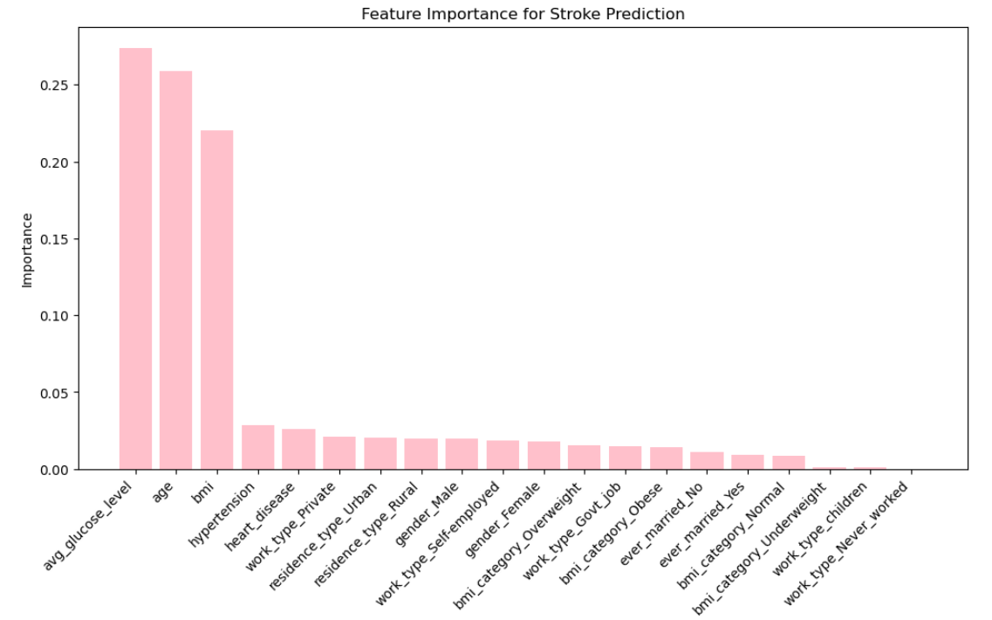
Feature Importance
Notes:
In terms of feature importance for the predictive model, 'avg_glucose_level,' 'age,' and 'bmi' are the most influential factors, contributing 27.40%, 25.91%, and 22.05%, respectively.
Health-related features such as 'hypertension' and 'heart_disease' play a smaller role.
Employment factors ('work_type_Private,' 'work_type_Self-employed,' 'work_type_Govt_job') and residence types ('residence_type_Urban' and 'residence_type_Rural') also contribute.
Gender and marital status have a lesser impact, and different BMI categories provide additional insights.
'work_type_Never_worked' has negligible importance.
Understanding these feature contributions helps interpret the model's decision-making process.

Slide 6
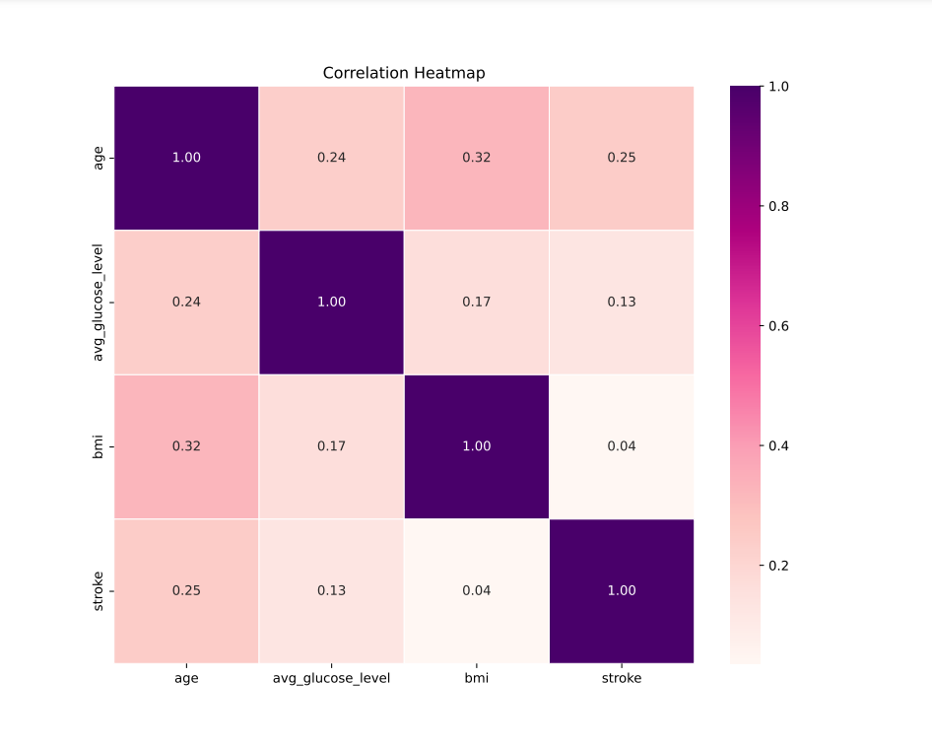
Correlation Heatmap
Notes:
In our analysis, we observed key correlations among age, average glucose level, BMI, and stroke risk. Age is positively correlated with both average glucose level (0.24) and BMI (0.32), indicating higher levels with increasing age. A positive correlation (0.25) between age and stroke risk suggests a link between age and a higher likelihood of stroke. Additionally, a modest positive correlation (0.13) between average glucose level and stroke risk hints at a potential association. These findings offer valuable insights into the interplay of these factors but remind us that correlation doesn't imply causation.
Overall it appears that age is a strong influential factor in stroke. So let’s explore this further

Slide 7
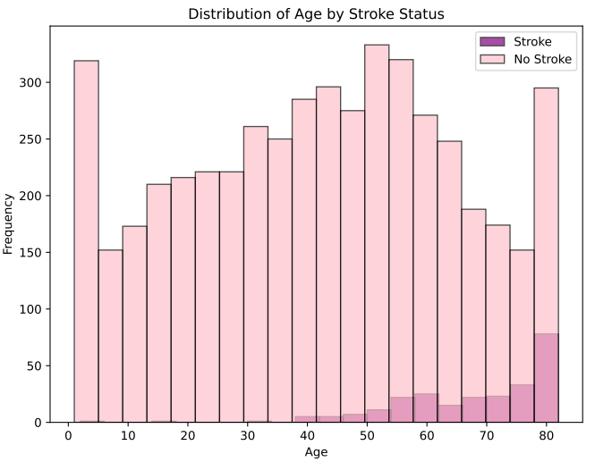
Age Distribution
Notes:
Individuals with a stroke tend to be older, with a mean age of 67.73 years, compared to those without a stroke, who have a mean age of 41.99 years. The age distribution for those with a stroke has a higher mean, median, and interquartile range, indicating that strokes are more prevalent among older individuals. The age range for both groups spans from 1 to 82 years. These statistics provide insights into the age distribution within each group and can be valuable for understanding the demographic characteristics associated with strokes.
Age emerges as a crucial predictor, with an imbalanced dataset emphasizing its significance. Incorporating age into machine learning models can enhance predictive accuracy, offering insights for targeted interventions and personalized medicine.
The older you get the more likely you are to have a stroke. But the data is highly skewed with only about 1 in 20 people actually experiencing a stroke (which you will see later on, influenced our model choice and optimization).
Distribution of strokes was slightly more weighted to females

Slide 8
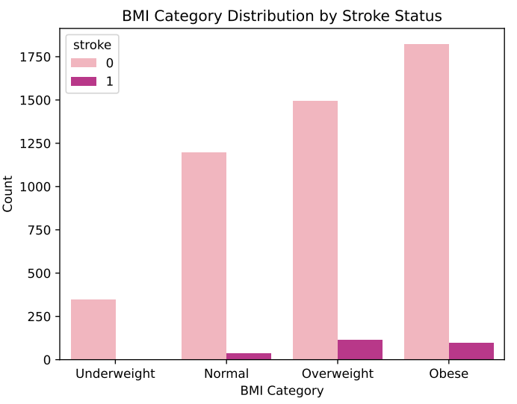
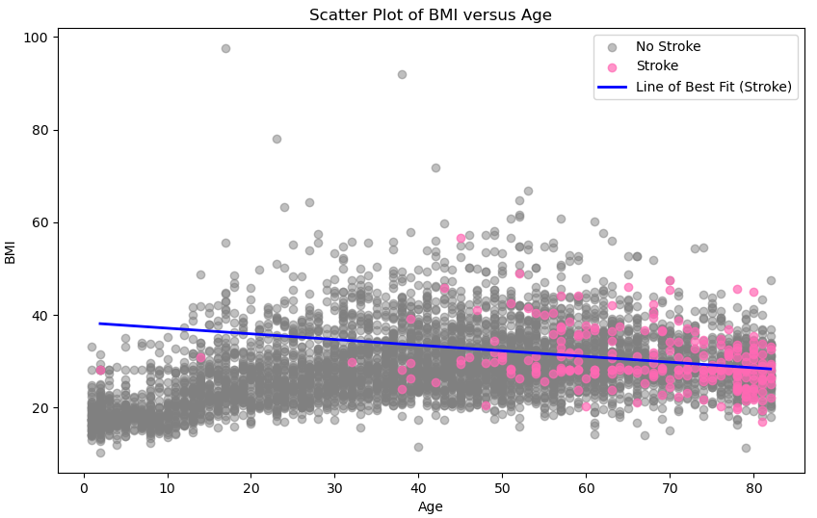
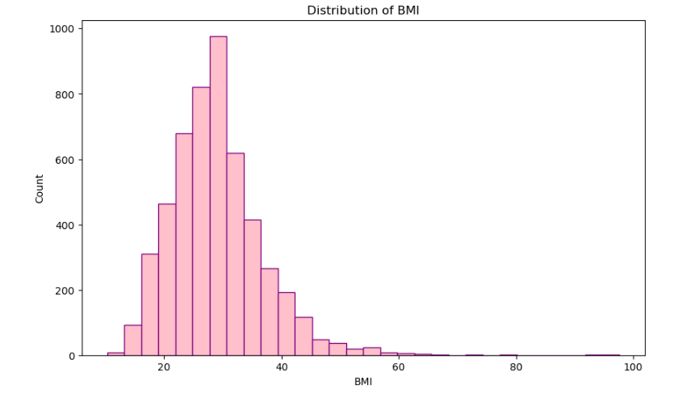
Age vs BMI
Notes:
Let’s take a further look at the relationship between age and the other two notable features, blood glucose and bmi, and how this data is spread.
Individuals with a stroke, on average, have a slightly higher mean BMI compared to those without a stroke.
The distribution of BMI is narrower among individuals with a stroke, as indicated by the lower standard deviation, suggesting less variability in BMI within this group.
For BMI we can see the data is far more clustered, with the exception of extreme bmis. There appears to be a negative correlation between age and bmi (the older you get the lower your bmi. The incidence of stroke in those of an overweight and obese bmi seems to increase the older you get.

Slide 9
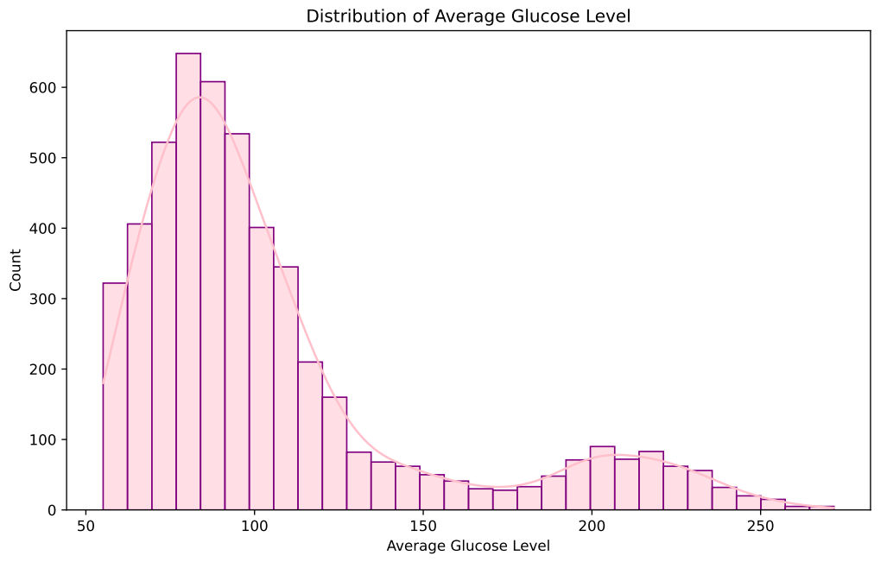
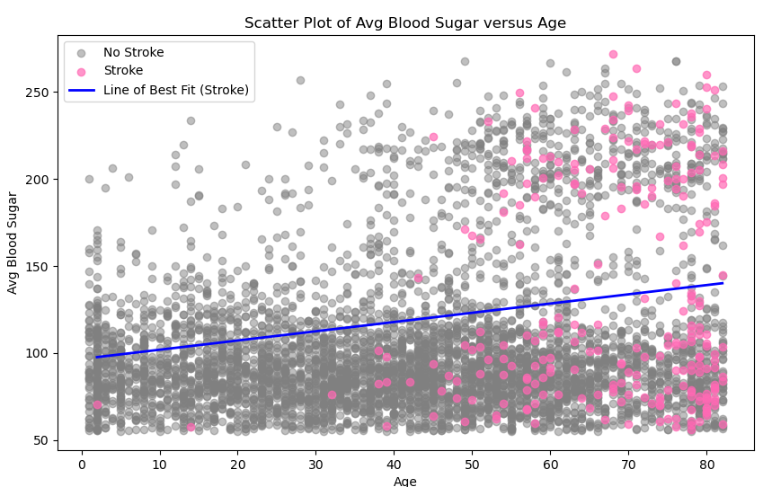
Age vs Blood Sugar
Notes:
For the Blood sugar you can see the data is far more variable, but there is a positive relationship between age and blood sugar. The pink dots show those patients who had a stroke and you can see the data is quite spread out towards the extremes of blood sugar. So this may suggest that blood sugar control becomes more important the older you get in terms of managing stroke risk.
As briefly mentioned, there are anomalous results. These visualisations are key to highlight issues such as this as most models will require normally distributed data in order to ‘learn’ effectively and make accurate predictions.

Slide 10
Supervised Machine Learning
Introduction
Data Cleaning – SQL
Visualization – Python Matplotlib & Pandas
Supervised Machine Learning Models
Result & Conclusion

Slide 11
Model Optimization
Introduction
Data Cleaning – SQL
Visualization – Python Matplotlib & Pandas
Supervised Machine Learning Models
Result & Conclusion

Slide 12
Results & Conclusion
Introduction
Data Cleaning – SQL
Visualization – Python Matplotlib & Pandas
Supervised Machine Learning Models
Result & Conclusion

Slide 13

Questions?
The End

