Slide 1
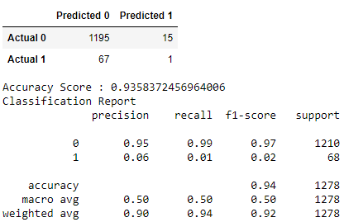
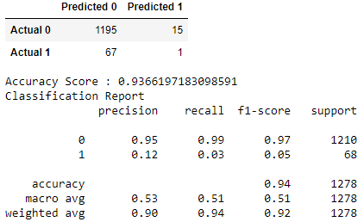
Optimisations
1. Oversampling data and using RandomForestClassifier
2. Oversampling data, dropping columns found less important, and using RandomForestClassifier

Slide 2
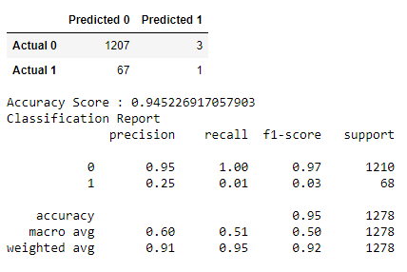
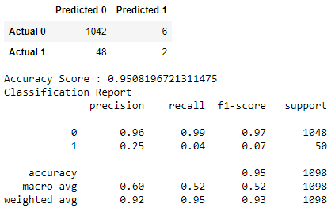
Optimisations
3. Random Forest Classifier optimised using GridSearchCV
4. Outliers removed from original dataset, oversampled, using RandomForestClassifier

Slide 3
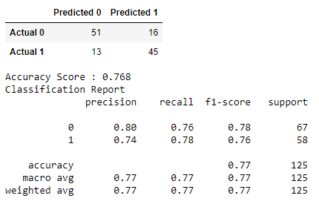
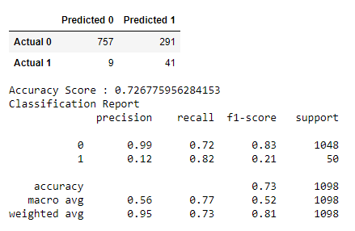
Optimisations
5. Balancing no-stroke to match stroke, using RandomForestClassifier
6. Outliers removed, oversampled, using Support Vector Model

Slide 4
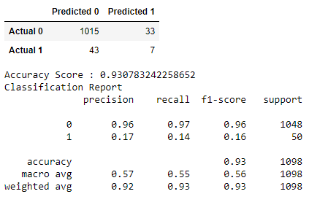
Optimisations
7. Outliers removed, oversampled, using Decision Tree Model

