Slide 1
SNAC Algorithm

Slide 2

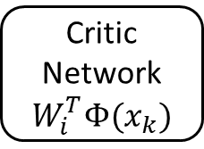

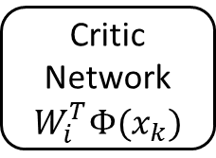






$$x_{k}$$
Critic Network
$$W_{i}^{T}Φ(x_{k})$$
Critic Training
$$W_{i+1}^{T}$$
$$λ_{k+1}$$
$$λ_{k+1}^{t}$$
Optimal Control Equation
Costate Equation
$$x_{k}$$
$$u_{k}$$
$$λ_{k+2}$$
State Equation
Critic Network
$$W_{i}^{T}Φ(x_{k})$$
$$x_{k+1}$$

Slide 3
Control Diagram

Slide 4

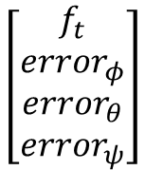


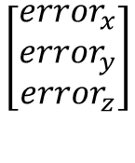






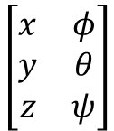
$$[r_{ψ}]$$
$$\left[\begin{matrix}f_{t} \\ r_{φ} \\ r_{θ} \\ r_{ψ}\end{matrix}\right]$$
$$\left[\begin{matrix}f_{t} \\ {error}_{φ} \\ {error}_{θ} \\ {error}_{ψ}\end{matrix}\right]$$
$$\left[\begin{matrix}f_{t} \\ τ_{x} \\ τ_{y} \\ τ_{z}\end{matrix}\right]$$
$$\left[\begin{matrix}r_{x} \\ r_{y} \\ r_{z}\end{matrix}\right]$$
$$\left[\begin{matrix}x & φ \\ y & θ \\ z & ψ\end{matrix}\right]$$
$$\left[\begin{matrix}{error}_{x} \\ {error}_{y} \\ {error}_{z}\end{matrix}\right]$$
$$\left[\begin{matrix}u_{x} \\ u_{y} \\ u_{z}\end{matrix}\right]$$
Position Regulator
System Solver
Attitude Regulator
Quadcopter Dynamics
$$+$$
$$+$$
$$−$$
$$−$$
$$\left[\begin{matrix}x \\ y \\ z\end{matrix}\right]$$
$$\left[\begin{matrix}φ \\ θ \\ ψ\end{matrix}\right]$$

Slide 5
Bellman’s Optimality Principle

Slide 6


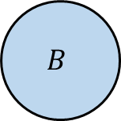


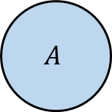
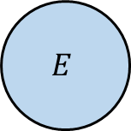



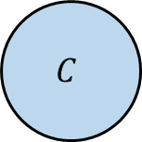


$$B$$
$$2$$
$$16$$
$$5$$
$$A$$
$$C$$
$$E$$
$$5$$
$$10$$
$$8$$
$$7$$
$$5$$
$$D$$

