Slide 1








Exploding Kittens
scala edition
Joāo Morais

Slide 2
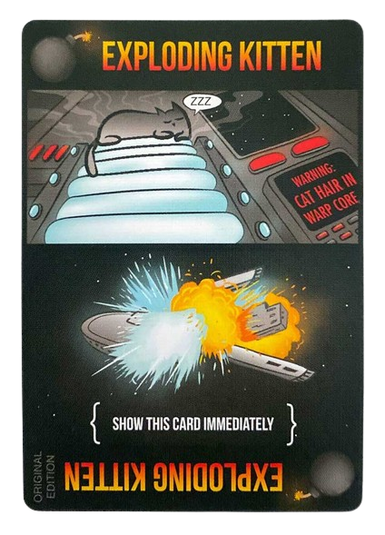



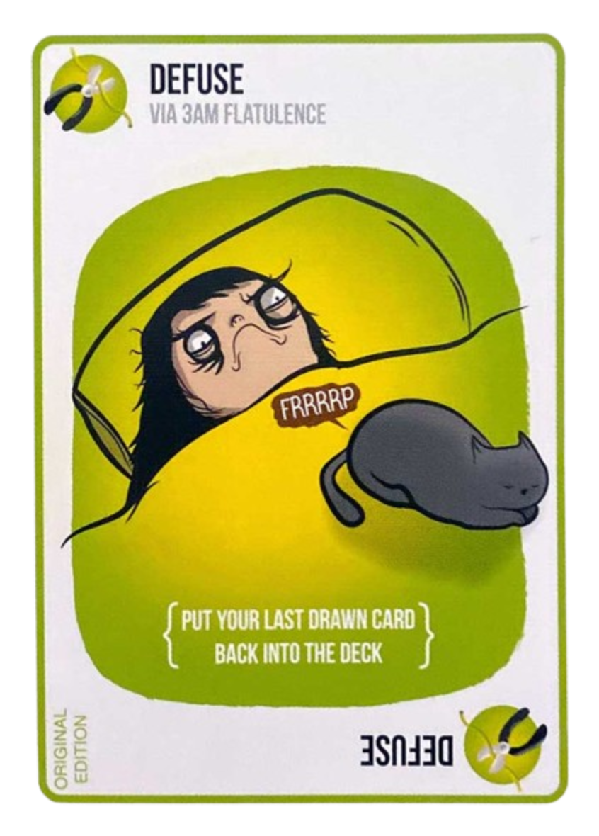
Rules
Deck with some action cards and Exploding Kittens
Each player starts with a set number of cards
Turn starts by playing a card from hand (optional)
Turns ends by drawing a card (required)
If this card is an Exploding Kitten:
You have a Defuse card in your hand. You play it and put the Exploding Kitten back in the deck, wherever you want
You don’t have a Defuse card. You die
The game ends when there’s one player left - the winner

Slide 3
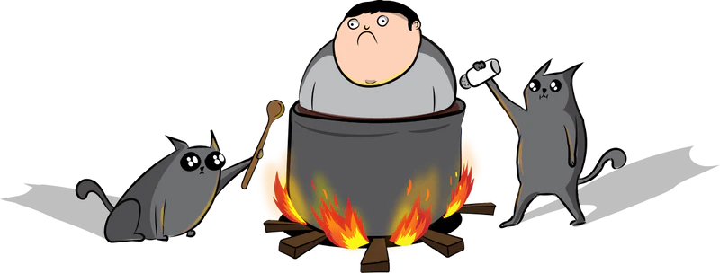
Recipes
To decide which cards go in the deck, while ensuring a balanced game, there are some recipes we can follow.
I used the Nope Sauce Recipe

Slide 4

Cards
Shuffle {Shuffle the draw pile}
Skip {End your turn without drawing a card}
Alter The Future (3x) {Privately view and rearrange the top three cards of the draw pile}
Swap Top And Bottom {Swap the top and bottom cards of the draw pile}
Attack (2x) {End your turn without drawing a card. Force the next player to take two turns}
Targeted Attack (2x) {Choose a player to take 2 turns. Continues from that player}
Catomic Bomb {Remove Exploding Kittens from deck. Shuffle. Put kittens on top of the deck. Your turn ends after playing this card}
Bury {End your turn by putting the next card you draw back as if you had defused it}
Tacocat {This is a cat card and is powerless on its own}
Feral Cat {Use as any cat card}
Reverse {Reverse the order of play and end your turn without drawing a card}
Nope {Stop the action of another player. You can play this at any time}

Slide 5
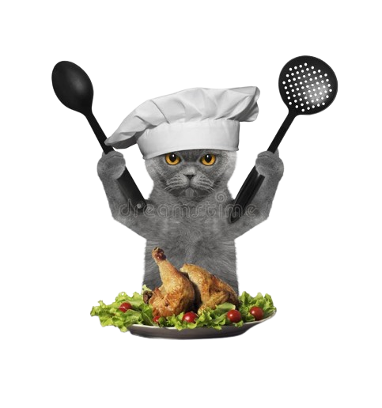
Nope Sauce (2 to 5 players)
In a large bowl, mix the following ingredients:
Exploding Kitten x (Number of Players - 1)
Defuse x Number of Players
Nope x 8
Shuffle x 4
Skip x 4
Alter The Future (3x) x 2
Swap Top And Bottom x 2
Attack (2x) x 3
Targeted Attack (2x) x 2
Catomic Bomb x 1
Bury x 3
Tacocat x 4
Feral Cat x 6
Reverse x 4
Each player starts with 7 cards (not Exploding Kittens) + a Defuse

Slide 6
Objective
1st Milestone
2nd Milestone
3rd Milestone
4th Milestone
1
2
3
4
Functional game w/ cards implemented exc. Nope and cat cards
Multiplayer server hosting a single game
Server hosting rooms, each with its game
Nope and cat cards implementation

Slide 7
How To Play
Rooms created for a set number of players and each room hosts its own game.
curl GET http://localhost:8080/lobby : Returns list of the rooms with the players connected to them.
curl GET http://localhost:8080/create/${roomName}/${#Players}: Creates a room with roomName for number of players = #Players
websocat ws://localhost:8080/join/${roomName}/${playerID}: Connects a player with PlayerID to the room with roomName
websocat ws://localhost:8080/start/${roomName}: If the room is full, starts the game on this room

Slide 8
Limitations
Players should be able to play multiple cards at once
Players should be able to stack Attack and cancel theirs
Players should be able to Nope Cat Cards combos and other Nope

Slide 9
Demo Time!

Slide 10

THANKS!
Do you have any questions?

