Slide 1
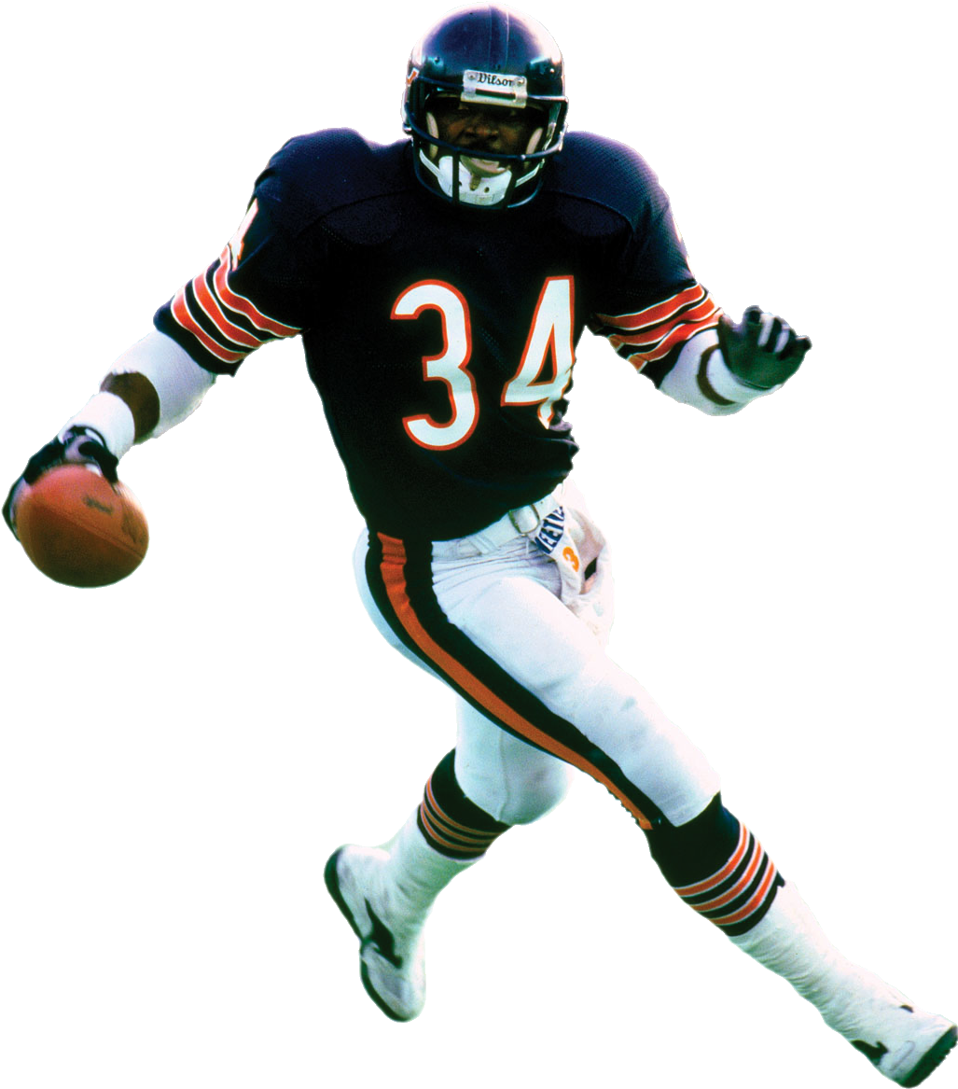
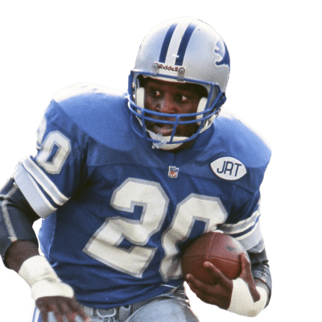
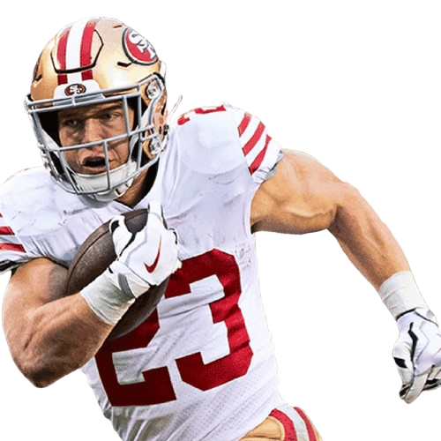
DSCI-510 2025
The NFL Running Back Debate
Johnny Minard

Slide 2
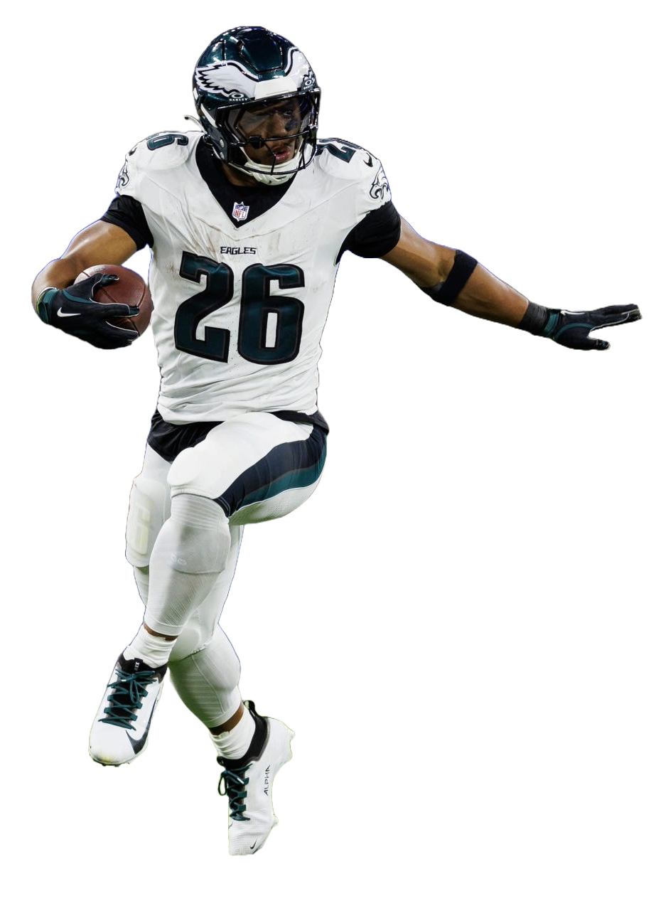
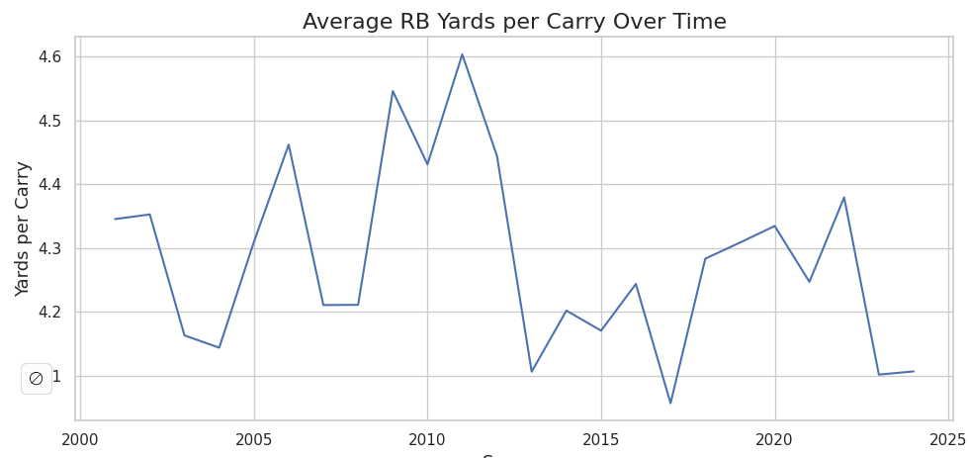
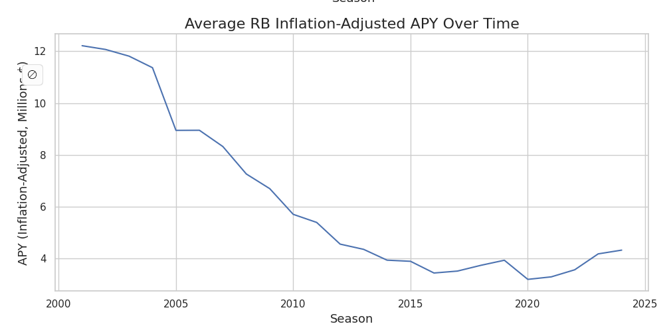
Introduction
With running backs holding out for periods of time for contract disputes, there is a broad consensus that running backs are less valuable than other skill positions. In today’s pass-first NFL, running backs are seeing their value diminish in spite of receivers, quarterbacks, and defensive players signing record-breaking contracts.
The goal of this project is to use contracts and performance data to evaluate running backs over time and determine whether or not teams are justified the current valuation of the running back market.

Slide 3
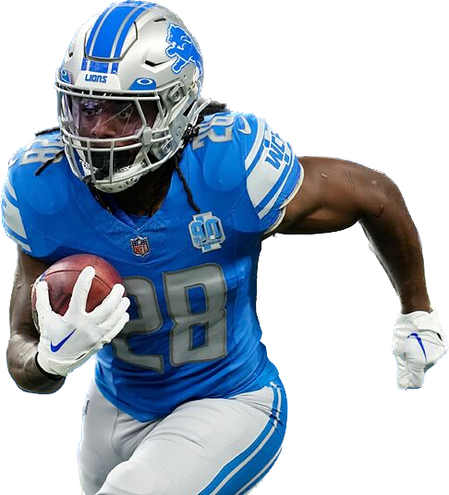

Data Sources
Data Source # | Name/Short Description | Description | Purpose | Types | Data Size
1 | Pro Football Reference | Individual player stats including Rushing yards, attempts, touchdowns, yards per carry, fumbles, longest rush, yards per game, and the year | Collected via Kaggle API into CSV; The stats are used to measure a player’s on-field performance using basic metrics | Kaggle API / CSV | Rows : 7634 Columns : 13
2 | OverTheCap | Player contract stats (with inflation considered) which include the year signed, total contract, signing bonus, average per year | Collected via web scraping; this contract data shows how much a player is valued at, this will help to determine value | Web Scraping | Rows : 3608 Columns : 14
3 | ESPN | Team-level stats from years 2001-2024, this will include wins and losses as well as team total passing and rushing yards | Scraped ESPN’s public API; this took all season stats per team from the years 2001-2024 to find the season outcomes as well as offensive stats. | Web Scraping | 768 team’s seasons

Slide 4
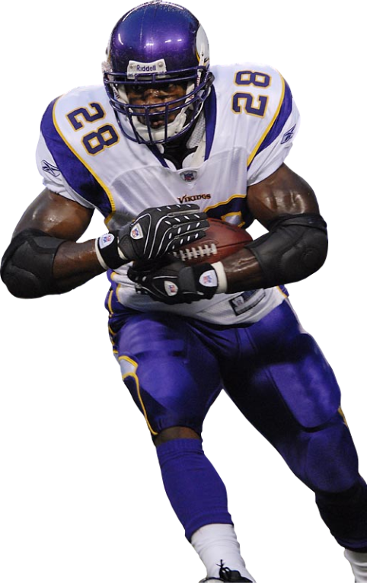
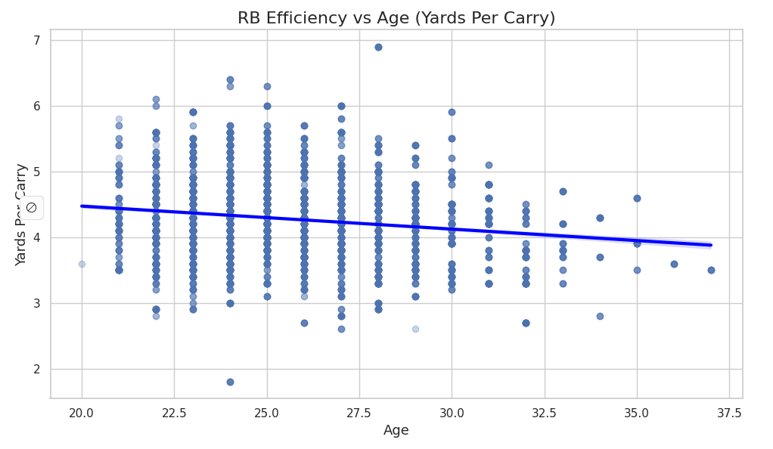
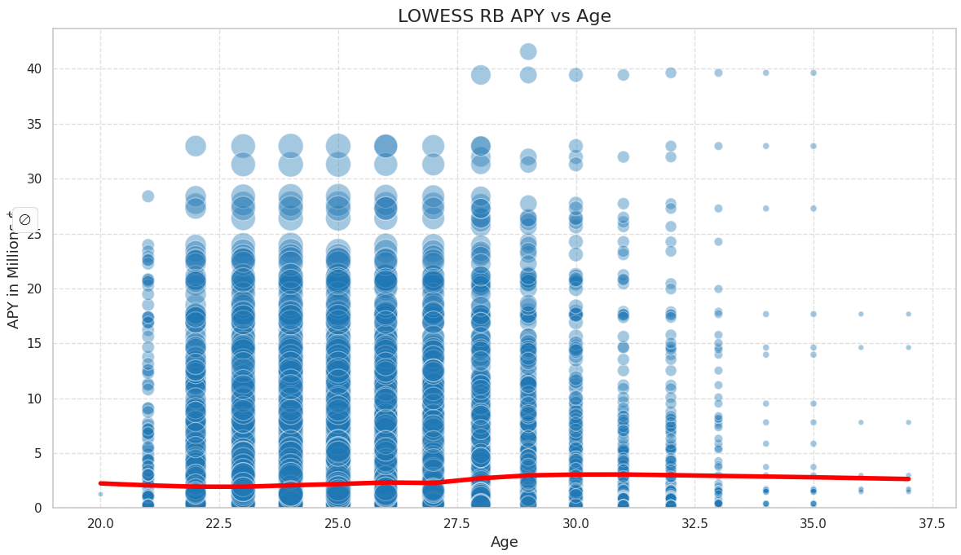
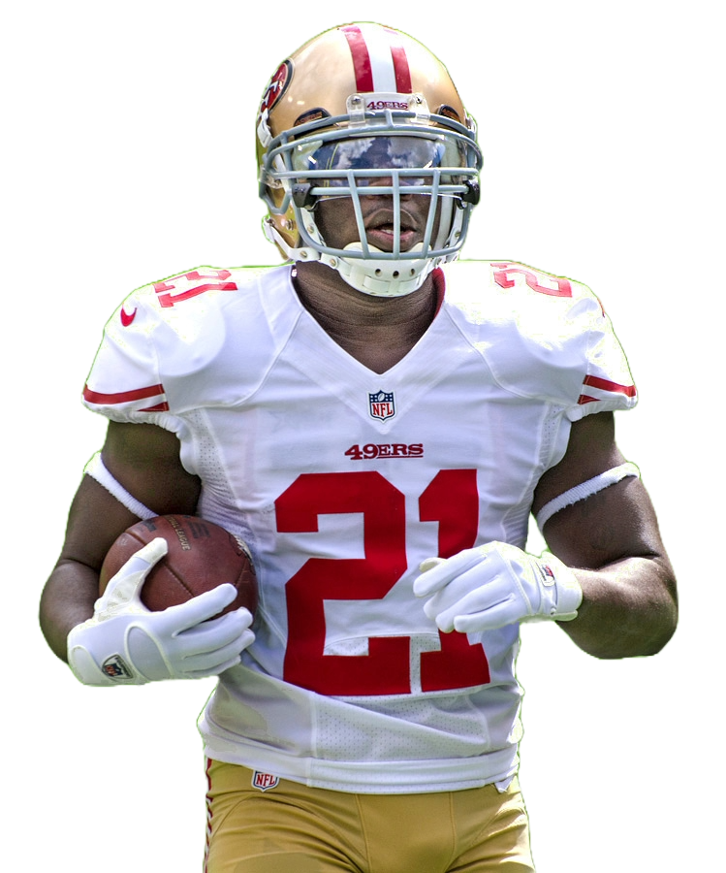
Running Backs Over Time
There is a decline in running back efficiency as they age, an average of 0.21 yards per carry is lost per year.
The LOWESS shows there is a significant decrease in running backs over the age of 30.
Despite the average APY increasing with age, the LOWESS regression shows that running backs tend to fizzle out of the league after 27.

Slide 5
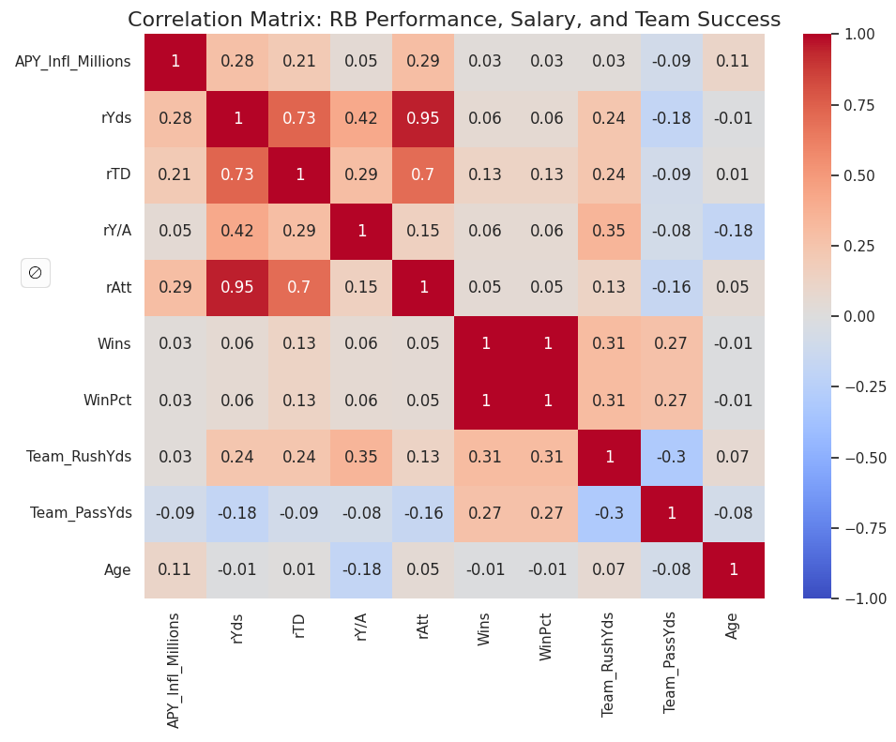
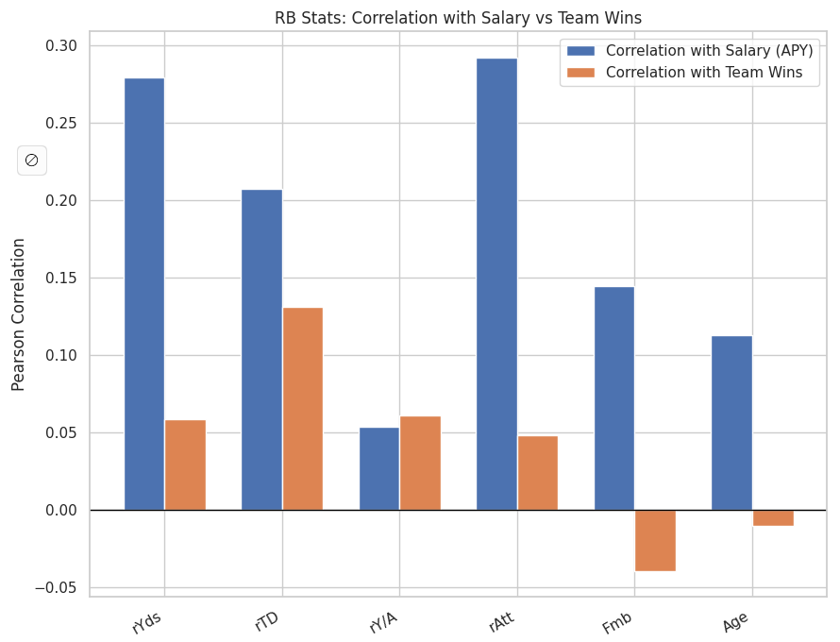
Correlation Analysis
The heatmap shows weak correlations between rushing yards, rushing tds, and yards per attempt and APY or wins.
There is a correlation between rushing attempts and APY, this indicates that teams pay running backs for volume, but those stats do not necessarily translate to wins.
There is a slight negative correlation between age and wins, this points to the short-lived value of running backs.
Notes:
There is a decline in running back efficiency as they age, an average of 0.21 yards per carry is lost per year.
The LOWESS shows there is a significant decrease in running backs over the age of 30.
Despite the average APY increasing with age, the LOWESS regression shows that running backs tend to fizzle out of the league after 27.

Slide 6
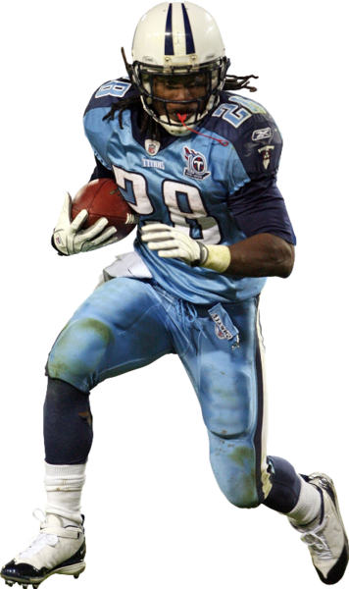
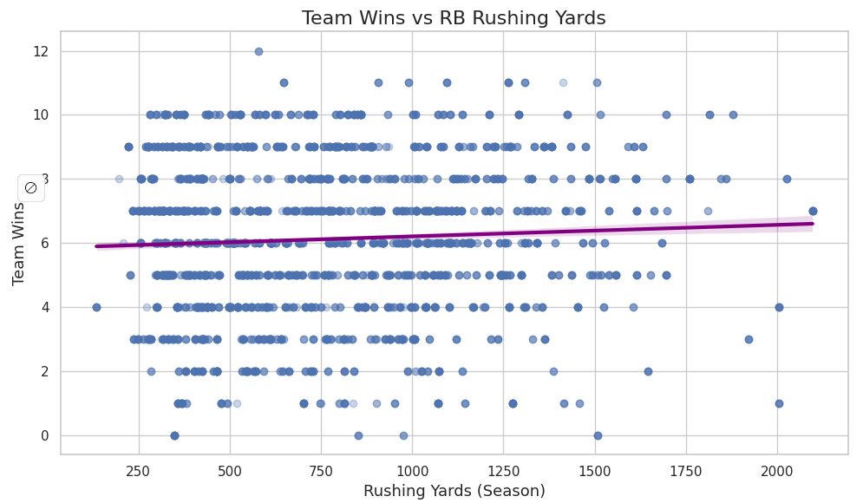
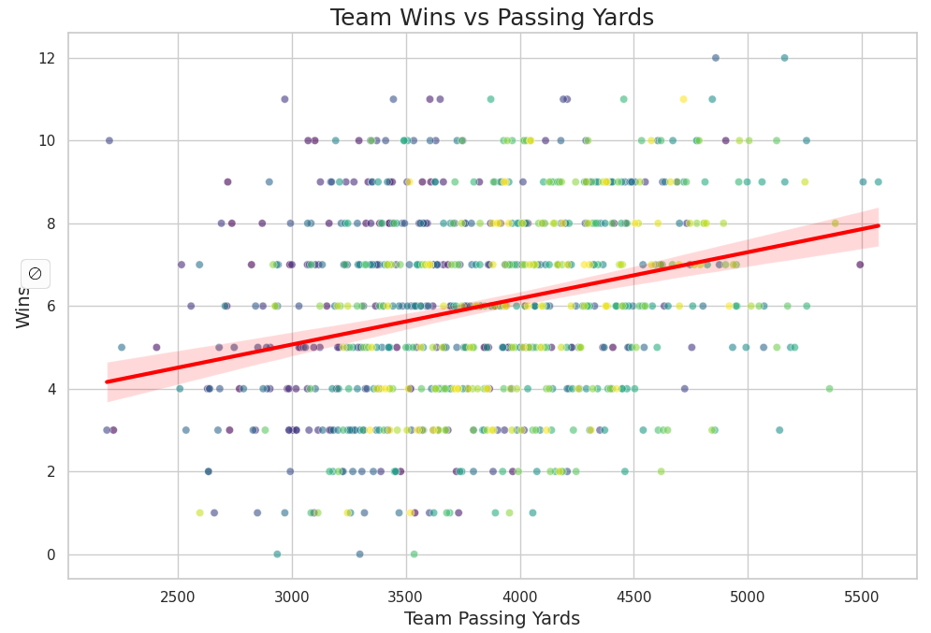
Do Rushing Yards Lead to Wins?
When it comes to passing yards vs rushing yards impact on wins passing yards have a clear stronger positive relationship with team wins. There is a notable clustering around 4000-5000 passing yards -> 8+ win season and 2500-3300 passing yards -> 3-6 win season.
When looking at wins vs Running Back rushing yards, the regression line is almost flat. Running backs with 1600-2000 yard seasons don’t consistently come from winning seasons.
This suggests a strong meaningful consistent correlation between passing production and team success. Passing offenses drive modern NFL success and high-performing QBs correlate strongly with winning seasons. This reinforces the idea that success is driven by quarterback play than individual Running Back performance.

Slide 7
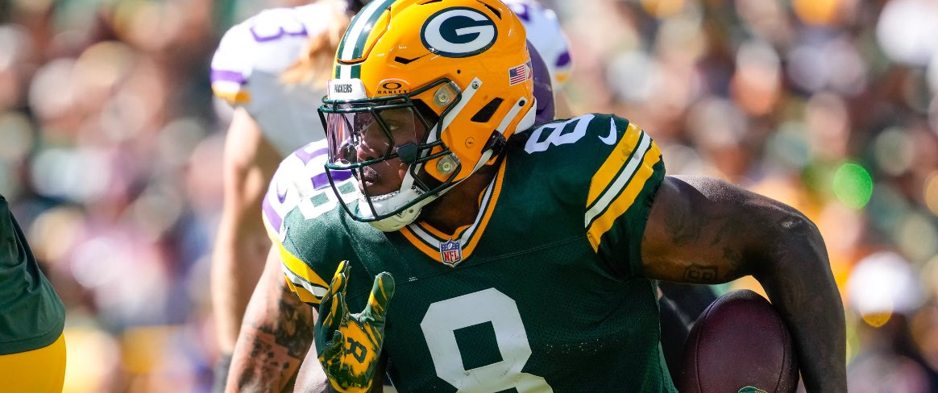
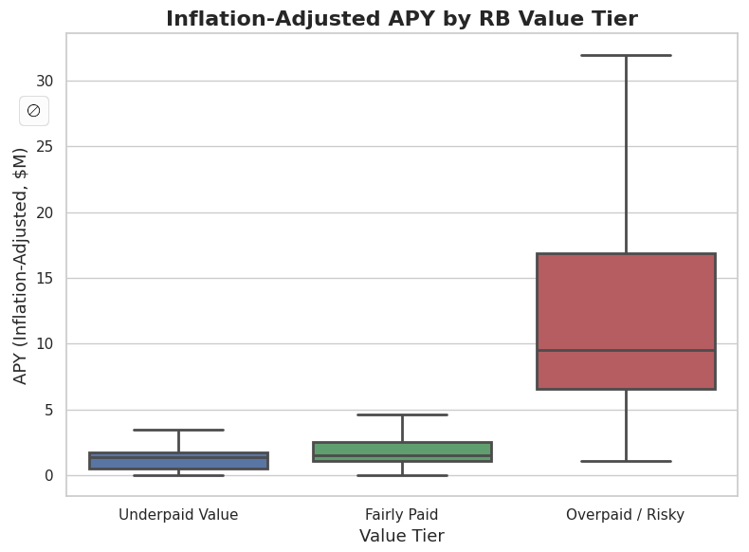
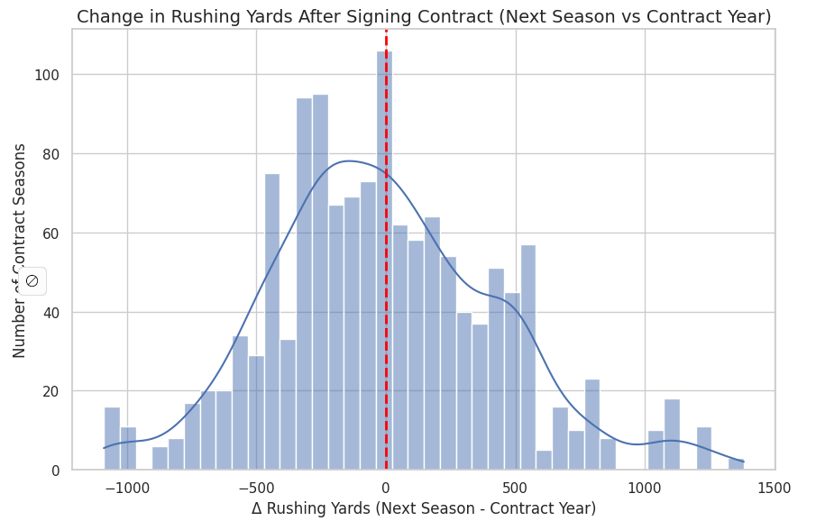
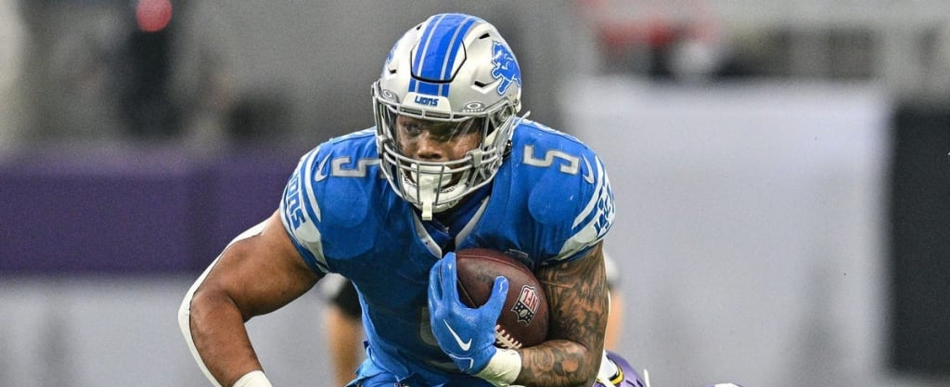
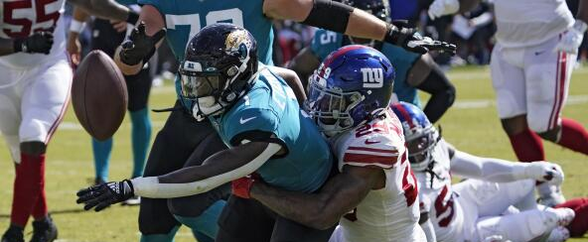
Running Back Value
On average, running backs regress after signing a new contract
Tiers | APY | rAttempts | rYards | rTDs | Y/A | Wins
Fairly Paid | $2.04 | 131.07 | 552.44 | 3.84 | 4.2 | 6.01
Overpaid | $11.88 | 185.49 | 808.58 | 6.00 | 4.31 | 6.14
Underpaid | $1.39 | 221.64 | 973.47 | 7.25 | 4.36 | 6.24

Slide 8
Conclusion
RB Performance Declines with Age
Running Backs lose ~0.21 yards per carry per year, and there is an especially large drop off after age 27-30
LOWESS Regression confirms the steep efficiency decline as well as decrease of running backs past the age of 30
RB Output has a weak correlation with wins
Relevant rushing statistics have weak correlation(|r| < 0.20) with team wins
Teams pay for volume rather than efficiency
Rushing attempts correlate more strongly with APY than yards or touchdowns which indicate team’s reward usage, not impact
Runnings backs also regress the season after signing (see histogram)

Slide 9
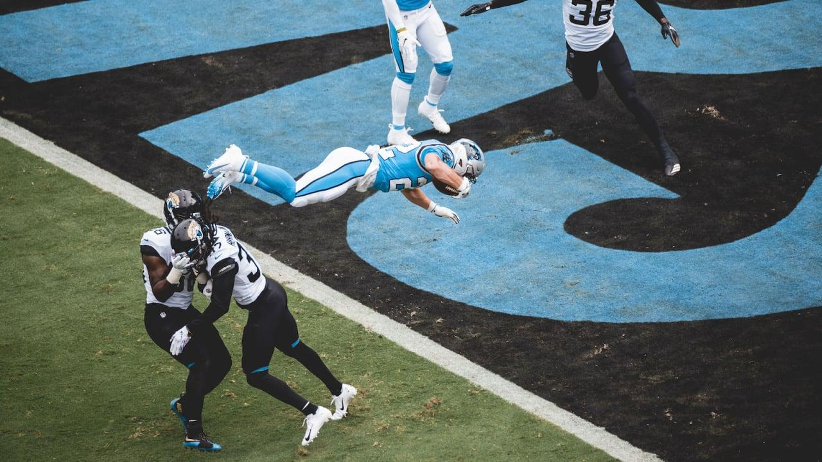
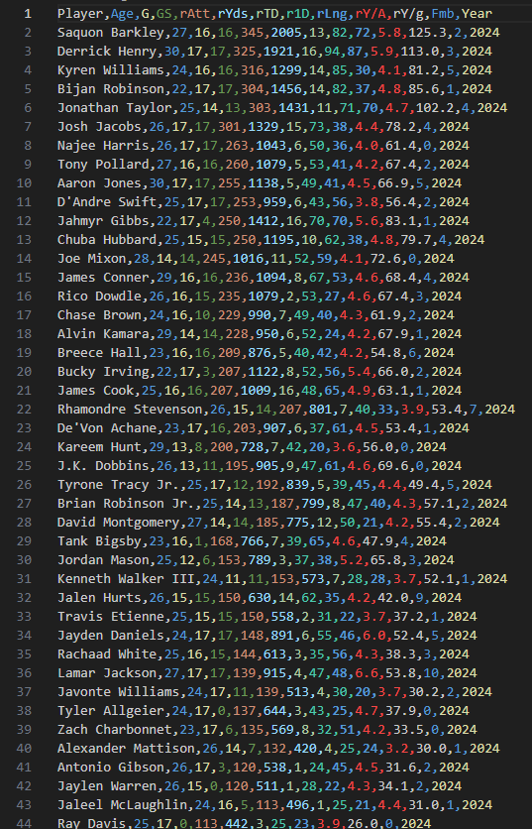
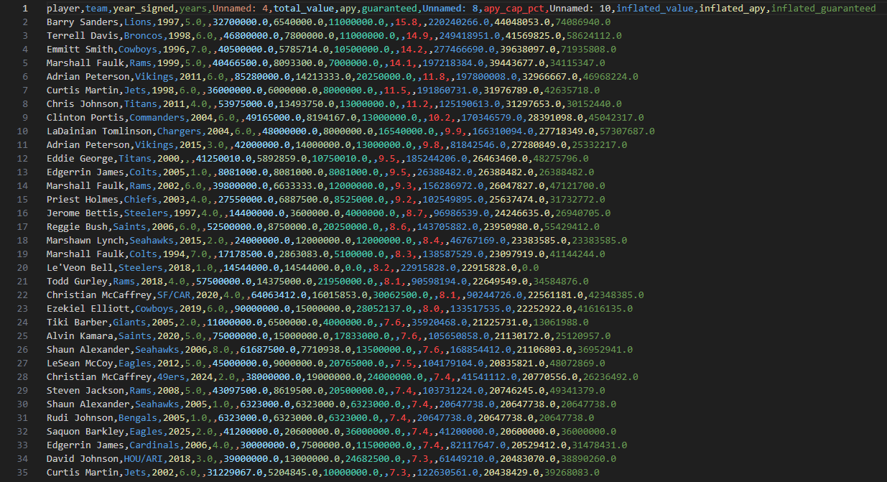
Challenges
Visualization
Variance in running back statistics and large drop offs of running backs past a certain age required LOWESS to draw meaningful conclusions.
Blocked bot and bulk
ProFootballReference frequently blocked automated requests, which forced more of a manual scraping method
Merging + Condensing data
Combining 7,634 player rows, 3,608 contract rows, and 768 team seasons. Inconsistencies in identifiers, multi-season players, and missing contract-years all led to extensive clearing and conditional joins.
Relevant / irrelevant / missing data
Inconsistent running back contract histories and irregular ESPN API team stats required additional cleaning

Slide 10
Thank You

