Slide 1
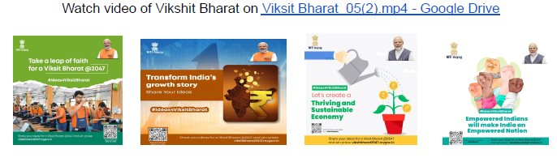
DARK PATTERNS BUSTER HACKATHON (DPBH’2023)
ROUND II
Sikkim Manipal Institute of Technology
Team Name: Pixel Prophets
Presented by:
Gagan Sarmah
Kunsang Moktan
Grenish Rai
Anish Acharya
Mentor: Dr Ranjit Panigrahi
Department: Computer Applications
Sikkim Manipal Institute of Technology

Slide 2
Problem Statement
Design and development of a software-based solutions that can detect the use, type, and scale of dark patterns on e-commerce platforms.

Slide 3
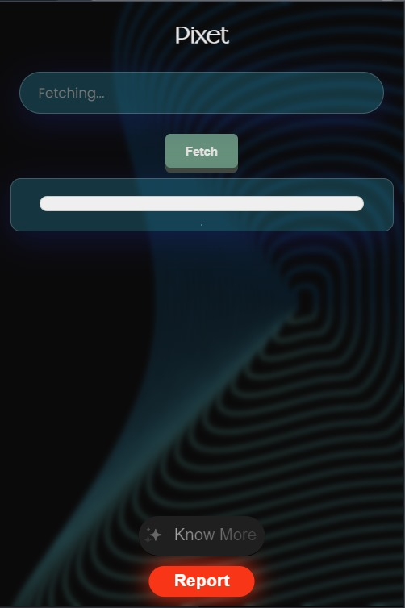

Solution Strategy
To solve the problem, we have developed a browser extension “Pixet” that detects the types and number of dark patterns present in a webpage. It uses transformer-based open-source language models (BERT, RoBERTa and XLNet) to detect the dark patterns present in the webpage. Works on all chromium-based browsers.

Slide 4
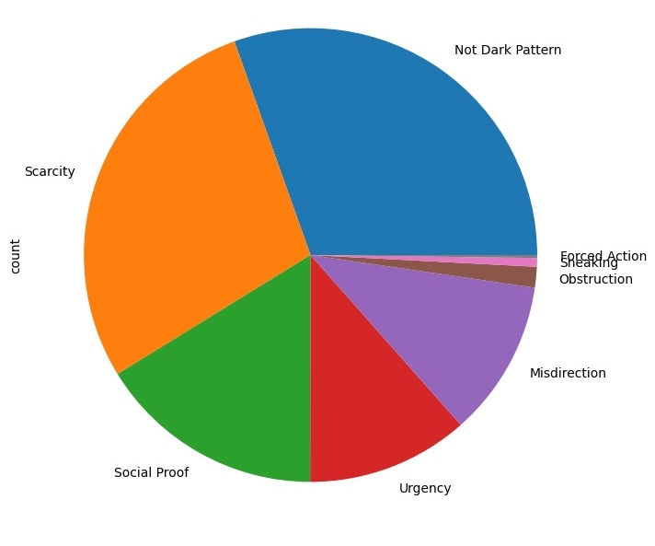
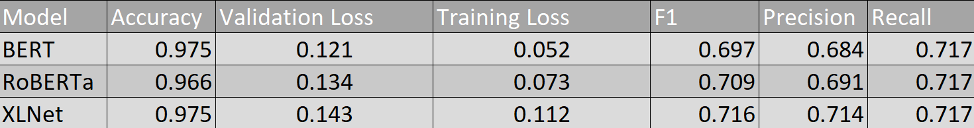
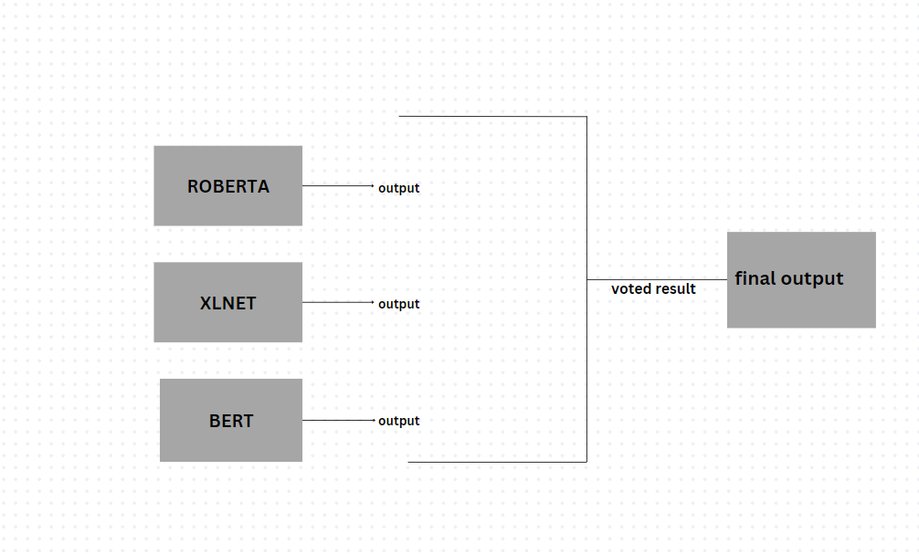
Transformer Based Language Models
We have used three open source language models, fine tuned them according to our dataset.
Dataset used to fine tune the models
Using all three models:

Slide 5
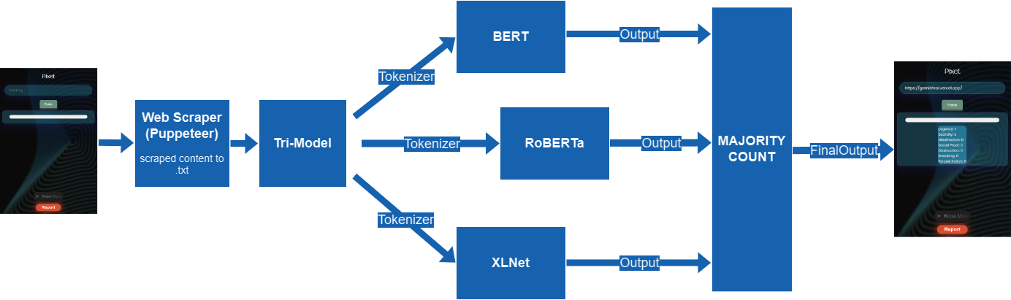
Flow of Data

Slide 6
Tools Used
Extension: HTML, CSS and Vanilla JavaScript
Models: Python (Transformers, Pytorch, Pandas other python libraries)
Content Scraping: Node.js (Puppeteer, Express, Cors, Child_Process)
Tech Stack: Jupyter Notebook, GitHub, VS code

Slide 7
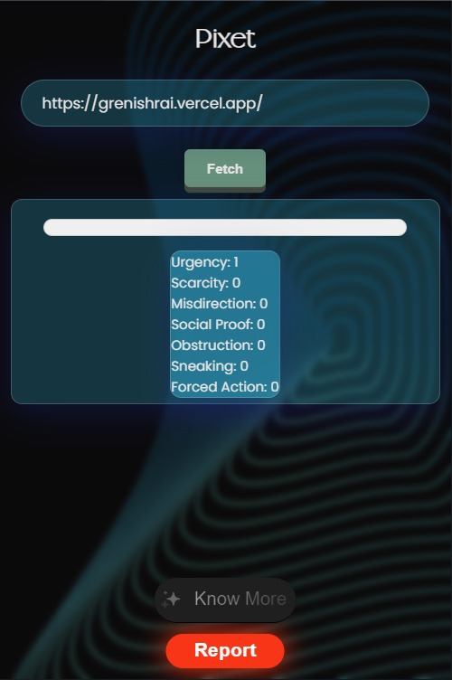
Result and Demonstration
The Extension gives us output as the number of occurrences of types of dark patterns present in the webpage and the percentage of dark patterns. It also has a risk meter that calculates the risk of visiting the website by using the number of dark patterns.

Slide 8
Future Scope
Deployment of Extension
Collection of more datasets to train the models
Making the model learn by itself using user’s feedback in real time
Using various technologies like OCR (to extract text from images) and site tracking for better detection of dark patterns

Slide 9
Thank You

