Slide 1
Introduction of Theano: scan

Slide 2








RNN
y^{t}=softmax(W_{o}a^{t})
_{W}o
copy
a^{t}=σ(W_{i}x^{t}+W_{h}a^{t-1})
memory
_{a}t-1
_{W}i
_{W}h
_{x}t
step
_{x}t _{a}t-1 _{y}t-1
_{a}t _{y}t
W^{h}, Wº, W^{i}

Slide 3


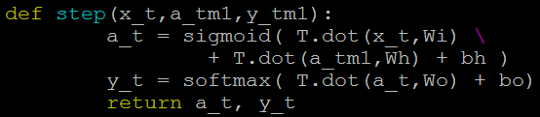
RNN
step
_{x}t _{a}t-1 _{y}t-1
_{a}t _{y}t
W^{h}, Wº, W^{i}

Slide 4



















RNN
_{y}1
_{y}2
_{y}3
_{W}o
_{W}o
_{W}o
W
h
_{W}h
_{W}h
……
_{a}0
_{W}i
_{W}i
_{W}i
_{x}1
_{x}2
_{x}3
step
step
step
_{x}1 _{a}0 _{y}0
_{x}2 _{a}1 _{y}1
_{x}3 _{a}2 _{y}2
_{a}3 _{y}3
W^{h}, Wº, W^{i}
W^{h}, Wº, W^{i}
W^{h}, Wº, W^{i}

Slide 5







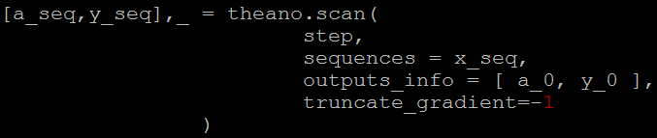











theano.scan
step
step
step
_{x}1
_{x}2
_{x}3
_{a}0
_{a}1
_{a}2
_{a}3
W^{h}, Wº, W^{i}
W^{h}, Wº, W^{i}
W^{h}, Wº, W^{i}
_{y}0
_{y}1
_{y}2
_{y}3
Matrix:
_{x}1
_{x}2 _{x}3
……
……
_{y}1
_{y}2 _{y}3
……
_{a}1
_{a}2
_{a}3
a_0, y_0 are shared variables

Slide 6








Computing Cost & Gradients
_{y}1 _{y}2
_{y}3
……
𝑦 ¹
𝑦 ²
𝑦 ³
……
W^{h}, Wº, W^{i} ……
BPTT

Slide 7
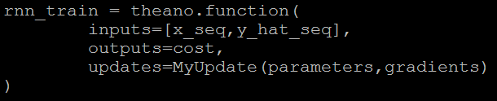

That’s it

Slide 8





HW
1.2
……
0.5
0
0.3
1
0.1
0
0.2
0
0.9
1
0.8
0
One dimension is sampled uniformly from [0,1] and the other is all zeros except at two samples where it is 1.
The goal for each time series is to output the sum of the values in the first dimension at the indices where the second dimension is 1.

Slide 9
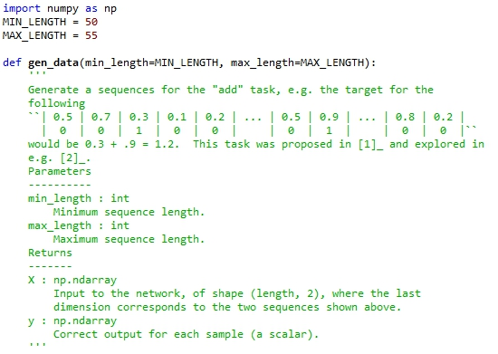

Slide 10
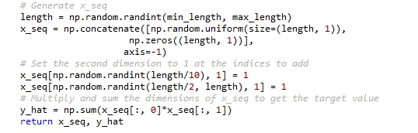

Slide 11
HW 1.使用gen_data產生訓練需要用的資料訓練出一個RNN。 2.使用gen_data產生10組testing data，將x_seq丟進訓練好的RNN做測試。 3.同時print出你的test結果以及正確的y_hat(共10組)並截圖。 4.上傳a.程式碼(txt檔) b.截圖

