Slide 1

BANK LOAN ANALYSIS
DETAILS OF PROJECT REPORT
JYOTI MISHARA

Slide 2
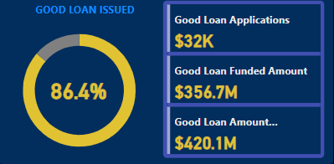
INFORMATIONS DASHBOARD 1: SUMMARY
Good Loan Vs Bad Loan KPI’s
Good Loan:
Goad Loan Application Percentage
Good Loan Applications
Good Loan Funded Amount
Good Total Received Amount
Bad Loan:
Bad Loan Application Percentage
Bad Loan Applications
Good Loan Funded Amount
Good Total Received Amount

Slide 3
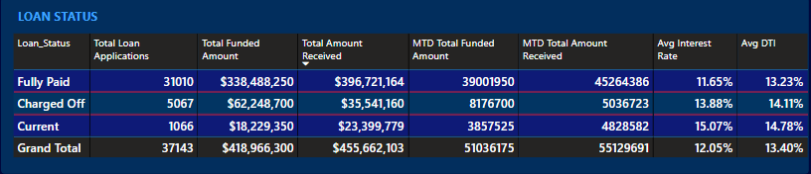
Loan Status Grid View
In order to gain a comprehensive of our lending operation and monitor the performance of loans, we aim to create a grid view report categorized by ‘Loan Status’. By providing insights into metrics such as ‘Total Loan Applications’, ‘Total Funded Amount’, ‘Total Amount Received’, ‘Month-to-Date(MTD) Funded Amount’, ‘MTD Amount Received’, ‘Average Interest Rate’ and ‘Average Debt-to Income Ratio (DTI)’ this grid view will empower us to make data-driven decision and assess the health of our loan portfolio.

Slide 4
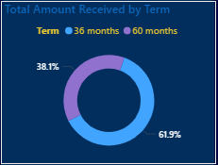
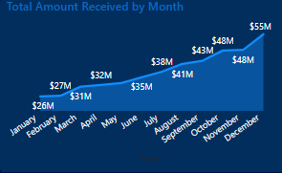
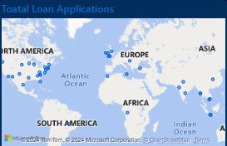
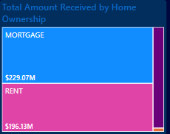
DASHBOARD 2: OVERVIEW CHARTS
3. Loan Term Analysis(Donut Chart): To allow the client to understand the distribution of loan across various term lengths.
4.Home Ownership Analysis(Tree Map): For a hierarchical view of how home ownership impacts loan applications and disbursements.
1.Monthly Trends by Issue Date (Line Chart): To identify seasonality and loang-term trends in lending activities.
2.Regional Analysis by State(Map): To identify regions with significant lending activity and assess regional disparities.

Slide 5
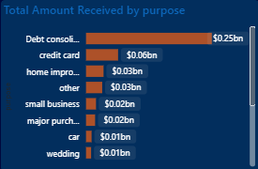
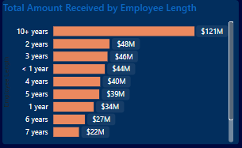
CHARTS
5. Employee Length Analysis(Bar Chart): How lending metrics are distributed among borrowers with different employment lengths, helping us assess the impact of employment history on loan applications.
6. Loan Purpose Breakdown(Bar Chart): Will provide a visual breakdown of loan metrics based on the stated purposes of loan, aiding in the understanding of the primary reasons borrowers seek finacing.

Slide 6
THANK YOU

