Slide 1

w e q r t y u o h s k
Microcomputer Principles and Applications
Project Report 5/12/2019
Pudding Protector
Group 7
林修維 B10702113
羅偉明 B10702109

Slide 2
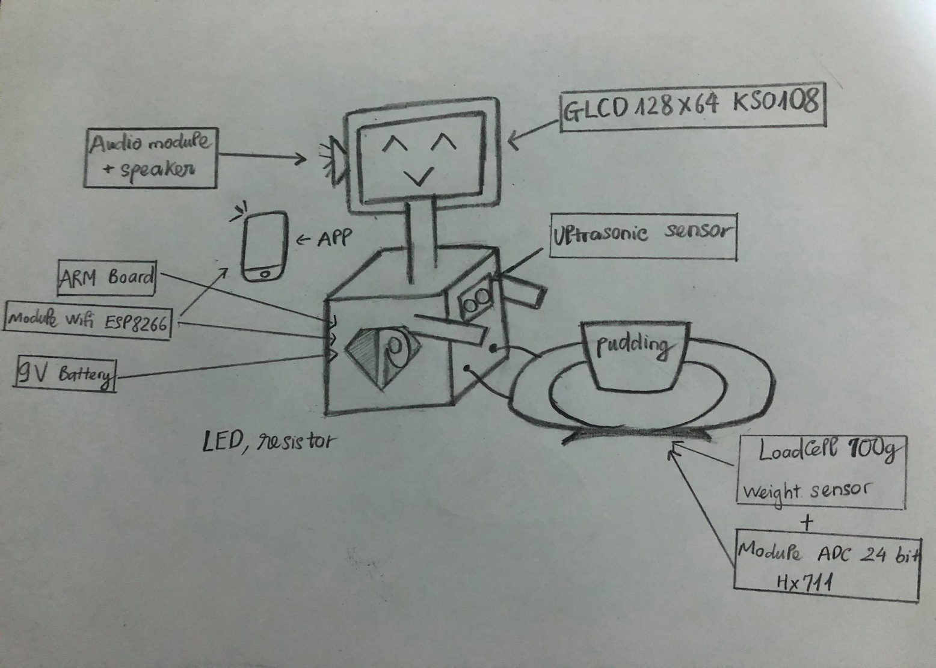
1 . Introduction :
- Colleagues or classmates are always waiting to sneak up your pudding .
- You are not brave enough to remind them .
- You want a smart cool gadget .
* Don’t worry ! Pudding man is here to help you .
He can :
Detect someone is approaching through the ultrasonic sensor and send an alert to your smartphone .
Realize someone takes away the pudding through the weight sensor and make a loud sound to everyone around until it is returned .
Perform many different types of faces and emotions .
Speak human voice .

Slide 3
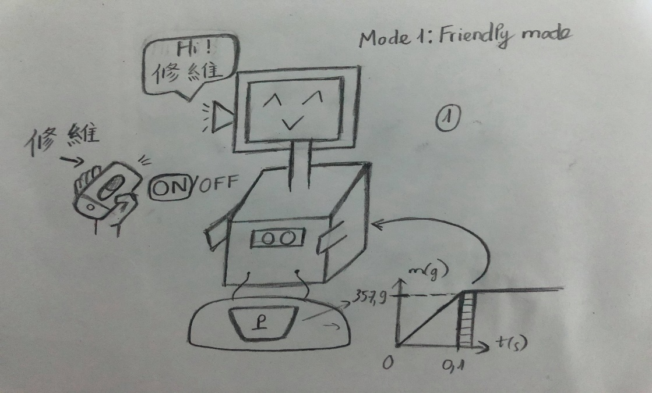
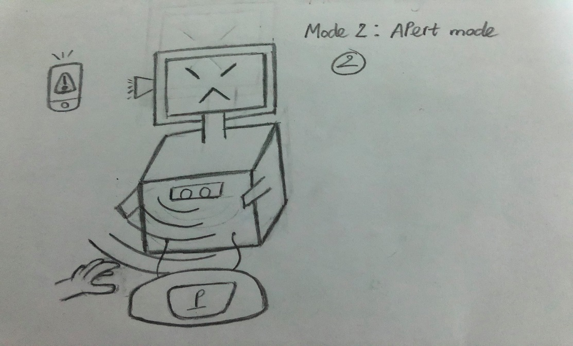
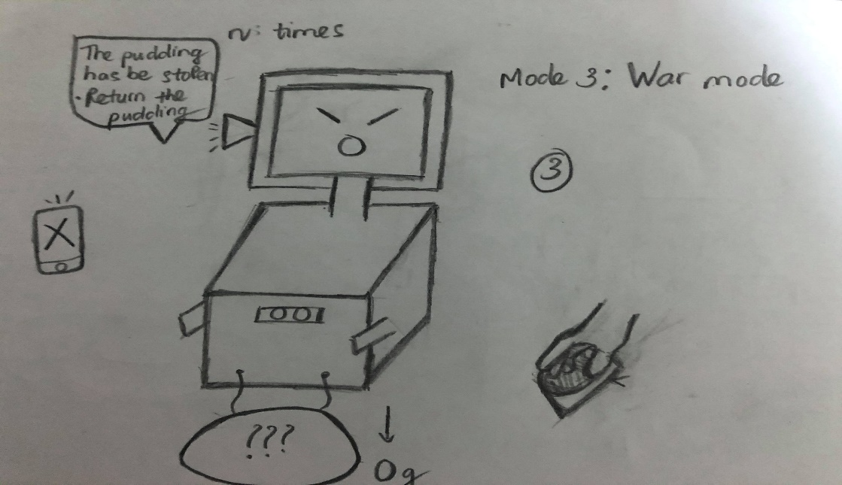
2 . How it works ?
He will know if someone tries to trick him by putting another object instead of the pudding back into place ( through weight sensor with high accuracy ) .

Slide 4
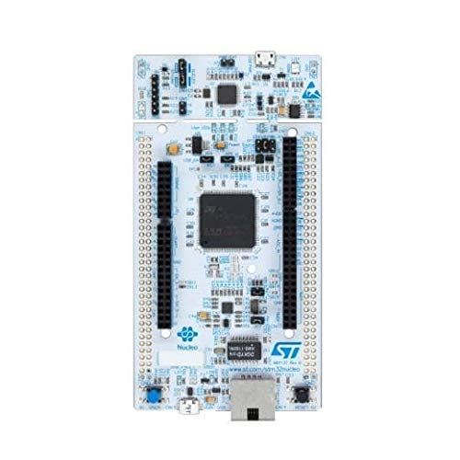
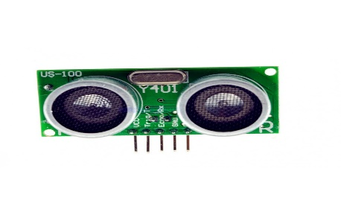
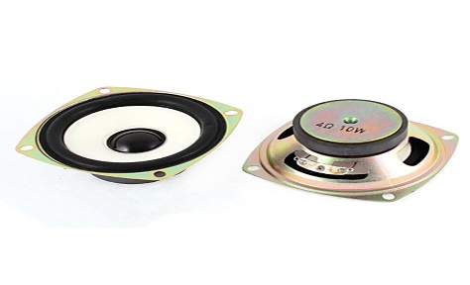
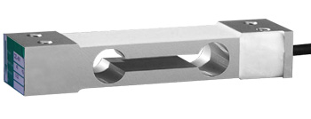
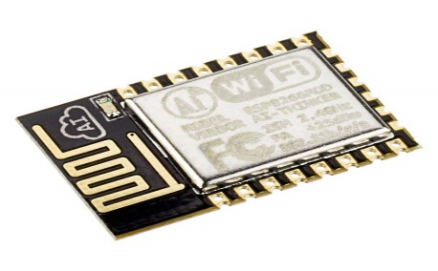
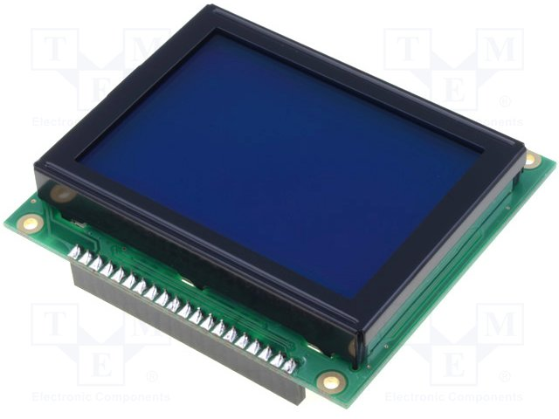
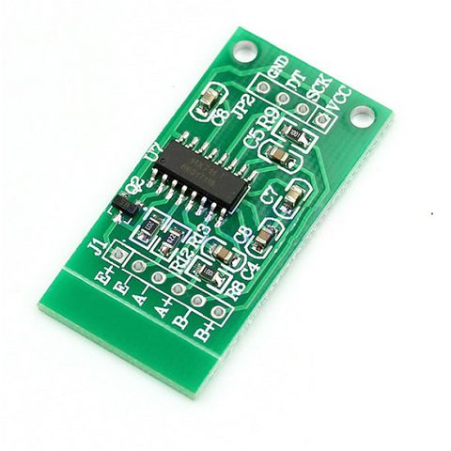
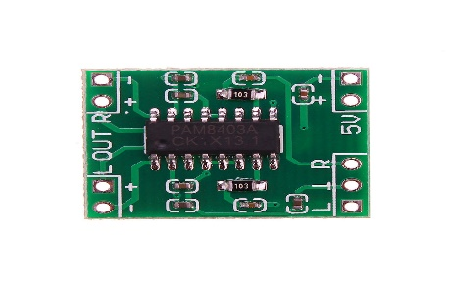
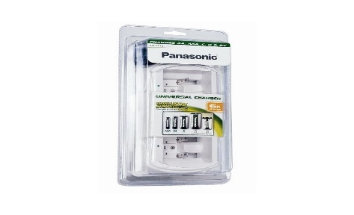
3 . Material :
- ARM board
- Ultrasonic sensor US- 100
- ISD1820
- Load Cell 700g
- Wifi module ESP8266
- GLCD 128x64
- ADC 24bit HX711
- Audio module
- 9V battery charger
LED , Breadboard , Resistors, Decorative accessories , …

Slide 5
4 . Process :
First week:
Solder all electronic components together and connect them to ARM board .
Write program for ARM board by using Keil uVision 5 and Cube .
Second week & Third week:
Write APP for smartphone by using App Inventor .
Test and improve the project .
Run Demo with Pudding , Drink cans , Snack(chocolate) , …
* Estimated time to complete the project and write report : 3 weeks .
s d f g h j k l z x c

Slide 6
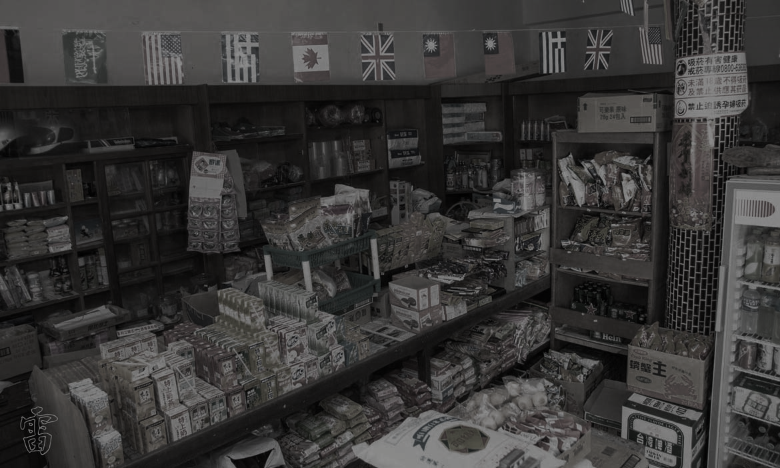
5. Future Development:
In the future, I hope that it can be applied to unmanned stores or grocery store. In addition to achieving the effect of supervision, it can also affect people's hearts through the lovely interaction of computers.

Slide 7
Thanks for Watching

