Slide 1



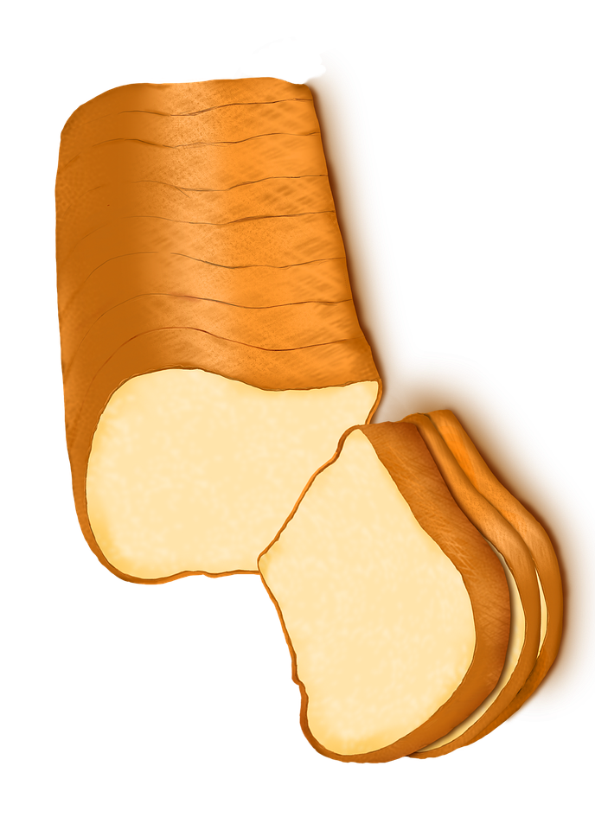
Fraction Grocery Cards
8
1
1

Slide 2




Fraction Grocery Cards

