Slide 1


Slide 2

Mini Project (01CE0609)
Semester 6
Review 1 (07/03/2026)
Student Performance Prediction Using Ml
Team ID: T_069
Team Member 1: Harsh Vadgama (92410103123) (EC3)
Team Member 2: Mayank Shukla (92410103121) (EC3)
Guided By
Internal Guide
Dr. Dhara Joshi
Department of Computer Engineering, Faculty of Engineering & Technology

Slide 3
Outline
Introduction
Problem Statement
Literature review by students
Project Objective
Project Methodology
Dataset Description
EDA(Exploratory Data Analysis
Expected Outcome

Slide 4
Introduction
Student performance prediction uses Machine Learning techniques to analyze academic and behavioral data of students. The objective is to identify patterns that influence student success and build predictive models that can estimate academic outcomes.

Slide 5
Abstract
This project focuses on predicting student academic performance using machine learning. Features such as study time, attendance, parental support, extracurricular activities, and past grades are used to train regression models. The data is preprocessed with normalization and encoding for better performance. Models are evaluated using MSE, MAE, RMSE, and R², showing high accuracy in predicting GPA. The results demonstrate that machine learning can help identify students needing support and assist educators in making informed decisions

Slide 6
Technology Used
Python
Python libraries such as numpy, pandas, sklearn, seaborn, matplotlib
Platform used – Google colab

Slide 7
Problem Statement
Educational institutions need effective methods to analyze large student datasets to identify factors affecting academic performance and predict student results early.

Slide 8
Literature Review
Ref no. | Author/Year | Title | Method | Dataset | Key Finding
[1] | Zhu (2024) | Prediction and Analysis of University Student Performance Based on ML | Random Forest | Academic records, tests, homework | RF predicted performance effectively; key factors were test scores and homework.
[2] | Vijayalakshmi & Venkatachalapathy (2019) | Predicting Student Performance using ML Algorithms | DNN, SVM, RF, KNN | Kaggle student dataset | Deep Neural Networks achieved highest accuracy (~84%).
[3] | Yekun & Teklay (2019) | Student Performance Prediction with Multilabel Ensemble | SVM, RF, KNN, MLP | High school academic dataset | Ensemble models improved prediction accuracy.
[4] | Sukanya & Albert (2023) | Predict Students Performance through ML | Supervised ML models | Demographic and academic attributes | ML helps identify at‑risk students.
[5] | Lyu (2023) | Academic Performance Prediction using Regression Models | Random Forest Regression | Student grades dataset | Regression models effectively predict grades.

Slide 9
Literature Review
Ref no. | Author/Year | Title | Method | Dataset | Key Finding
[6] | Cortez & Silva(2008) | Using Data Mining to Predict Secondary School Student Performance | Decision Tree, Random Forest, Naïve Bayes | Portuguese secondary school dataset including grades, family background, and lifestyle attributes | Study showed that student grades, study time, and failures were the most important predictors of academic performance.
[7] | Romero & Ventura(2010) | Educational Data Mining: A Review of the State of the Art | Various data mining and ML techniques | Multiple educational datasets including student activity logs and academic records | how data mining techniques can improve academic decision-making and student performance monitoring.
[8] | Pandey & Pal(2011) | A Data Mining View on Class Room Teaching Language | Naïve Bayes Classification | Student academic performance dataset | teaching language and classroom environment significantly influence student performance.
[9] | Hussain, Zhu, Zhang & Abid(2018) | Student Academic Performance Prediction Using Supervised Machine Learning | Logistic Regression, Decision Tree, Random Forest | University student academic dataset including attendance, quizzes, and assignments | Random Forest achieved the highest accuracy in predicting student academic outcomes.
[10] | Abu Saa(2016) | Educational Data Mining & Students Performance Prediction | Artificial Neural Networks | Student academic dataset with demographic and academic attributes | Neural networks were effective in identifying patterns that influence student performance and dropout risk.

Slide 10
Project Objectives
• Analyze student dataset
• Identify important factors affecting student performance
• Apply Machine Learning algorithms
• Predict student GradeClass or GPA

Slide 11
Proposed Methodology
1. Data Collection
2. Data Preprocessing
3. Exploratory Data Analysis
4. Feature Selection
5. Model Training (Using Linear Regression)
6. Model Evaluation

Slide 12
Dataset Description
Dataset includes features such as
Age
Student ID
Gender
Ethnicity
Parental Education
Study Time Weekly
Absences
Tutoring
ParentalSupport
Extracurricular activities
Sports
Music
Volunteering
GPA
GradeClass

Slide 13
Dataset Description
First 5 rows of dataset
Age | Gender | Ethnicity | Parental Education | Study Time Weekly | Absences | Tutoring | ParentalSupport | Extra curricular | Sports | Music | Volunteering | GPA | Grade Class
17 | 1 | 0 | 2 | 19.833723 | 7 | 1 | 2 | 0 | 0 | 1 | 0 | 2.929196 | 2.0
18 | 0 | 0 | 1 | 15.408756 | 0 | 0 | 1 | 0 | 0 | 0 | 0 | 3.042915 | 1.0
15 | 0 | 2 | 3 | 4.210570 | 26 | 0 | 2 | 0 | 0 | 0 | 0 | 0.112602 | 4.0
17 | 1 | 0 | 3 | 10.028829 | 14 | 0 | 3 | 1 | 0 | 0 | 0 | 2.054218 | 3.0
17 | 1 | 0 | 2 | 4.672495 | 17 | 1 | 3 | 0 | 0 | 0 | 0 | 1.288061 | 4.0

Slide 14
Dataset Description
Target Variable : GPA
Reason for choosing GPA over GradeClass.
 | count | mean | std | min | 25% | 50% | 75% | max
GradeClass
0.0 | 107.0 | 3.102942 | 0.946137 | 0.214570 | 2.562795 | 3.548460 | 3.694455 | 4.000000
1.0 | 269.0 | 3.001673 | 0.630402 | 0.000000 | 3.055254 | 3.167455 | 3.332789 | 3.572945
2.0 | 391.0 | 2.659742 | 0.378969 | 0.557549 | 2.590990 | 2.712230 | 2.851936 | 3.597766
3.0 | 414.0 | 2.215545 | 0.361295 | 0.000000 | 2.122740 | 2.238196 | 2.377751 | 4.000000
4.0 | 1211.0 | 1.208041 | 0.547875 | 0.000000 | 0.816809 | 1.247482 | 1.626695 | 3.979421
We have grouped statistical summary for GPA and GradeClass.
Reason to choose GPA over Grade class is that GradeClass is dependent on GPA.
As GradeClass increases , GPA(mean) value decreases.
It shows negative correlation between columns.

Slide 15
EDA
Exploratory data analysis

Slide 16
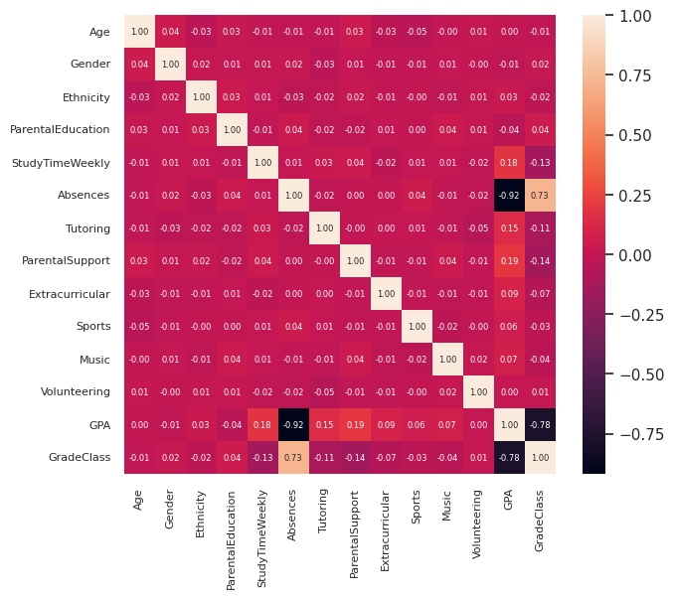
Correlation matrix (Heatmap)

Slide 17
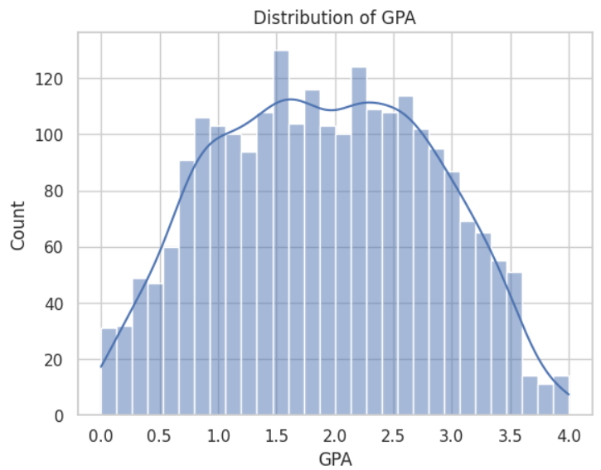
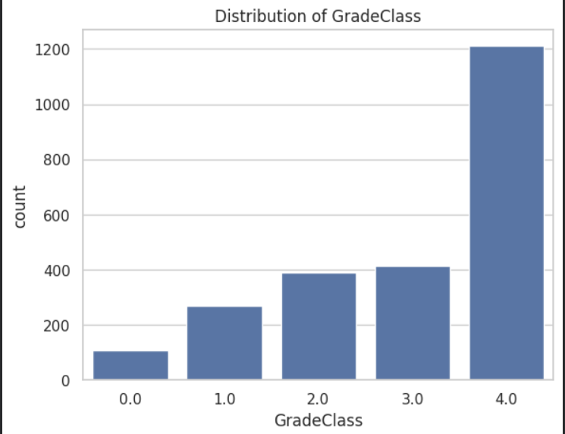
Distribution of GPA and GradeClass

Slide 18
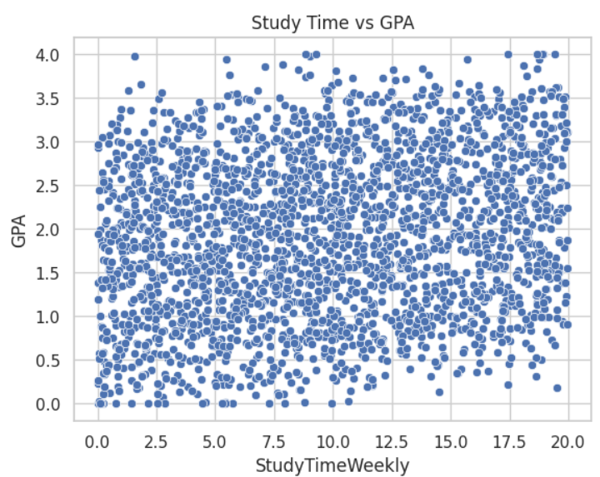
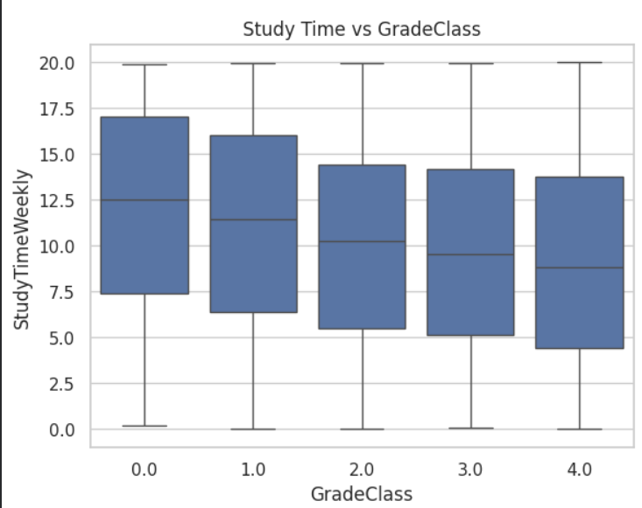
Study Time VS GPA and GradeClass

Slide 19
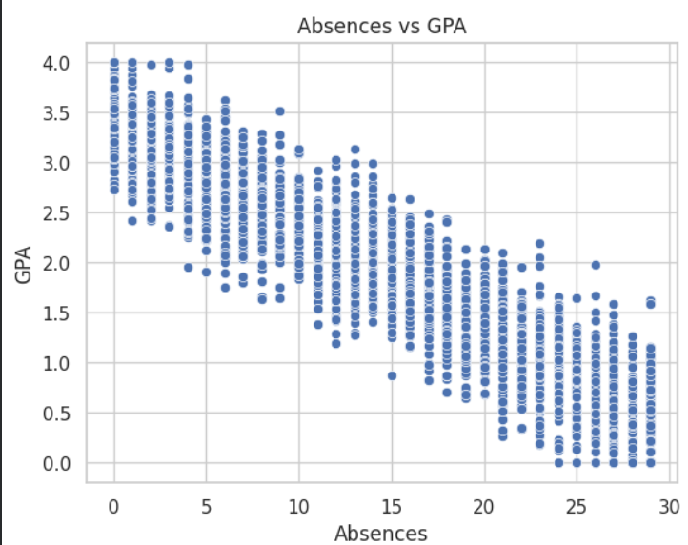
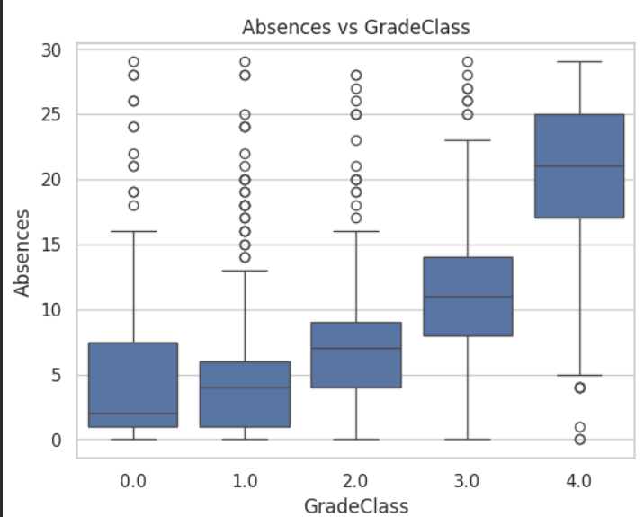
Absences VS GPA and GradeClass

Slide 20
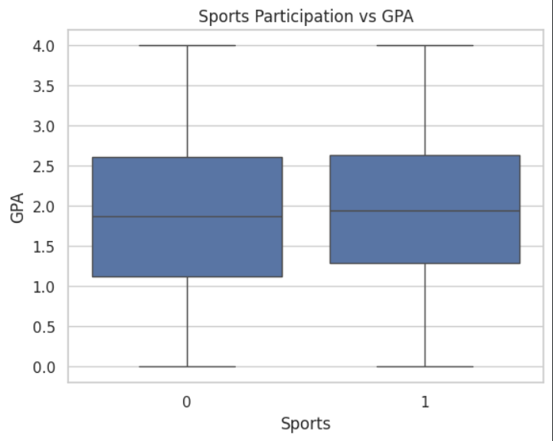
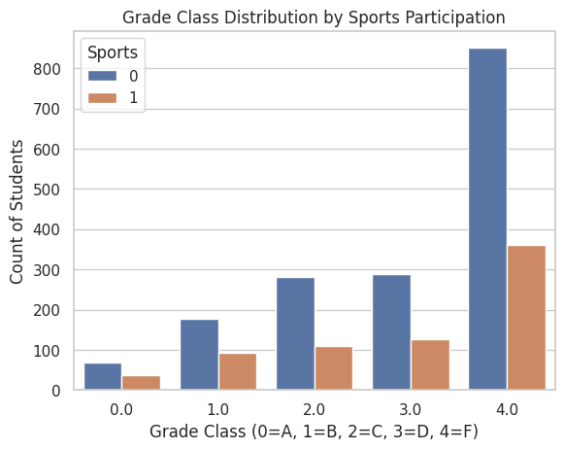
Sports Participation VS GPA and GradeClass

Slide 21
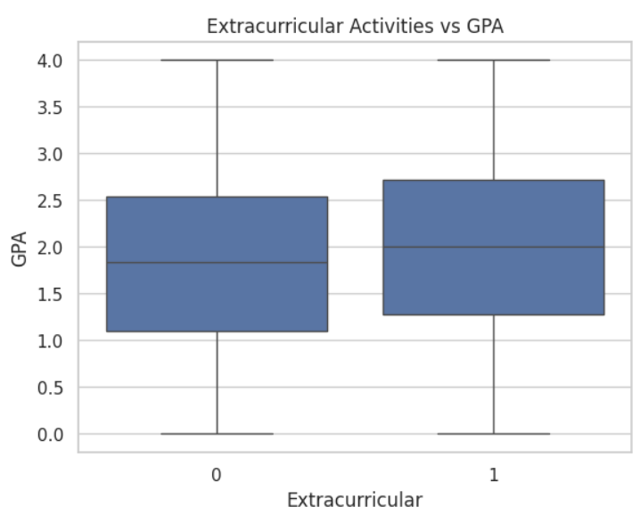
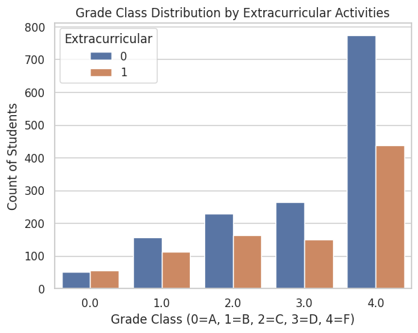
Extracurricular activities VS GPA and GradeClass

Slide 22
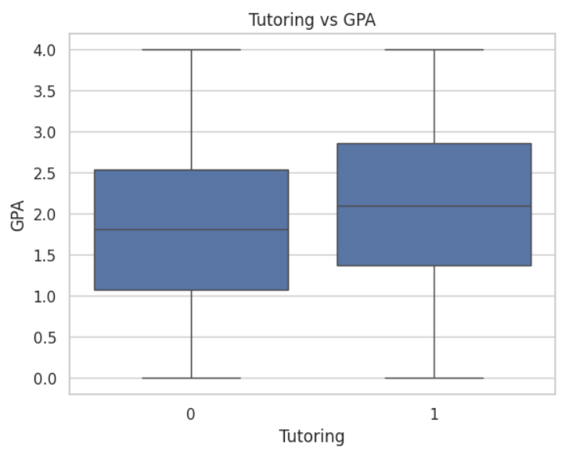
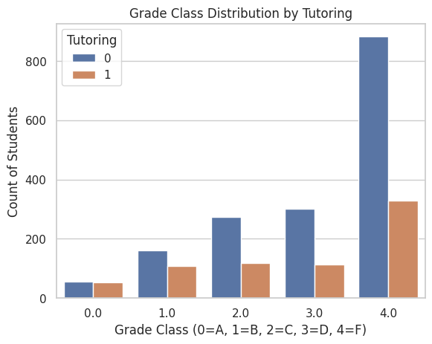
Tutoring VS GPA and GradeClass

Slide 23
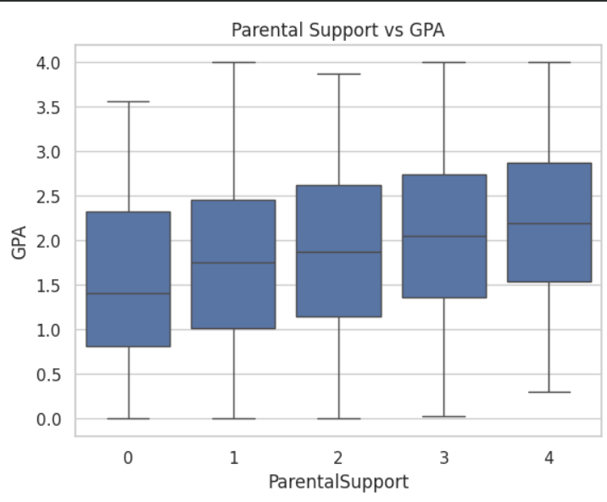
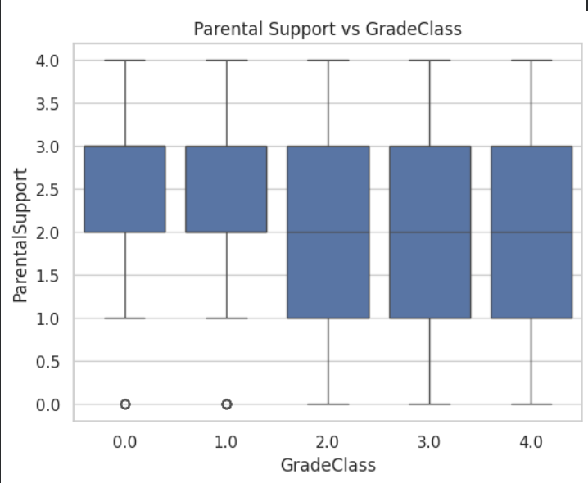
Parental Support VS GPA and GradeClass

Slide 24
Expected Outcome
The system will predict student academic performance using machine learning models and identify the key factors affecting student success.
Model will predict the GPA and based on value of GPA we can apply condition and classify student in GradeClass
Stuent_Performance_Data -> GPA(predicted) -> GradeClass

Slide 25
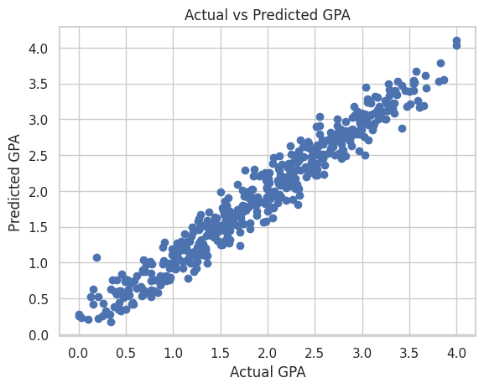
Actual vs predicted
Testing Data Error
MSE: 0.03866144149454257
MAE: 0.15529483485748097
R2 Score: 0.9532471681022928
RMSE: 0.19662512935670906
Training Data Error
MSE: 0.038497064610156735
MAE: 0.15918013522226315
R2 Score: 0.9541479286300485
RMSE: 0.1962066884949561

Slide 26
Review 1 Complete

Slide 27
Comments of review 1
Balanced the dataset => Used Different models 1) Random forest regressor 2) Decision tree regressor
Compared the accuracy between models to find the best one

Slide 28
Review 2

Slide 29
Method used for balancing dataset
Sinse the GPA is continuous variable , this problem was treated as a regression problem. So instead of oversampling or undersampling a “weighted balancing approach” was used.
This method assigns higher importance to underrepresented GPA groups and lower importance to overrepresented GPA groups during model training.
Steps to balance dataset :
Step 1: Convert GPA into Categories
To balance the target distribution, GPA was grouped into 3 categories:
Low → GPA < 2.0
Medium → 2.0 ≤ GPA < 3.0
High → GPA ≥ 3.0
This created a new column: “GPA_Category”

Slide 30
Method used for balancing dataset
Step 2: Count Students in Each Category
Example category distribution:
high → 292 students
Medium → 900 students
low → 1200 students
This shows that High GPA students are more frequent, while Low GPA students are fewer
Step 3: Assign Sample Weights
Weights were assigned using inverse frequency weighting:
Weight = 1 / Number of students in that GPA category
This means:
More students in category → lower weight
Fewer students in category → higher weight

Slide 31
Method used for balancing dataset
Example from Dataset
Suppose a student has:
StudentID: 1003
GPA: 0.112602
Since GPA < 2.0, this student belongs to:
Low GPA Category
If:
Low GPA students = 292
Then the weight becomes:
Weight = 1 / 292 = 0.00342
After normalization, this weight becomes relatively higher than average, so this student gets more importance during model training.

Slide 32
Balanced dataset
Dataset after applying balancing approach
Age | Gender | Ethnicity | ParentalEducation | StudyTimeWeekly | Absences | Tutoring | ParentalSupport | Extracurricular | Sports | Music | Volunteering | GPA | GradeClass | GPA_Category | sample_weight
17 | 1 | 0 | 2 | 19.833723 | 7 | 1 | 2 | 0 | 0 | 1 | 0 | 2.929196 | 2 | Medium | 1.000418
18 | 0 | 0 | 1 | 15.408756 | 0 | 0 | 1 | 0 | 0 | 0 | 0 | 3.042915 | 1 | High | 2.483904
15 | 0 | 2 | 3 | 4.21057 | 26 | 0 | 2 | 0 | 0 | 0 | 0 | 0.112602 | 4 | Low | 0.62585
17 | 1 | 0 | 3 | 10.028829 | 14 | 0 | 3 | 1 | 0 | 0 | 0 | 2.054218 | 3 | Medium | 1.000418
17 | 1 | 0 | 2 | 4.672495 | 17 | 1 | 3 | 0 | 0 | 0 | 0 | 1.288061 | 4 | Low | 0.62585
We have not removed any column or data nor changed any data in the dataset
We have Added a new column at last “sample_weights” based on target variable GPA

Slide 33
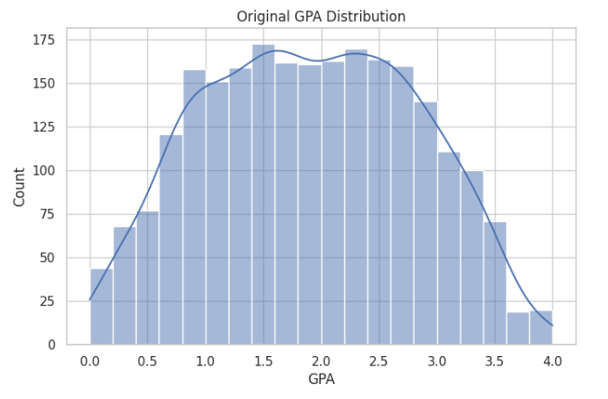
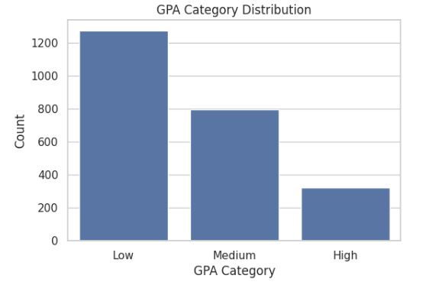
Distribution

Slide 34
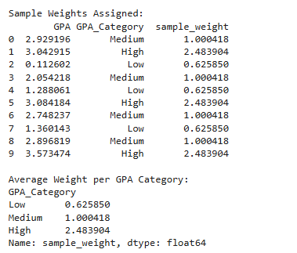
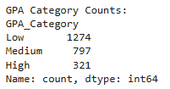
Distribution

Slide 35
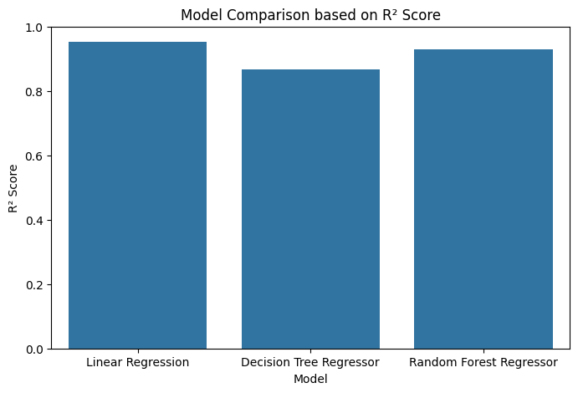
R2 score based comparison

Slide 36
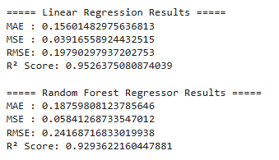
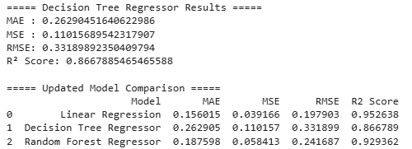
Results
Results after applying models to balanced dataset

Slide 37
conclusion
Since the GPA column of our dataset is continuous , absence and GPA columns having strong negative correlation with value -0.92, linear regression is working fine and it is best model for our project and dataset while other two models were not performing as expected because of nature of the data so we can now use linear regression model to predict student data.
Now we can finally say that our model is properly configured to predict the exact outcome for specific inputs to identify which student need the academic support and for those who are already performing well, we can plan accordingly for their future enhancements

Slide 38
Future Enhancement
For Future enhancement we can do as follows -:
Deploy model in web
We can add container for users to input values according to our dataset and then the model will predict and display the output in the same container.
Take .csv or .xlsx file as input and generate the prediction report in output

Slide 39
References
[1] X. Zhu, “Prediction and Analysis of University Student Performance Based on Machine Learning,” *Academic Journal of Computing & Information Science*, vol. 7, no. 8, pp. 74–78, 2024. [Online]. Available: https://www.francis-press.com/index.php/papers/16850 :contentReference[oaicite:0]{index=0}
[2] V. Vijayalakshmi and K. Venkatachalapathy, “Comparison of Predicting Student’s Performance using Machine Learning Algorithms,” *Int. J. Innov. Sci. Adv. Technol.*, vol. 11, no. 12, pp. (if available), 2019. [Online]. Available: https://www.mecs-press.org/ijisa/ijisa-v11-n12/v11n12-4.html
[3] E. A. Yekun and A. Teklay, “Student Performance Prediction with Optimum Multilabel Ensemble Model,” *arXiv*, 2019. [Online]. Available: https://arxiv.org/abs/1909.07444
[4] S. Sukanya and D. William Albert, “A Novel Approach to Predict Students Performance through Machine Learning,” *Int. J. Eng. Technol. Manag. Sci.*, vol. 7, no. 5, pp. (if available), 2023. [Online]. Available: https://ijetms.in/Vol-7-issue-5/Vol-7-Issue-5-32.html
[5] S. Lyu, “Student’s Academic Performance Prediction Based on Machine Learning Regression Models,” in *Proc. 2023 Int. Conf. on Image, Algorithms and Artificial Intelligence (ICIAAI 2023)*, Advances in Computer Science Research, Atlantis Press, pp. 293–299, 2023. doi: 10.2991/978-94-6463-300-9_29. [Online]. Available: https://www.atlantis-press.com/proceedings/iciaai-23/125994553 :contentReference[oaicite:1]{index=1}
[6] A. Cortez and A. M. Silva, “Using Data Mining to Predict Secondary School Student Performance,” UCI Machine Learning Repository (Dataset). [Online]. Available: https://archive.ics.uci.edu/ml/datasets/student+performance
[7] C. Romero and S. Ventura, “Educational Data Mining: A Review of the State of the Art,” *Computers & Education*, vol. 53, no. 3, pp. 601–618, 2010. [Online]. Available: https://www.sciencedirect.com/science/article/pii/S0360131509002688

Slide 40
References
[8] U. K. Pandey and S. Pal, “A Data Mining View on Classroom Teaching Language,” in *Proc. IEEE Int. Conf. on Education and e-Learning Innovations*, 2011. [Online]. Available: https://ieeexplore.ieee.org/document/5942358
[9] M. Hussain, W. Zhu, W. Zhang, and S. Abidi, “Student Academic Performance Prediction Using Supervised Machine Learning,” *Applied Computing and Informatics*, vol. 14, no. 1, pp. 27–36, 2018. [Online]. Available: https://doi.org/10.1016/j.aci.2018.05.001
[10] A. Abu Saa, “Educational Data Mining & Students Performance Prediction,” 2016. [Online]. Available: https://www.researchgate.net/publication/307987164

Slide 41
Q&A

Slide 42


