Slide 1
ParkingMap
Jehezkiel Eugene | Vincent Surja | Nathania Hendradjaja | Ryan Lam

Slide 2
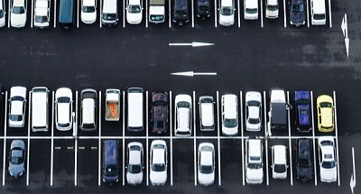













Slide 3













Bitmapping.
at this stage, the bitmapping process is manual.

Slide 4










Bitmapping.
at this stage, the bitmapping process is manual.

Slide 5
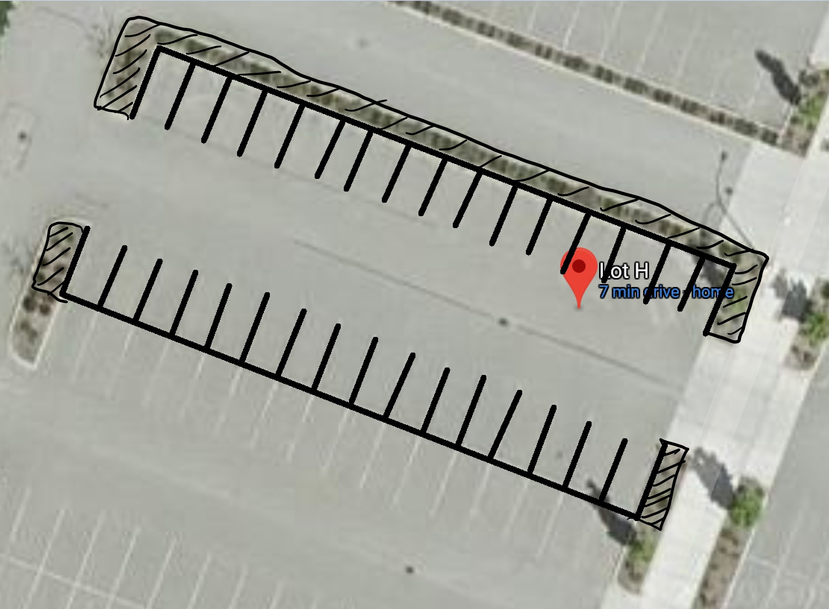


Slide 6
