Slide 1
Edu Hub
An interactive students community

Slide 2
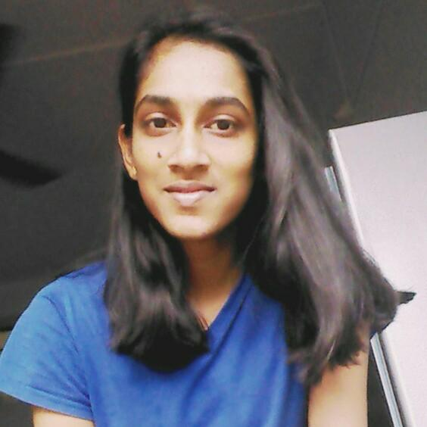


Team

Slide 3
Use Case:
Creating a students community to aid each other:
Since the virtualization of education has boosted up students have lost good experience of discussion among the peers.
We take this as an opportunity to bring back the culture in educational institutes by providing a proper channel to have interactions.
We believe this would bring back various behaviors like kindness, competitiveness, and improve their confidence through effective communication.

Slide 4
Blogs
Teachers
Ecosystem
Students
EDU HUB
Competitions
Doubts forum
Intra/Inter-school events
Performance Metrics

Slide 5
Solutioning
Easy to use webapp:
We aim in providing an simple web interface for the students to hover upon. The user gets authenticated with his/her school id and a custom password. The admins/teachers are provided with governance and validation functionalities.
Questions forum:
We provide students an environment to ask and answer doubts among each other anonymously. To encourage this helping behavior among them we are introducing point system where student gets a point to every accepted correct answer he provides. This also brings a competitiveness among them to provide maximum answers.
Performance metrics:
Introducing the performance measuring portal of the students for their own retrospection. A tabular and graphical representation of the leaderboard of an event or contribution of students can be seen.
Blogs:
Students can write blogs and other content to showcase an idea or schools can publish any content series/newsletter on the same. This would also bring the parental community closer to the school organization

Slide 6
Schema diagram
Forum
->User_ask_id
->Question_id
->Questions
->Answers
->Answer_id
->User_ans_id
Student
->Id
->Name
->School
->Standard
->Parent_Id
Score
->User_id
->Score
->Timestamp
Competition
->Event
->Event_id
->User_id
->Score
Parents
->Id
->Stud_Id
->Name
Blogs
->Post_id
->Author_id

Slide 7
User Interface
Hi xyz
Forum | Blogs | Leaderboard
LOGIN
Username
Profile
Activities
Password
Login Screen
Home screen

Slide 8

Forum
Blog Corner
News letter | Tech news | Stud Corner
search
My Questions
Post Abc
Questions
Leaderboard
Abc event
Ratings
Event
Forum
Blog
Leaderboard

Slide 9
Solutioning
For the initial round we have created a basic prototype of our idea. We have created a flask based web application to depict our perspective. Our webapp consists of four modules .
A user Login for the governance of the individuals. This also creates a personalized profile and choices instead of a common school based website.
A home screen module where the user can view his personal scores, standings and other metrics. He can also move to the other pages with the options present in the navigation bar on the top. Home screen also provides with the graphical representations of the users metrics.
Forum Page in which the users can communicate by sharing their doubts and replies, and hence building a social bonding along with improving helpful behavior.
Blog corner, a place to post their personal thoughts and ideas. This is aimed in extroverted behavior of the students and encourages them to help in giving inputs to others ideas.
Leaderboard page gives an insight on the scores of the students and their current ranking . This could be also used in inter and intra school level to increase the competitiveness in them.

Slide 10
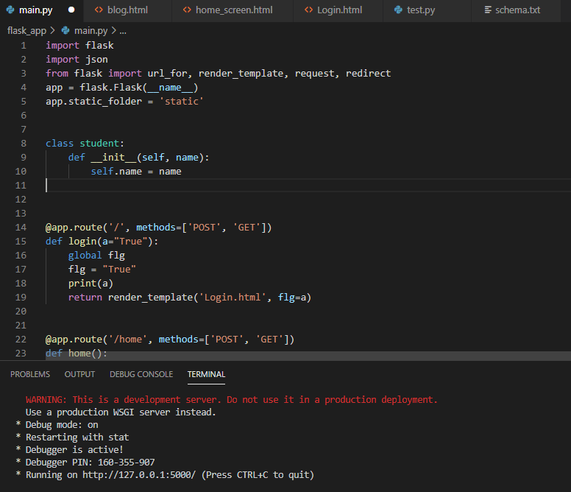
Screen shots
Flask App

Slide 11
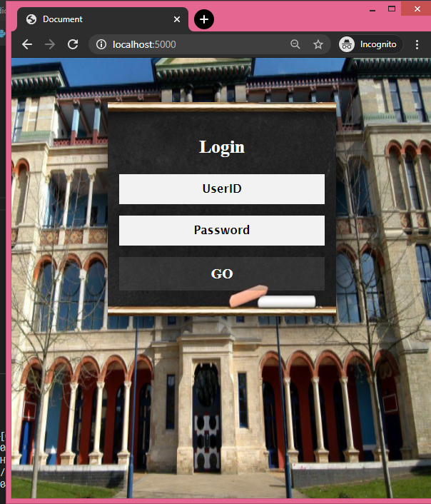
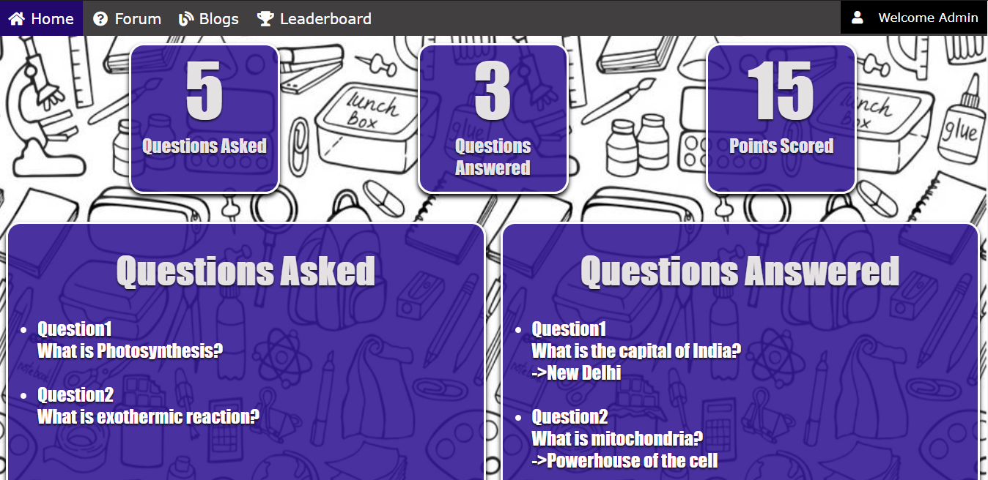
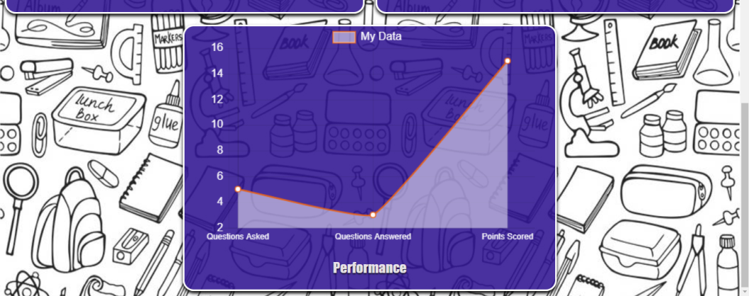
Screen shots
Login screen
Home Screen

Slide 12
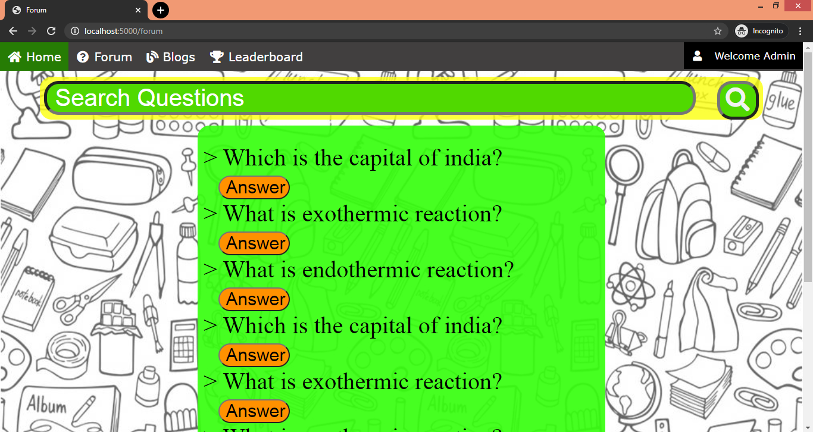
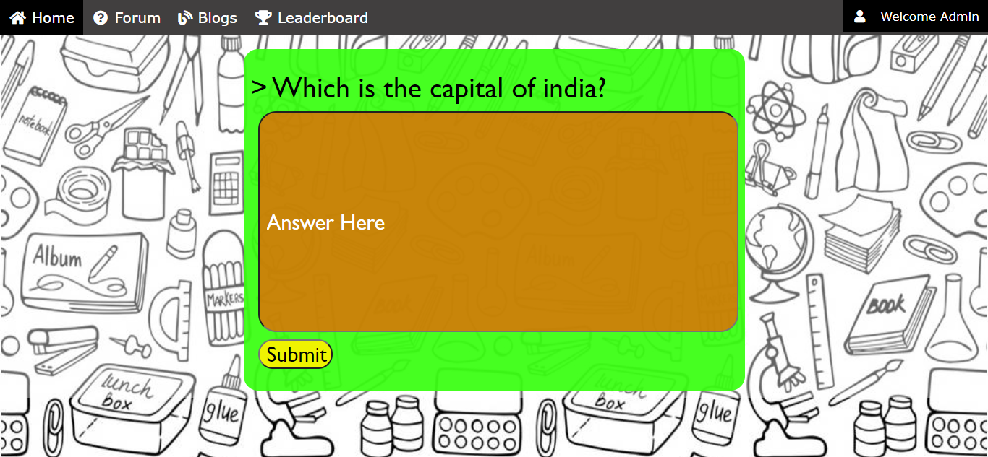
Screen shots
Forum Screen
Forum answer Screen

Slide 13
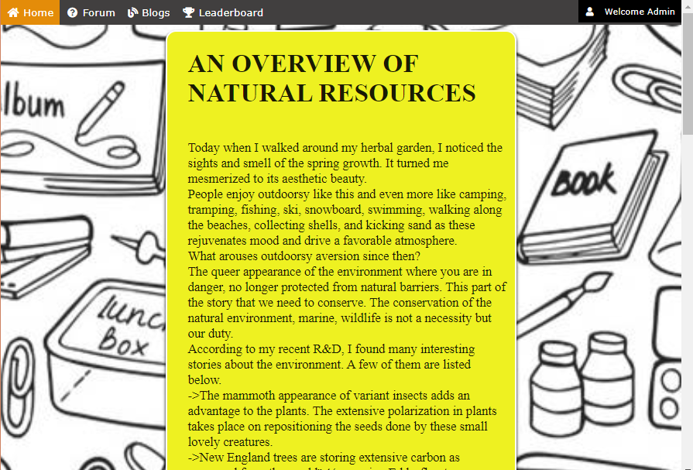
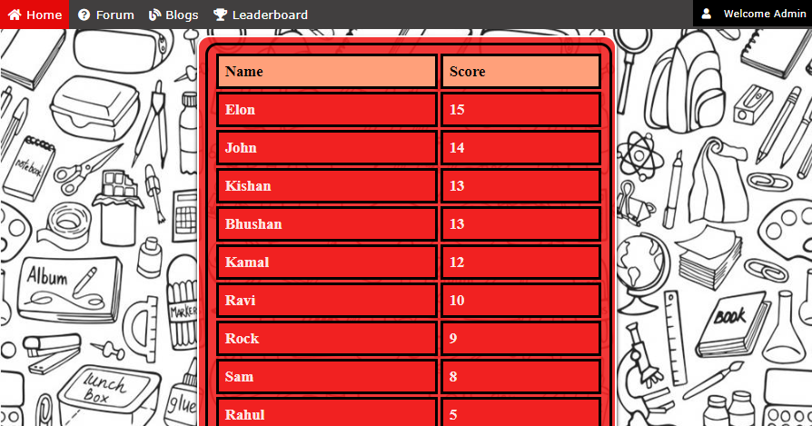
Blog Screen
Blog Screen

Slide 14
We are working on improving and adding more features in our idea. Find the project updates in the following github repo.
Git Hub Link:
https://github.com/jokercoder100/SlashHack
THANK YOU_

