Slide 1





Multi-Level Clustering Technique Leveraging Expert Insight
Sarthak Ahuja
IBM Research
Ritwik Chaudhuri
IBM Research
Manu Kuchhal
IBM Research
Gyana Parija
IBM Research
Shudhanshu Singh
IBM Research

Slide 2
Outline
Introduction
Business Context
Methodology
Multilevel clustering
Splitting and Merging of data
Case study for Recruitment Process Benchmarking

Slide 3
Motivation
In industry and academia, recruitment of new candidates is often a prolonged process, which usually involves multiple steps - creating a job requisition, approving the requisition, collecting applications, manual screening of applications to select a smaller subset of applicants, interviewing applicants, and finally making a decision to form a list of candidates to whom the offers are extended.
There are industry benchmarks for each of these stages, and organizations strive to meet those.
An interesting feature about these benchmarks is that are they are uniform over all job families in the industry leading to cases where for some job positions, these benchmark thresholds are met comfortably while for some others, they turn out to be too aggressive.
One benchmark threshold set over all jobs does not suffice, making it important to have different benchmarks for similar jobs within a particular industry. In order to set the described benchmarks, it is important to cluster similar jobs together.
Notes:
Since the recruitment process is divided into several stages, any delay incurred in one of these stages culminates into a delay in the overall recruitment process. To prevent such delays, there are industry benchmarks set for each company, but more often than not are failed to be met.

Slide 4
Motivation
State of the art clustering algorithms operate well on numeric data but for textual data rely on conversion to numeric representation.
This conversion is done by adopting approaches like TFIDF, Word2Vec, etc. and require large amount of contextual data to do the learning. Such contextual data may not be always available for a given domain.
We propose a novel algorithm that incorporates Subject Matter Experts’ (SME) inputs in lieu of contextual data to be able to do effective clustering of a mix of textual and numeric data.
We present the results from a Recruitment Process Benchmarking case study on data from multiple jobs. We applied the proposed technique to create suitable job categories for establishing benchmarks. This approach provides far more meaningful insights than traditional approach where benchmarks are calculated for all jobs put together.
We leverage Apache Spark for the implementation of the clustering methodologies.

Slide 5
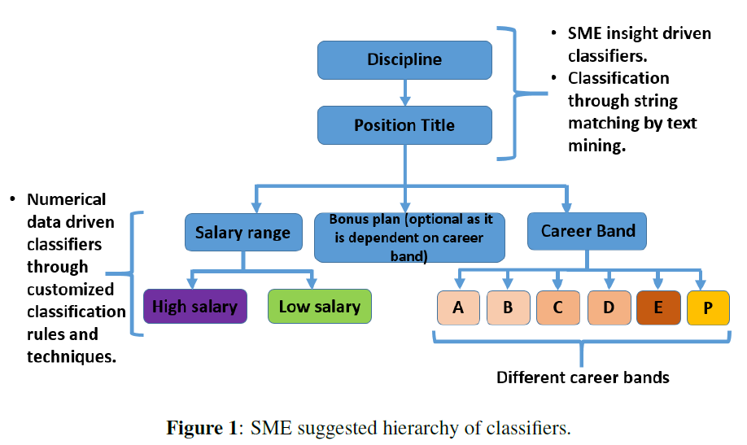
Clustering Methodology – Flow Diagram
Clustering jobs into similarity cluster is a non-trivial problem. In an industry, there could be jobs within a discipline which fall in different classes but also jobs from different disciplines which are similar to each other and hence should be analyzed together.
A job is defined by several parameters such as job description, position title, career band level, bonus type, discipline, business group, salary range, geo etc.
SME suggested hierarchy for job clustering include discipline, position title, salary range, career band and bonus type in the descending order of importance. The use of bonus plan as an attribute remains optional as it is dependent on Career Band.
The novelty of our work is based on two fundamental and efficient customized clustering techniques which can be used to cluster jobs. We test our methodology on a real data set and carry out a qualitative analysis of the results obtained by seeking feedback from the SME.

Slide 6
Basic Methodology Used For Clustering
Clustering with multiple qualitative and quantitative attributes
“K” Level divisive clustering based on attribute importance order.
Re merging of divisive clusters based on cluster distances
Sequential merging
Clique based merging
The novelty of the proposed methods can be used in different domains of clustering problems where some sort of prior information on the similarity of the data instances is provided to supervise the clustering technique.

Slide 7
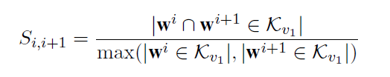
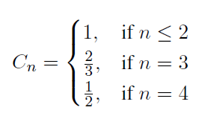

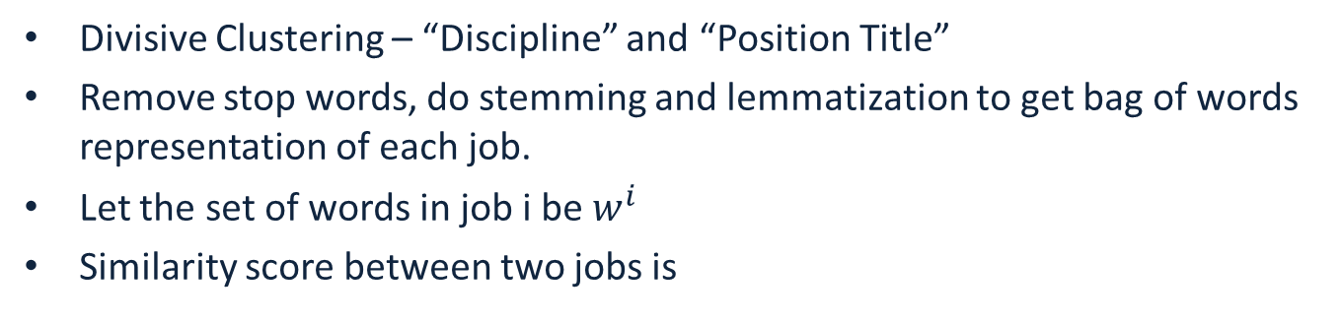
Similarity Among Qualitative Variables
Divisive Clustering – “Discipline” and “Position Title”
Remove stop words, do stemming and lemmatization to get bag of words representation of each job.
Let the set of words in job i be $w^{i}$
Similarity score between two jobs is
In general we say that two jobs are close enough if the similarity between them is more than a certain threshold.

Slide 8
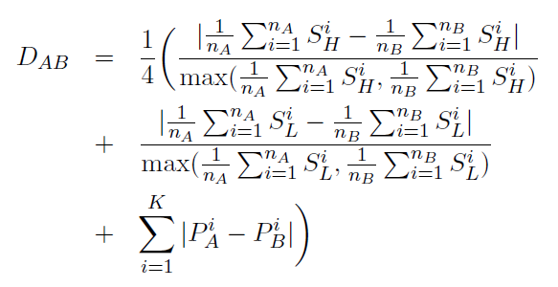
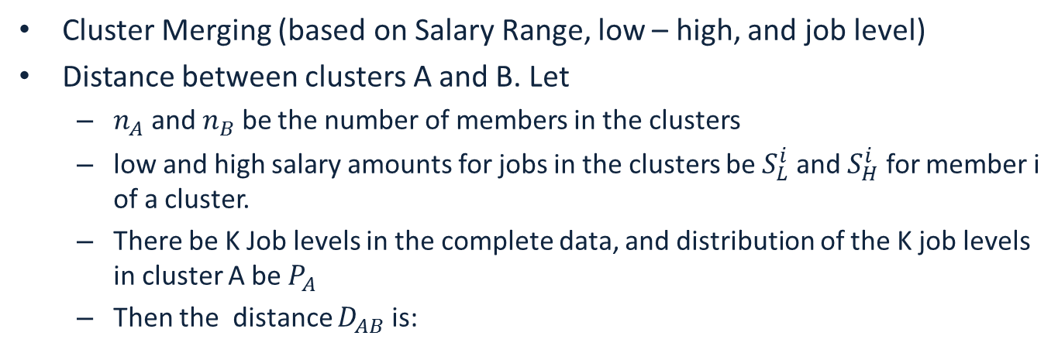
Similarity Among Clusters
Cluster Merging (based on Salary Range, low – high, and job level)
Distance between clusters A and B. Let
$n_{A}$ and $n_{B}$ be the number of members in the clusters
low and high salary amounts for jobs in the clusters be $S_{L}^{i}$ and $S_{H}^{i}$ for member i of a cluster.
There be K Job levels in the complete data, and distribution of the K job levels in cluster A be $P_{A}$
Then the distance $D_{AB}$ is:

Slide 9
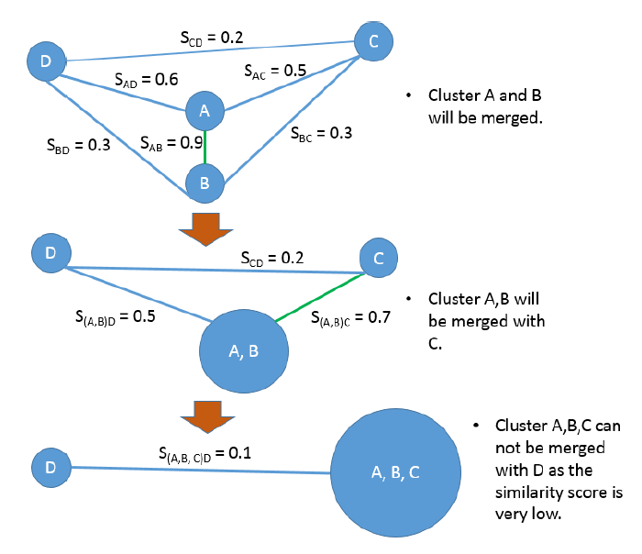
Sequential Merging Approach

Slide 10
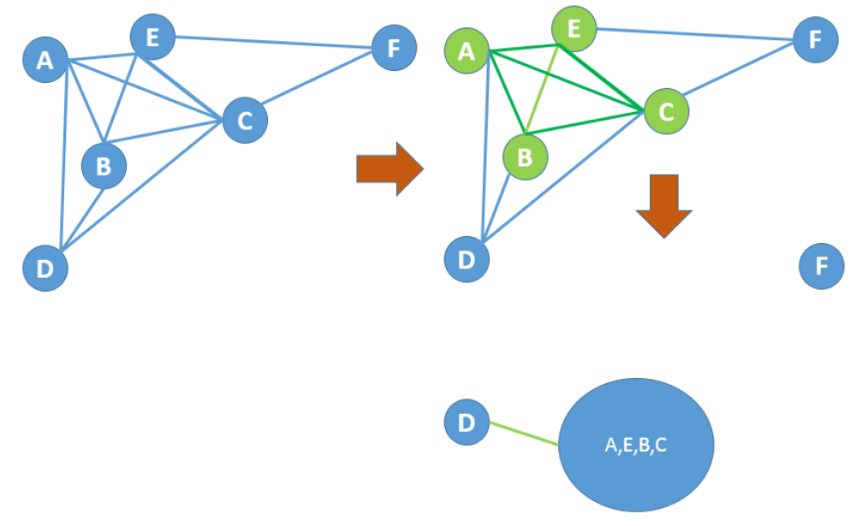
Clique Based Merging Approach

Slide 11
Merging of Clusters
Intra level merging:
Merge second level clusters within the same first level cluster.
Similarity scores are recomputed after each merge.
Inter level merging:
Merge second level clusters across different first level clusters.
Similarity scores are recomputed after each merge.

Slide 12
Complexity and Reason For Leveraging Apache Spark
The complexity of the customized algorithm grows with the number of job families and also with the number of different jobs discipline and job positions.
Essentially, if the number of different jobs are n, then the computation complexity of the customized algorithm is O(n⁴).
Hence for large enough n, which is usually the case, it is essential to parallelize the customized algorithm in an efficient manner to execute the clustering methodology in a reasonable time frame.
The parallelization of the algorithm is done leveraging Spark capabilities. Spark essentially parallelizes the basic operations such as addition, subtraction, multiplication, division, counting, returning query results in an efficient inherent way when the data is stored in the form of a Resilient Distributed Datasets (RDDs).

Slide 13
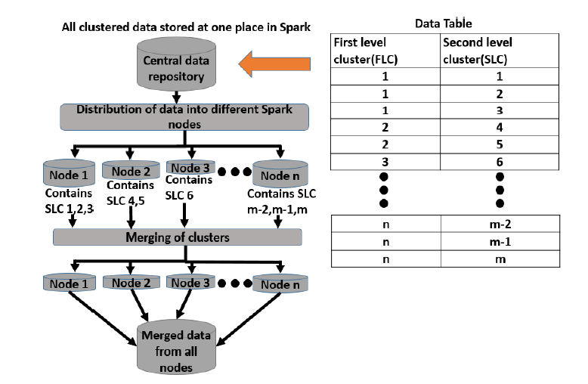
Complexity and Reason For Leveraging Apache Spark

Slide 14
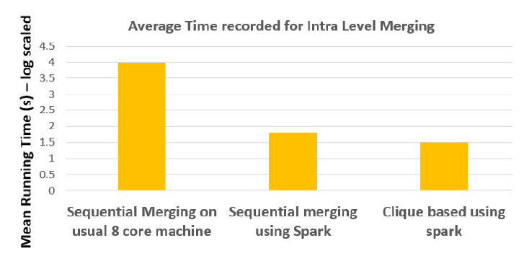
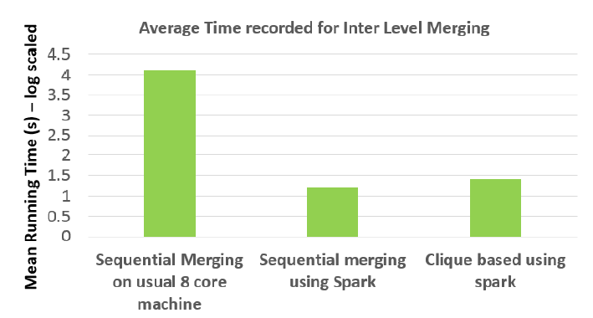
Experiments
247000 data points – 16 first level clusters, 512 second level
Sequential merging – 191 second level clusters after intra merging, 60 after inter
Clique based merging – 190 second level clusters after intra, 60 after inter

Slide 15
Case Study – Recruitment Process Benchmarking
Number of days to close a requisition
Number of days between approval of requisition to opening to the requisition
Number of days between creation of requisition to approval of the requisition
Proportion of applications received for a requisition to screened
Proportion of candidates called for interview to screened
Proportion of candidates rejected in the interview to number of candidates called for the interview
Proportion of candidates rejected an offer to the number of candidates to which offers were extended.

Slide 16
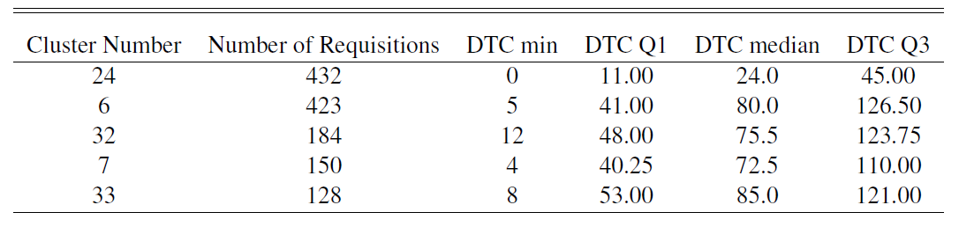
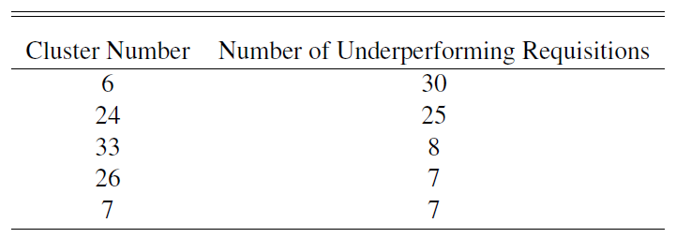
Case Study – Recruitment Process Benchmarking
Cluster the jobs
Establish benchmarks over last two years
Identify bad clusters based on benchmark violation over last 3 months

Slide 17
Conclusion
Multilevel Hierarchical clustering approach produces good results when SME input on feature importance hierarchy is available.
The approach proposed here involves
Dividing the data into multiple similarity groups based on attribute importance hierarchy
Re Clustering the clusters formed based on other variables as directed by SMEs
The clustering can be done either sequentially or with a clique based approach.
Parallelization with spark speeds up the clique based approach, and provides a little benefit for the sequential approach.
Benchmarks created at cluster level can help precisely point out what job requisitions are truly trailing in terms of recruitment process.

