Slide 1


#VisualHashtags
Visual Summarization of Social Media Events using Mid-Level Visual Elements
Sonal Goel (IIIT-Delhi), Sarthak Ahuja (IBM Research, India), A.V. Subramanyam (IIIT-Delhi), Ponnurangam Kumaraguru (IIIT-Delhi)
ACM Multimedia 2017

Slide 2
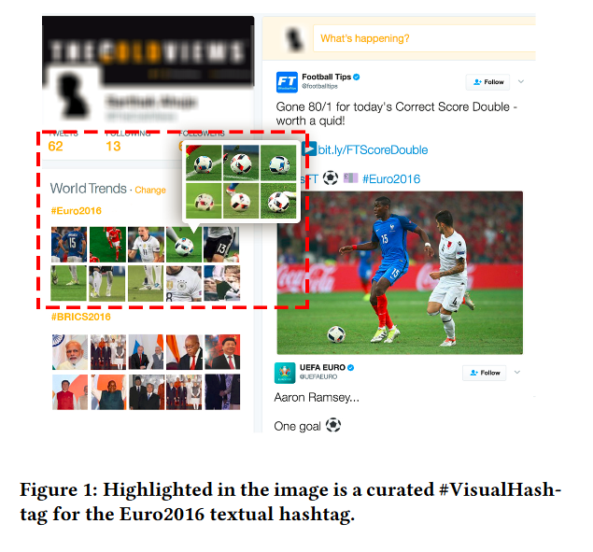
Introduction
The data generated on social media sites grows at an increasing rate with more than 36% of tweets containing images
We aim to discover #VisualHashtags, i.e., meaningful patches that can become the visual analog of a regular text hashtag that Twitter generates
These the entities which are both representative and discriminative to the target dataset besides being human-readable and hence more informative
Our core novelty –
a novel pipeline to summarize images from social media events instead of the conventional method of only identifying key-images to represent the event.
Our approach includes a multi-stage filtering process which when coupled with the basic methodology to discover mid-level visual elements leads to an improvement in coverage over existing methods.

Slide 3
Prior Art
Work on Social Media Image Dataset Summarization
Schinas et al. use both tweets and images to summarize an event. My reveal topics from a set of tweets as highly connected messages in a graph, whose nodes encode messages and whose edges encode their similarities. Finally, the images that best represent the topic are selected based on their relevance and diversity.
Cavalin et al. propose a social media imagery analytics system that processes and organize the images in more manageable way by removing duplicate, near-duplicate images and clustering images having similar content
Work on Image Dataset Summarization at Patch Level
Doersch et al. collect data from Google Street View of different cities, and aim to automatically and the visual patches like windows, balconies, and street signs, that are most distinctive for a certain geo-spatial area.
Rematas et al. propose data-mining approach for exploring image collections by interesting patterns that use discriminative patches and further show the results on Pascal VOC and Microsoft COCO datasets.

Slide 4
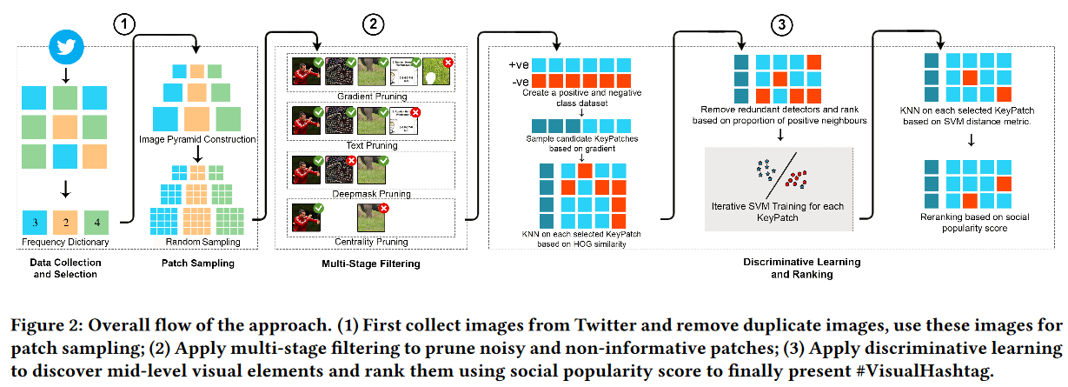
Methodology
1
2

Slide 5
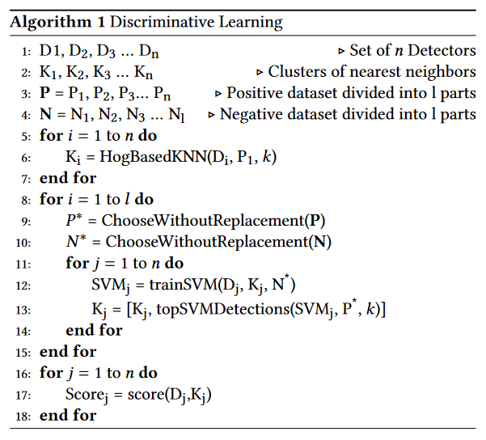

Algorithm
score_{i} is the score of the detector
n is the number of nearest neighbors,
c is the class of the nearest neighbor (1 for negative, 0 for positive),
S_{j} is the frequency (number of duplicates) of the image to which the patch belongs.

Slide 6
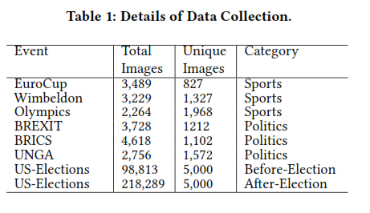
Dataset
The data generated on social media sites grows at an increasing rate with more than 36% of tweets containing images
We aim to discover #VisualHashtags, i.e., meaningful patches that can become the visual analog of a regular text hashtag that Twitter generates
These the entities which are both representative and discriminative to the target dataset besides being human-readable and hence more informative

Slide 7
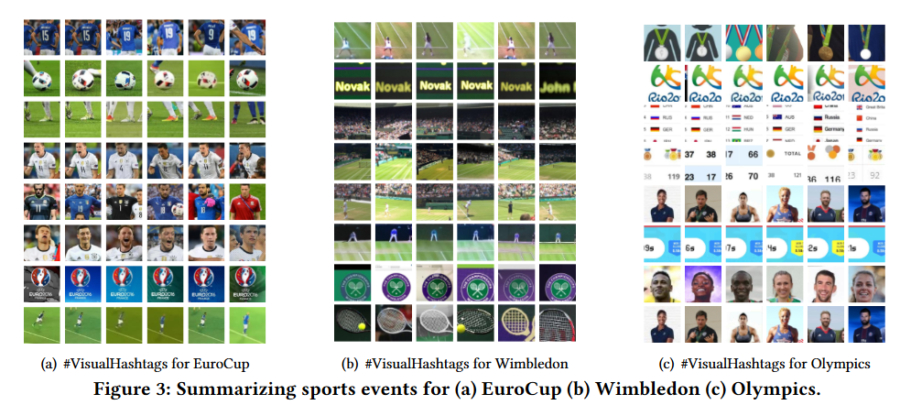
Results – 1 (Sports)

Slide 8
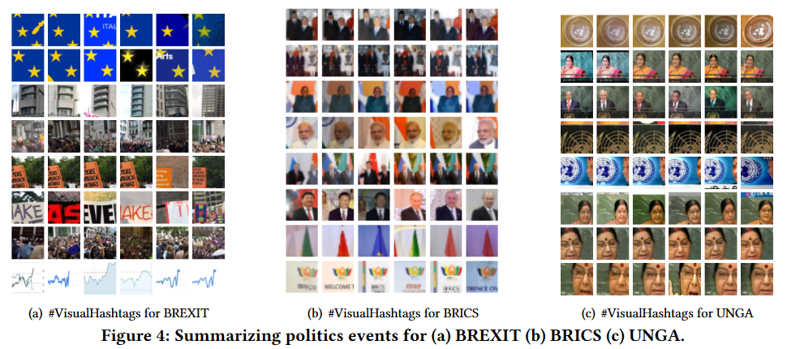
Results – 2 (Politics)

Slide 9
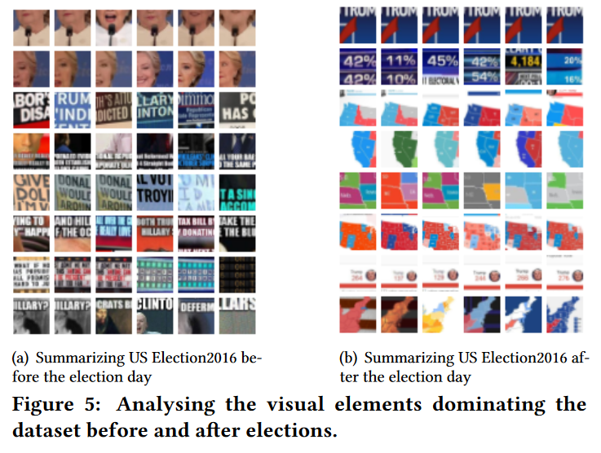
Results – 3 (Temporal Analysis)

Slide 10
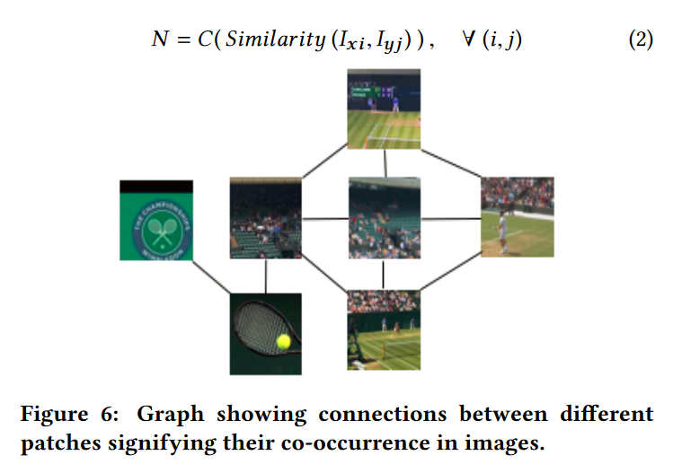
Results – 3 (Pattern Mining)

Slide 11
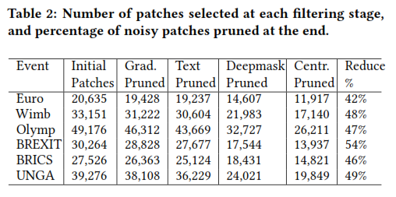
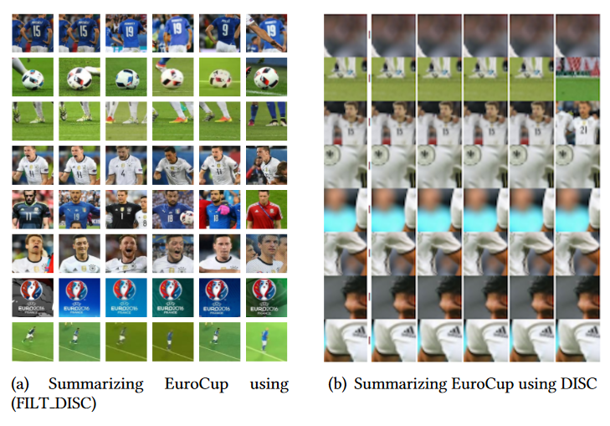
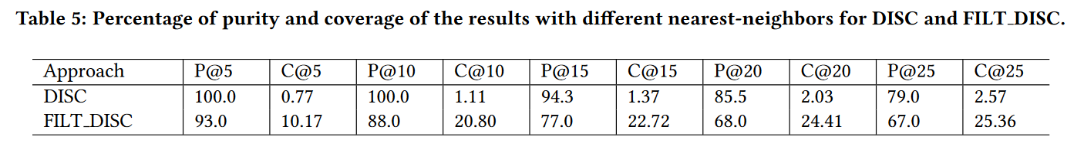
Evaluation - Quantitative

Slide 12
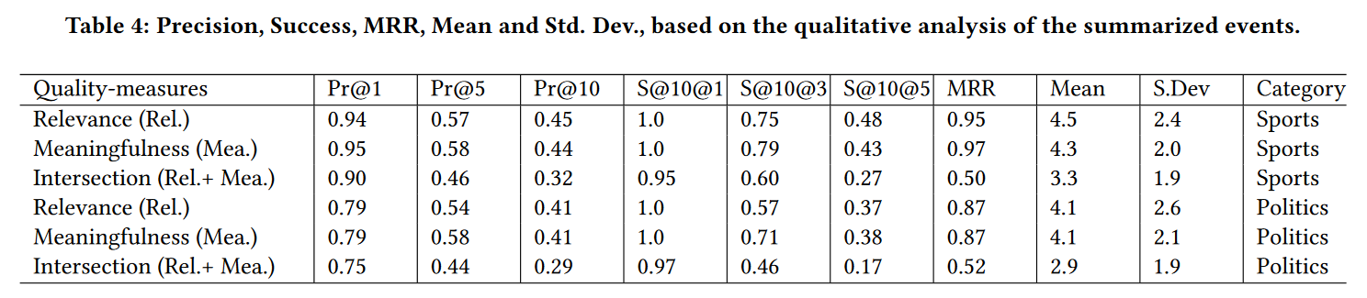
Evaluation - Qualitative
User Study – 21 People
Given the set of patches below, choose the most appropriate event which it summarizes.
Select all the patches that can be distinctly linked with the event chosen above.
Select all the patches that are Meaningful ,i.e. covering a meaningful part of an image
How many of the below rows demonstrate strong correlation (containing similar elements like faces/buildings, etc) among their elements?
Metrics
(1) Precision (Pr@N): percentage of patches among the top N that are relevant/meaningful to the corresponding event, averaged
among all events.
(2) Success (S@N@D): percentage of responses, where there exist at least D relevant/meaningful patches amongst the top N.
(3) Mean Reciprocal Rank (MRR): Computed as 1/r, where r is the rank of the first relevant/meaningful patch returned, averaged over all events.

Slide 13
Future Work
Currently, our approach is centered around events that contain images with relative stylistic coherence and uniqueness, and thus #VisualHashtags generated also focus on concrete entities.
As future work, the technique can be modified to summarize more abstract phenomenon like violence, summer, etc.
Mid-level patches obtained as a summary of a particular viral event, can be further generalized to pave way for finding higher-level image features that can cover the essence of an event.
While the current approach needs to be re-run to generate #VisualHashtags at different time instances, dynamic re-summarization would be an interesting direction to explore, making it a more real-time system.

