Slide 1
ITC
OCT 15, 2024
T-1, Report, Poster, and Billable HOURS

Slide 2
Contents
Data Analysis
Challenges in Data Analysis
Standardized Data Processing Steps
Charts or Results Provided to ITC
Problem Statement on Greener Software
The Need for Greener Solutions
Environmental Impact and Software Efficiency
Proposed Solution
Literature Review: Focus on Greener Software
Identifying Gaps in Current Solutions
Comparison of Two Potential Solutions
Evaluation for Simulation
Simulation Setup
Key Metrics for Evaluation
Timeline

Slide 3
Data Analysis - Challenges and Action Plan
Challenges We Faced:
Large Volume of Data: The dataset is vast, making processing and analysis difficult.
Incomplete Information: Some entries lack key details or contain irrelevant information.
Detailed Classification: Hard to distinguish details in categories, requiring more analysis.
Attributes Relationships: Identifying meaningful connections between attributes.
Steps to Take:
Select Key Attributes: Identify and match relevant features in the dataset for deeper analysis.
Data Cleaning: Remove irrelevant entries and filter for contracts with values over $10,000.
Data Processing: Classify contract details into more specific categories.
Data Analysis: Perform statistical and comparative analysis to gain actionable insights.

Slide 4
Achieving Greener Practices in Data Analysis
Green Data Analysis:
The ITC project uses a green data analysis method to reduce waste and conserve resources, helping to decrease its environmental impact.
Sustainability Metrics:
The project measures sustainability through energy efficiency, resource use, and carbon emissions from IT operations.
Life Cycle Assessment:
Lifecycle assessments evaluate the environmental effects of the data processing solution at each stage.
Reference - S. R. A. Ibrahim, J. Yahaya, H. Salehudin, and A. Deraman. “The Development of Green Software Process Model”. In: International Journal of Advanced Computer Science and Applications (2021). doi: 10.14569/ijacsa.2021.0120869.

Slide 5
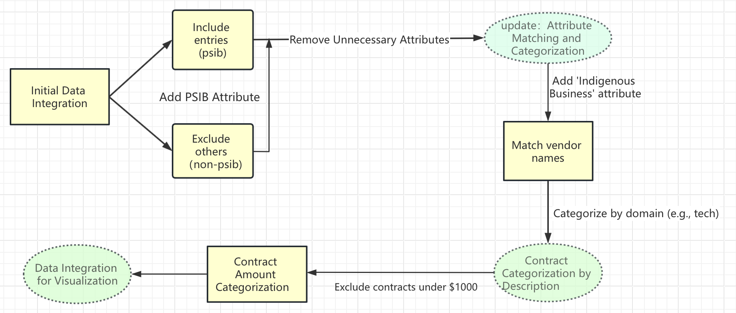
Standardized Data Processing Steps
Eg: Procurement_id
Agreement_type_code_en
Original_value_range_en
…

Slide 6
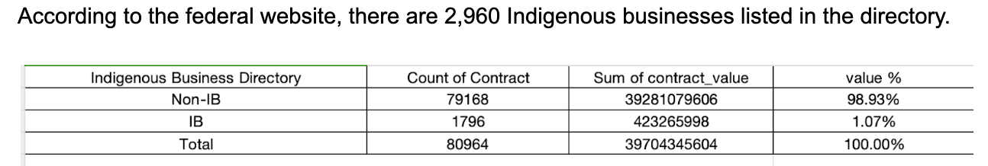
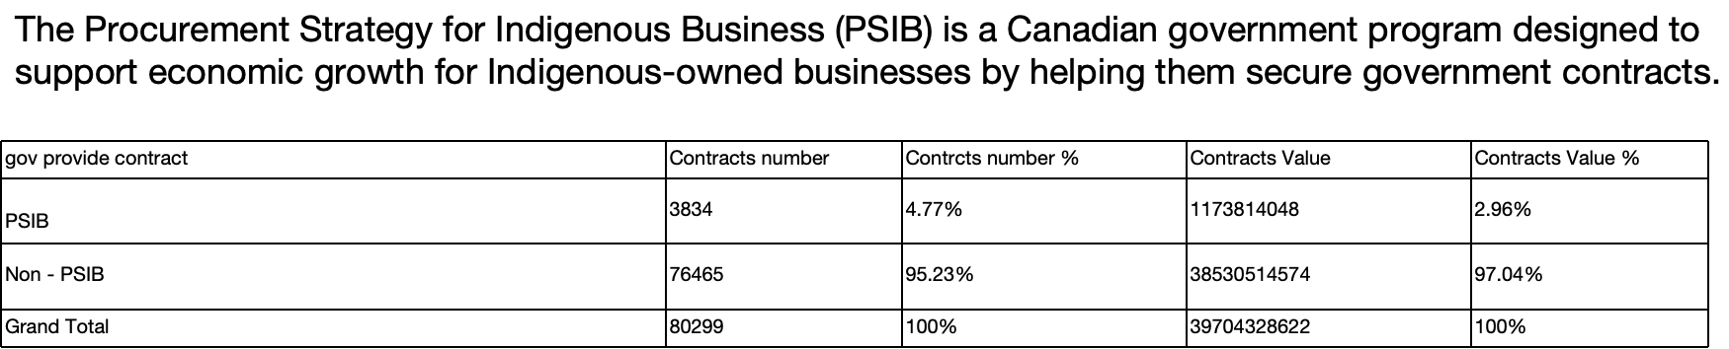
Preliminary Result
Despite the PSIB initiative, Indigenous businesses still capture a minor portion of total contract value

Slide 7
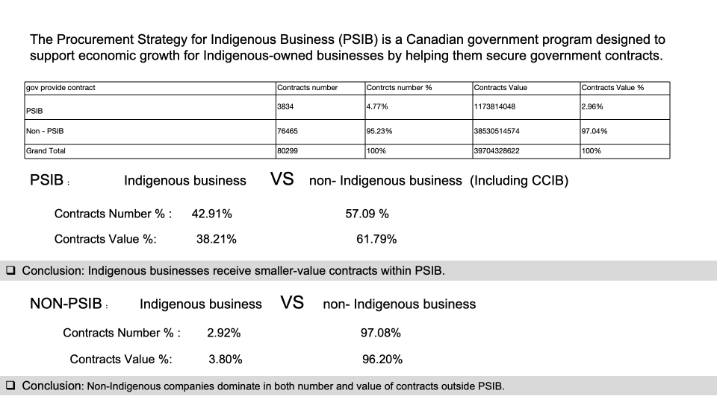

Slide 8
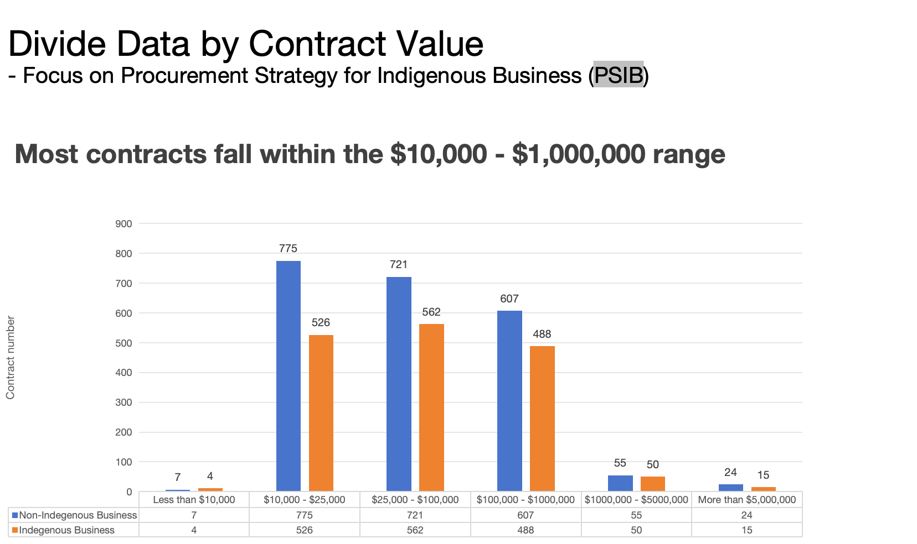

Slide 9
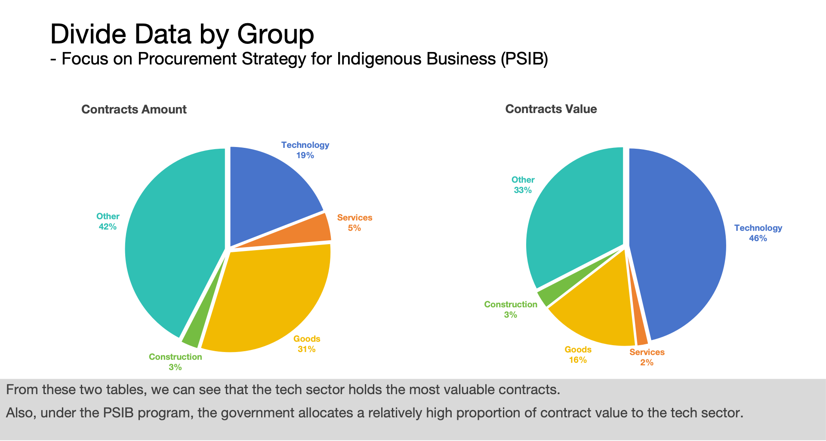

Slide 10
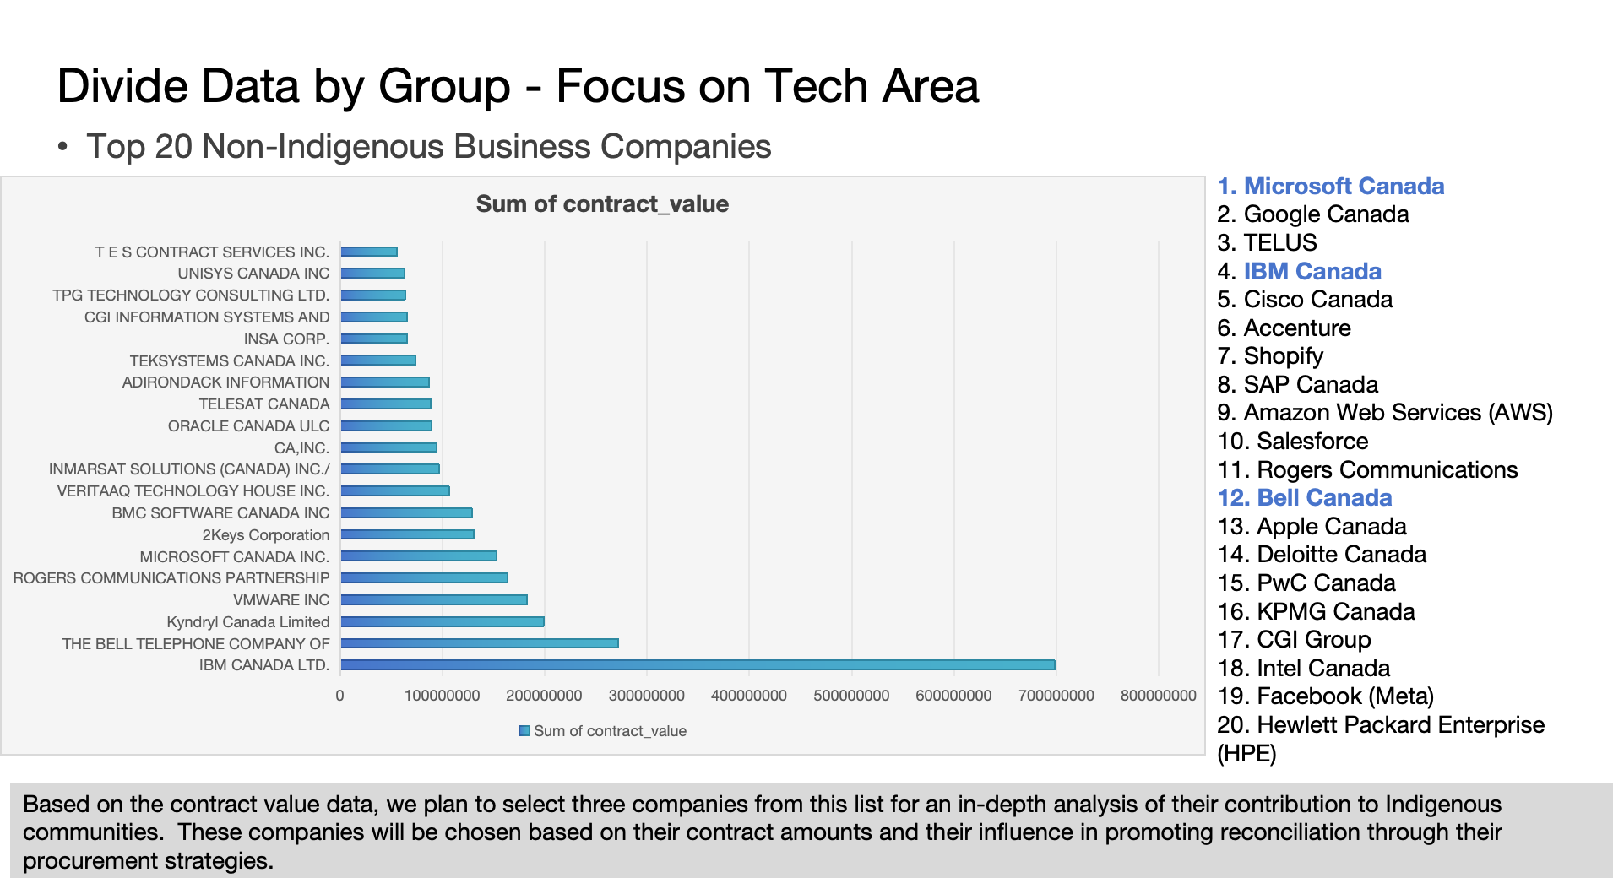

Slide 11
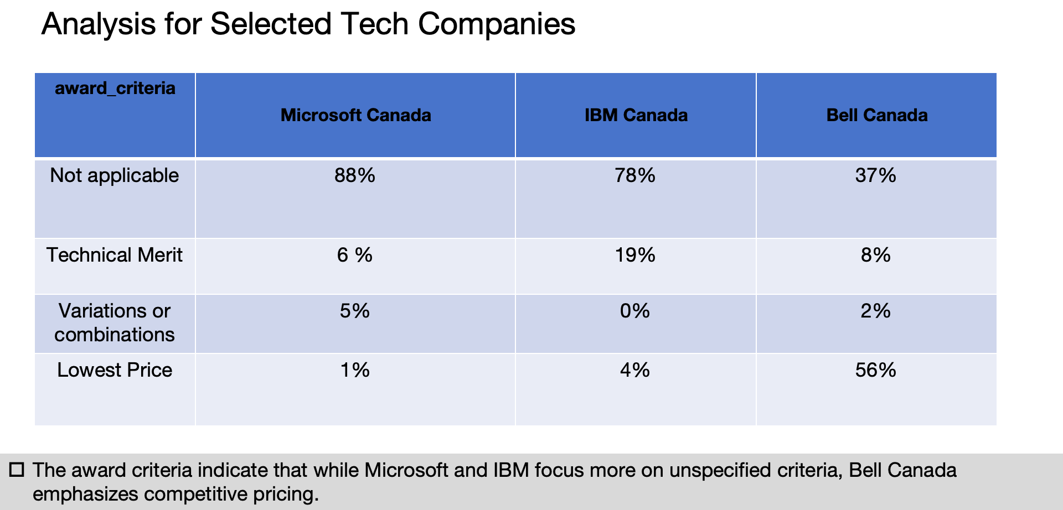

Slide 12
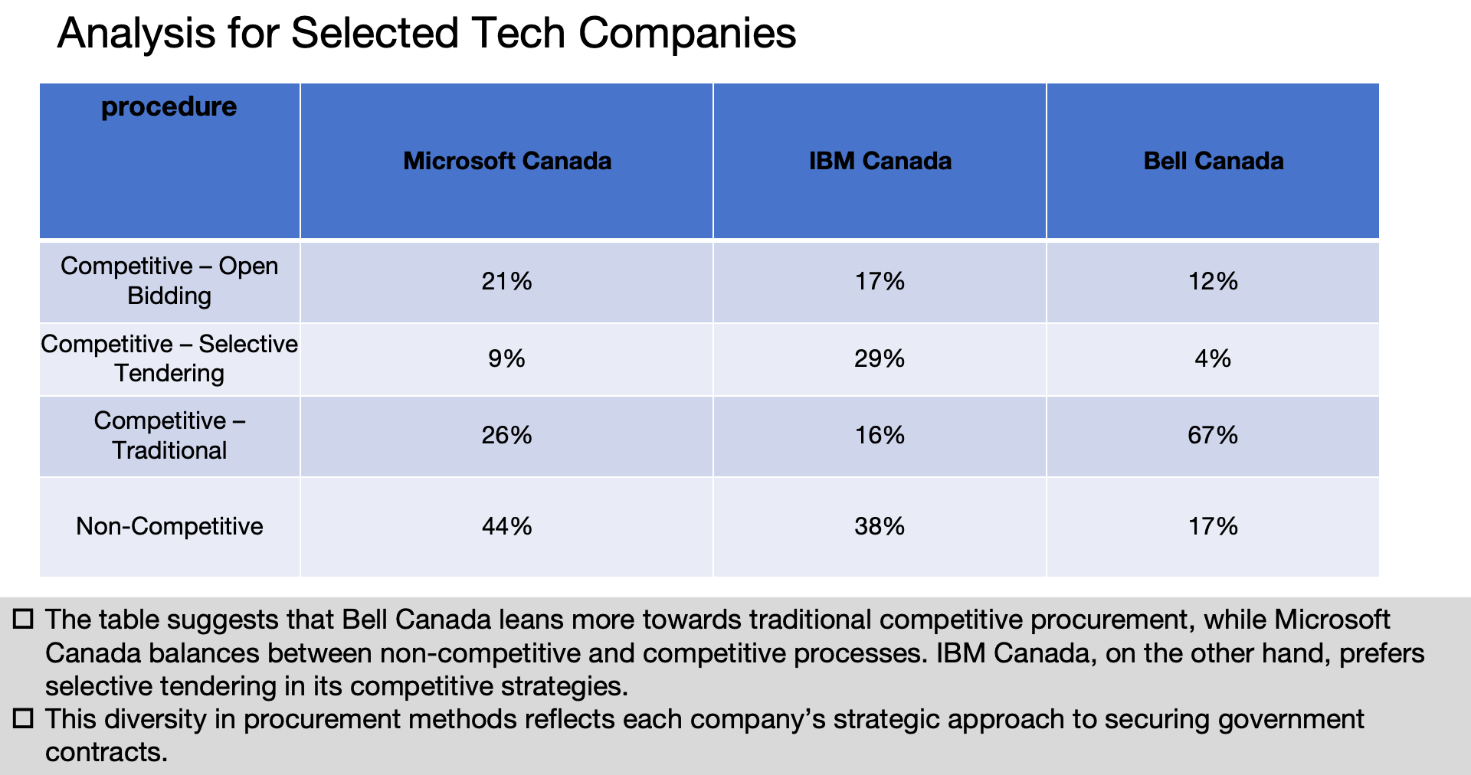

Slide 13
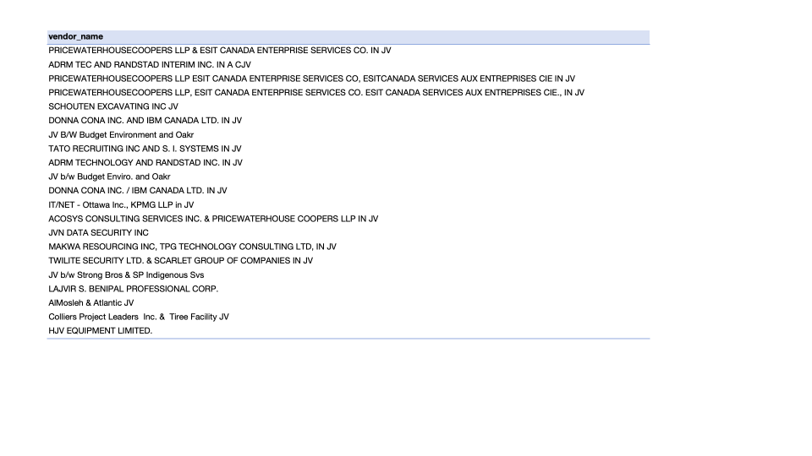
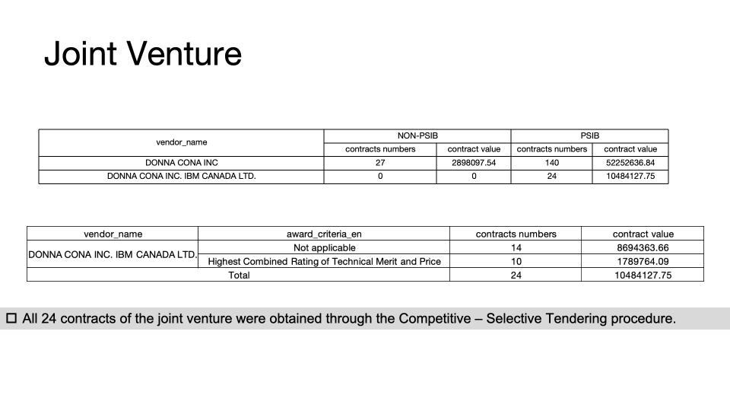
Data Analysis Objectives
Proportion of the number and amount of contracts
Details of non-Indigenous Business(IB) contracts in the proportion
Identify the proportion of contracts in different sectors(focus on the techpart).
Based on the analysis above, we'll use the top 20 tech companies list provided by ITC to pick some representative companies and analyze the reasons behind their success.
Overview of Our Dataset
Government Contracts (2023)
Total Entries: 81,000
Attributes: 48
CCIB - 2561 Indigenous Business
Indigenous Business Directory - Company Profiles
Total Entries: 2,960
Attributes: 20
Tech Companies List：Includes 20 Major Tech Companies

Slide 14
Problem Statement
Indigenous tech companies face challenges in scaling and securing larger contracts due to complex procurement processes dominated by larger firms, despite government and corporate targets supporting Indigenous capacity development. At the same time, the rapid growth of technology businesses, including Indigenous-led companies, significantly contributes to global greenhouse gas emissions. Software, as a major driver of energy consumption, exacerbates these environmental challenges. However, the lack of a standardized framework for assessing software energy efficiency makes it difficult for Indigenous companies to align with sustainability goals. This project aims to address these issues by incorporating green software engineering principles, helping Indigenous businesses scale while contributing to global efforts in reducing emissions.

Slide 15
Problem Statement
Disadvantage in Growth Opportunities
Indigenous businesses struggle to access growth opportunities
Lack of larger contracts limits their scalability
Procurement Obstacles
Indigenous tech companies face procurement barriers
Struggles include creating competitive advantages and securing key contracts
ICT Expansion and Rising Environmental Impact
ICT sector growth heavily increases global greenhouse gas emissions
Software drives energy consumption, worsening environmental issues
Lack of a Unified Framework for Software Efficiency
No standard framework to assess software energy efficiency
Indigenous tech companies struggle to meet sustainability goals

Slide 16
Problem Statement
The rapid growth of the Information and Communication Technology (ICT) sector is contributing significantly to global greenhouse gas emissions, accounting for approximately 2-3% of total emissions. Software plays a critical role in energy consumption, as it drives hardware usage, which in turn impacts resource and energy consumption. However, there is currently no standardized framework for measuring software’s resource and energy efficiency. This leads to inconsistent and incomparable results, hindering efforts to reduce software-driven environmental impacts.
While various researchers and industry groups have developed tools and methods to measure energy consumption, there is no unified approach. The absence of a comprehensive measurement model complicates efforts to assess and improve the environmental efficiency of software. Software practitioners lack the tools and guidelines to integrate energy efficiency into everyday software development processes.

Slide 17
Problem
Environmental Impact of Software: As digital transformation accelerates, software running on data centers, servers, and devices consumes significant energy, driving high hardware resource consumption and increasing global greenhouse gas emissions.
Lack of Standardized Measurement: Currently, there is no unified framework to measure software’s resource and energy efficiency, making it difficult to compare the environmental impact of different software, which hinders developers from optimizing energy consumption.
Impact on Global Sustainability Goals: Standardizing resource efficiency measurements not only reduces energy consumption in individual projects but also drives the entire software development ecosystem toward a greener future, contributing to global efforts to reduce carbon emissions and combat climate change.

Slide 18
Proposed Solution - literature review
Software practitioners are aware of the problem, but lack of resources and tools (An Empirical Study of Practitioners’ Perspectives on Green Software Engineering)
Requirement and Design phases are of most interest (Green and Sustainable Software Engineering - a Systematic Mapping Study)
Lessons that could be learned from Mobile Application Development
Reduce data size, caching
Let server do the heavy lifting (data fetching)
(RMVRVM - A Paradigm for Creating Energy Efficient User Applications Connected to Cloud through REST API) (Energy Patterns for Web: An Exploratory Study)

Slide 19
Proposed Solution - filling the gap
Current studies are abstract because they:
either focus on best practices but without quantifying the impact
or propose an evaluation methodology without concrete examples from real-world scenarios
We aim to fill this gap by answering:
What are the options to consider for a greener system design?
How to quantify the impact of a greener solution by adopting existing tools?
Which components may have contributed to the most difference in energy consumption?

Slide 20
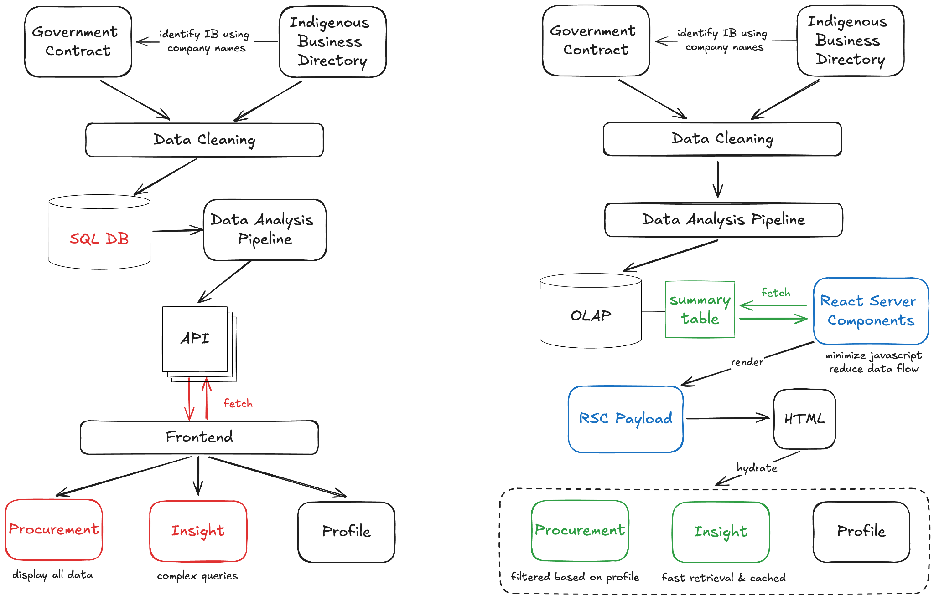

Slide 21
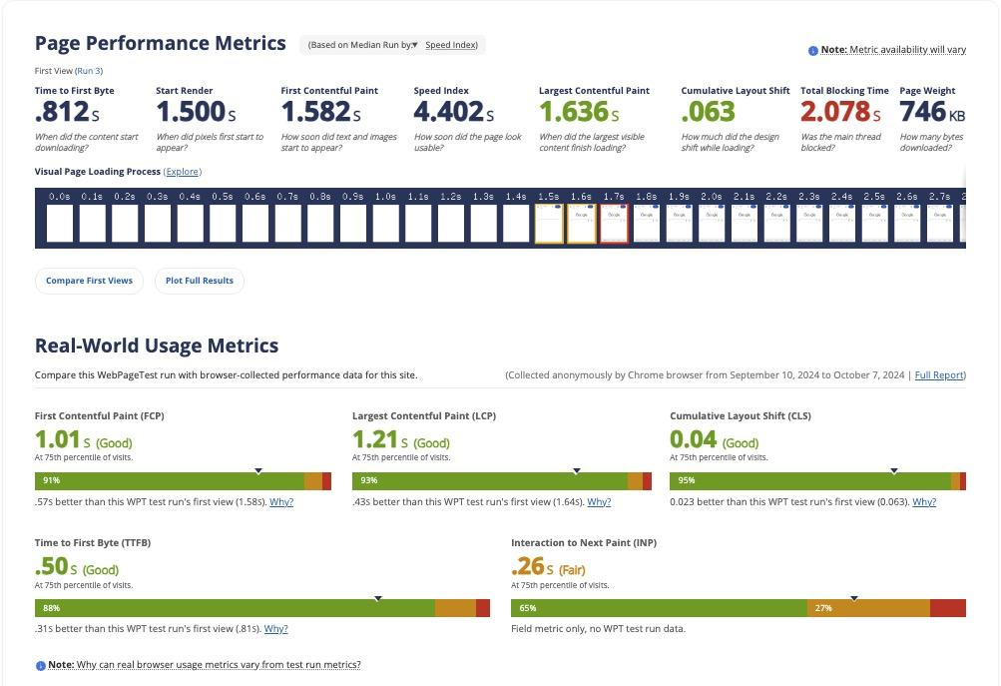
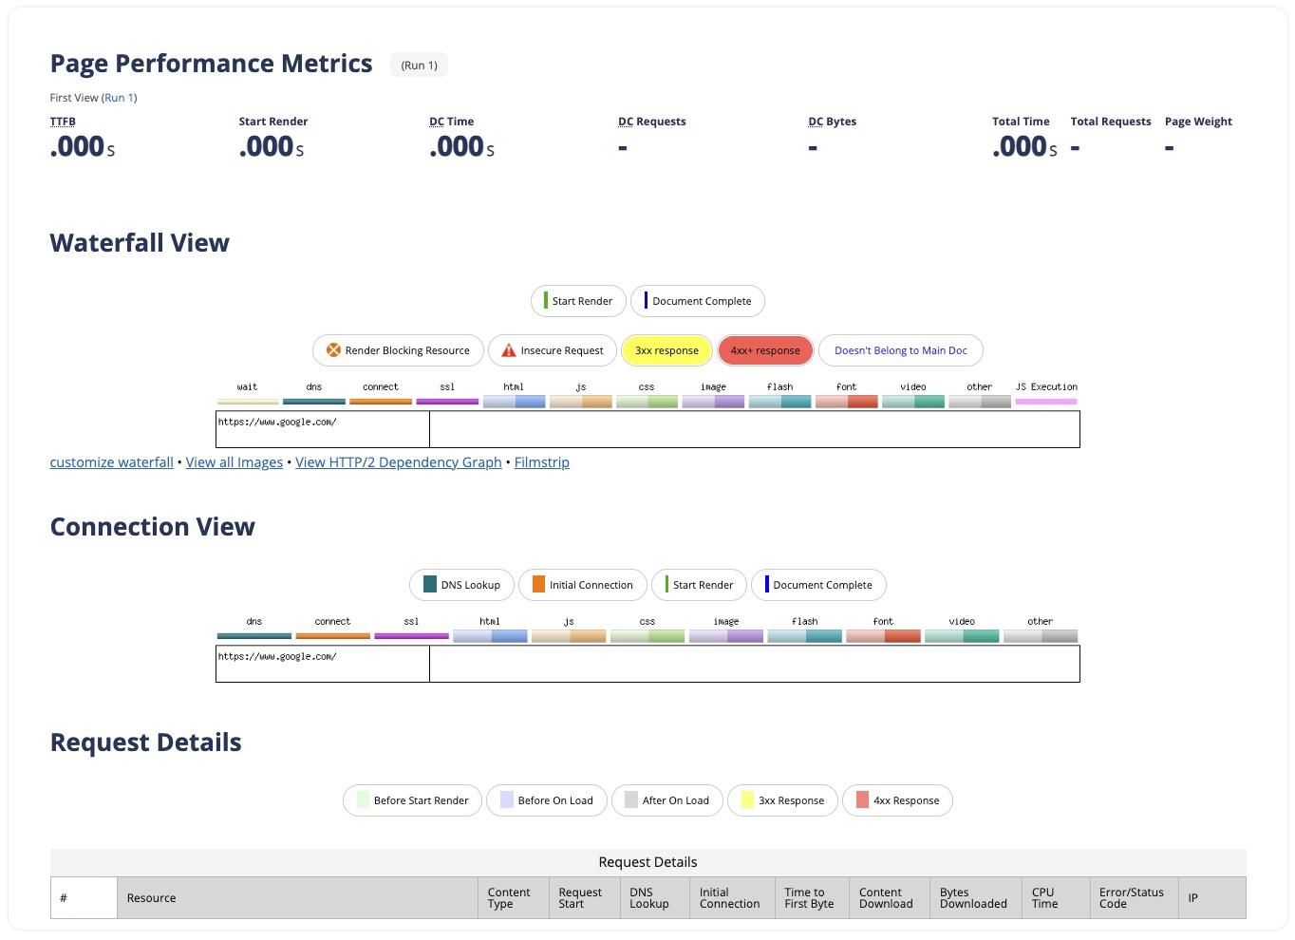
Evaluation for simulation
Test Case: google.com
Tool: Webpagetest

Slide 22
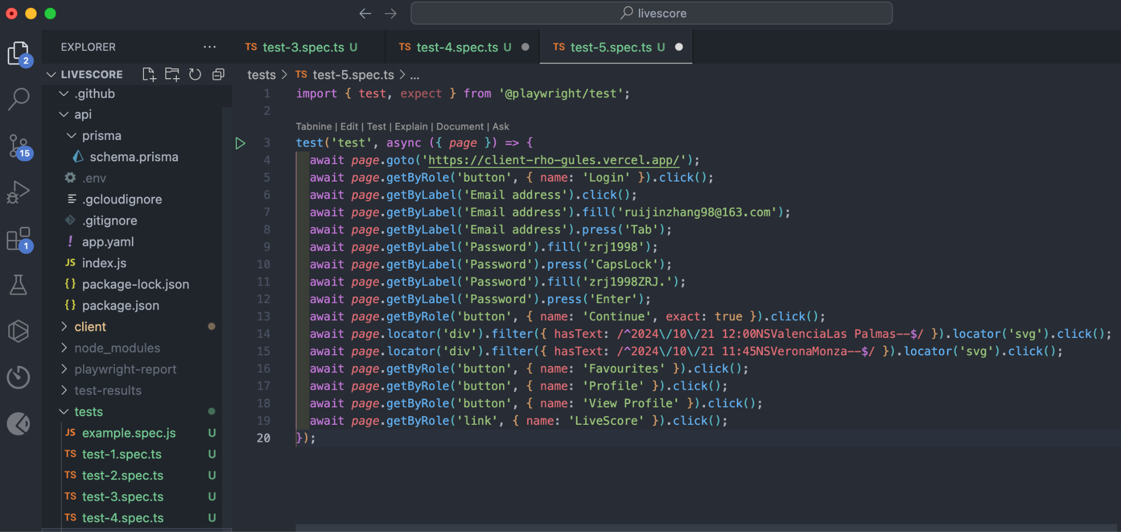
Evaluation for simulation
Test Case: livescore

Slide 23
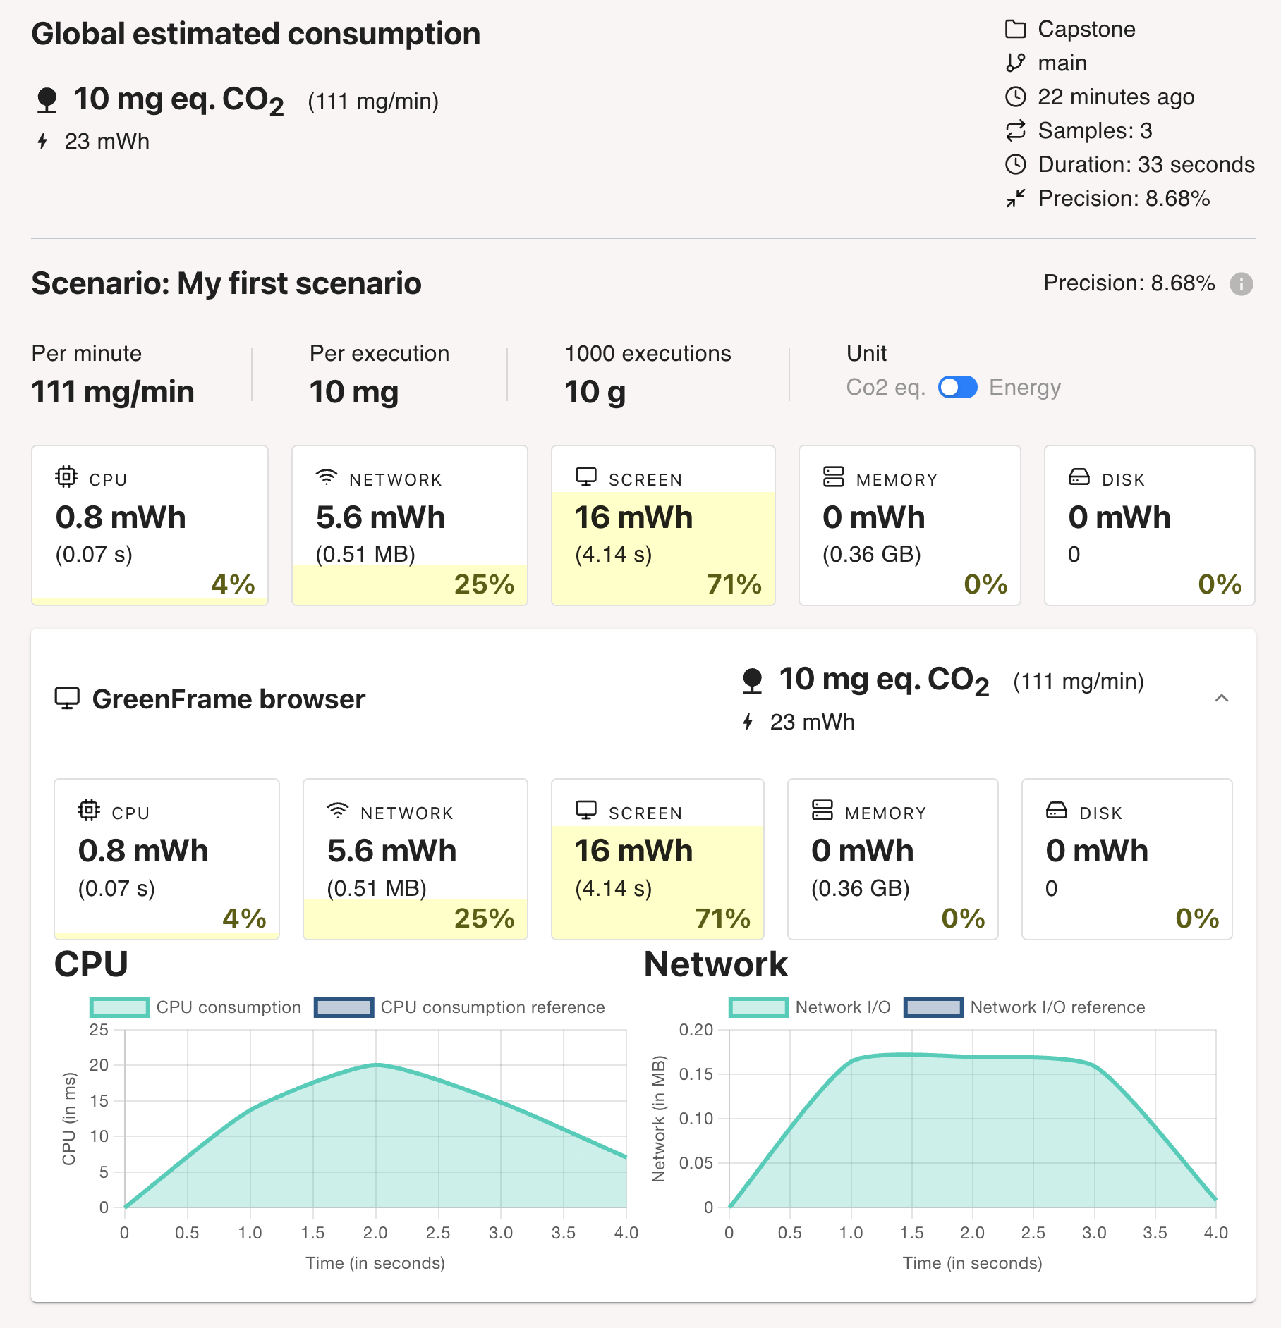
Measurement Tool: GreenFrame
we adopted the Green Software Measurement Model (GSMM) as outlined by Guldner et al. (2024). This model provides a structured methodology for measuring software-induced energy consumption through a variety of metrics, including power draw, CPU usage, and memory consumption. By applying GSMM, we were able to conduct a evaluation of our software, ensuring that our approach aligns with sustainable software engineering practices

Slide 24
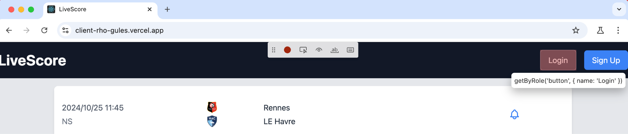
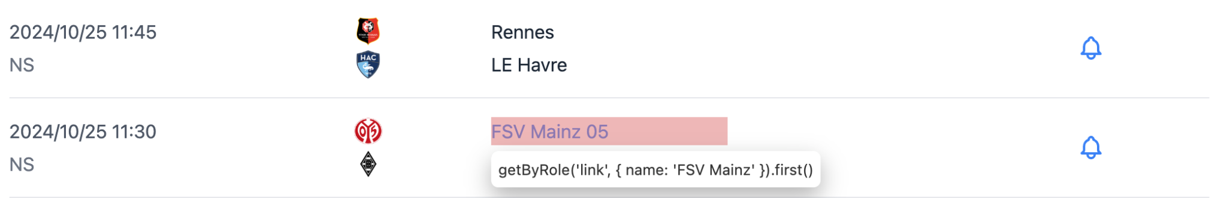
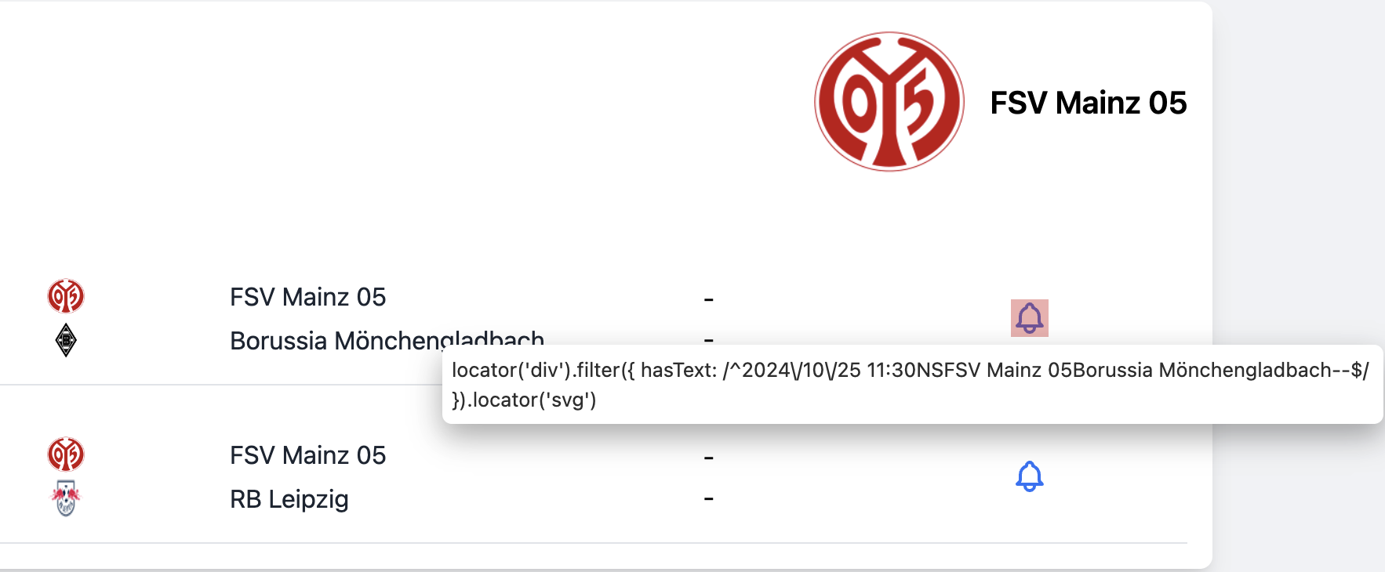
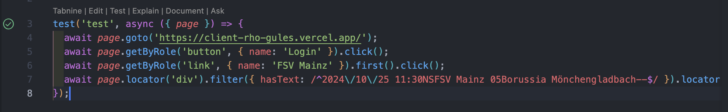
1
Scenario tool: playwright
Playwright comes with the ability to generate tests for you, as you perform actions in the browser and is a great way to quickly get started with testing. Playwright will look at your page and figure out the best locator, prioritizing role, text and test id locators.
2
3

Slide 25
Timeline
Evaluation Activities | Timeframe | Details
1 . Evaluation Environment Setup | week 1 | Perform idle and baseline measurements of system.
2. Define Measurement Goals | Week 2 | Set specific evaluation goals and select the metrics and scenarios to measure.
3. Conduct Idle and Usage Tests | Week 2 | Run tasks in controlled environments, measuring energy consumption.
4. Run Load Tests | Week 2 | Simulate stress scenarios to capture high-resource usage performance.
5. Data Collection | Week 3 | Gather all raw data for energy, CPU, and memory consumption during tests.
6. Analysis and Initial Report | Week 3 | Analyze the data to compute energy efficiency and performance metrics.
7. Comparative Analysis | Week 3 | Compare different versions of your software or configurations.
8. Draft Final Report | Week 3 | Summarize the findings, highlighting energy consumption patterns and efficiency improvements.
9. Final Adjustments and Review | Week 4 | Make final changes to the report and review the results for accuracy.

Slide 26
Future work
Expansion of Energy-Efficient Software Design
Focus on software architecture areas
Optimize network communications for energy savings
Advanced Energy Measurement
Develop real-time energy tracking tools
Integrate into development environments for dynamic adjustments
Balancing Energy Efficiency and User Experience
Maintain energy efficiency without compromising performance and usability
Global Standardization
Collaborate with industry and academia to establish global frameworks
Promote green software practices worldwide

Slide 27
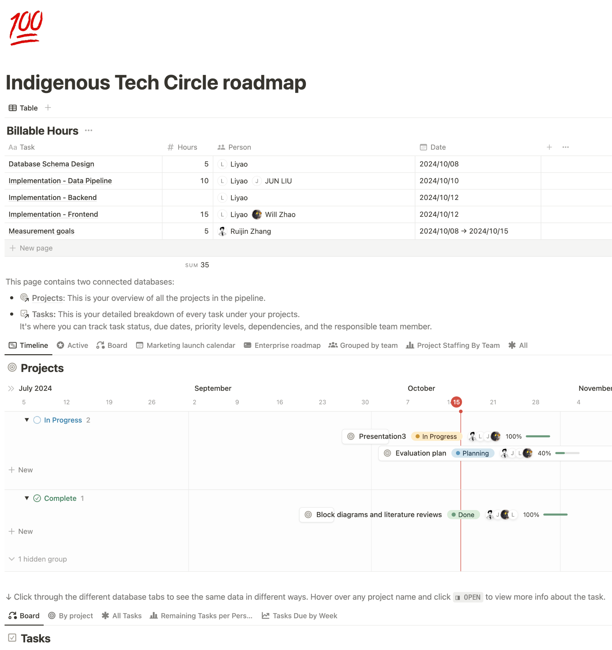
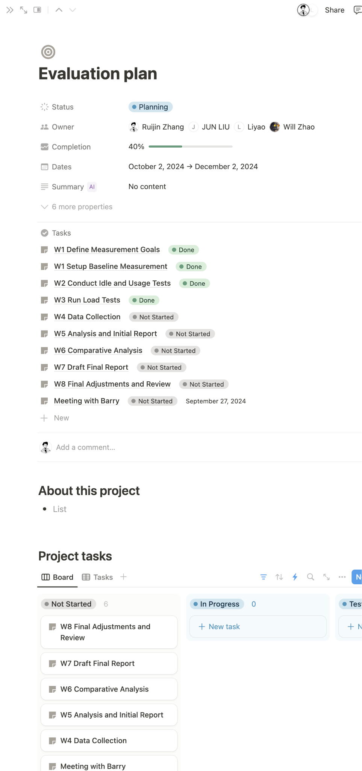
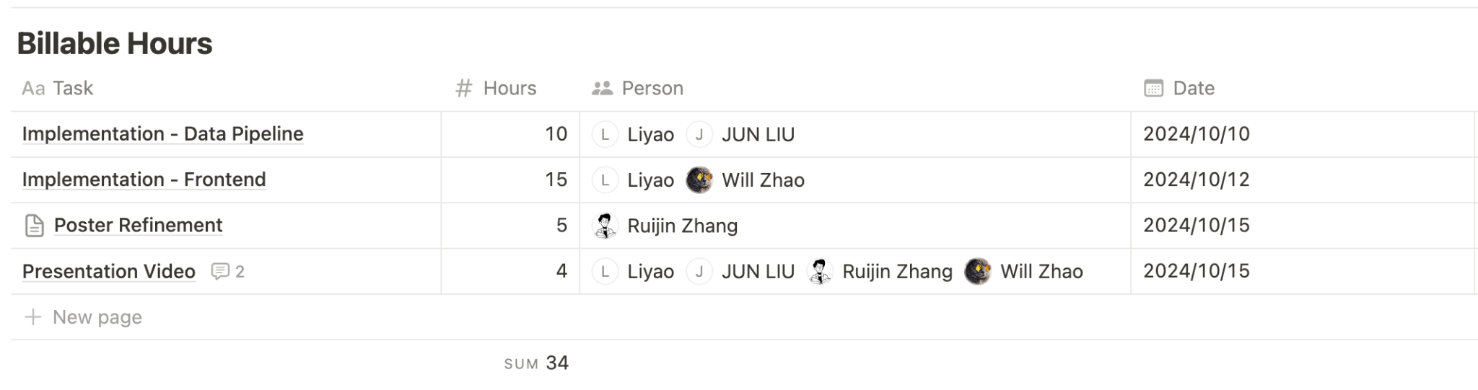

Slide 28
Reference
I. Manotas et al. "An Empirical Study of Practitioners' Perspectives on Green Software Engineering". In: Proceedings of the 38th International Conference on Software Engineering (ICSE '16). New York, NY, USA: Association for Computing Machinery, May 2016, pp. 237-248. DOI: 10.1145/2884781. 2884810.
B. C. Mourão, L. Karita, and I. do Carmo Machado. "Green and Sustainable Software Engineering - A Systematic Mapping Study". In: Proceedings of the XVII Brazilian Symposium on Software Quality (SBQS '18). New York, NY, USA: Association for Computing Machinery, Oct. 2018, pp. 121-130. DOI: 10.1145/3275245.3275258.
A. Brunnert. "Green Software Metrics". In: Companion of the 15th ACM/SPEC In-ternational Conference on Performance Engineering (ICPE 24 Companion). New York, NY, USA: Association for Computing Machinery, May 2024, pp. 287-288. DOI: 10.1145/3629527.3652883.
R. D. Caballar. "We Need to Decarbonize Software". In: IEEE Spectrum (Mar.2024). Retrieved September 15, 2024. URL: https://spectrum.ieee.org/green-software.
P. Rani et al. "Energy Patterns for Web: An Exploratory Study". In: Proceedings of the 46th International Conference on Software Engineering: Software Engineering in Society. Lisbon, Portugal: ACM, Apr. 2024, pp. 12-22. DOI: 10.1145/3639475.3640110.
L. Singh. "RMVRVM - A Paradigm for Creating Energy Efficient User Applications Connected to Cloud through REST APP". In: Proceedings of the 15th Innovations in Software Engineering Conference (ISEC '22). New York, NY, USA: Association for Computing Machinery, Feb. 2022, pp. 1-11. DOI: 10.1145/3511430.

Slide 29
Reference
Guldner, Achim & Bender, Rabea & Calero, Coral & Fernando, Giovanni & Funke, Markus & Gröger, Jens & Hilty, Lorenz & Hörnschemeyer, Julian & Hoffmann, Geerd-Dietger & Junger, Dennis & Kennes, Tom & Kreten, Sandro & Lago, Patricia & Mai, Franziska & Malavolta, Ivano & Murach, Julien & Obergöker, Kira & Schmidt, Benno & Tarara, Arne & Naumann, Stefan. (2024). Development and evaluation of a reference measurement model for assessing the resource and energy efficiency of software products and components—Green Software Measurement Model (GSMM). Future Generation Computer Systems. 155. 10.1016/j.future.2024.01.033.
S. R. A. Ibrahim, J. Yahaya, H. Salehudin, and A. Deraman. “The Development of Green Software Process Model”. In: International Journal of Advanced Computer Science and Applications (2021). doi: 10.14569/ijacsa.2021.0120869.

