Slide 1
HLCD Final project
2023. 12. 25

Slide 2
Outline
Background
Data Structure and Algorithm
Your Task
Hint
Criterion & DDL

Slide 3
Dense vs sparse Matrix
1
6
2
1
2
4
7
5
4
9
3
8
3
Dense Matrix
Sparse Matrix

Slide 4
matrix multiplication
1
6
2
3
7
1
GEMM: General Matrix Multiplication
4
7
5
5
8
6
9
3
8
4
9
2
1
2
2
SpGEMM: General Sparse Matrix Multiplication
4
1
3
3
4

Slide 5
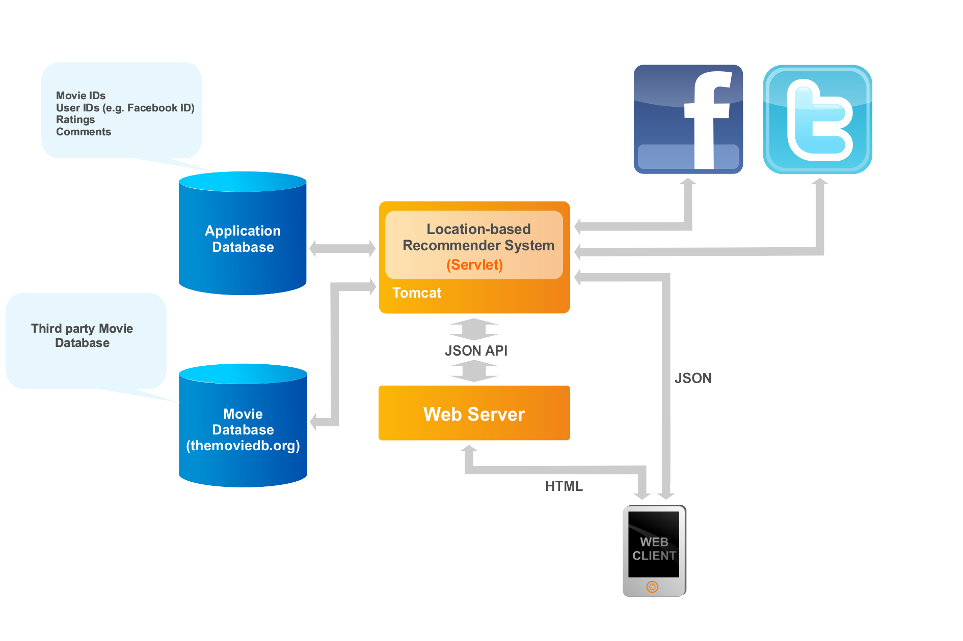
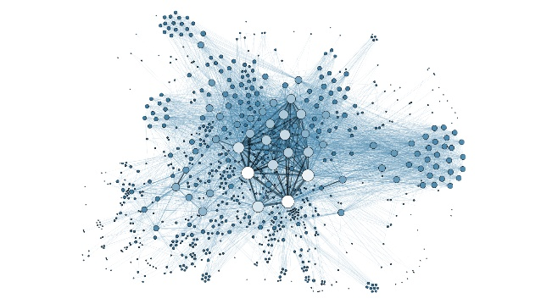

SpGEmm Application
Recommender Systems
Graph Analytics
Neural Networks
PageRank
Breadth First Search
Betweenness
Centrality
Sparse DNNs
Graph Neural Networks
Collaborative Filtering

Slide 6


SpGEmm Background
0.0003%
non-zero elements
2.31%
non-zero elements
Real World Matrices Have High Sparsity!

Slide 7

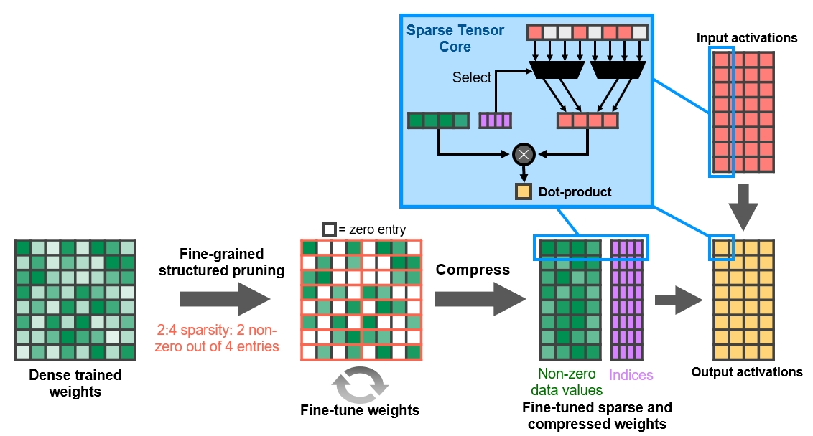
SpMM Hardware
Sparse Tensor Core doubles math throughput by skipping the zeros.

Slide 8
compressed sparse row (CSR)
5
3
4
RowIdx
0
2
3
4
8
Col
0
2
3
1
3
3
Values
5
3
4
8
3
Sparse Matrix
CSR

Slide 9
SpGEMM Patterns
Row-by-Row
Inner-Product
Outer-Product
Column-by-Column

Slide 10
SpGEMM Pattern: Row-by-row
1
2
1
1
1
3
✖️
2
3
=
4
5
4
+
1
2
1
8
8
3
✖️
2
3
=
4
5
4
…
…
+
…
+
1
2
1
3
✖️
2
3
=
4
5
4
20
20

Slide 11
SpGEMM Pattern: Row-by-row
1
2
1
1
1
3
✖️
2
3
=
4
5
4
8
1
+
6
9
1
2
1
8
8
20
4
3
✖️
2
3
=
4
5
4
…
…
+
…
+
1
2
1
3
✖️
2
3
=
4
5
4
20
20

Slide 12
SpGEMM Pattern: inner-product
1
2
1
8
8
3
✖️
2
3
=
4
5
4
+
1
2
1
1
1
3
✖️
2
3
=
4
5
4
…
…
+
…
+
1
2
1
3
✖️
2
3
=
4
5
4

Slide 13
SpGEMM Pattern: inner-product
1
2
1
8
8
3
✖️
2
3
=
4
5
4
8
1
+
6
9
1
2
1
1
1
20
4
3
✖️
2
3
=
4
5
4
…
…
+
…
+
1
2
1
3
✖️
2
3
=
4
5
4

Slide 14
SpGEMM Pattern: Outer-product
1
2
1
1
1
3
✖️
2
3
=
4
5
4
4
4
+
1
2
1
3
✖️
2
3
=
6
9
6
9
4
5
4
+
1
2
1
8
8
3
✖️
2
3
=
4
5
4
20
20

Slide 15
SpGEMM Pattern: column-by-column
1
2
1
8
8
3
✖️
2
3
=
4
5
4
20
20
+
1
2
1
1
1
3
✖️
2
3
=
4
5
4
4
4
…
…
+
…
+
1
2
1
3
✖️
2
3
=
9
9
4
5
4

Slide 16
SpGEMM Pattern: column-by-column
1
2
1
8
8
3
✖️
2
3
=
4
5
4
20
20
8
1
+
6
9
1
2
1
1
1
20
4
3
✖️
2
3
=
4
5
4
4
4
…
…
+
…
+
1
2
1
3
✖️
2
3
=
9
9
4
5
4

Slide 17

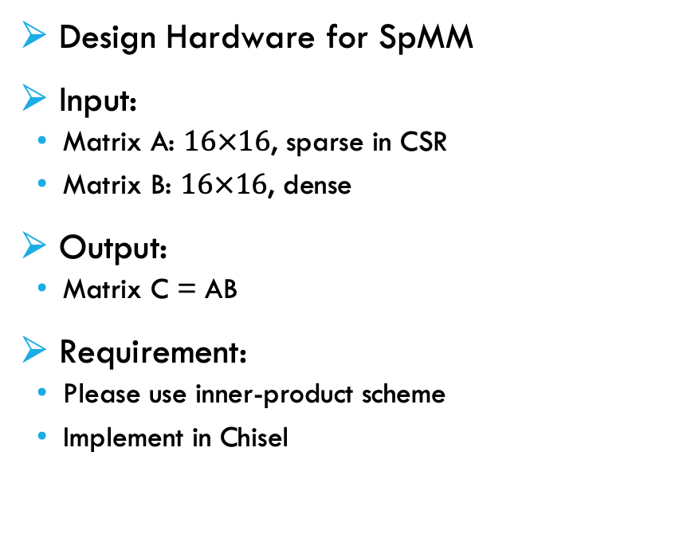
Task
Design Hardware for SpMM
Input:
Matrix A: $16×16$, sparse in CSR
Matrix B: $16×16$, dense
Output:
Matrix C = AB
Requirement:
Please use inner-product scheme
Implement in Chisel
0
1
…
15
RowIdx
0
2
3
…
…
$$n−1$$
1
2
…
16
…
…
…
Col
0
2
3
1
…
3
Values
5
3
4
8
…
3
15
16
…
31
Matrix A (lhs)
Matrix B (rhs)

Slide 18

workflow
0
0
1
2
3
4
5
6
7
Slot for A
5
3
4
Selection
Multiplication
Reduction
2
8
9
10
11
Slot for B
0
8
12
3
12
13
14
15
Results of Mul
0
24
48
A Column of Matrix B
+
RowIdx
0
2
0
1
3
…
…
$$n−1$$
(0,0)
(1,0)
Col
0
2
3
0
2
3
1
…
3
5
3
4
Values
5
3
4
8
…
3
Matrix A

Slide 19
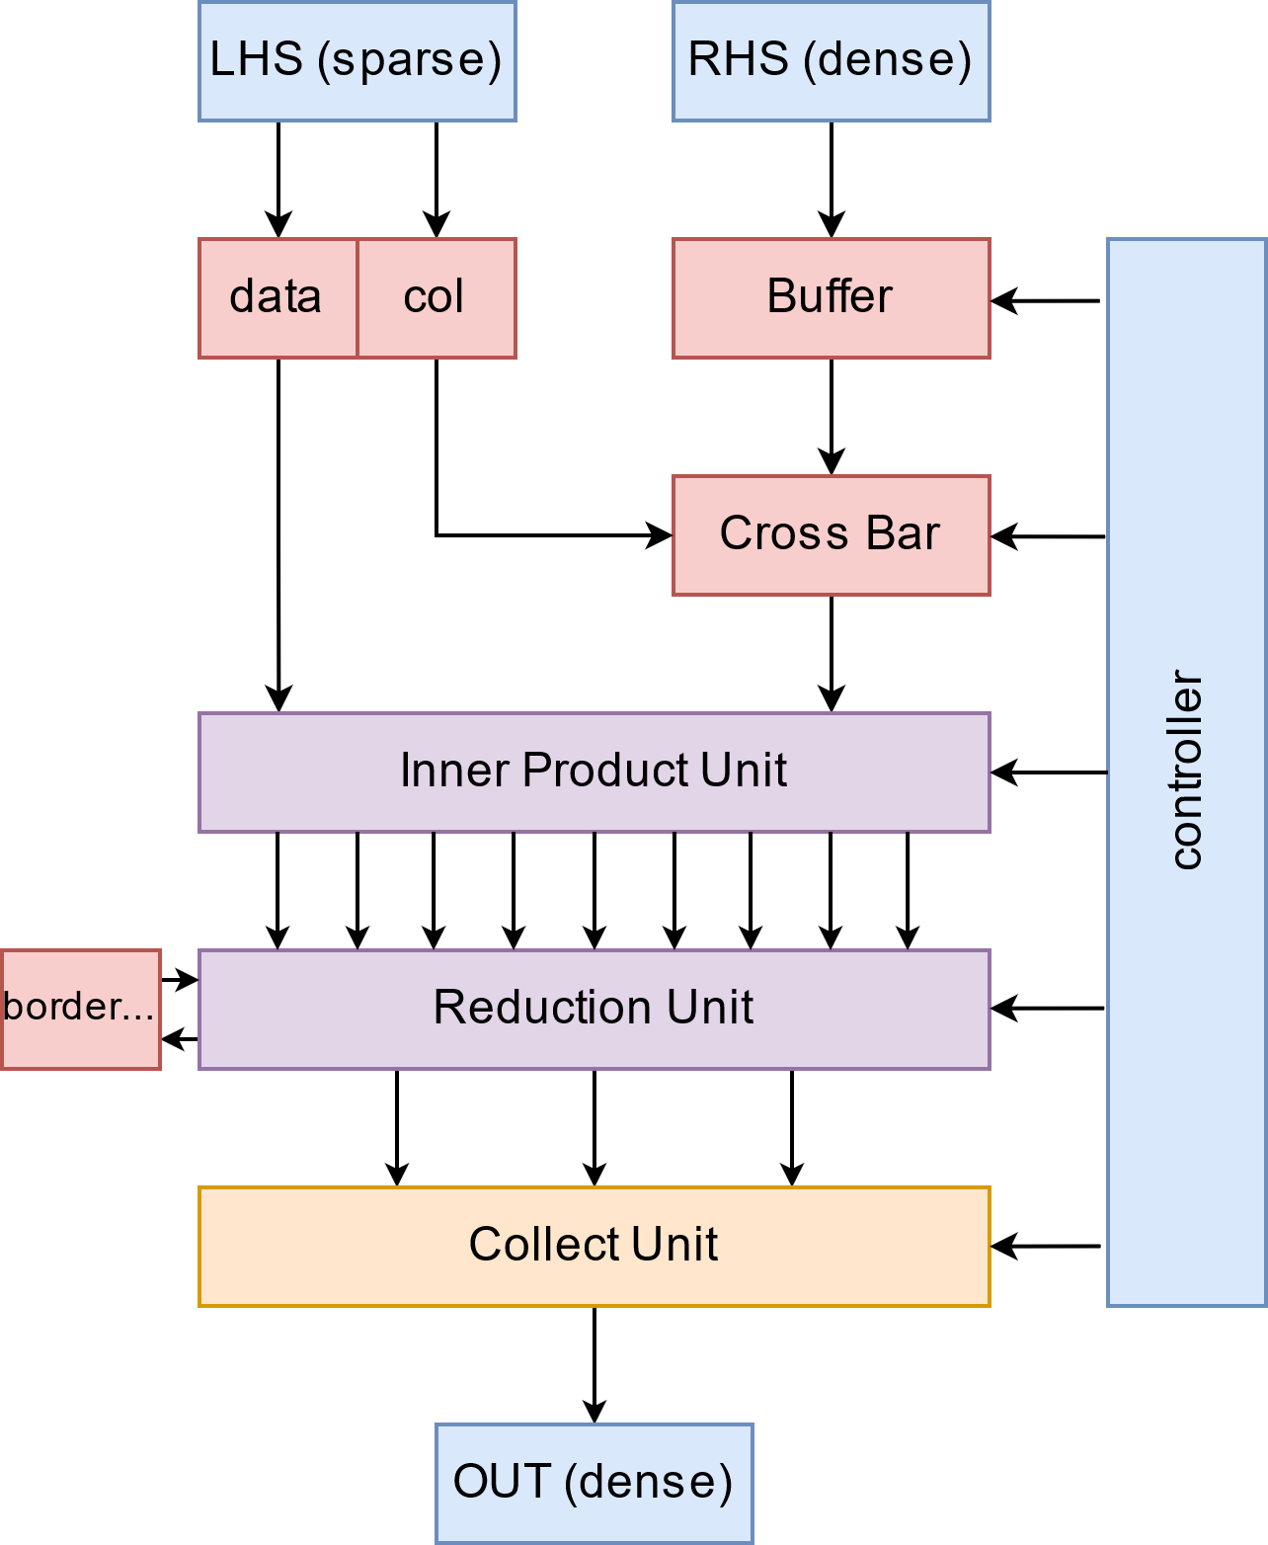
Architecture
class SpMMIO extends Bundle {
val start = Input(Bool())
val inputReady = Output(Bool())
val lhsRowIdx = Input(Vec(16, UInt(8.W)))
val lhsCol = Input(Vec(16, UInt(8.W)))
val lhsData = Input(Vec(16, UInt(8.W)))
val rhsReset = Input(Bool())
val rhsData = Input(Vec(16, UInt(8.W)))
val outData = Output(Vec(16, UInt(8.W)))
val outValid = Output(Bool())
}

Slide 20
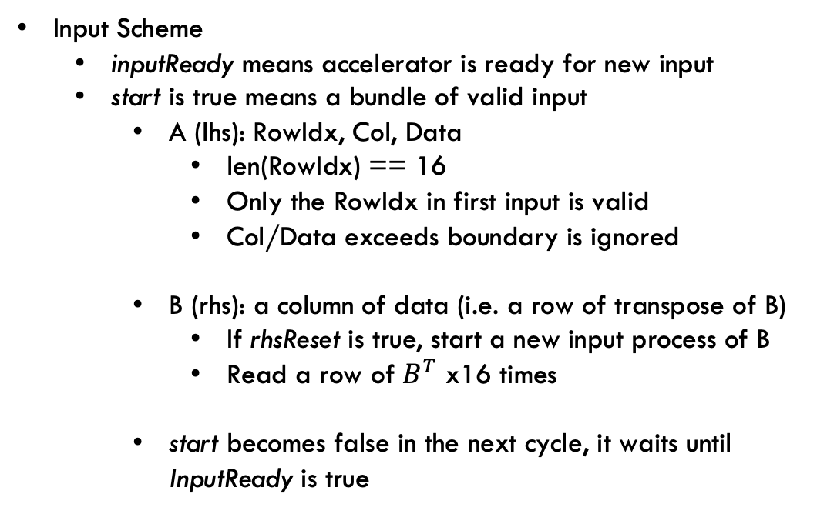
Input/Output
Input Scheme
inputReady means accelerator is ready for new input
start is true means a bundle of valid input
A (lhs): RowIdx, Col, Data
len(RowIdx) == 16
Only the RowIdx in first input is valid
Col/Data exceeds boundary is ignored
B (rhs): a column of data (i.e. a row of transpose of B)
If rhsReset is true, start a new input process of B
Read a row of $B^{T}$ x16 times
start becomes false in the next cycle, it waits until InputReady is true
inputReady
start
Accelerator
lhsRowIdx
RowIdx
A
lhsCol
Col
lhsData
Data
rhsReset
rhsData
Data
B

Slide 21
Input/Output
Output Scheme
outValid means accelerator outputs a column of C in outData
i.e. a row of transpose of C
testbench checks correctness when it receives all 16 columns of inputs
outValid
Accelerator
Notice
A, B being input to Accelerator only ONCE
The Accelerator is expected to buffer necessary data
See reference SystemC model in handout for better understanding of I/O scheme
outData
Data
C

Slide 22
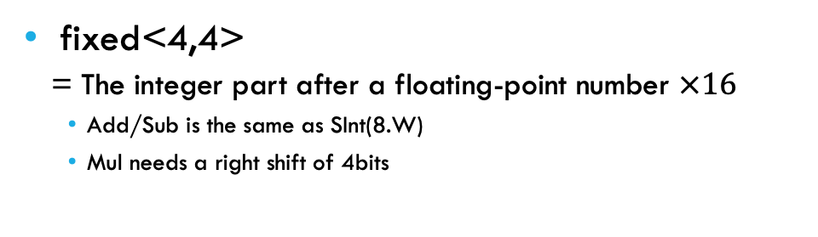
Datatype
fixed<4,4>
= The integer part after a floating-point number $×16$
Add/Sub is the same as SInt(8.W)
Mul needs a right shift of 4bits
7
6
5
4
3
2
1
0
package spmm
import chisel3._
object F44 {
def apply(): F44 = new F44
}
class F44 extends Bundle {
private val data = SInt(8.W)
private def arithFunc(f: (SInt, SInt) => Bits)(r: F44): F44 = {
val ret = Wire(F44())
ret.data := RegNext(f(data, r.data))
ret
}
def + (rhs: F44): F44 = arithFunc(_ + _)(rhs)
def - (rhs: F44): F44 = arithFunc(_ - _)(rhs)
def * (rhs: F44): F44 = arithFunc((a, b) => (a * b) >> 4)(rhs)
}

Slide 23

Hint
Level-0: You can treat sparse matrix as a dense one Process only one row each time Sum up with a reduction tree
Slot for A
5
Slot for B
0
4
8
12
Results of Mul
0
RowIdx
0
0
1
2
3
0
1
2
3
…
$$n$$
4
5
6
7
+
+
Col
0
0
2
3
1
…
3
8
9
10
11
+
5
Values
5
3
4
8
…
3
12
13
14
15
(0,0)
Matrix A
A Column of Matrix B

Slide 24
Hint
If you can select multiple rows concurrently You need to implement flexible reduction
Results of Mul
0
1
2
3
0
1
2
3
0
1
2
3
+
+
+
+
+
+

Slide 25
Hint
Level-1: Flexible Reduction with O(nlogn) adders, depth O(logn)
Results of Mul
0
1
2
3
0
1
2
3
0
1
2
3
+
+
+
+
+
+
+
+
+
+
+
+
+
+
+
+
+
+
Reduction Result
S
S
S
S
S
S

Slide 26

Hint
Level-2: Reduction with Prefix-Sum, O(n) adders, O(logn) depth
Row index [0,2]
-1
0
2
Results of Mul
0
1
2
3
Prefix Sum
0
0
1
3
6
+
+
Select
0
3
+
+
Substract
$$−$$
Sum of [0,2]
3
Prefix Sum
0
0
1
3
6
See binary indexed tree (Fenwick Tree) at https://oi-wiki.org/ds/fenwick/

Slide 27
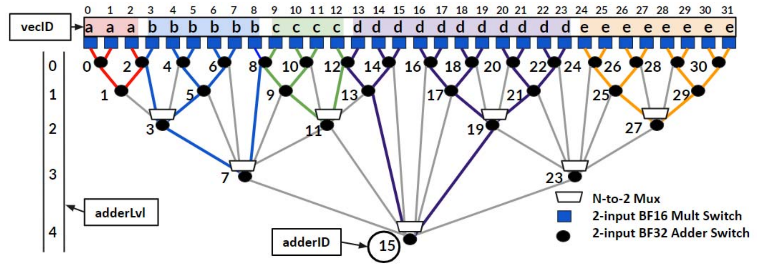
HINT
Level-3: Reduction with SOTA Structure See Qin, Eric, et al. "Sigma: A sparse and irregular gemm accelerator with flexible interconnects for dnn training." 2020 IEEE International Symposium on High Performance Computer Architecture (HPCA). IEEE, 2020.

Slide 28
Criterion & DDL
Concat TA:
彭伟桀 weijiepeng@pku.edu.cn
周可行 zhoukexing@pku.edu.cn
Functional Correctness (60%)
Passing testbench
Performance (30%)
Resources within constraints
Higher acceleration (less cycles), higher score
Detailed scoring rules will be released next week
Report & Interview (10%)
Explain your design in report and in face
Online meeting, reservation required
No Plagiarism
Copying others’ work will result in a score of ZERO
Please complete the project independently
Timeline
Today (2023.12.26)
Release project
Testbench will be available later
Next week (2024.1.2~)
Release detailed scoring rules for performance score
Submission DDL: 2024.1.21 23:59
Please submit your report & project file to course.pku.edu.cn
Interview period (TBA)
Online interview
Please make reservation in advance

Slide 29
Useful Resources
Qin, Eric, et al. "Sigma: A sparse and irregular gemm accelerator with flexible interconnects for dnn training." 2020 IEEE International Symposium on High Performance Computer Architecture (HPCA). IEEE, 2020.
Gao, Jianhua, et al. "A systematic survey of general sparse matrix-matrix multiplication." ACM Computing Surveys 55.12 (2023): 1-36.
https://oi-wiki.org/ds/fenwick/

