Slide 1
Pin Tutorial
Robert Cohn
Intel

Slide 2
About Me
Robert Cohn
    Original author of Pin
    Senior Principal Engineer at Intel
    Ph.D. in Computer Science Carnegie Mellon University
    Profile guided optimization, post link optimization, binary translation, instrumentation
    Robert.S.Cohn@intel.com
Today’s Agenda
        Morning: Pin Intro and Overview
        Afternoon: Advanced Pin

Slide 3
What is Instrumentation?
A technique that inserts extra code into a program to collect runtime information
counter++;
sub $0xff, %edx
cmp %esi, %edx
jle <L1>
mov $0x1, %edi
add $0x10, %eax
counter++;
counter++;
counter++;
counter++;
Notes:
Program analysis: Code coverage, call-graph generation, memory-leak detection
Architectural studies: Processor simulation, fault injection
Other binary-level instrumentation systems:
Static: ATOM, EEL, Etch, Morph
Dynamic: Dyninst, Vulcan, DTrace, Valgrind, Strata, DynamoRIO

Slide 4
Instrumentation Approaches
  Source instrumentation:
    Instrument source programs
  Binary instrumentation:
    Instrument executables directly
Advantages for binary instrumentation
Language independent
Machine-level view
Instrument legacy/proprietary software

Slide 5
Instrumentation Approaches
When to instrument:
Instrument statically – before runtime
Instrument dynamically – at runtime
Advantages for dynamic instrumentation
No need to recompile or relink
Discover code at runtime
Handle dynamically-generated code
Attach to running processes

Slide 6
How is Instrumentation used in Computer Architecture Research?
  Trace Generation
  Branch Predictor and Cache Modeling
  Fault Tolerance Studies
  Emulating Speculation
  Emulating New Instructions

Slide 7
How is Instrumentation used in Program Analysis?
  Code coverage
  Call-graph generation
  Memory-leak detection
  Instruction profiling
  Data dependence profiling
  Thread analysis
    Thread profiling
    Race detection

Slide 8
Advantages of Pin Instrumentation
Easy-to-use Instrumentation:
  Uses dynamic instrumentation
    Do not need source code, recompilation, post-linking
Programmable Instrumentation:
  Provides rich APIs to write in C/C++ your own instrumentation tools (called Pintools)
Multiplatform:
  Supports x86, x86-64, Itanium
  Supports Linux, Windows
Robust:
  Instruments real-life applications: Database, web browsers, …
  Instruments multithreaded applications
  Supports signals
Efficient:
  Applies compiler optimizations on instrumentation code

Slide 9
Widely Used and Supported
Large user base in academia and industry
    30,000 downloads
    400 citations
    Active mailing list (Pinheads)
Actively developed at Intel
    Intel products and internal tools depend on it
    Nightly testing of 25000 binaries on 15 platforms

Slide 10

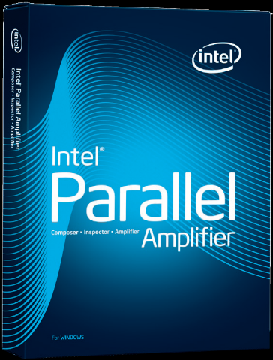
Program Analysis Products That Use Pin
Detects: memory leaks, uninitialized data, dangling pointer, deadlocks, data races
Performance analysis: concurrency, locking

Slide 11
Using Pin
Launch and instrument an application
  $ pin –t pintool.so –- application
Instrumentation engine
(provided in the kit)
Instrumentation tool
(write your own, or use one provided in the kit)
Attach to and instrument an application
  $ pin –mt 0 –t pintool.so –pid 1234

Slide 12
Pin Instrumentation APIs
Basic APIs are architecture independent:
  Provide common functionalities like determining:
    Control-flow changes
    Memory accesses
Architecture-specific APIs
  e.g., Info about opcodes and operands
Call-based APIs:
  Instrumentation routines
  Analysis routines

Slide 13
Instrumentation vs. Analysis
Concepts borrowed from the ATOM tool:
Instrumentation routines define where instrumentation is inserted
  e.g., before instruction
   Occurs first time an instruction is executed
Analysis routines define what to do when instrumentation is activated
  e.g., increment counter
   Occurs every time an instruction is executed

Slide 14
Pintool 1: Instruction Count
counter++;
sub $0xff, %edx
cmp %esi, %edx
jle <L1>
mov $0x1, %edi
add $0x10, %eax
counter++;
counter++;
counter++;
counter++;

Slide 15
Pintool 1: Instruction Count Output
  $ /bin/ls
  Makefile imageload.out itrace proccount imageload inscount0 atrace itrace.out
  $ pin -t inscount0.so -- /bin/ls
  Makefile imageload.out itrace proccount imageload inscount0 atrace itrace.out
Count 422838

Slide 16
ManualExamples/inscount0.cpp
#include <iostream>
#include "pin.h"
UINT64 icount = 0;
void docount() { icount++; }
void Instruction(INS ins, void *v)
{
INS_InsertCall(ins, IPOINT_BEFORE, (AFUNPTR)docount, IARG_END);
}
void Fini(INT32 code, void *v)
{ std::cerr << "Count " << icount << endl; }
int main(int argc, char * argv[])
{
PIN_Init(argc, argv);
INS_AddInstrumentFunction(Instruction, 0);
PIN_AddFiniFunction(Fini, 0);
PIN_StartProgram();
return 0;
}
analysis routine
instrumentation routine

Slide 17
Pintool 2: Instruction Trace
printip(ip);
sub $0xff, %edx
cmp %esi, %edx
jle <L1>
mov $0x1, %edi
add $0x10, %eax
printip(ip);
printip(ip);
printip(ip);
printip(ip);
Need to pass ip argument to the analysis routine (printip())

Slide 18
Pintool 2: Instruction Trace Output
  $ pin -t itrace.so -- /bin/ls
  Makefile imageload.out itrace proccount imageload inscount0 atrace itrace.out
$ head -4 itrace.out
    0x40001e90
    0x40001e91
    0x40001ee4
    0x40001ee5

Slide 19
ManualExamples/itrace.cpp
#include <stdio.h>
#include "pin.h"
FILE * trace;
void printip(void *ip) { fprintf(trace, "%p\n", ip); }
void Instruction(INS ins, void *v) {
INS_InsertCall(ins, IPOINT_BEFORE, (AFUNPTR)printip, IARG_INST_PTR, IARG_END);
}
void Fini(INT32 code, void *v) { fclose(trace); }
int main(int argc, char * argv[]) {
trace = fopen("itrace.out", "w");
PIN_Init(argc, argv);
INS_AddInstrumentFunction(Instruction, 0);
PIN_AddFiniFunction(Fini, 0);
PIN_StartProgram();
return 0;
}
argument to analysis routine
analysis routine
instrumentation routine

Slide 20
Examples of Arguments to Analysis Routine
IARG_INST_PTR
    Instruction pointer (program counter) value
IARG_UINT32 <value>
    An integer value
IARG_REG_VALUE <register name>
    Value of the register specified
IARG_BRANCH_TARGET_ADDR
    Target address of the branch instrumented
IARG_MEMORY_READ_EA
    Effective address of a memory read
  And many more … (refer to the Pin manual for details)

Slide 21
Instrumentation Points
Instrument points relative to an instruction:
  Before: IPOINT_BEFORE
  After:
    Fall-through edge: IPOINT_AFTER
    Taken edge: IPOINT_TAKEN_BRANCH
cmp %esi, %edx
jle <L1>
mov $0x1, %edi
count()
count()
count()
<L1>:
mov $0x8,%edi

Slide 22
Instrumentation Granularity
Instrumentation can be done at three different granularities:
  Instruction
  Basic block
    A sequence of instructions terminated at a control-flow changing instruction
    Single entry, single exit
  Trace
    A sequence of basic blocks terminated at an unconditional control-flow changing instruction
    Single entry, multiple exits
sub $0xff, %edx
cmp %esi, %edx
jle <L1>
mov $0x1, %edi
add $0x10, %eax
jmp <L2>
1 Trace, 2 BBs, 6 insts

Slide 23
Recap of Pintool 1: Instruction Count
counter++;
sub $0xff, %edx
cmp %esi, %edx
jle <L1>
mov $0x1, %edi
add $0x10, %eax
counter++;
counter++;
counter++;
counter++;
Straightforward, but the counting can be more efficient

Slide 24
Pintool 3: Faster Instruction Count
counter += 3
sub $0xff, %edx
cmp %esi, %edx
jle <L1>
mov $0x1, %edi
add $0x10, %eax
basic blocks (bbl)
counter += 2

Slide 25
ManualExamples/inscount1.cpp
#include <stdio.h>
#include "pin.H“
UINT64 icount = 0;
void docount(INT32 c) { icount += c; }
void Trace(TRACE trace, void *v) {
for (BBL bbl = TRACE_BblHead(trace);
BBL_Valid(bbl); bbl = BBL_Next(bbl)) {
BBL_InsertCall(bbl, IPOINT_BEFORE, (AFUNPTR)docount,
IARG_UINT32, BBL_NumIns(bbl), IARG_END);
}
}
void Fini(INT32 code, void *v) {
fprintf(stderr, "Count %lld\n", icount);
}
int main(int argc, char * argv[]) {
PIN_Init(argc, argv);
TRACE_AddInstrumentFunction(Trace, 0);
PIN_AddFiniFunction(Fini, 0);
PIN_StartProgram();
return 0;
}
analysis routine
instrumentation routine

Slide 26
Modifying Program Behavior
Pin allows you not only to observe but also change program behavior
Ways to change program behavior:
  Add/delete instructions
  Change register values
  Change memory values
  Change control flow

Slide 27
Instrumentation Library
#include <iostream>
#include "pin.H"
UINT64 icount = 0;
VOID Fini(INT32 code, VOID *v) {
std::cerr << "Count " << icount << endl;
}
VOID docount() {
icount++;
}
VOID Instruction(INS ins, VOID *v) {
INS_InsertCall(ins, IPOINT_BEFORE,(AFUNPTR)docount, IARG_END);
}
int main(int argc, char * argv[]) {
PIN_Init(argc, argv);
INS_AddInstrumentFunction(Instruction, 0);
PIN_AddFiniFunction(Fini, 0);
PIN_StartProgram();
return 0;
}
Instruction counting Pin Tool
#include <iostream>
#include "pin.h"
#include "instlib.h"
INSTLIB::ICOUNT icount;
VOID Fini(INT32 code, VOID *v) {
cout << "Count" << icount.Count() << endl;
}
int main(int argc, char * argv[]) {
PIN_Init(argc, argv);
PIN_AddFiniFunction(Fini, 0);
icount.Activate();
PIN_StartProgram();
return 0;
}
Notes:
User writes instrumentation routines:
Walk list of instructions, and
Insert calls to analysis routines
Pin invokes instrumentation routines when placing new instructions in code cache
Repeated execution uses already instrumented code in code cache
User inserts calls to analysis routine:
User-specified arguments
E.g., increment counter, record data address, …
User writes in C, C++, ASM
Pin provides isolation so analysis does not affect application
Optimizations like inlining, register allocation, and scheduling make it efficient

Slide 28
Useful InstLib Abstractions
ICOUNT
    # of instructions executed
FILTER
    Instrument specific routines or libraries only
ALARM
    Execution count timer for address, routines, etc.
CONTROL
    Limit instrumentation address ranges

Slide 29
Debugging Pintools
Invoke gdb (don’t “run”)
In another window, start your pintool with the “-pause_tool” flag
Go back to gdb window:
  Attach to the process, copy symbol command
  “cont” to continue execution; can set breakpoints as usual
$ gdb
(gdb)
$ pin –pause_tool 5 –t $HOME/inscount0.so -- /bin/ls
Pausing to attach to pid 32017
To load the tool’s debug info to use gdb
add-symbol-file …
(gdb) attach 32017
(gdb) add-symbol-file …
(gdb) break main
(gdb) cont

Slide 30
Pin Internals

Slide 31
Pin’s Software Architecture
Address space
Pintool
Pin
Instrumentation APIs
Virtual Machine (VM)
JIT Compiler
Code
Cache
Application
Emulation Unit
Operating System
Hardware

Slide 32
Instrumentation Approaches
JIT Mode
  Pin creates a modified copy of the application on-the-fly
  Original code never executes
  More flexible, more common approach
Probe Mode
  Pin modifies the original application instructions
  Inserts jumps to instrumentation code (trampolines)
  Lower overhead (less flexible) approach

Slide 33
JIT-Mode Instrumentation
Original code
Code cache
1
1’
Exits point back to Pin
2
3
2’
5
4
7’
6
7
Pin
Pin fetches trace starting block 1
and start instrumentation

Slide 34
JIT-Mode Instrumentation
Original code
Code cache
1
1’
2
3
2’
5
4
7’
6
7
Pin
Pin transfers control into
code cache (block 1)

Slide 35
JIT-Mode Instrumentation
Original code
Code cache
trace linking
1
1’
3’
2
3
2’
5’
5
4
7’
6’
6
7
Pin
Pin fetches and instrument
a new trace

Slide 36
Instrumentation Approaches
JIT Mode
  Pin creates a modified copy of the application on-the-fly
  Original code never executes
  More flexible, more common approach
Probe Mode
  Pin modifies the original application instructions
  Inserts jumps to instrumentation code (trampolines)
  Lower overhead (less flexible) approach

Slide 37
A Sample Probe
  A probe is a jump instruction that overwrites original instruction(s) in the application
    Instrumentation invoked with probes
    Pin copies/translates original bytes so probed functions can be called
  Entry point overwritten with probe:
  0x400113d4: jmp 0x41481064
  0x400113d9: push %ebx
  Original function entry point:
  0x400113d4: push %ebp
  0x400113d5: mov %esp,%ebp
  0x400113d7: push %edi
  0x400113d8: push %esi
  0x400113d9: push %ebx
Copy of entry point with original bytes:
  0x50000004: push %ebp
  0x50000005: mov %esp,%ebp
  0x50000007: push %edi
  0x50000008: push %esi
  0x50000009: jmp 0x400113d9

Slide 38
PinProbes Instrumentation
Advantages:
  Low overhead – few percent
  Less intrusive – execute original code
  Leverages Pin:
    API
    Instrumentation engine
Disadvantages:
  More tool writer responsibility
  Routine-level granularity (RTN)

Slide 39
Using Probes to Replace a Function
AFUNPTR origPtr = RTN_ReplaceProbed( RTN rtn,
AFUNPTR replacementFunction );
RTN_ReplaceProbed() redirects all calls to application routine rtn to the specified replacementFunction
    Arguments to the replaced routine and the replacement function are the same
    Replacement function can call origPtr to invoke original function
To use:
    Must use PIN_StartProgramProbed()

Slide 40
Using Probes to Call Analysis Functions
VOID RTN_InsertCallProbed( RTN rtn, IPOINT_BEFORE,
AFUNPTR (funptr), PIN_FUNCPROTO(proto),
IARG_TYPE, …, IARG_END);
RTN_InsertCallProbed() invokes the analysis routine before or after the specified rtn
    Use IPOINT_BEFORE or IPOINT_AFTER
    PIN IARG_TYPEs are used for arguments
To use:
    Must use RTN_GenerateProbes() or PIN_GenerateProbes()
    Must use PIN_StartProgramProbed()
    Application prototype is required

Slide 41
Tool Writer Responsibilities
No control flow into the instruction space where probe is placed
  6 bytes on IA32, 7 bytes on Intel64, 1 bundle on IA64
  Branch into “replaced” instructions will fail
  Probes at function entry point only
Thread safety for insertion and deletion of probes
  During image load callback is safe
  Only loading thread has a handle to the image
Replacement function has same behavior as original

Slide 42
Pin Probes Summary
 | PinProbes | PinClassic (JIT)
Overhead | Few percent | 50% or higher
Intrusive | Low | High
Granularity | Function boundary | Instruction
Safety & Isolation | More responsibility for tool writer | High

Slide 43
Pin Applications

Slide 44
Pin Applications
Sample tools in the Pin distribution:
  Cache simulators, branch predictors, address tracer, syscall tracer, edge profiler, stride profiler
Some tools developed and used inside Intel:
  Opcodemix (analyze code generated by compilers)
  PinPoints (find representative regions in programs to simulate)
Companies are writing their own Pintools
Universities use Pin in teaching and research
Notes:
A major database vendor, a major search engine provider
U. of Virginia, U. of Colorado, MIT, Harvard, Princeton, U of Minnesota, Northeastern, Tufts, University of Rochester, …

Slide 45
Compiler Bug Detection
Opcodemix uncovered a compiler bug for crafty
Instruction Type | Compiler A Count | Compiler B Count | Delta
*total | 712M | 618M | -94M
XORL | 94M | 94M | 0M
TESTQ | 94M | 94M | 0M
RET | 94M | 94M | 0M
PUSHQ | 94M | 0M | -94M
POPQ | 94M | 0M | -94M
JE | 94M | 0M | -94M
LEAQ | 37M | 37M | 0M
JNZ | 37M | 131M | 94M

Slide 46
Thread Checker Basics
Detect common parallel programming bugs:
  Data races, deadlocks, thread stalls, threading API usage violations
Instrumentation used:
  Memory operations
  Synchronization operations (via function replacement)
  Call stack
Pin-based prototype
  Runs on Linux, x86 and x86_64
  A Pintool ~2500 C++ lines

Slide 47
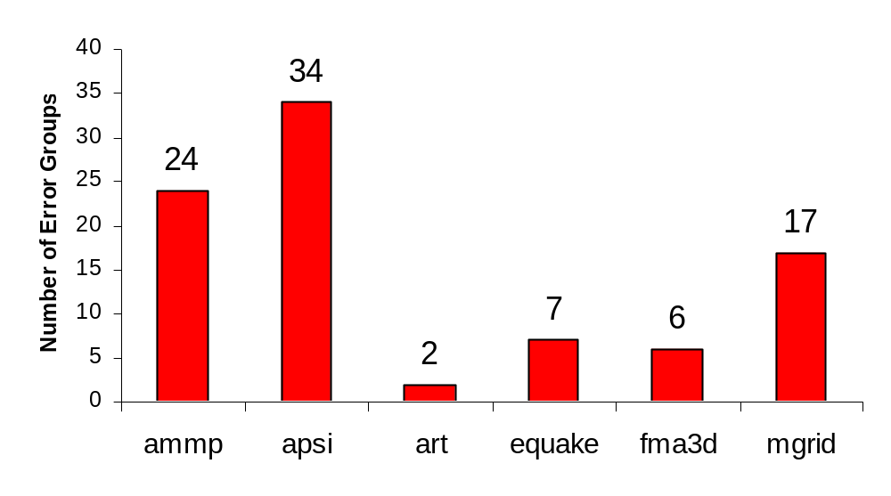
Thread Checker Results
Potential errors in SPECOMP01 reported by Thread Checker
(4 threads were used)

Slide 48
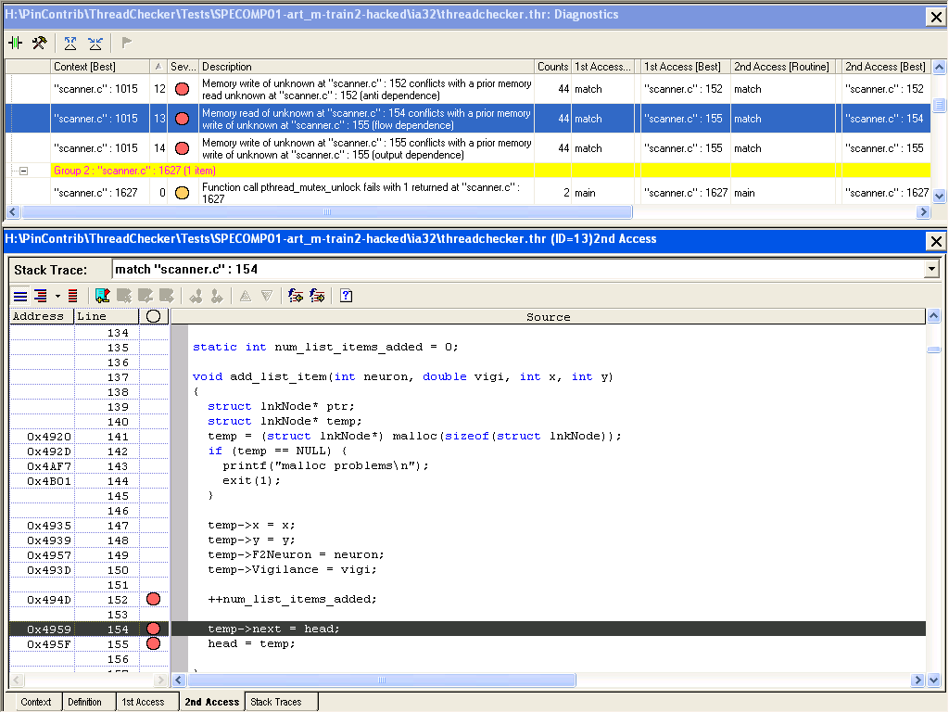
a documented data race in the art benchmark is detected

Slide 49
Instrumentation-Driven Simulation
Fast exploratory studies
  Instrumentation ~= native execution
  Simulation speeds at MIPS
Characterize complex applications
  E.g. Oracle, Java, parallel data-mining apps
Simple to build instrumentation tools
  Tools can feed simulation models in real time
  Tools can gather instruction traces for later use

Slide 50
Performance Models
Branch Predictor Models:
  PC of conditional instructions
  Direction Predictor: Taken/not-taken information
  Target Predictor: PC of target instruction if taken
Cache Models:
  Thread ID (if multi-threaded workload)
  Memory address
  Size of memory operation
  Type of memory operation (Read/Write)
Simple Timing Models:
  Latency information

Slide 51
Branch Predictor Model
Pin
API data
BPSim
Pin Tool
Branch instr info
BP
Model
API()
Instrumentation Tool
Instrumentation Routines
Analysis Routines
BPSim Pin Tool
  Instruments all branches
  Uses API to set up call backs to analysis routines
Branch Predictor Model:
  Detailed branch predictor simulator

Slide 52
BP Implementation
BranchPredictor myBPU;
VOID ProcessBranch(ADDRINT PC, ADDRINT targetPC, bool BrTaken) {
BP_Info pred = myBPU.GetPrediction( PC );
if( pred.Taken != BrTaken ) {
// Direction Mispredicted
}
if( pred.predTarget != targetPC ) {
// Target Mispredicted
}
myBPU.Update( PC, BrTaken, targetPC);
}
VOID Instruction(INS ins, VOID *v)
{
if( INS_IsDirectBranchOrCall(ins) || INS_HasFallThrough(ins) )
INS_InsertCall(ins, IPOINT_BEFORE, (AFUNPTR) ProcessBranch,
ADDRINT, INS_Address(ins),
IARG_UINT32, INS_DirectBranchOrCallTargetAddress(ins),
IARG_BRANCH_TAKEN, IARG_END);
}
int main() {
PIN_Init();
INS_AddInstrumentationFunction(Instruction, 0);
PIN_StartProgram();
}
ANALYSIS
INSTRUMENT
MAIN

Slide 53
Performance Model Inputs
Branch Predictor Models:
  PC of conditional instructions
  Direction Predictor: Taken/not-taken information
  Target Predictor: PC of target instruction if taken
Cache Models:
  Thread ID (if multi-threaded workload)
  Memory address
  Size of memory operation
  Type of memory operation (Read/Write)
Simple Timing Models:
  Latency information

Slide 54
Cache Simulators
Pin
API data
Cache
Pin Tool
Mem Addr info
Cache
Model
API()
Instrumentation Tool
Instrumentation Routines
Analysis Routines
Cache Pin Tool
  Instruments all instructions that reference memory
  Use API to set up call backs to analysis routines
Cache Model:
  Detailed cache simulator

Slide 55
Cache Implementation
CACHE_t CacheHierarchy[MAX_NUM_THREADS][MAX_NUM_LEVELS];
VOID MemRef(int tid, ADDRINT addrStart, int size, int type) {
for(addr=addrStart; addr<(addrStart+size); addr+=LINE_SIZE)
LookupHierarchy( tid, FIRST_LEVEL_CACHE, addr, type);
}
VOID LookupHierarchy(int tid, int level, ADDRINT addr, int accessType){
result = cacheHier[tid][cacheLevel]->Lookup(addr, accessType );
if( result == CACHE_MISS ) {
if( level == LAST_LEVEL_CACHE ) return;
LookupHierarchy(tid, level+1, addr, accessType);
}
}
VOID Instruction(INS ins, VOID *v)
{
if( INS_IsMemoryRead(ins) )
INS_InsertCall(ins, IPOINT_BEFORE, (AFUNPTR) MemRef,
IARG_THREAD_ID, IARG_MEMORYREAD_EA, IARG_MEMORYREAD_SIZE,
IARG_UINT32, ACCESS_TYPE_LOAD, IARG_END);
if( INS_IsMemoryWrite(ins) )
INS_InsertCall(ins, IPOINT_BEFORE, (AFUNPTR) MemRef,
IARG_THREAD_ID, IARG_MEMORYWRITE_EA, IARG_MEMORYWRITE_SIZE,
IARG_UINT32, ACCESS_TYPE_STORE, IARG_END);
}
int main() {
PIN_Init();
INS_AddInstrumentationFunction(Instruction, 0);
PIN_StartProgram();
}
ANALYSIS
INSTRUMENT
MAIN

Slide 56
Moving from 32-bit to 64-bit Applications
Benchmark | Language | 64-bit vs. 32-bit speedup
perlbench | C | 3.42%
bzip2 | C | 15.77%
gcc | C | -18.09%
mcf | C | -26.35%
gobmk | C | 4.97%
hmmer | C | 34.34%
sjeng | C | 14.21%
libquantum | C | 35.38%
h264ref | C | 35.35%
omnetpp | C++ | -7.83%
astar | C++ | 8.46%
xalancbmk | C++ | -13.65%
Average |  | 7.16%
  How to identify the reasons for these performance results?
  Profiling with Pin!
Ye06, IISWC2006

Slide 57
Main Observations
In 64-bit mode:
Code size increases (10%)
Dynamic instruction count decreases
Code density increases
L1 icache request rate increases
L1 dcache request rate decreases significantly
Data cache miss rate increases

Slide 58
Instrumentation-Based Simulation
  Simple compared to detailed models
  Can easily run complex applications
  Provides insight on workload behavior over their entire runs in a reasonable amount of time
Illustrated the use of Pin for:
  Program Analysis
    Bug detection, thread analysis
  Computer architecture
    Branch predictors, cache simulators, timing models, architecture width
  Architecture changes
    Moving from 32-bit to 64-bit

