Slide 1



Hello! C#

Slide 2

Day 1 outline
Introduction to C#
Program Structure
Types of Variables
Expressions
Statements
Classes and Objects
Structs
Arrays
Interfaces
Enums
Delegates
Attributes

Slide 3
Day 1 outline
Object Oriented Programming in C#
Encapsulation
Polymorphism
Abstraction
Inheritance
Object Manipulation using LINQ
Managing your Code
Git Repository
Introduction to Azure DevOps

Slide 4
introduction
C# is a modern, general-purpose, object-oriented programming language developed by Microsoft and approved by European Computer Manufacturers Association (ECMA) and International Standards Organization (ISO).
C# was developed by Anders Hejlsberg and his team during the development of .Net Framework.

Slide 5
Program structure
Namespace declaration
A class
Class methods
Class attributes
A Main method
Statements and Expressions
Comments

Slide 6
Expressions
Expressions are constructed from operands and operators. The operators of an expression indicate which operations to apply to the operands. Examples of operators include +, -, *, /, and new. Examples of operands include literals, fields, local variables, and expressions.

Slide 7
TYPES OF VARIABLES
Integral types | sbyte, byte, short, ushort, int, uint, long, ulong, and char,string
Floating point types | float and double
Decimal types | Decimal
Boolean types | true or false values, as assigned
Nullable types | Nullable data types

Slide 8
STATEMENTS
Actions in program are expressed in statements.
Block
Consists of list statements written between the delimiters “ { } “
Declaration Statement
Are used to declare local variables and constants
Selection Statement
Are used to select one possible statement. We usually use “if” and “switch” condition
Expression Statement
Method invocation, object allocation using “new”, increment and decrement operations using “++” or “--”
Jump Statement
Are used to transfer control.
In this group are continue; / break; / throw; / return; / yield;

Slide 9
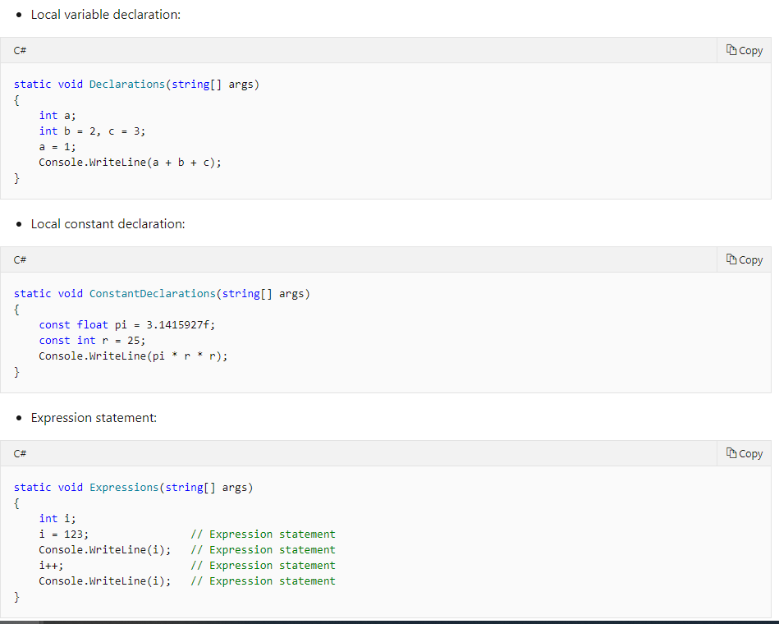
STATEMENTS

Slide 10
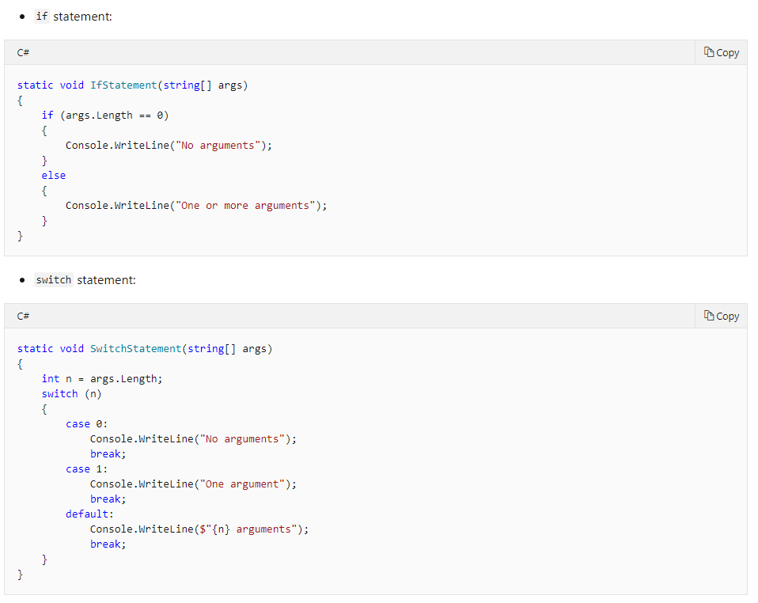
STATEMENTS

Slide 11
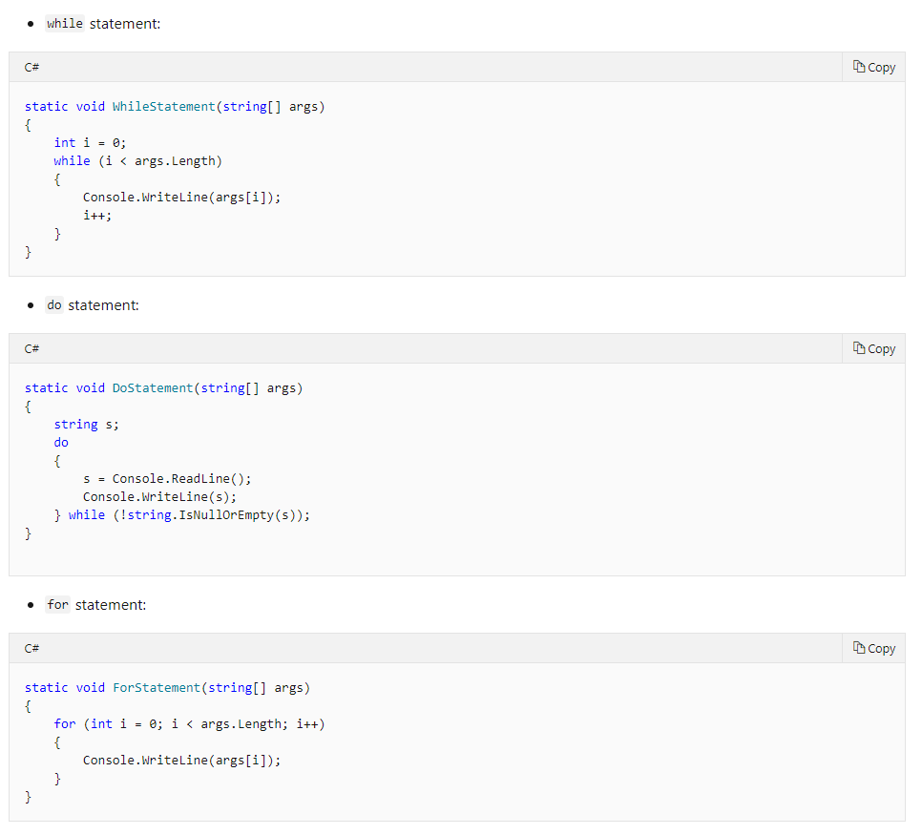
STATEMENTS

Slide 12
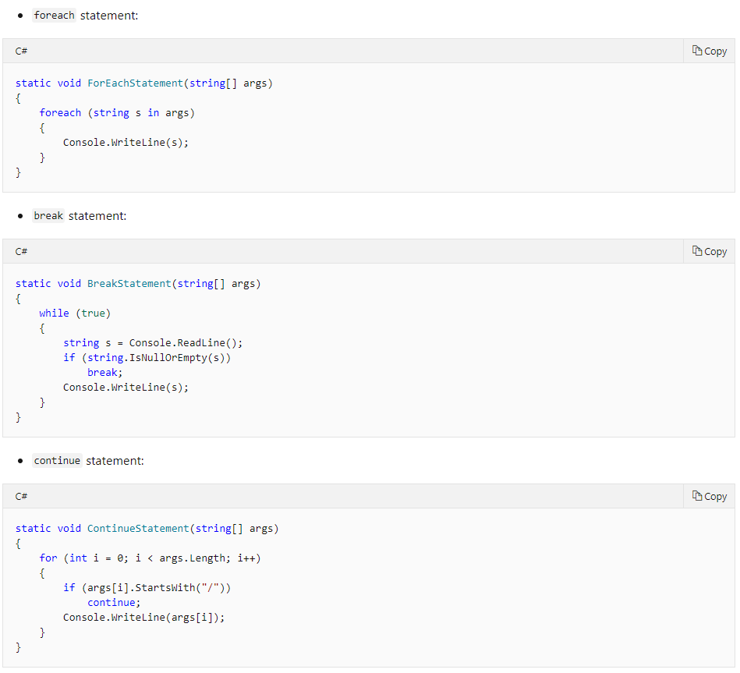
STATEMENTS

Slide 13
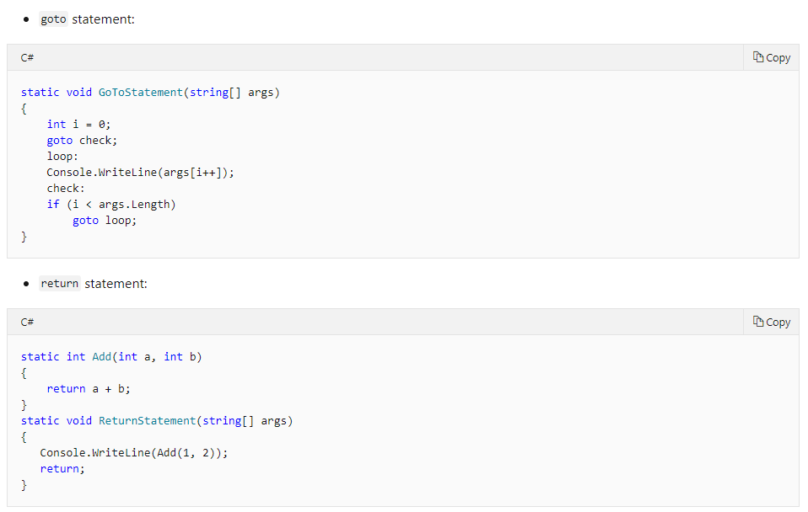
STATEMENTS

Slide 14
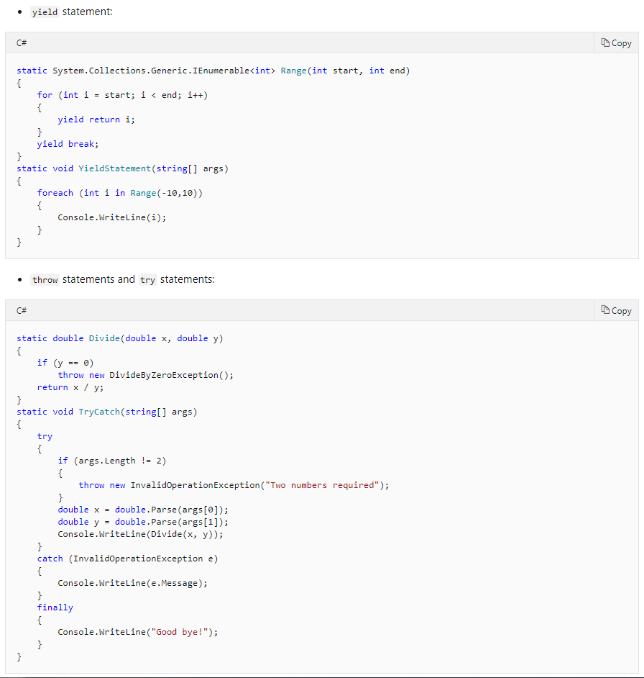
STATEMENTS

Slide 15
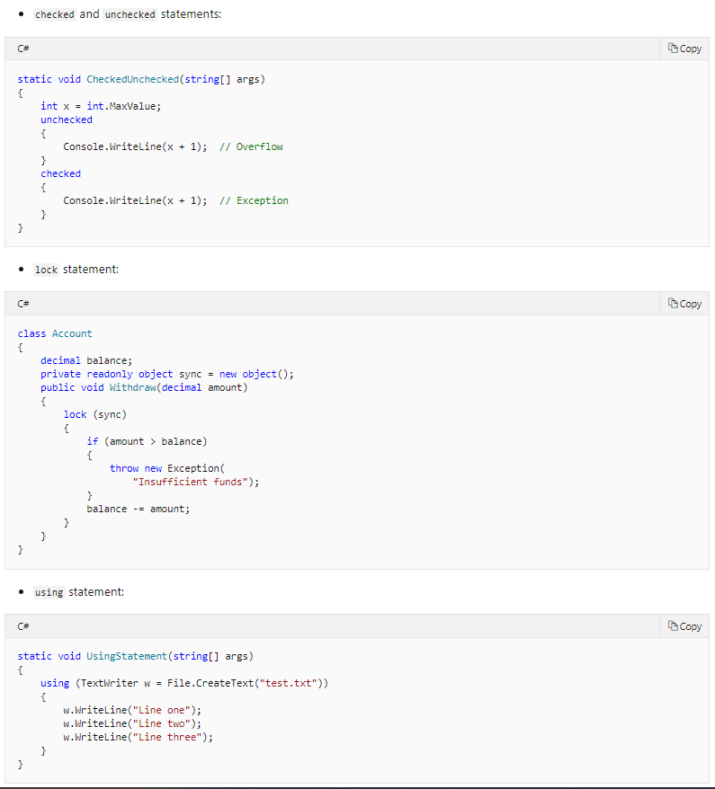
STATEMENTS

Slide 16
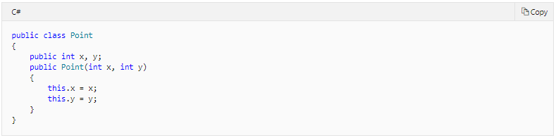
Classes and objects
Class is the most fundamental type in C#

Slide 17
Members
Constants
Constant values associated with the class
Fields
Variables of the class
Methods
Computations and actions that can be performed by the class
Properties
Actions associated with reading and writing named properties of the class
Indexers
Actions associated with indexing instances of the class like an array
Events
Notifications that can be generated by the class
Operators
Conversions and expression operators supported by the class
Constructors
Actions required to initialize instances of the class or the class itself
Finalizers
Actions to perform before instances of the class are permanently discarded
Types
Nested types declared by the class

Slide 18
Accessibility
Each member of a class has an associated accessibility, which controls the regions of program text that are able to access the member. There are six possible forms of accessibility. These are summarized below.
public
Access not limited
protected
Access limited to this class or classes derived from this class
internal
Access limited to the current assembly (.exe, .dll, etc.)
protected internal
Access limited to the containing class, classes derived from the containing class, or classes within the same assembly
private
Access limited to this class
private protected
Access limited to the containing class or classes derived from the containing type within the same assembly

Slide 19
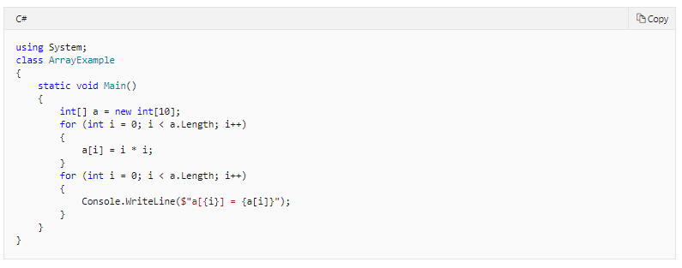
Arrays
An array is a data structure that contains a number of variables that are accessed through computed indices

Slide 20
OBJECT ORIENTED PROGRAMMING in C#

Slide 21
Object Oriented Programming
Object Oriented Programming (OOP) is a programming model where programs are organized around objects and data rather than action and logic.
OOP allows decomposition of a problem into a number of entities called objects and then builds data and functions around these objects. The software is divided into a number of small units called objects. The data and functions are built around these objects.
The data of the objects can be accessed only by the functions associated with that object.
The functions of one object can access the functions of another object.

Slide 22
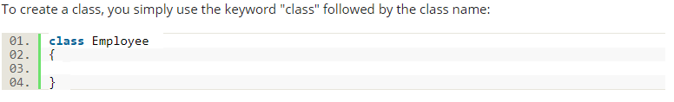
Important features of OOP
Class
A class is the core of any modern Object Oriented Programming language such as C#.
In OOP languages it is mandatory to create a class for representing data.

Slide 23
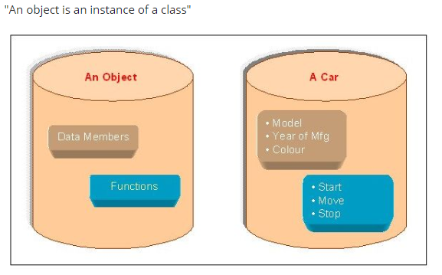
Important features of OOP
Object
Objects are the basic run-time entities of an object oriented system. They may represent a person, a place or any item that the program must handle. "An object is a software bundle of related variable and methods." "An object is an instance of a class"

Slide 24
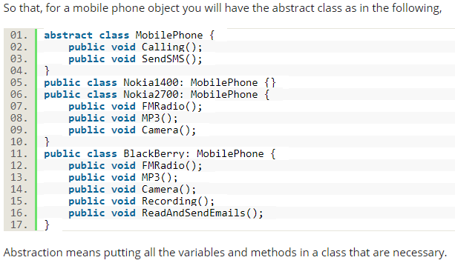
Pillars of OOP
Abstraction
Abstraction is "To represent the essential feature without representing the background details." Abstraction lets you focus on what the object does instead of how it does it.

Slide 25
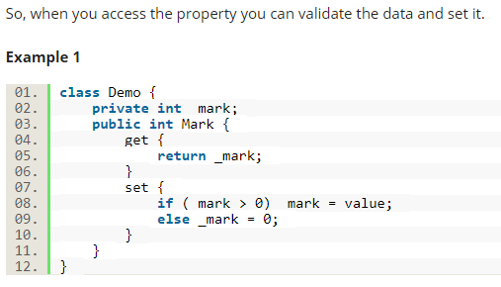
Pillars of OOP
Encapsulation
Wrapping up a data member and a method together into a single unit (in other words class) is called Encapsulation.
Encapsulation is like enclosing in a capsule. That is enclosing the related operations and data related to an object into that object.

Slide 26
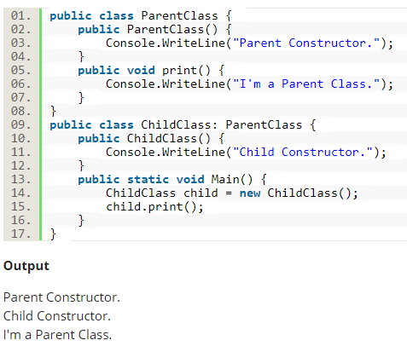
Pillars of OOP
Inheritance
When a class includes a property of another class it is known as inheritance.
Inheritance is a process of object reusability.
For example, a child includes the properties of its parents.

Slide 27
Pillars of OOP
Polymorphism
Polymorphism means one name, many forms.
One function behaves in different forms.
In other words, "Many forms of a single object is called Polymorphism.“
Real-world Example of Polymorphism
Example 1
A teacher behaves students.
A teacher behaves his/her seniors.
Here teacher is an object but the attitude is different in different situations.
Example 2
A person behaves the son in a house at the same time that the person behaves an employee in an office.
Example 3
Your mobile phone, one name but many forms:
As phone
As camera
As mp3 player
As radio

Slide 28
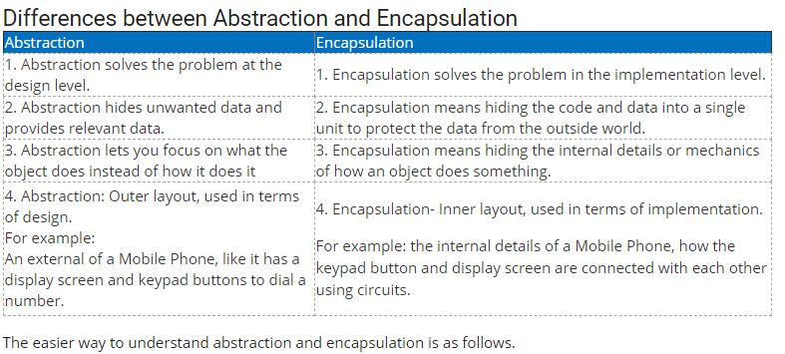
Pillars of OOP

Slide 29
.NET Web API 2.0

Slide 30
Routing Tables
API Controller
is a class that handles HTTP requests
Controller default route template (api/{controller}/{action})
Routing Variations
[HttpGet]
[HttpPost]
[HtpDelete]
[HttpPut]
Attributing Route in Web API 2.0
[Route("customers/{customerId}/orders")] [HttpGet] public IEnumerable<Order> FindOrdersByCustomer(int customerId)

Slide 31
Working with Data
Add models and controllers
Seed Database
Handling Entity Relationship
Create Data Transformation Objects

Slide 32
More exciting learning on day 2!

