Slide 1




Slide 2


Slide 3
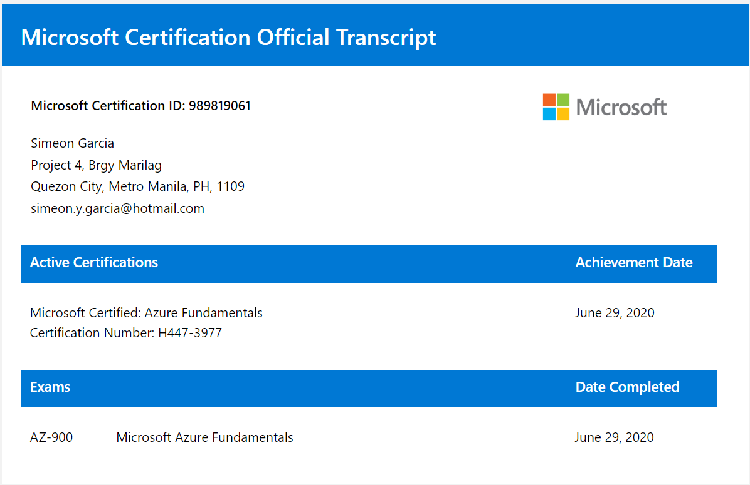

Slide 4
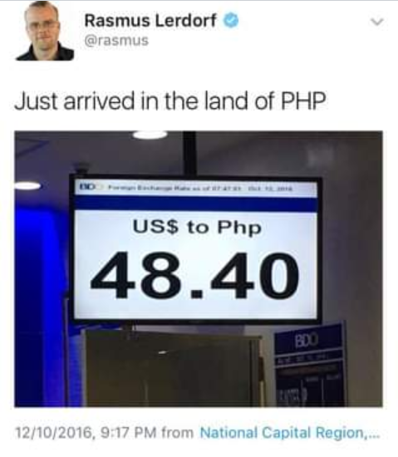
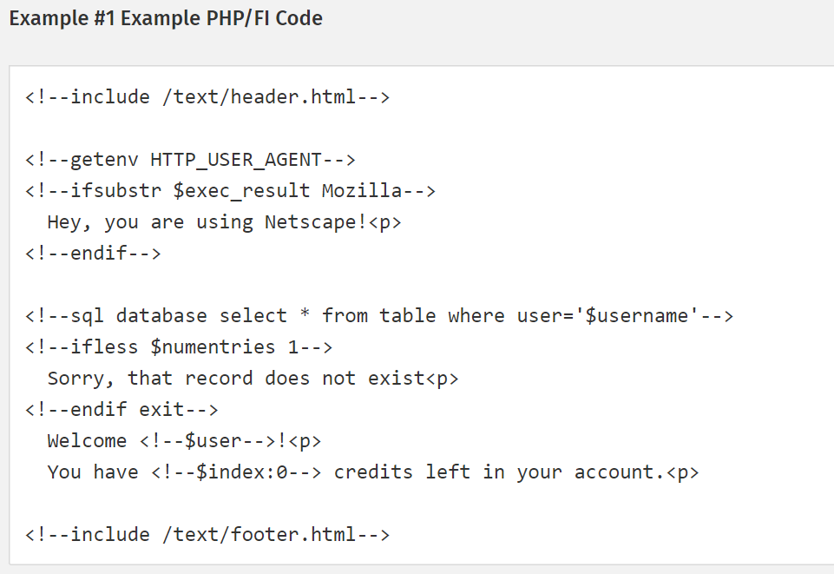
PHP History
PHP as it's known today is actually the successor to a product named PHP/FI. Created in 1994 by Rasmus Lerdorf

Slide 5
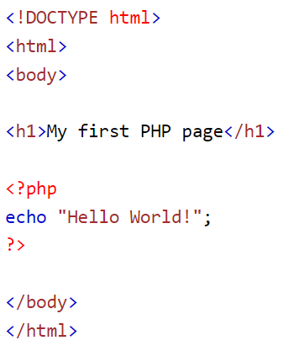
PHP + HTML Starter

Slide 6
Variables and Data Types
String
Integer
Float (floating point numbers - also called double)
Boolean
Array
Object
NULL
Resource

Slide 7
Variables and Data Types
Hands-On

Slide 8
Functions
A function is a self-contained block of code that performs a specific task.
Built-In
Can call directly within your PHP scripts to perform a specific task, like gettype(), print_r(), var_dump, etc.
User Defined
PHP also allows you to define your own functions. It is a way to create reusable code packages

Slide 9
Advantages of Functions
Functions reduces the repetition of code within a program
Functions makes the code much easier to maintain.
Functions makes it easier to eliminate the errors
Functions can be reused in other application

Slide 10
Functions
Hands-On

Slide 11
Conditional Statements
This means, you can create test conditions in the form of expressions that evaluates to either true or false and based on these results you can perform certain actions.
if
if else
if..elseif..else or switch..case
Ternary operator

Slide 12
Conditional Statement
Hands-On

Slide 13
Loops
Loops are used to execute the same block of code again and again, as long as a certain condition is met.
while — loops through a block of code as long as the condition specified evaluates to true.
do…while — the block of code executed once and then condition is evaluated. If the condition is true the statement is repeated as long as the specified condition is true.
for — loops through a block of code until the counter reaches a specified number.
foreach — loops through a block of code for each element in an array.

Slide 14
Loops
Hands-On

Slide 15
PHP GET and POST
A web browser communicates with the server typically using one of the two HTTP (Hypertext Transfer Protocol) methods — GET and POST.
Both methods pass the information differently and have different advantages and disadvantages

Slide 16
PHP GET Method
n GET method the data is sent as URL parameters that are usually strings of name and value pairs separated by ampersands (&). In general, a URL with GET data will look like this:
http://www.example.com/action.php?name=john&age=24

Slide 17
Pros and Cons of GET Method
Since the data sent by the GET method are displayed in the URL, it is possible to bookmark the page with specific query string values.
The GET method is not suitable for passing sensitive information such as the username and password, because these are fully visible in the URL query string as well as potentially stored in the client browser's memory as a visited page.
Because the GET method assigns data to a server environment variable, the length of the URL is limited. So, there is a limitation for the total data to be sent.

Slide 18
GET Method
Hands-On

Slide 19
PHP POST Method
In POST method the data is sent to the server as a package in a separate communication with the processing script. Data sent through POST method will not visible in the URL.

Slide 20
Pros and Cons of GET Method
It is more secure than GET because user-entered information is never visible in the URL query string or in the server logs.
There is a much larger limit on the amount of data that can be passed, and one can send text data as well as binary data (uploading a file) using POST.
Since the data sent by the POST method is not visible in the URL, so it is not possible to bookmark the page with specific query.

Slide 21
POST Method
Hands-On

Slide 22


