Slide 1
https://groundgurus.net
https://www.youtube.com/@groundgurus

Slide 2
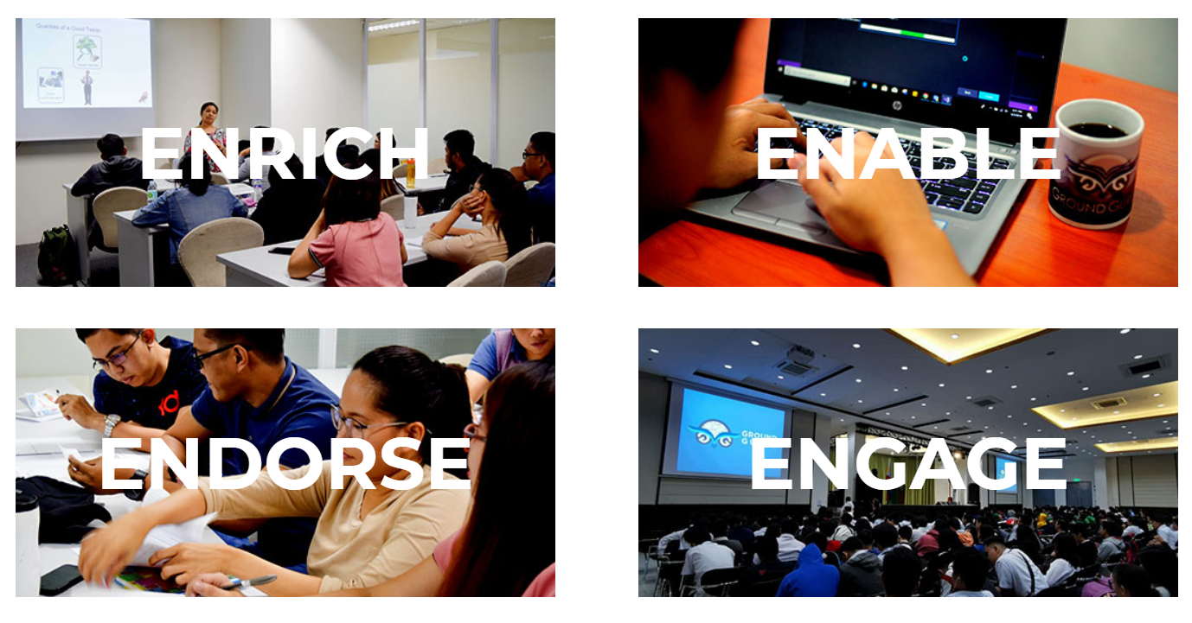
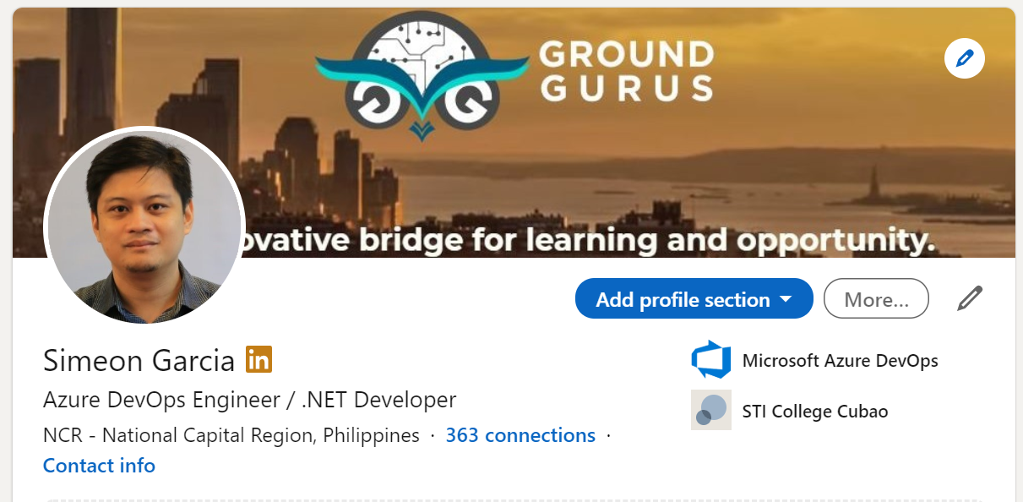
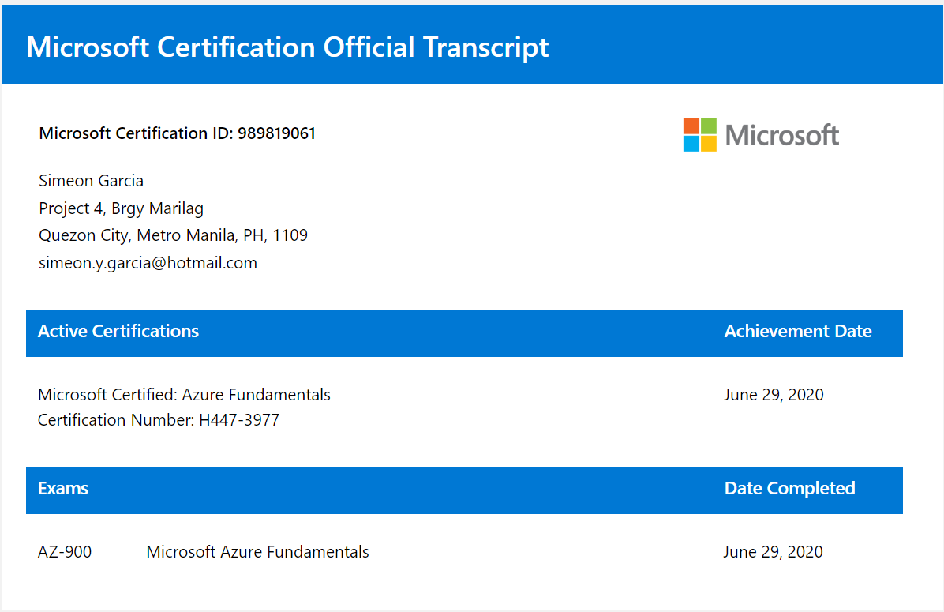
Phone: 09171100312
Email: groundgurus2017@gmail.com
Facebook page: groundgurus
Twitter: https://twitter.com/groundgurus
Facebook page: https://www.facebook.com/groundgurus
Linkedin: https://www.linkedin.com/company/ground-gurus/
Youtube: https://www.youtube.com/@groundgurus

Slide 3
.NET MAUI and Web API Development

Slide 4
Session 1 (A.M)
C# Introduction
Visual Studio Installation and Setup
Basic C#
Variables / Data Type / Flow Control / Methods
Input and Ouput
Advance C#
C# Object Oriented Programming
Access Modifiers / Constructors
Inheritance / Interface / Dependency Injection
C# Lambda
.NET Web API Introduction
REST and Web API
Online Shop API Project
Defining the API Project Structure
API Testing (Postman / PHP)
Database Development
Online Shopping Database Overview
Database Interpretation using Entity Framework Core (EF Core)
Code First
Database First
Adding C.R.U.D (Create/Retrieve/Update/Delete) Code Baseline in the API
CRUD Transaction Testing

Slide 5
Session 2 (P.M)
.NET MAUI Mobile App Development
.NET MAUI In a Nutshell
Introduction to XAML Language
Basic Pages
Layouts
Controls
Mini App 1 – Travel Info App
Flyouts
Menu
Tabbed layouts
SQLite
SQLite Overview
Package Installation and Configuration
Creating Database Models
SQLite Data Types
Database Connection
Database Class and Tables
SQLite CRUD Baseline
MOCK API for .NET MAUI
Mockapi.io registration
Creating HTTP Objects
Sample CRUD API

Slide 6
Tool Installation / Setup
VS Pro/Ent
.NET version (8 or 9)
Test Project
Visual Studio Code (optional for Session 1 and 2)
SQL Server
SSMS Installation
SQl Developer
SQL Project Test
.NET MAUI
SDK Installation for Android Development
Emulator Setup and Test
Nugget Packages

Slide 7
C# Introduction An Object-Oriented Ready Programming Language
Variables – symbolic name given to a memory location.
Private / Public declaration
Data Types
Primitive or simple data types
Collections
Flow Control
If else condition – use for comparison or test conditions
switch
Loops – incremental / decremental
Advance
Lambda Expressions
Anonymous Types

Slide 8
C# Object Oriented Programming – Part 1
C# Classes – blueprint of the project
C# Objects is an instance of a class
Method – code block that performs a specific tasks.
Calling and Declaring
Return Type
Constructor – same as a method
Does not have return type
Parameterized and Default Type Constructor

Slide 9
C# Object Oriented Programming – Part 2
C# Inheritance – creates new class from an existing class
Single Inheritance and Multilevel
Nested Class – define a class within another class.
Calling and Declaring
Return Type

Slide 10
C# Collections Provides an easy way to work with a group of objects
List – multiple objects of the same data type that can be accessed using index.
ArrayList – stores elements of multiple data types whose size can be changed.
Dictionary – is a generic collection that consist of elements as key/value pairs that are sorted in an order.

Slide 11
.NET Web API
Data Service for ALL

Slide 12
REST and Web API
REST (Representational State Transfer)
HTTP verbs (POST,GET,PUT,DELETE,UPDATE)
Supported input/ouput formats
Web API – focused on providing Data. Part of the Back-end system
Capable of securing and sharing data to other web and mobile application

Slide 13
.NET Core Web API
Setting up a .Net Web API Project
Project Structure
NuGet packages
Simple API Project
Using HTTP Verbs on API End Points
Implementing Best Practices
API Documentation
Setting Up Swagger UI

Slide 14
Online Shop Web API Project
Expanding Project structure
Project Structure
NuGet packages
Defining Data Structure / Entity
Entity Framework Core for Database Development
Online Shop Database Schema
Modeling our Data

