Slide 1
DATA MINING
Joko Suntoro
jokosuntoro@usm.ac.id
SMS/Telp: 082242369670
WA/Telegram: 085641970170
http://jokosuntoro.com

Slide 2

Joko Suntoro
SDN Pandean Lamper 03 Semarang (2001)
SMPN 32 Semarang (2004)
SMA Institut Indonesia Semarang (2007)
S1 Teknik Informatika Universitas Semarang (2010-2015)
S2 Teknik Informatika Universitas Dian Nuswantoro (2015-2016)
Tim Operasi dan Teknik, Domestic Gas PT Pertamina (Persero) (2008-sekarang)
Dosen dan Peneliti di Fakultas Teknologi Informasi dan Komunikasi Universitas Semarang
Peneliti dan Reviewer di Romi Satria Wahono (RSW) Intelligent System Research Group
Bidang Penelitian: Data Mining, Intelligent System dan Machine Learning

Slide 3
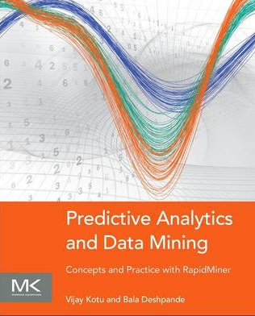


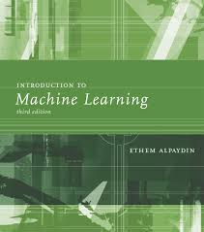
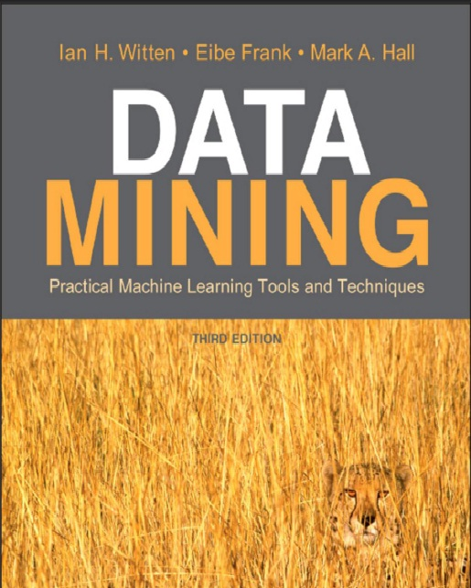

Textbooks

Slide 4
Referensi
Bache, K., & Lichman, M. (2013). UCI Machine Learning Repository. Retrieved from http://www.ics.uci.edu/~mlearn/MLRepository.html
Ethem Alpaydin. Introduction to Machine Learning. 3rd ed. MIT Press. 2014
Harrington, P. (2012). Machine Learning in Action. United States of America: Manning Publications Co.
Hofmann, M., & Klinkenberg, R. (2013). Rapid Miner Data Mining Use Cases and Business Analytics Applications. CRC Press Taylor & Francis Group
Ian H. Witten, Frank Eibe, Mark A. Hall. Data mining: Practical Machine Learning Tools and Techniques 3rd Edition. Elsevier. 2011
Jiawei Han and Micheline Kamber. Data Mining: Concepts and Techniques Third Edition. Elsevier. 2012
Lantz, Brett. Machine Learning with R. Packt Publishing. 2013
Larose, D. T. (2006). Data Mining Methods and Models. Data Mining Methods and Models. Canada: Willey Publishing, Inc.
Noth, Matthew. Data Mining for The Masses. Creative Commons Attribution. 2012
V. Kotu, Predictive analytics and data mining. USA: Elsevier Inc., 2015.
Wahono, R. S. (2016). Computing Courses Data Mining. Retrieved from http://romisatriawahono.net/dm/

Slide 5
1. Pengertian Data Mining

Slide 6


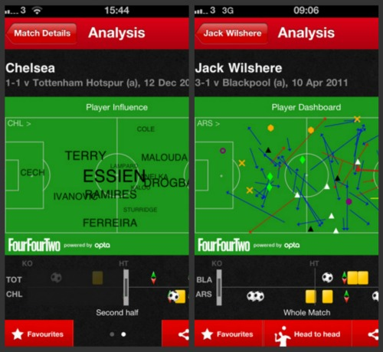
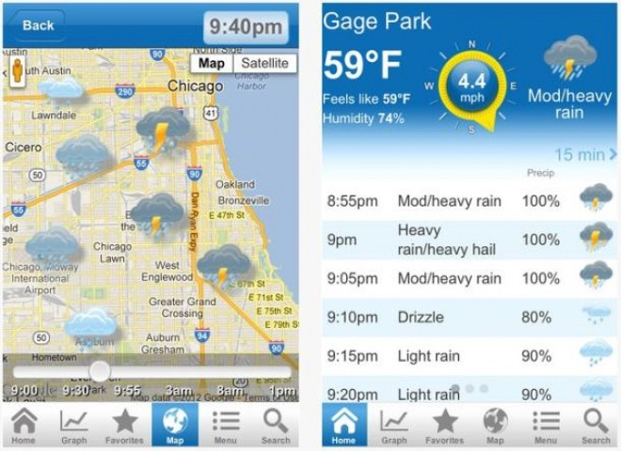
Manusia Memproduksi Data
Manusia memproduksi beragam data yang jumlah dan ukurannya sangat besar
Astronomi
Bisnis
Kedokteran
Ekonomi
Olahraga
Cuaca
Financial
…

Slide 7
Pertumbuhan Data
Astronomi
Sloan Digital Sky Survey
New Mexico, 2000
140TB over 10 years
Large Synoptic Survey Telescope
Chile, 2016
Will acquire 140TB every five days
kilobyte (kB) | 10³
megabyte (MB) | 10⁶
gigabyte (GB) | 10⁹
terabyte (TB) | 10¹²
petabyte (PB) | 10¹⁵
exabyte (EB) | 10¹⁸
zettabyte (ZB) | 10²¹
yottabyte (YB) | 10²⁴
Biologi dan Kedokteran
European Bioinformatics Institute (EBI)
20PB of data (genomic data doubles in size each year)
A single sequenced human genome can be around 140GB in size

Slide 8
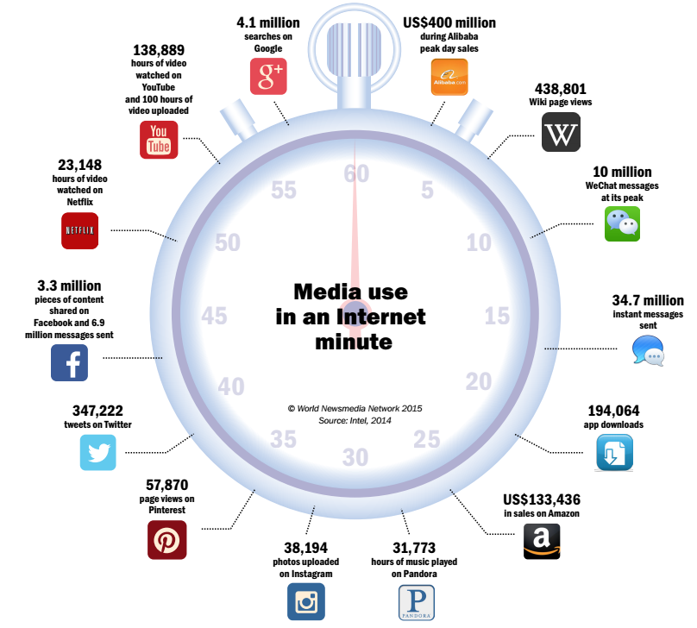
Perubahan Kultur dan Perilaku
(Insight, Big Data Trends for Media, 2015)

Slide 9
Datangnya Tsunami Data
kilobyte (kB) | 10³
megabyte (MB) | 10⁶
gigabyte (GB) | 10⁹
terabyte (TB) | 10¹²
petabyte (PB) | 10¹⁵
exabyte (EB) | 10¹⁸
zettabyte (ZB) | 10²¹
yottabyte (YB) | 10²⁴
Mobile Electronics market
5B mobile phones in use in 2010
150M tablets was sold in 2012 (IDC)
200M is global notebooks shipments in 2012 (Digitimes Research)
Web and Social Networks generates amount of data
Google processes 100 PB per day, 3 million servers
Facebook has 300 PB of user data per day
Youtube has 1000PB video storage
235 TBs data collected by the US Library of Congress
15 out of 17 sectors in the US have more data stored per company than the US Library of Congress

Slide 10
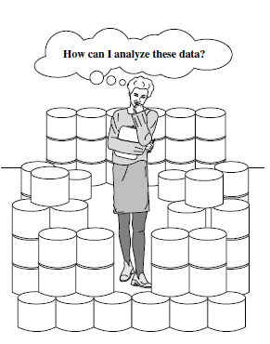
Why Is Data Mining?
The world is data rich but information poor
(Han et al., 2012)

Slide 11
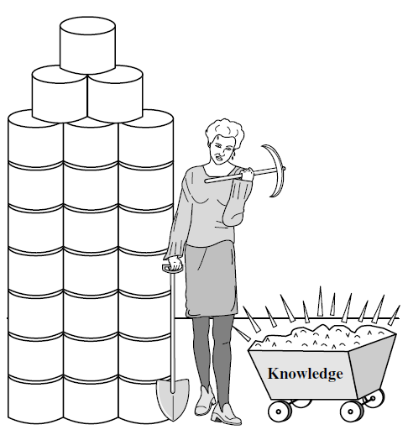
What Is Data Mining?
Process extraction of interesting patterns (non-trivial, implicit, previously unknown and potentially useful) or knowledge from huge amount of data
(Witten, 2011)

Slide 12
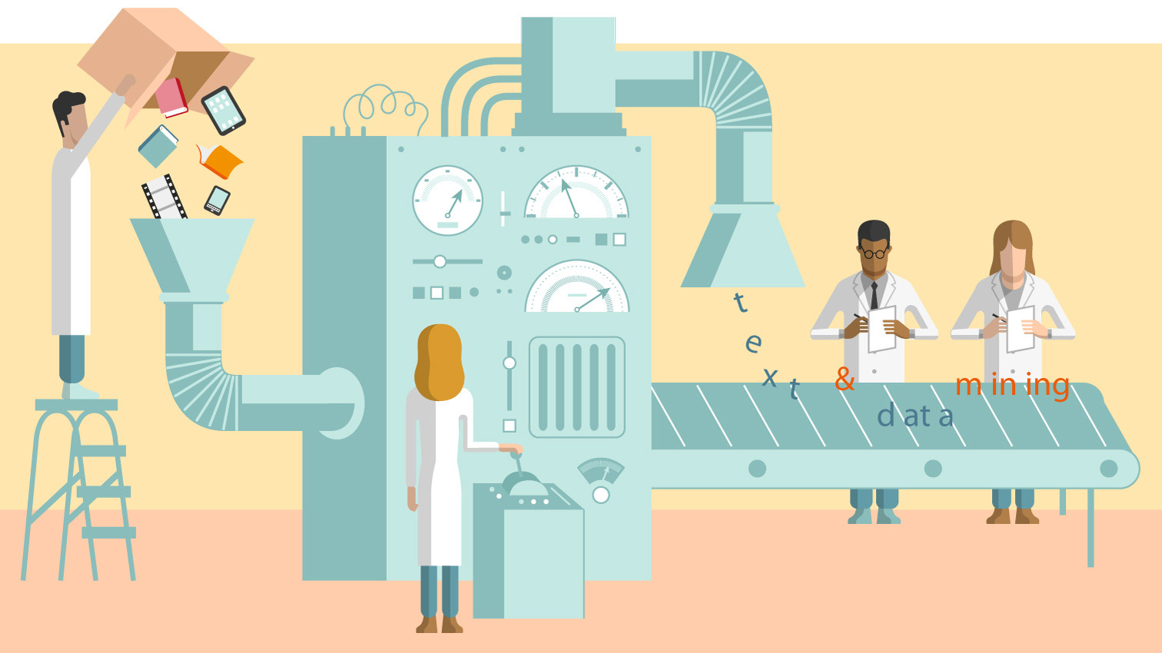
Illustration of Data Mining

Slide 13
Definisi Data Mining
Ekstraksi untuk mendapatkan informasi penting yang sifatnya implisit dan sebelumnya tidak diketahui, dari suatu data (Witten et al., 2011)
Disiplin ilmu yang mempelajari metode untuk mengekstrak pengetahuan atau menemukan pola dari suatu data yang besar

Slide 14
Bidang Pendukung Data Mining
Data Mining
Machine Learning
Statistic
Pattern Recognition
Computing Algorithms
Database Techmology

Slide 15
2. Peranan Utama Data Mining

Slide 16
Dataset (Himpunan Data)
Attribute/Feature
Class/Label/Target
Housing | Existing Credits | Dependent | Telephone | Foreign Worker | Default
own | 2 | 1 | yes | yes | Good
own | 1 | 1 | none | yes | Bad
own | 1 | 2 | none | yes | Good
for free | 1 | 2 | none | yes | Good
for free | 2 | 2 | none | yes | Bad
for free | 1 | 2 | yes | yes | Good
own | 1 | 1 | none | yes | Good
rent | 1 | 1 | yes | yes | Good
Record/
Object/
Sample/
Tuple
Nominal
Numerik

Slide 17
Lima Peranan Data Mining
1. Estimasi
2. Prediksi
3. Klasifikasi
4. Klastering
5. Asosiasi

Slide 18
Perbedaan Kegunaan Data Mining
Jenis | Attribute/Feature | Class/Label/Target | Keterangan
Estimasi | Numerik | Numerik
Prediksi | Numerik | Numerik | Rentang Waktu
Klasifikasi | Numerik/Nominal | Numerik/Nominal
Klustering | Numerik | Tidak Ada
Asosiasi | - | - | Hubungan antar attribute

Slide 19
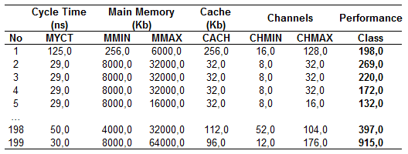
1. Estimasi
atribut numerik
class numerik

Slide 20
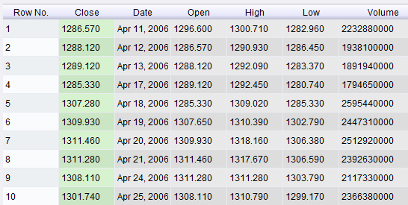
2. Prediksi
class numerik
atribut numerik
rentang waktu

Slide 21
3. Klasifikasi
Age | Income (USD) | Student | Credit Rating | Buys_Computer
youth | 1000 | no | fair | no
youth | 1200 | no | excellent | no
middle_aged | 1000 | no | fair | yes
senior | 500 | no | fair | yes
senior | 100 | yes | fair | yes
senior | 600 | no | excellent | no
atribut
numerik/nominal
class
numerik/nominal

Slide 22
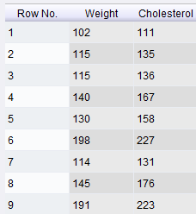
4. Klustering
TANPA LABEL
atribut numerik

Slide 23
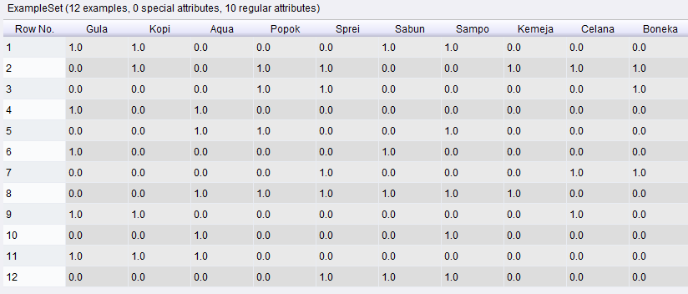
5. Asosiasi

Slide 24
Data Mining Menurut Jenisnya
Association Learning
Unsupervised Learning
Supervised Learning

Slide 25
Jenis Algoritme Data Mining
Estimation (Estimasi):
Linear Regression, Neural Network, Support Vector Machine, etc
Prediction/Forecasting (Prediksi/Peramalan):
Linear Regression, Neural Network, Support Vector Machine, etc
Classification (Klasifikasi):
Naive Bayes, K-Nearest Neighbor, C4.5, ID3, CART, Linear Discriminant Analysis, Logistic Regression, etc
Clustering (Klastering):
K-Means, K-Medoids, Self-Organizing Map (SOM), Fuzzy C-Means, etc
Association (Asosiasi):
FP-Growth, A Priori, Coefficient of Correlation, Chi Square, etc

Slide 26
3. Representasi Pengetahuan

Slide 27
Pretest
Jelaskan pengertian data mining!
Sebutkan 5 peranan utama data mining!
Jelaskan perbedaan estimasi dan prediksi!
Jelaskan perbedaan estimasi dan klasifikasi!
Jelaskan perbedaan klasifikasi dan klastering!
Jelaskan perbedaan klastering dan prediksi!

Slide 28
Data Golf (UCI Dataset Repository)
Cuaca | Temperatur | Kelembaban | Angin | Play
cerah | 85 | 85 | tidak | tidak
cerah | 80 | 90 | ya | tidak
mendung | 83 | 78 | tidak | ya
hujan | 70 | 96 | tidak | ya
hujan | 68 | 80 | tidak | ya
hujan | 65 | 70 | ya | tidak
mendung | 64 | 65 | ya | ya
cerah | 72 | 95 | tidak | tidak
cerah | 69 | 70 | tidak | ya
hujan | 75 | 80 | tidak | ya
cerah | 75 | 70 | ya | ya
mendung | 72 | 90 | ya | ya
mendung | 81 | 75 | tidak | ya
hujan | 71 | 80 | ya | tidak

Slide 29
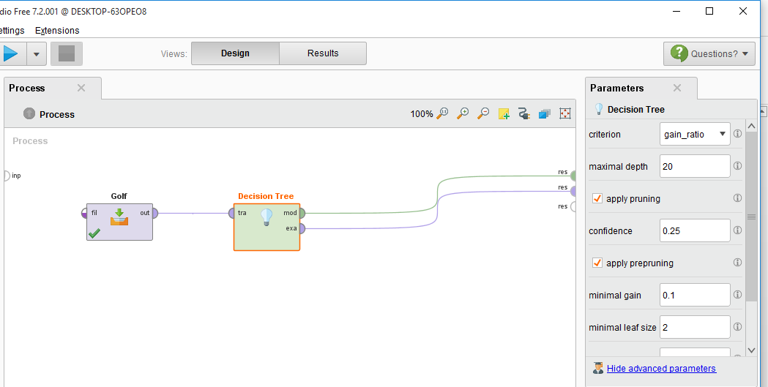
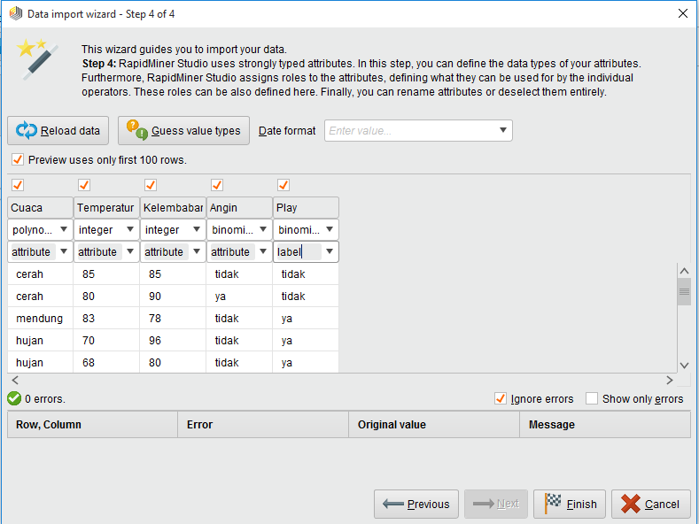
Proses Data Mining

Slide 30
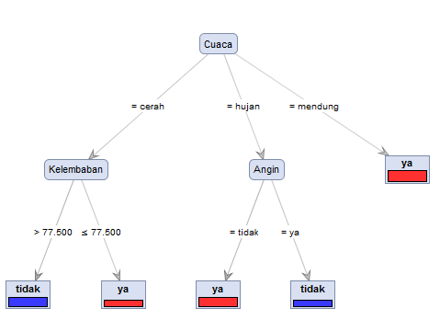
Output/Pengetahuan/Pola

Slide 31
Output/Pengetahuan/Pola
Jika cuaca cerah dan kelembaban > 77.5 maka tidak bermain
Jika cuaca cerah dan kelembaban <= 77.5 maka bermain
Jika cuaca hujan dan ada angin maka tidak bermain
Jika cuaca hujan dan tidak ada angin maka bermain
Jika cuaca mendung maka bermain

Slide 32
3.1. Representasi Pengetahuan Estimasi
Performance = 0.038 * MYCT + 0.017 * MMIN + 0.004 * MMAX +
0.603 * CACH + 1.291 * CHMIN + 0.906 * CHMAX - 43.975

Slide 33
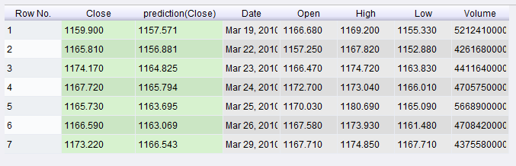
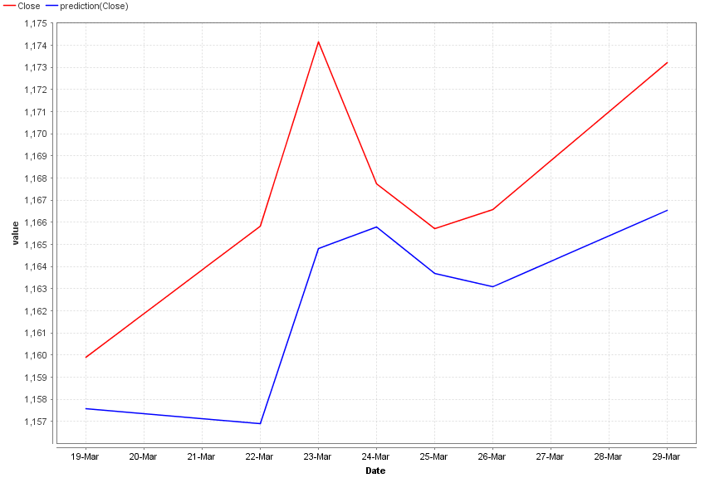
3.2. Representasi Pengetahuan Prediksi

Slide 34
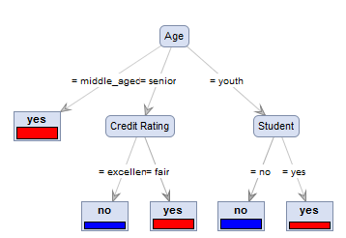
3.3. Representasi Pengetahuan Klasifikasi
Age | Income | Student | Credit Rating | Buys_Computer
youth | high | no | fair | no
youth | high | no | excellent | no
middle_aged | high | no | fair | yes
senior | medium | no | fair | yes
senior | low | yes | fair | yes
senior | medium | no | excellent | no

Slide 35
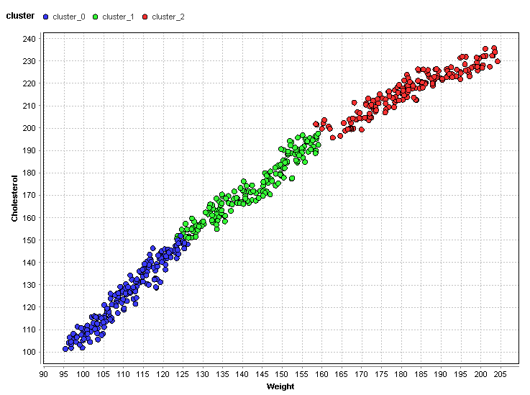
3.4. Representasi Pengetahuan Klastering

Slide 36
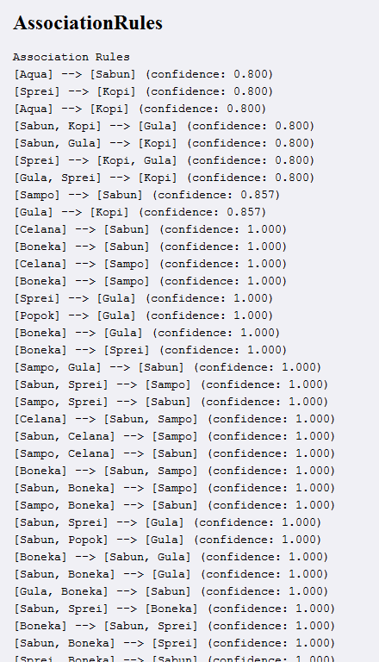
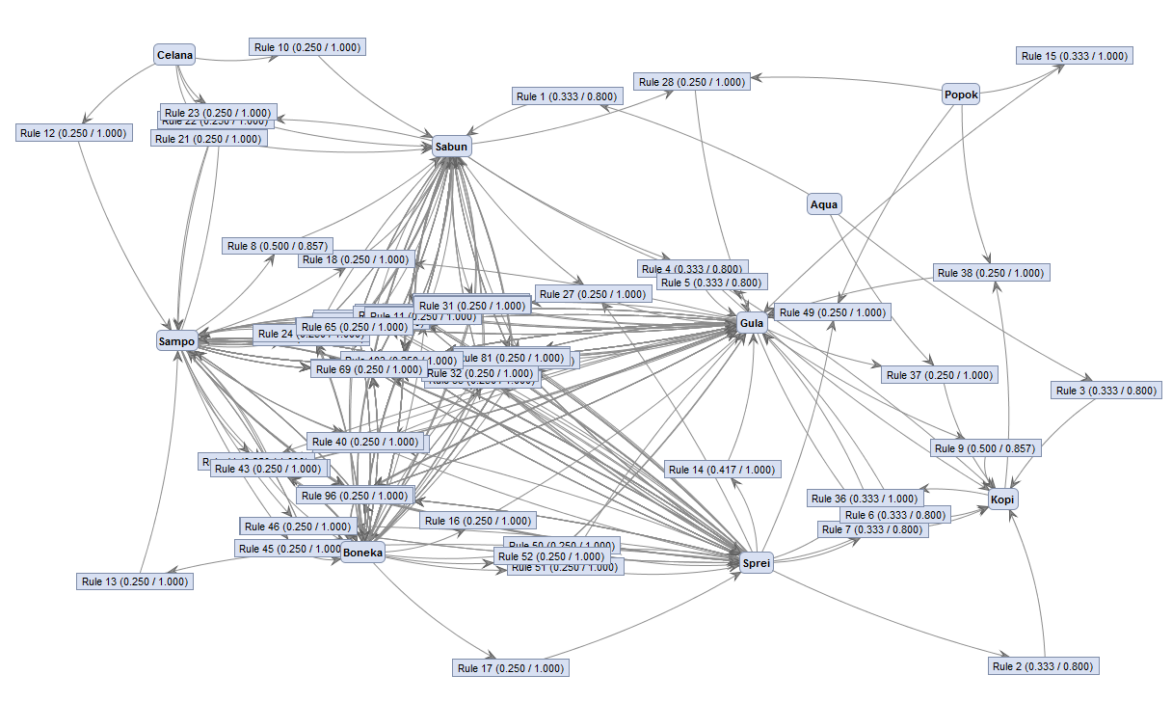
3.5. Representasi Pengetahuan Asosiasi

