Slide 1
Red wine quality evaluation
Which chemical measurements
are associated with higher quality wine?
UCI Wine Quality dataset
Red Vinho Verde, Portugal
Jokubas Banaitis
Notes:
Source: Cortez, P., Cerdeira, A., Almeida, F., Matos, T., & Reis, J. (2009). Wine Quality [Dataset]. UCI Machine Learning Repository. https://doi.org/10.24432/C56S3T. CC BY 4.0. Red subset, winequality-red.csv. Dataset: https://archive.ics.uci.edu/dataset/186/wine+quality

Slide 2
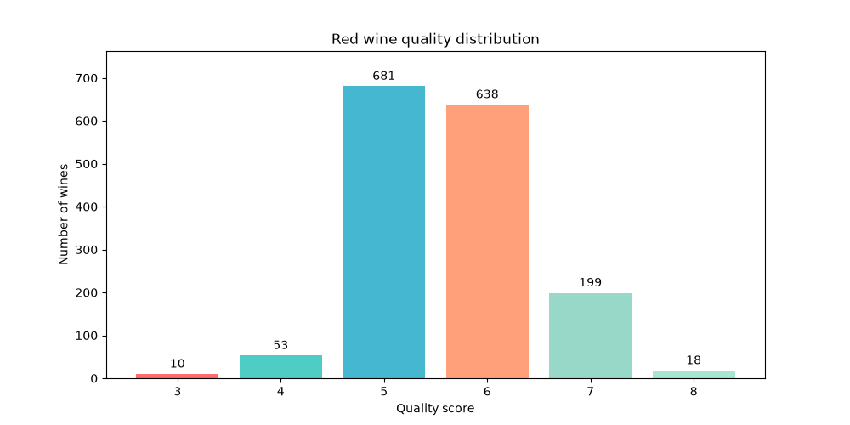
Most wines score 5 or 6
Python analysis: Pandas and Matplotlib
1,599
wine samples
11 measurements
+ quality score
82.5%
of them score 5 or 6
Notes:
Source: Cortez, P., Cerdeira, A., Almeida, F., Matos, T., & Reis, J. (2009). Wine Quality [Dataset]. UCI Machine Learning Repository. https://doi.org/10.24432/C56S3T. CC BY 4.0. Red subset, winequality-red.csv. Dataset: https://archive.ics.uci.edu/dataset/186/wine+quality

Slide 3
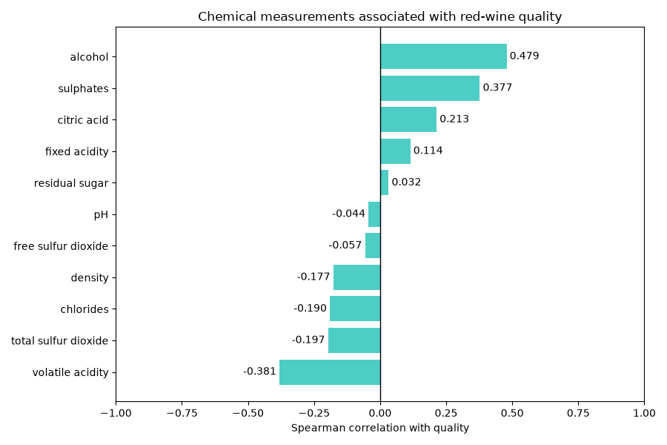
Alcohol has the strongest individual correlation
+0.479
alcohol
−0.381
volatile acidity
Sulphates also
stand out: +0.377
Notes:
Source: Cortez, P., Cerdeira, A., Almeida, F., Matos, T., & Reis, J. (2009). Wine Quality [Dataset]. UCI Machine Learning Repository. https://doi.org/10.24432/C56S3T. CC BY 4.0. Red subset, winequality-red.csv. Dataset: https://archive.ics.uci.edu/dataset/186/wine+quality

Slide 4
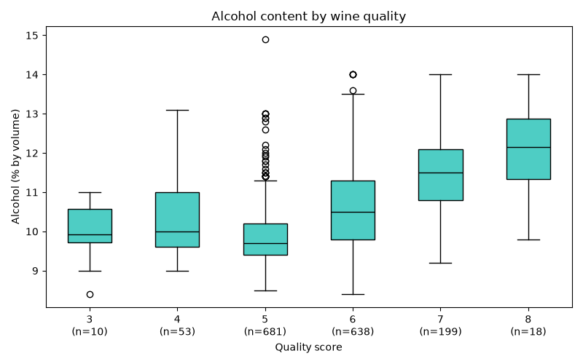
Higher scores tend to accompany higher alcohol
Median alcohol
9.7%
quality 5
11.5%
quality 7
Notes:
Source: Cortez, P., Cerdeira, A., Almeida, F., Matos, T., & Reis, J. (2009). Wine Quality [Dataset]. UCI Machine Learning Repository. https://doi.org/10.24432/C56S3T. CC BY 4.0. Red subset, winequality-red.csv. Dataset: https://archive.ics.uci.edu/dataset/186/wine+quality

Slide 5
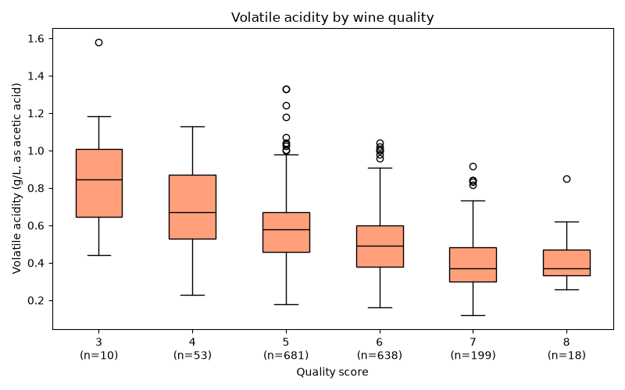
Higher scores accompany lower volatile acidity
Median acidity
0.58 g/L
quality 5
0.37 g/L
quality 7
Notes:
Source: Cortez, P., Cerdeira, A., Almeida, F., Matos, T., & Reis, J. (2009). Wine Quality [Dataset]. UCI Machine Learning Repository. https://doi.org/10.24432/C56S3T. CC BY 4.0. Red subset, winequality-red.csv. Dataset: https://archive.ics.uci.edu/dataset/186/wine+quality

Slide 6
What the analysis supports
Higher alcohol
Lower volatile acidity
Both tend to accompany higher quality scores
Overlapping groups. Few extreme scores.
Observational data cannot establish an ideal recipe.
Notes:
Source: Cortez, P., Cerdeira, A., Almeida, F., Matos, T., & Reis, J. (2009). Wine Quality [Dataset]. UCI Machine Learning Repository. https://doi.org/10.24432/C56S3T. CC BY 4.0. Red subset, winequality-red.csv. Dataset: https://archive.ics.uci.edu/dataset/186/wine+quality

Slide 7
Predicting quality is a next step
PROPOSED FUTURE WORK
01
Compare baseline, 2 factors, and all 11 factors
02
Test on unseen wines
An “ideal” profile would need experimental validation
Notes:
Source: Cortez, P., Cerdeira, A., Almeida, F., Matos, T., & Reis, J. (2009). Wine Quality [Dataset]. UCI Machine Learning Repository. https://doi.org/10.24432/C56S3T. CC BY 4.0. Red subset, winequality-red.csv. Dataset: https://archive.ics.uci.edu/dataset/186/wine+quality

