Slide 1
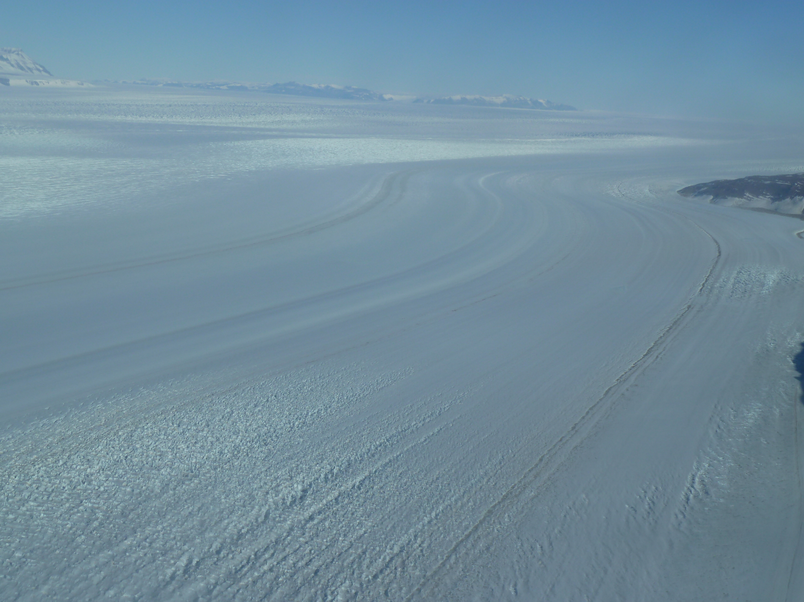
Fabric model with nearest neighbor interaction and recrystallization
Mike Hay
with Ed Waddington
University of Washington
Oct 17, 2014

Slide 2

Intro
- Ice crystals are anisotropic. It deforms easily on the basal plane, but not in any other orientation.
- Grains line up in response to strain, forming a bulk anisotropic response.
-Thorsteinsson 2002 developed a fabric model including nearest neighbor interaction.
- This work takes a similar approach, but with a more general treatment of fabric topology.

Slide 3
Each grain has a variable number of neighbors (transitive) with whom it can exchange mass through whatever process. Kind of an undirected graph.
The volume of the polycrystal is preserved – One grain's loss is another's gain.

Slide 4
Grain boundary velocity:
- Surface energy (normal grain growth)
- Strain energy/dislocation density
- Area shared between each pair of grains depends on the size of each and their neighbors.
Velocity from surface energy
Velocity from strain energy density
Total g.b. velocity

Slide 5
Recrystallization
- If a grain is completely consumed, it leaves a gap.
- Each timestep, zero-radius grains probabilistically recrystallize, taking volume from neighboring grains.

Slide 6
Grain Rotation
- Grains rotate away from extensional axes.
- Handled by Jeffery's equation.
- The velocity gradient, rather than the stress tensor, is supplied to the model.
- Softness parameter (Thorsteinsson 2002) means grains surround by soft grains receive more stress.

Slide 7
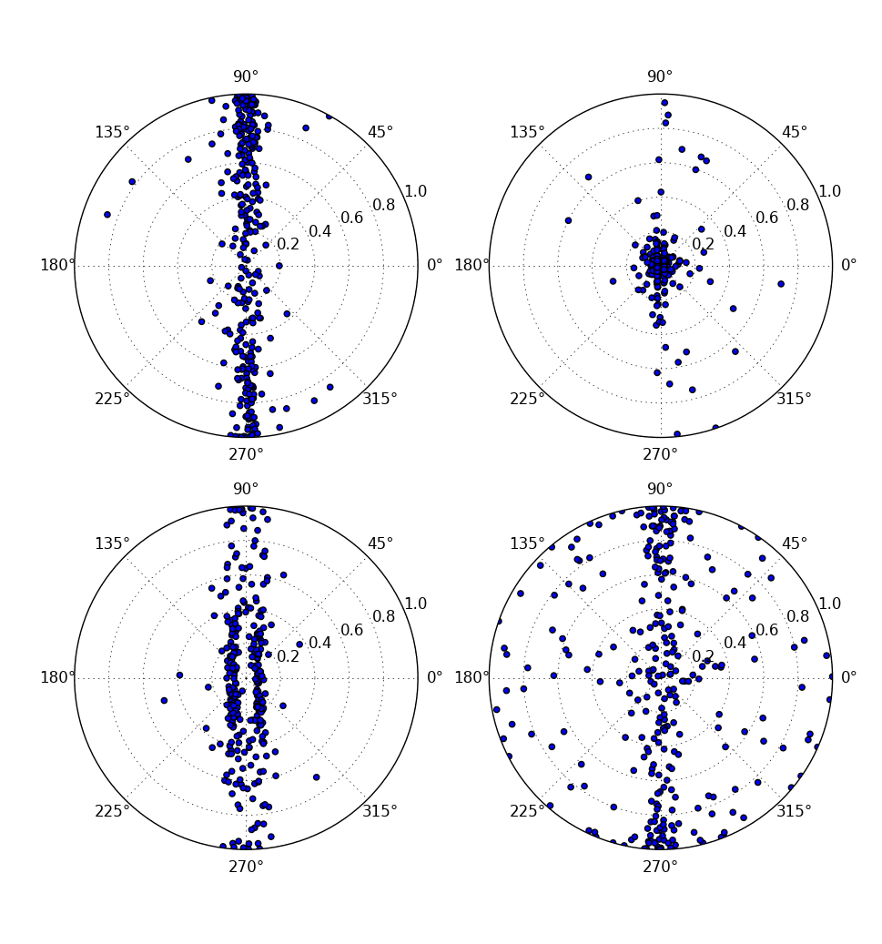
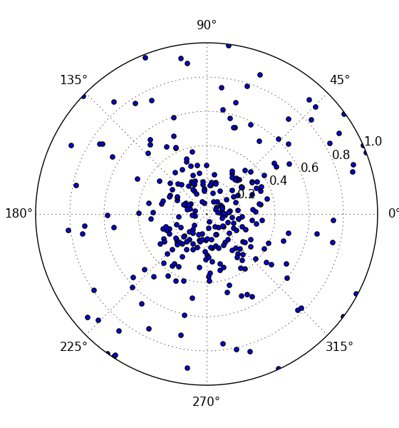
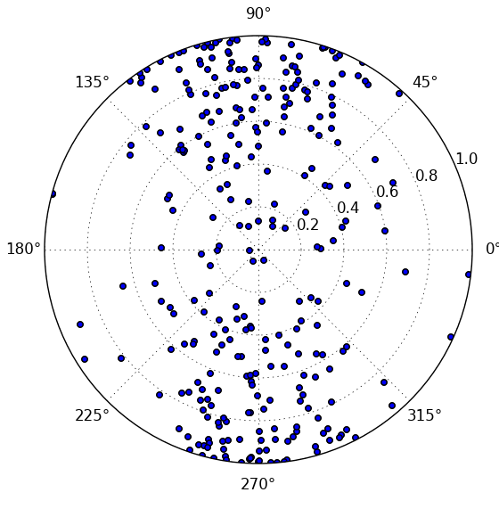
Validation
-The model does a good job of qualitatively reproducing fabric types
(like girdle, single maximum).
- How well does it match up to an ice core?

Slide 8
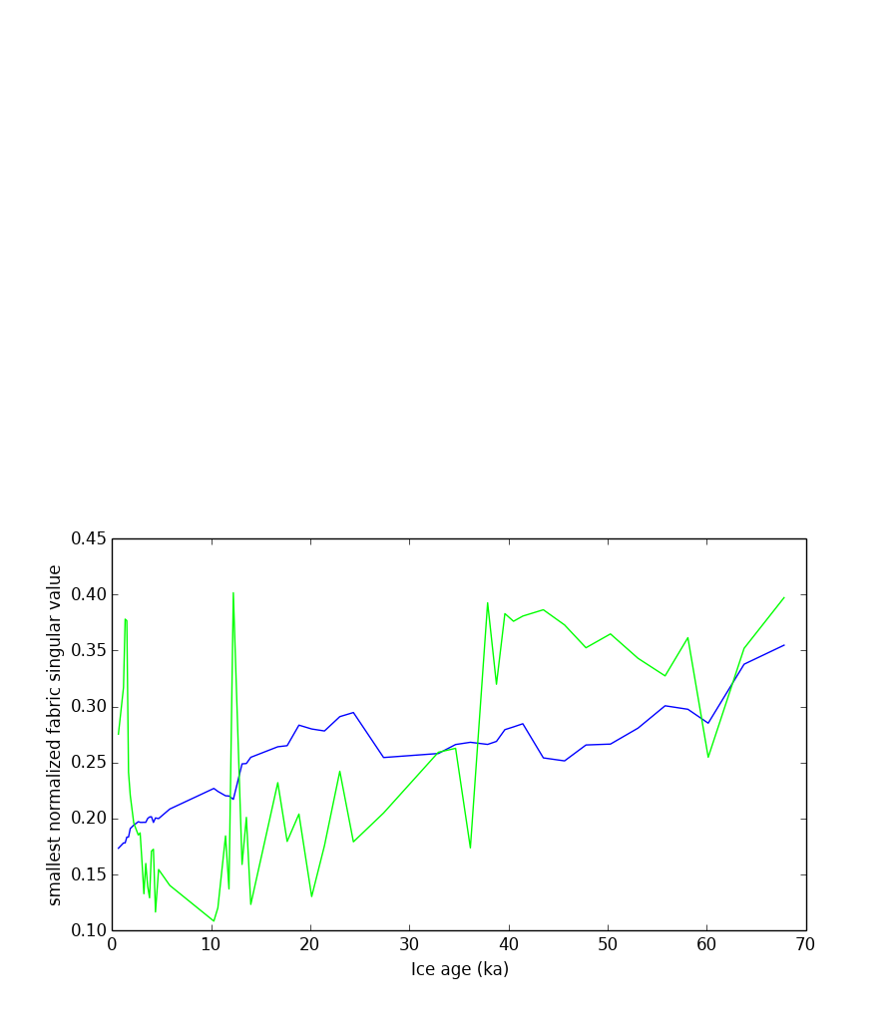
Validation
- We have used Don Voigt's thin sections from WAIS to see if we get reasonable answers from an actual core.
- WAIS is mostly divide flow. Girdle near the top, single maximum w/recrystallization at the bottom.
- TJ's d-a relationship along with Dansgaard-Johnsen model used to derive velocity gradient.

Slide 9
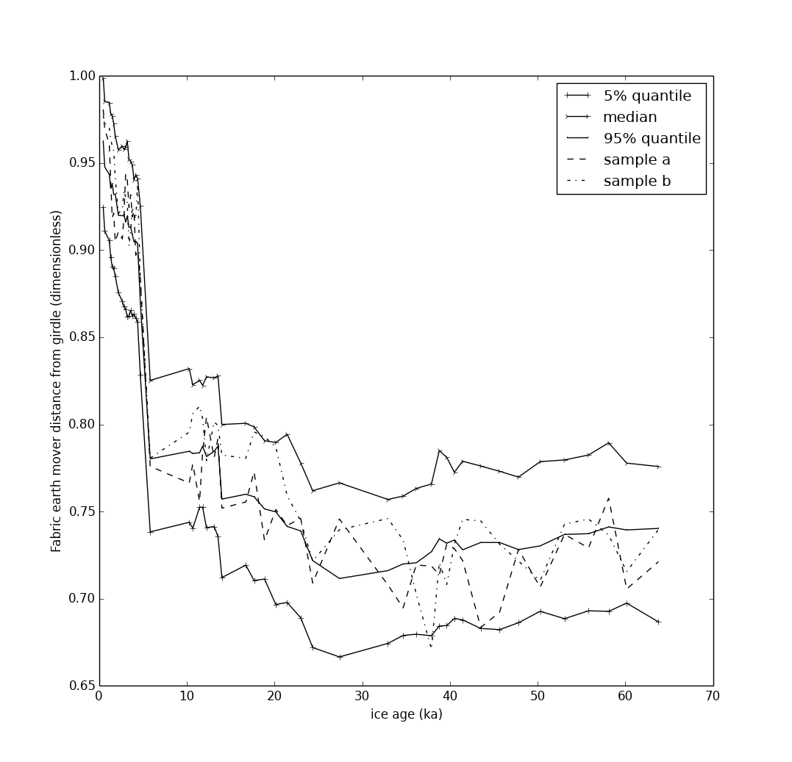
Nonuniqueness and stochasticity
- Constant accumulation, etc. assumed.
- Don't want to do too much fitting because of both stochasticity of thin section properties and uncertaintly about ICs and conditions in the core.
- There is a lot of inherent variability in the model itself.

Slide 10
Conclusions
- This model provides a more general way to look at ice fabric by including connectivity information.
- Fabric development can be unpredictable: ICs, variations in connectivity, recrystallization, etc.
- Probably should only trust really big variations in fabric thin sections.

Slide 11
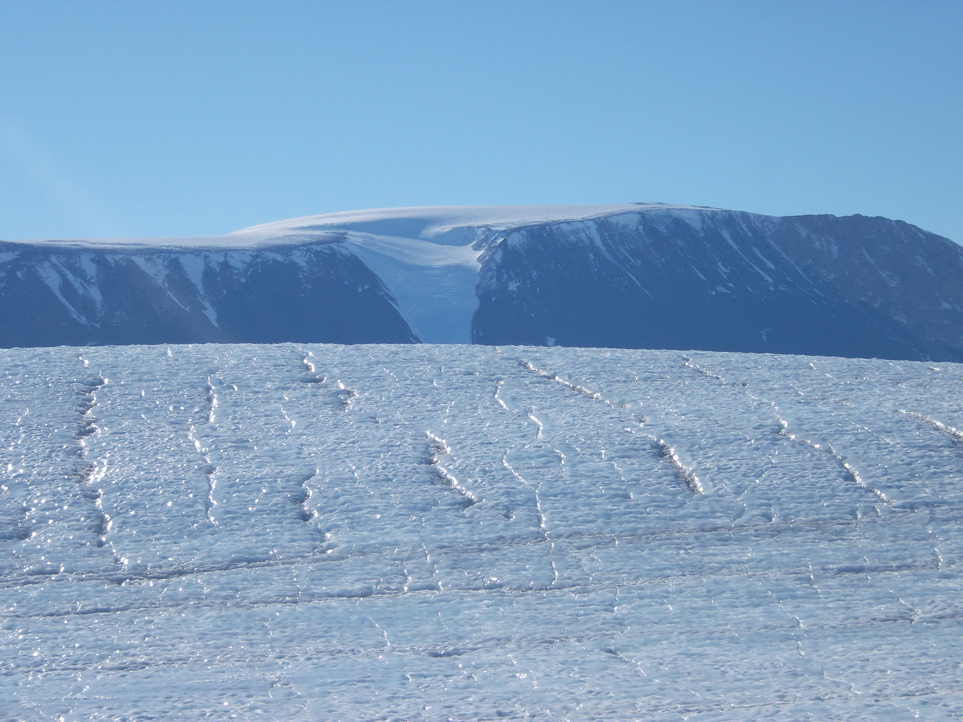
Thanks!

