Slide 1
FACTORS INFLUENCING MIGRATION FLOWS
PhD defence
Mariola Pytlikova
Aarhus, February 20th, 2006
Department of Economics, Aarhus School of Business

Slide 2
2 phenomena driving migration flows over the last decades:
1. Growing migration from less developed countries
lower social mobility, skill transferability and skill acquisition
immigrants have difficulties entering the destinations’ labor markets and integrate

Slide 3
2 phenomena driving migration flows over the last decades:
2. Fall of Iron Curtain – emigration from Central and Eastern Europe
Given geographical and cultural proximity and the large economic differences, Western Europe fear mass migration,
EU enlargement towards the East:
10 new countries joined EU15 in May 2004,
UK, Ireland and Sweden have opened, majority of “old” members imposes restrictions to free movement of workers,
In 2006 decision about extending the ”transition period”

Slide 4
Migration pressures will continue in the future
Growing globalization – improvements in communication, Internet, transportations
Demographic projections

Slide 5
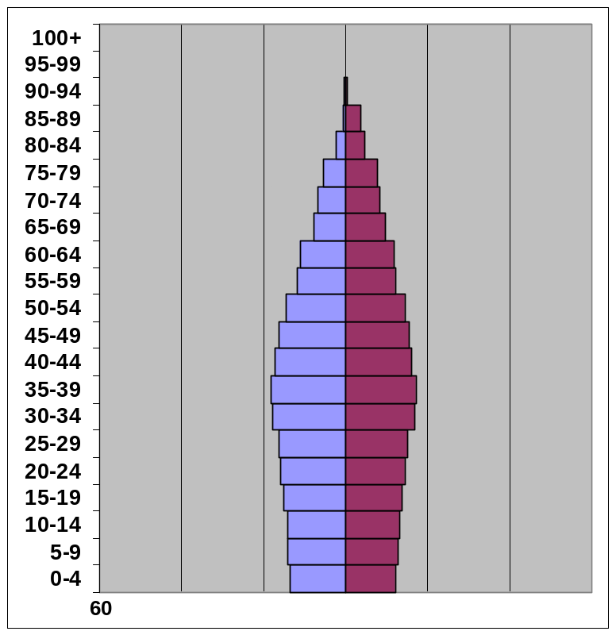
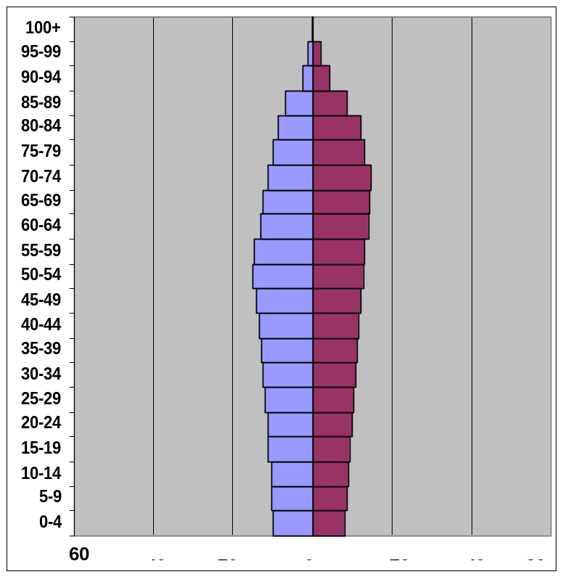
Demographic projections – European Union
2000
(Population: 451.4 million)
2050
(Population: 401 million)
Source: Cohen (2003): Human Population: The Next Half Century

Slide 6
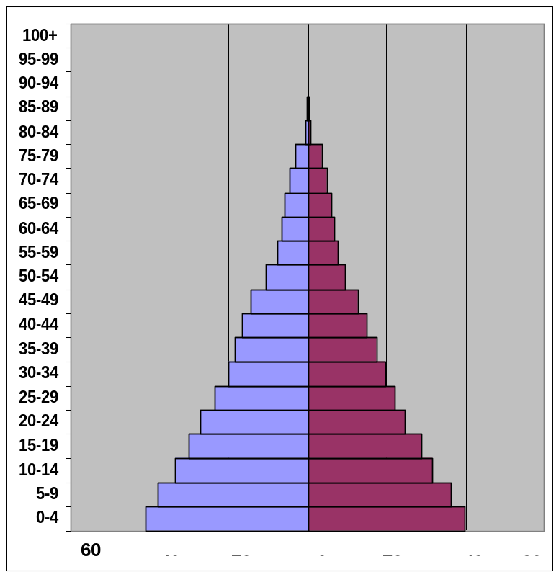
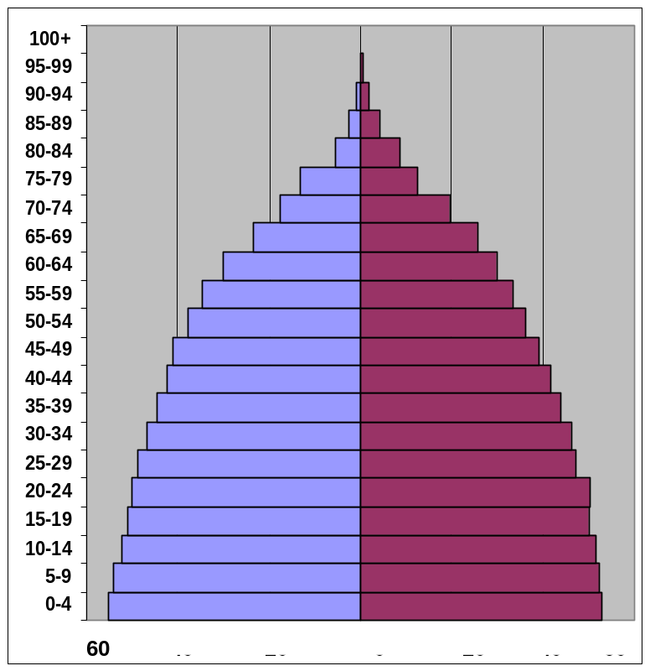
Demographic projections – North Africa and West Asia
2000
(Population: 587.3 million)
2050
(Population: 1,298 million)
Source: Cohen (2003): Human Population: The Next Half Century

Slide 7
Migration pressures will continue in the future
Growing globalization – improvements in communication, Internet, transportations
Demographic projections
Immigration policy must adjust to the migration pressures and to the aging populations.
DETERMINANTS OF MIGRATION FLOWS IMPORTANT FROM THE POLICY MAKERS POINT OF VIEW.

Slide 8
WHY DO PEOPLE MIGRATE? Theory I
ECONOMIC FACTORS:
Wage differences (Hicks, 1932),
“Human capital investment” (Sjaastad, 1962; Becker, 1964),
    Income expectations conditioned on being employed (Harris & Todaro, 1970; Hatton, 1995),
Family or households decision (Mincer, 1978; Holmlund, 1984),
Risk-diversifying strategy of families (Stark, 1991),
Relative deprivation approach (Stark, 1984),
“Welfare magnet” (Borjas, 1999).

Slide 9
WHY DO PEOPLE MIGRATE? Theory II
MIGRATION NETWORKS:
  migration networks: “…sets of interpersonal ties that connect migrants, former migrants, and non-migrants in origin and destination areas through ties of kinship, friendship, and shared community origin” (Massey, 1993)
  help to explain persistence in migration
  “herd behavior” effect (Bauer et al. 2002),
NON-ECONOMIC FACTORS: war, love/marriage, taste for adventure
OTHER (UN)OBSERVABLE COUNTRY SPECIFIC FACTORS

Slide 10
WHY DO PEOPLE NOT MIGRATE? Theory
But only around 2 percent of the world’s population resided in a country other than they were born.
??? WHY THERE IS NOT THAT MUCH MIGRATION ???
BARRIERS TO MIGRATION:
Immigration policies
Costs of migration
Cultural distance
Language barriers
out-of-pocket expenses
psychological costs

Slide 11
WHO MIGRATES??
SELECTION PROCESSES IN MIGRATION
“self-selection model” (Borjas, 1987) - skill differentials between immigrants and natives in relation to the variance in the wage distribution.
Positive selection
Negative selection
countries with big wage dispersion
countries with low wage dispersion
In line with the “Human capital investment” there are higher “returns to migration” for young with greater abilities (Chiswick, 2000).

Slide 12
WHAT DOES THE EMPIRICAL EVIDENCE SAY???
There are many studies on determinants of international migration – but mostly on migration into one country;
Evidence from a multi-country perspective has been in general rather scarce, mostly due to the data limitations;
Previous studies on migration from Central and Eastern Europe relied on out-of-sample data analysis, again due to the data limitations.

Slide 13
DATASET
It is difficult to obtain a consistent database on international migration
Contact statistical offices in the 26 OECD countries
Detailed information on immigration flows and stock into 26 OECD countries from 129 particular countries of origin.
Period: 1989 to 2000.
Dataset unbalanced, i.e. missing observations for some countries and some years
Given the lack of international migration databases - this new dataset serves a great source for analyses of international migration behavior.

Slide 14
DATASET
Besides - many other variables, which can help us explain the immigration behavior:
    Economic variables
    Demographic variables,
    Distance variables: cultural, physical, linguistic,
    Welfare state variables,
    Educational variables,
    Violated political rights and civil liberties variable
Sources: WB, ILO, OECD, IMF and national statistical offices of particular OECD countries.

Slide 15
METHODOLOGY
Regression analysis
Unobserved heterogeneity
Remaining error
Explanatory variables
CHALLENGES: | SOLUTION:
How to tackle unobserved country-specific heterogeneity ?
Panel data models - Fixed or Random effects estimators
Instrumental variable techniques
Arellano-Bond (1991) difference or the Arellano-Bover (1995) system GMM estimator
Economic Dynamics

Slide 16
MIGRATION DETERMINANTS: Aspects considered in my thesis
Chapter 2: How mobile are Central and Eastern Europeans? Evidence from inter-regional migration in the Czech Republic
Chapter 3: Selection and network effects – migration flows into OECD countries 1990-2000. (Joint with Peder J. Pedersen and Nina Smith)
Chapter 4: Where did Central and Eastern Emigrants go and why?
Chapter 5: EU enlargement: migration from new EU countries.

Slide 17
MIGRATION DETERMINANTS: Aspects considered in my thesis
Chapter 2: How mobile are Central and Eastern Europeans? Evidence from inter-regional migration in the Czech Republic
Chapter 3: Selection and network effects – migration flows into OECD countries 1990-2000. (Joint with Peder J. Pedersen and Nina Smith)
Chapter 4: Where did Central and Eastern Emigrants go and why?
Chapter 5: EU enlargement: migration from new EU countries.

Slide 18
MIGRATION DETERMINANTS: Aspects considered in my thesis
Chapter 2: How mobile are Central and Eastern Europeans? Evidence from inter-regional migration in the Czech Republic
Chapter 3: Selection and network effects – migration flows into OECD countries 1990-2000. (Joint with Peder J. Pedersen and Nina Smith)
Chapter 4: Where did Central and Eastern Emigrants go and why?
Chapter 5: EU enlargement: migration from new EU countries.

Slide 19
FACTORS INFLUENCING MIGRATION FLOWS – findings I
EFFECT ON GROSS MIGRATION FLOWS: | THEORY: | FINDINGS:
Economic factors:
Income destination
Income source
Income ratio
Unemployment destination
Unemployment source
Welfare magnet
+
+
Chapter 3
-
Inverted U-shape
Chapter 3, Faini and Venturini,1994
+
+
Chapters 2, 4 and 5
-
-
Chapters 2,3, 4 and 5
+
- or no effect/ insignificant
Chapters 2,3, 4 and 5
+
- or no effect/ insignificant
Chapter 3

Slide 20
FACTORS INFLUENCING MIGRATION FLOWS – findings II
EFFECT ON GROSS MIGRATION FLOWS: | THEORY: | FINDINGS:
NETWORKS
Other factors – human capital:
Tertiary enrollment rate source
Illiteracy rate source
Language in destinations
Non-economic factors
Freedom House Index
Other unobservable country-spec. effects
+
+
Chapters 3, 4 and 5
+
+
Chapter 4
-
-
Chapter 3
+
+
Chapter 4
+
+/insign.
Chapter 3
Important
Chapters 2, 3, 4 and 5

Slide 21
FACTORS INFLUENCING MIGRATION FLOWS– findings III
EFFECT ON GROSS MIGRATION FLOWS: | THEORY: | FINDINGS:
Barriers to migration:
Distance
Cultural distance
Neighboring dummy
Common history
Linguistic Distance
Business ties
-
-
Chapters 2, 3, 4 and 5
+
- or no effect/ insignificant
Chapters 3 and 4
+
+
Chapter 3
+
+
Chapter 3
+
+
Chapter 3

Slide 22
SELECTIVITY IN MIGRATION FLOWS– findings
Selectivity in migration:
No direct indications of “country based selectivity” effects.
Chapter 3
Some selectivity through “networks” – “networks” more important for immigrants coming from low-income countries than for immigrants coming from high-income source countries.
Chapter 3

Slide 23
PREDICTIONS OF MIGRATION
The obtained coefficients of the migration determinants can be used for prediction of migration potential.
Application to a prediction of migration potential from the new EU members into the “old” EU countries in years after the 2004 EU enlargement, 2004–2015. (chapter 5)
3 assumed scenarios concerning the future economic convergence of the countries.

Slide 24
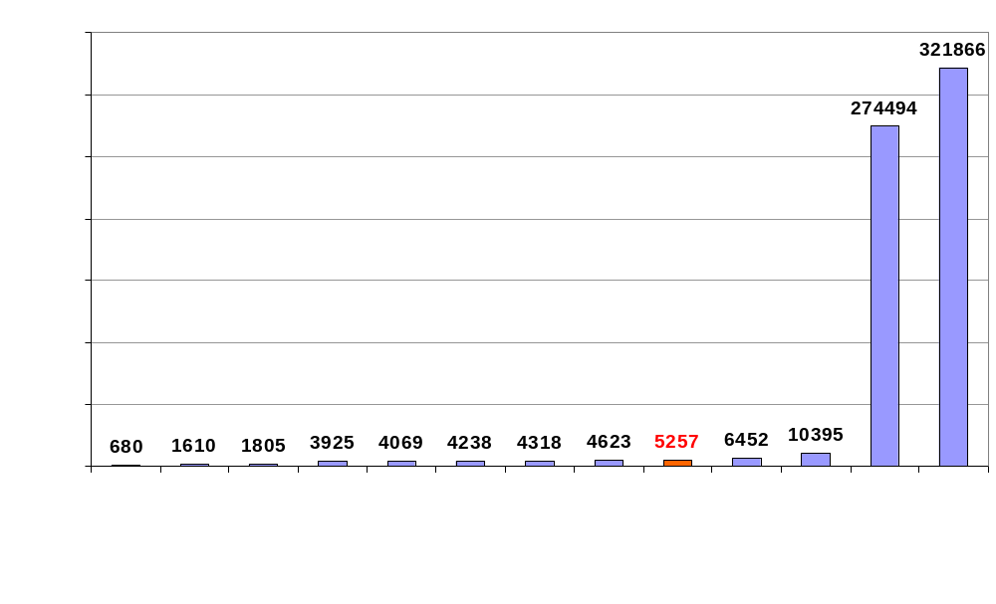
Predicted gross migration flows from 7 new EU members into the 12 EEA/EU countries.
Average flow 2004-2015, medium convergence scenario
*For Italy, only numbers of Poles are shown. ** For Spain, only numbers of Poles and Czechs are shown.

Slide 25
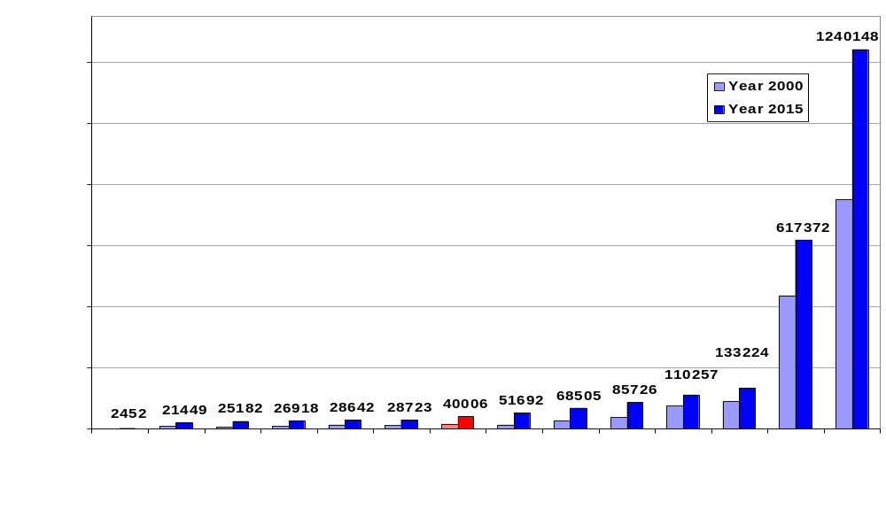
Predicted migration stocks from 7 new EU members residing in the 13 EEA/EU countries.
Year 2000 and 2015, medium convergence scenario.
For Spain, only numbers of Poles and Czechs are shown. UK numbers do not contain Baltic countries: Estonia, Latvia and Lithuania.

Slide 26
FACTORS INFLUENCING MIGRATION FLOWS summary of the findings
some policy recommendations for – Europe and Denmark:
  Shift towards economically based selective immigration policy :
  for Denmark - the point system idea of the welfare commission might be beneficial
  Emigration from Central and Eastern Europe – forecast for EU, prediction for Denmark – no “migration floods”

