Slide 1


Git Workflow Etiquette
Repository Organization for Clean Codebases
Jolene Langlinais
Notes:
Warning: There will be quite a few concepts that I’ll briefly cover, and won’t have enough time to discuss in depth. Happy to provide resources or follow up discussions afterward.

Slide 2
Agenda
↳ About Me
↳ Git
↳ Branch v. Fork
↳ Rebase v. Merge
↳ Commit (Messages)
↳ Pull Requests (and Reviews)
↳ GitHub Issues
↳ Open Source

Slide 3
Agenda
↳ About Me
↳ Git
↳ Branch v. Fork
↳ Rebase v. Merge
↳ Commit (Messages)
↳ Pull Requests (and Reviews)
↳ GitHub Issues
↳ Open Source

Slide 4
Agenda
↳ About Me
↳ Git
↳ Branch v. Fork
↳ Rebase v. Merge
↳ Commit (Messages)
↳ Pull Requests (and Reviews)
↳ GitHub Issues
↳ Open Source

Slide 5
Agenda
↳ About Me
↳ Git
↳ Branch v. Fork
↳ Rebase v. Merge
↳ Commit (Messages)
↳ Pull Requests (and Reviews)
↳ GitHub Issues
↳ Open Source

Slide 6
Agenda
↳ About Me
↳ Git
↳ Branch v. Fork
↳ Rebase v. Merge
↳ Commit (Messages)
↳ Pull Requests (and Reviews)
↳ GitHub Issues
↳ Open Source

Slide 7
Agenda
↳ About Me
↳ Git
↳ Branch v. Fork
↳ Rebase v. Merge
↳ Commit (Messages)
↳ Pull Requests (and Reviews)
↳ GitHub Issues
↳ Open Source

Slide 8
Agenda
↳ About Me
↳ Git
↳ Branch v. Fork
↳ Rebase v. Merge
↳ Commit (Messages)
↳ Pull Requests (and Reviews)
↳ GitHub Issues
↳ Open Source

Slide 9
Agenda
↳ About Me
↳ Git
↳ Branch v. Fork
↳ Rebase v. Merge
↳ Commit (Messages)
↳ Pull Requests (and Reviews)
↳ GitHub Issues
↳ Open Source

Slide 10
Agenda
↳ About Me
↳ Git
↳ Branch v. Fork
↳ Rebase v. Merge
↳ Commit (Messages)
↳ Pull Requests (and Reviews)
↳ GitHub Issues
↳ Open Source

Slide 11




Notes:
Utilizing GitHub.
Reference GitHub’s official workflow proposal.
May differ from GitLab or Bitbucket
but likely not by much.

Slide 12



Jolene Langlinais
jolenelanglinais.com
@jolanglinais
Maintainer
Full Stack Engineer
Notes:
1. AP -> Non-profit, open-source initiative and codebase for smart legal contracts
: Ecosystem enabling anyone to build smart agreements on technology neutral platform
: Building tools for smart legal contracts
2. Clause -> software platform for smart legal contracts
: Digitize and automate portions of or entire legal contracts
: Blockchain agnostic automated legal agreements, transparent or permissioned

Slide 13
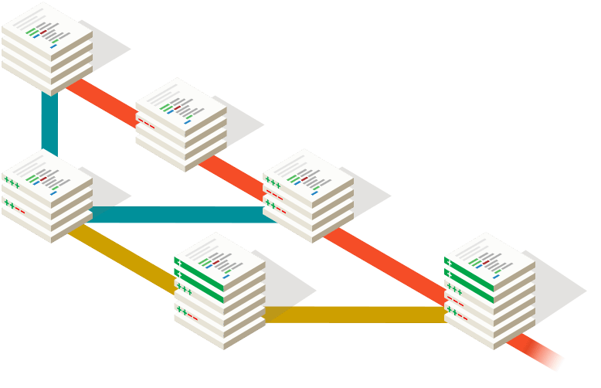
GIT
Version Control
Collaboration
Widely Used
Notes:
- Version control with git provides for powerful collaboration
: tight-knit tech team or a distributed network in an open source format.
Used widely and can manage a constantly evolving codebase.
Good quality software consists of, among other things, a solid history of documentation.
Anyone should be able to join the process and easily figure out and track the status of the project.

Slide 14
GIT Benefits
→ Branching
→ Offline
→ Content Tracking
→ Free Workflow
→ Small Repositories
→ Staging
→ Stashing
→ Malleable History
Notes:
- Branching:
Branches are lightweight and merging is easy
Branch off new work from an existing project to work in isolation until integrate back to project
No need to worry about mess-ups
Offline work is possible with git
Git tracks content rather than files
Git doesn't impose any workflow
Git repositories are small in file size
Staging area allows you to see the changes, commit partial changes, etc
Stashing is invaluable when you do "chaotic" development
You can rewrite history, great for preparing patch sets and fixing your mistakes

Slide 15
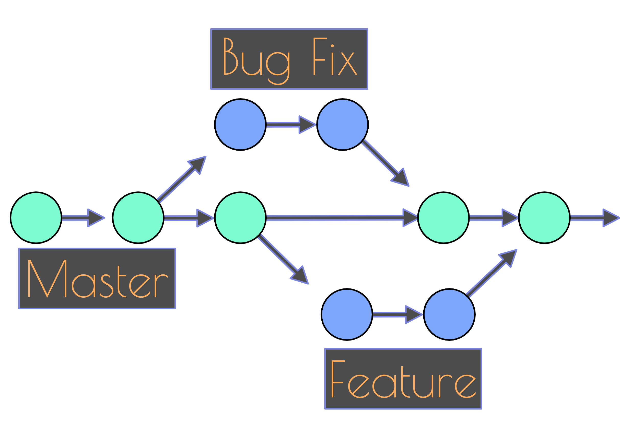
Branching
Forking
FORK
ORIGINAL
Notes:
Branching
+ All project work is centralized
+ Ease of collaboration
+ Single remote to handle
— Deprecated branches may clutter easily
Forking
+ Increased separation between user branches
+ Primary repository cleanliness
— Difficulty to track branches
— Collaboration requires extra steps
— Accessibility is lower for less experienced git users

Slide 16
Branching
Centralized, trackable branches
Quick and messy
Notes:
Small tech team benefit from centralized repository with trackable branches
It’s just a bit messy

Slide 17
Forking
Incentive to keep clean
Masters need to be synced
Notes:
Incentive to keep clean and tidy
While both have benefits, general rule:
Fork for open source / customize code for yourself
Branch for smaller and insular team

Slide 18
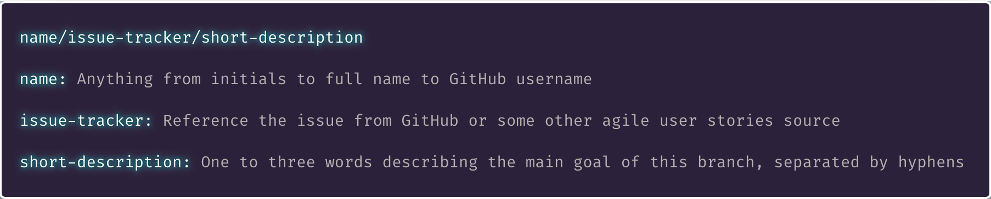
Branch Naming
Notes:
One of first methods for keeping a consistent tracking system of Issues, pull requests, and git history.
The important factor here is consistency.

Slide 19
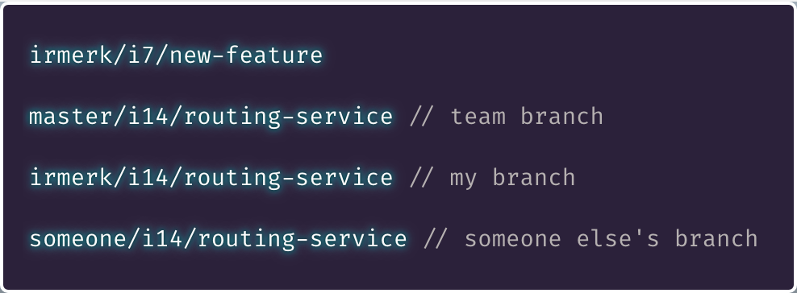
Branch Naming

Slide 20
Rebase
vs
Merge

Slide 21
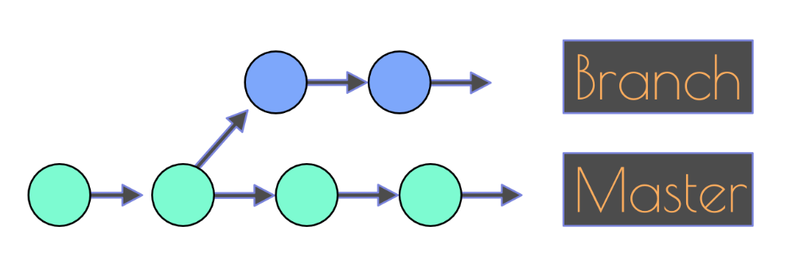
Rebase v Merge
Notes:
A feature or fix branch comes off the master code base

Slide 22
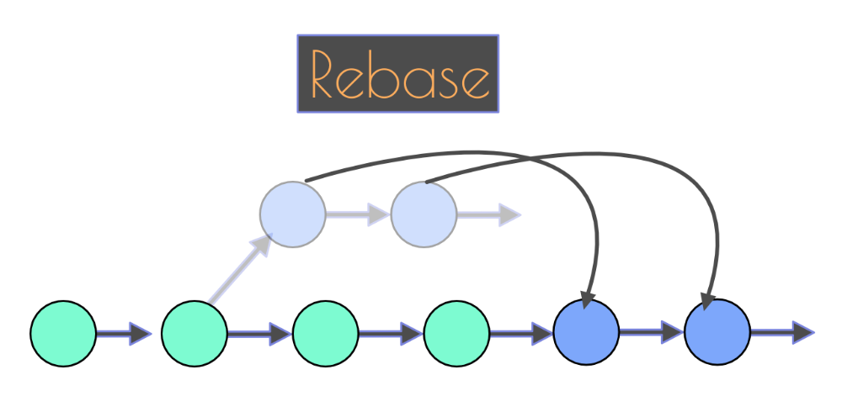
Rebase v Merge
Notes:
Ports a branch (master) into your current branch
Applying all of your commits on top of that branch (master),
Replacing your branch with the revised version.
Catches you up to a branch (master) by rewriting git history in your local git.
Think of it as moving your branch to the tip of master instead of having branched off from an earlier version of master.

Slide 23
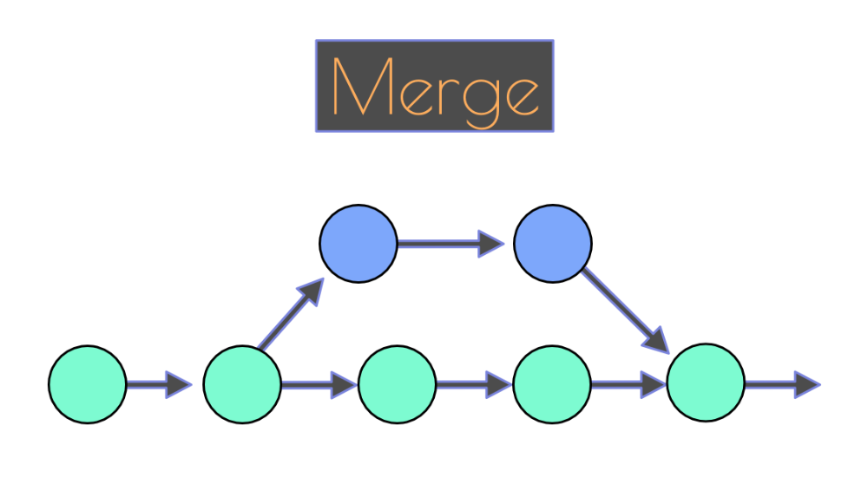
Rebase v Merge
Notes:
Creates a new commit specifically for the merge
Can clutter git log - more on this later

Slide 24
Squash
Reduces clutter
Maintains readable log
Notes:
Common practice to condense long commit message chains into one or a few commits
Useful when committing frequently
Can remove clutter from a commit just to remove `console.log`

Slide 25
Squash
✅ Rebase locally
✅ Squash in GitHub
Notes:
Rebase locally to ensure everything is in order
Squash in GitHub once everything is confirmed to be in order
Keeps merge commits in GitHub very clear (for investigation)

Slide 26
Squash
🚫 Squash locally
🚫 Rebase after
Notes:
Squashing before rebasing reduces conflicts
But changes history, not accurate representation

Slide 27
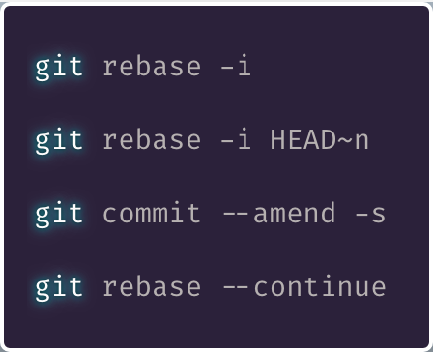
Interactive Rebase
Notes:
Useful when needing to remove multiple commits
Or resolve confusing conflicts
Otherwise overkill

Slide 28
Interactive Rebase
Notes:
Accord Project requires a Developer Certificate of Origin sign-off
May need to rapidly change messages on series of commits

Slide 29
Force Push
🚫 CAUTION 🚫
Notes:
Force pushing can have dire consequences if not used properly, consult others if unsure how to use this.
This is if previously pushed code to a remote branch
Pushing ammendments

Slide 30
Rewriting History
🚫 CAUTION 🚫
Notes:
Rebase for rewriting is useful
Still needs caution
Don’t interrupt others’ history
Caution: Avoid force pushing to a remote branch other people are working on.

Slide 31
Rebase Your Fears
Commit ongoing work
Practice practice practice
Think of the history!
Notes:
I still fear rebase and squash.
Merge conflicts can be more frequent and seem more difficult.
Commit frequently = Complications infrequent
Merge commit made with conflicts - important part of history

Slide 32
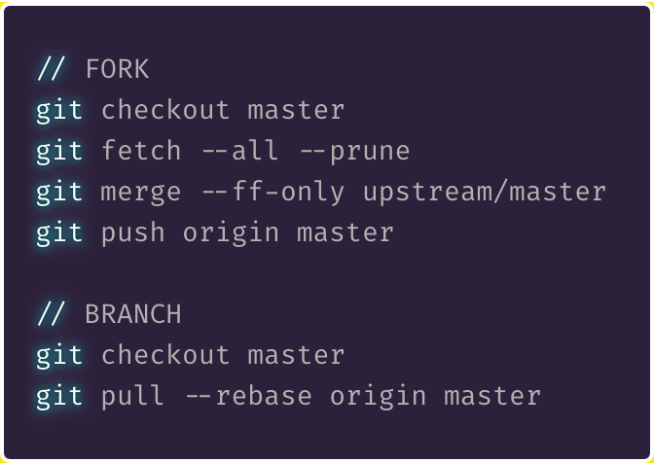
My Workflow
Notes:
My recommendation for a general workflow
Ensure you are currently in master →
If working in a fork, fetch
If working in a branch, pull

Slide 33
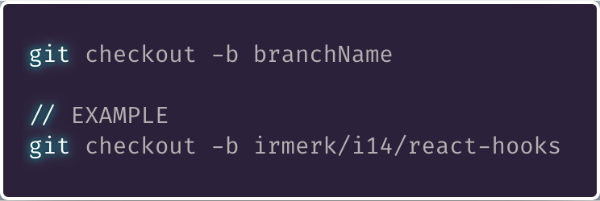
My Workflow
Notes:
Create a new branch for your feature or bug fix
Make changes with as many commits as necessary.
The final commit should build and pass tests.

Slide 34
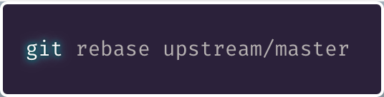
My Workflow
Notes:
Ensure branch sits on top of master
(as opposed to branch off a branch).
This ensures reviewer minimal effort to integrate your work by fast-fowarding master

Slide 35
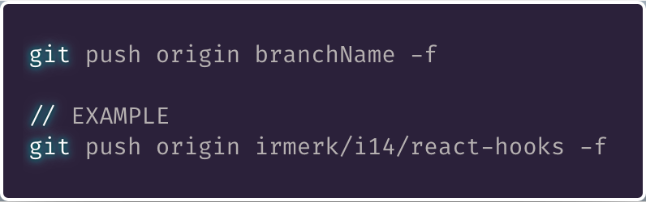
My Workflow
Notes:
If you have previously pushed your code to a remote branch, you will need to force push.
If not, omit the -f tag.
Open a pull request in GitHub from this forked branch.

Slide 36
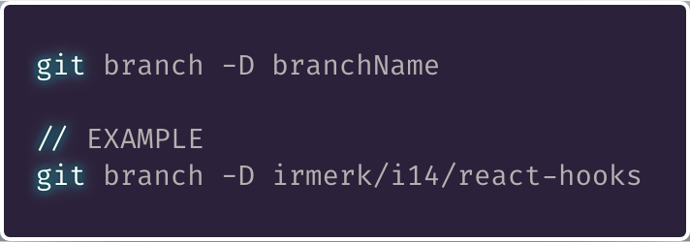
My Workflow
Notes:
Once merged to master - clear out your branch locally

Slide 37
🙅 Merge 🙅
Non-destructive
Easily pollutes log
Notes:
Non-destructive
but can pollute an active master
Many uncomfortable rebasing, just practice

Slide 38
Diff
Ensure Code is As Expected
Notes:
Adopt habit of `diff` prior to committing
Ensure code is as expected
No junk

Slide 39
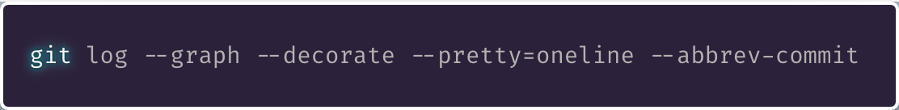
Log
Notes:
Reveal history of everything
This command builds ASCII graph for branch structure

Slide 40
Blame
Specific Lines
Whole Files
Date Ranges
Notes:
Method inspecting who changed what
VSCode? Use GitLens

Slide 41
Commit
Messages

Slide 42
Commits
Capture Single Logical Changes
Commit Often
Commit Working Order
Notes:
More than one change? Split
Small, incremental, self contained, chronological

Slide 43
Messages
Take Your Time
Include Issue References
Notes:
Don’t rush, document well
For future readers - including yourself
Vital accessibility of context

Slide 44
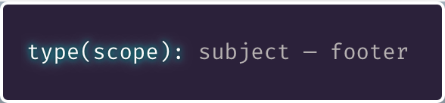
Commit Message Formatting

Slide 45
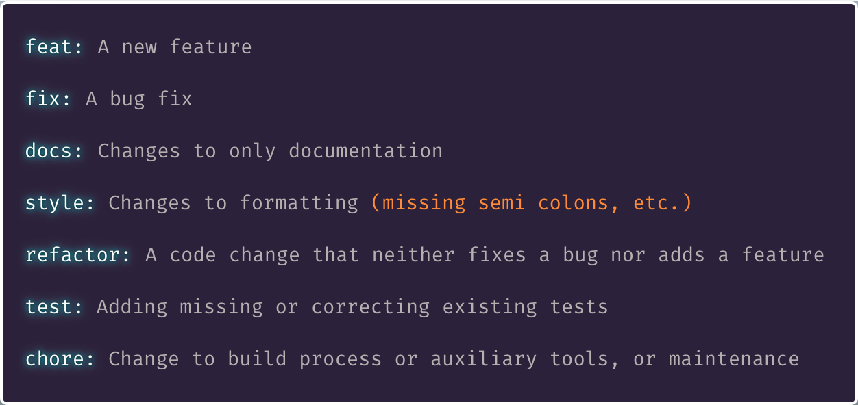
Commit Message Formatting
Types

Slide 46
Commit Message Formatting
Scope

Slide 47
Commit Message Formatting
Subject
Notes:
If applied, this commit will <SUBJECT LINE>

Slide 48

Commit Message Formatting
Footer

Slide 49
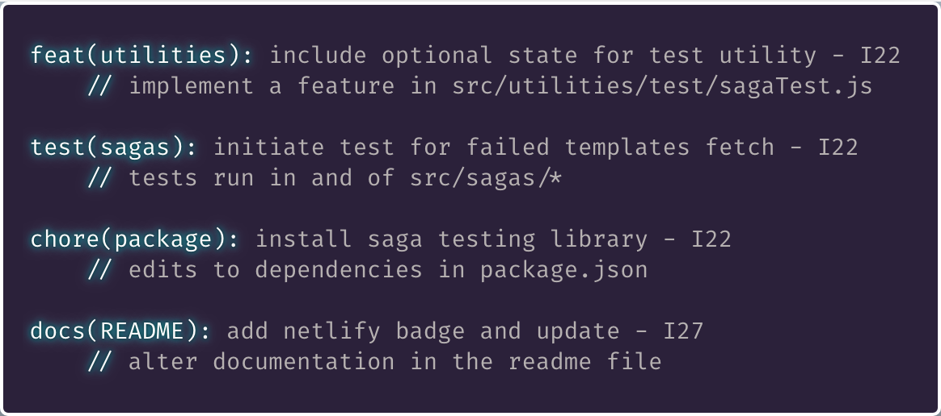
Commit Message Formatting
Examples
Notes:
If applied, this commit will:
INCLUDE OPTIONAL STATE FOR TEST UTILITY — in — UTILITIES
INITIATE TEST FOR FAILED TEMPLATES FETCH — in — SAGAS

Slide 50
GitHub

Slide 51
Pull
Requests
Notes:
Issue -> Feature or Bug
PR -> Code Changes
Done well = commits construct PR to tell story

Slide 52
Pull Requests
Share Information
Peer Reviews
Accountability

Slide 53
Pull Requests
Complete Code Addition
Title Format Follows Commits
Squash, Log Persists

Slide 54
PR ↔ Git
Title Maps to Git
Should be Small
Notes:
Similar to Git Commits
Small
Title = Commit message (format)

Slide 55
PR ↔ Issue
Cleanliness
Layers of Single Threaded Goals
Notes:
Merged PRs in GitHub:
Read like git log, chronological order

Slide 56
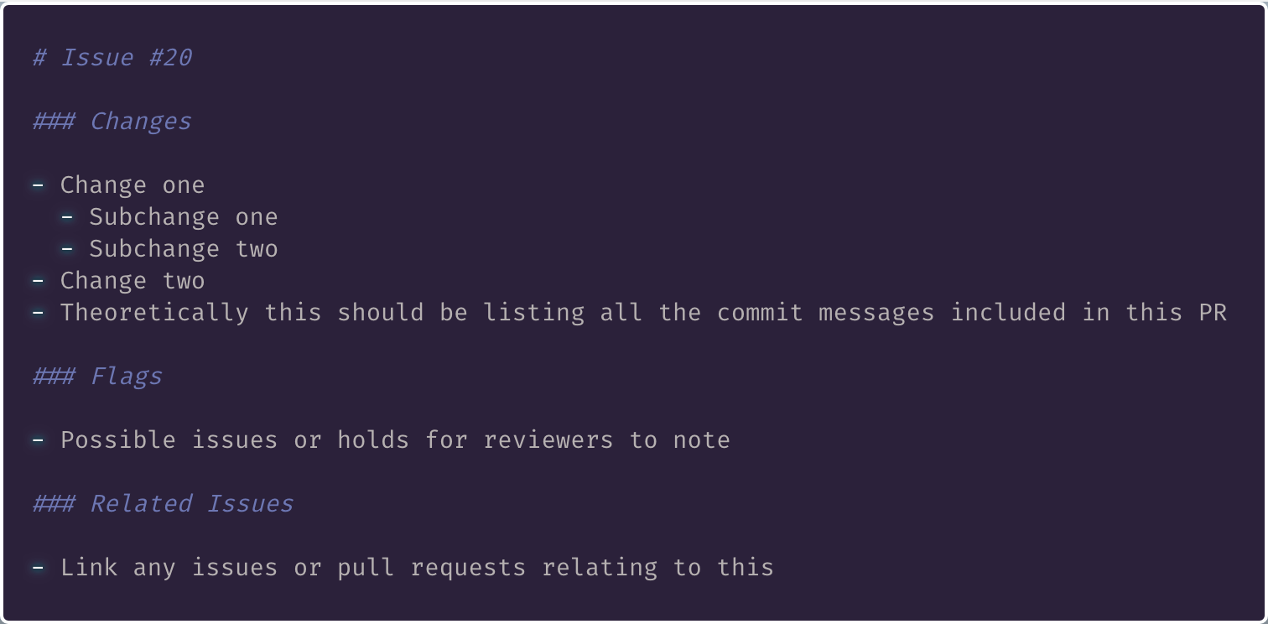
Pull Request Formatting
Notes:
Changes map to git commit messages

Slide 57
Pull Request
What Changes Address Issue?
What Side Effects?
Why is it Necessary?
Notes:
Preempt reviewer needing to ask questions
Be thorough

Slide 58
PR Reviews
Be Thorough
Guardian of Git History
Keeper of Code Quality

Slide 59
PR Reviews
Obvious Now ≠ Obvious Later
Pristine Code > Finishing Feature
… But Don’t Block

Slide 60
PR Reviews
Changes Necessary?
Contributors ≠ Reviewers

Slide 61
GitHub Issues
Easily Maintained
Use Liberally
Foundations for Conversations
Notes:
This goes into search engines,
Provides record for searches and links
Search first to reduce duplicates

Slide 62
GitHub Noise
Is Your Presentation Worth It?
Avoid Rushed Answers/Responses
Provide Context!
Notes:
Be mindful
Is this worth someone’s time?
Gentle bump to reviewers.

Slide 63
Open Source Software
Notes:
Or OSS

Slide 64
Open Source Software
Notes:
Thread for accessibility / documentation:
Commits -> PRs -> Issues -> labels -> projects
Foster collaborative and open atmosphere

