Slide 1


Git Workflow Etiquette
Repository Organization for Clean Codebases
Jolene Langlinais
Notes:
Warning: There will be quite a few concepts that I’ll briefly cover, and won’t have enough time to discuss in depth. Happy to provide resources or follow up discussions afterward.

Slide 2
Agenda
↳ About Me
↳ Git
↳ Branch v. Fork
↳ Rebase v. Merge
↳ Commit (Messages)
↳ Pull Requests (and Reviews)
↳ GitHub Issues
↳ Open Source

Slide 3



Jolene Langlinais
jolenelanglinais.com
@jolanglinais
Maintainer
Full Stack Engineer
Notes:
1. AP -> Non-profit, open-source initiative and codebase for smart legal contracts
: Ecosystem enabling anyone to build smart agreements on technology neutral platform
: Building tools for smart legal contracts
2. Clause -> software platform for smart legal contracts
: Digitize and automate portions of or entire legal contracts
: Blockchain agnostic automated legal agreements, transparent or permissioned

Slide 4
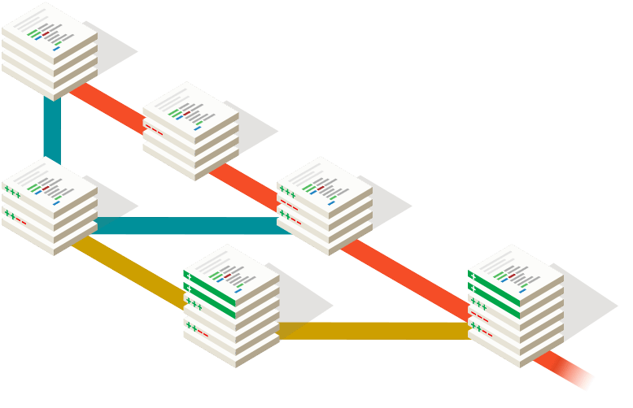
GIT
Version Control
Collaboration
Widely Used
Notes:
- Version control with git provides for powerful collaboration
: tight-knit tech team or a distributed network in an open source format.
Used widely and can manage a constantly evolving codebase.
Good quality software consists of, among other things, a solid history of documentation.
Anyone should be able to join the process and easily figure out and track the status of the project.

Slide 5
GIT Benefits
→ Branching
→ Offline
→ Content Tracking
→ Free Workflow
→ Small Repositories
→ Staging
→ Stashing
→ Malleable History
Notes:
- Branching:
Branches are lightweight and merging is easy
Branch off new work from an existing project to work in isolation until integrate back to project
No need to worry about mess-ups
Offline work is possible with git
Git tracks content rather than files
Git doesn't impose any workflow
Git repositories are small in file size
Staging area allows you to see the changes, commit partial changes, etc
Stashing is invaluable when you do "chaotic" development
You can rewrite history, great for preparing patch sets and fixing your mistakes

Slide 6
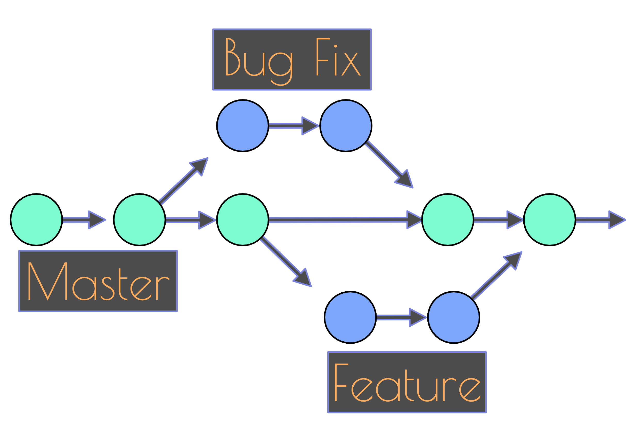
Branching
Forking
FORK
ORIGINAL
Notes:
Branching
+ All project work is centralized
+ Ease of collaboration
+ Single remote to handle
— Deprecated branches may clutter easily
Forking
+ Increased separation between user branches
+ Primary repository cleanliness
— Difficulty to track branches
— Collaboration requires extra steps
— Accessibility is lower for less experienced git users

Slide 7
Branching
Centralized, trackable branches
Quick and messy
Notes:
Small tech team benefit from centralized repository with trackable branches
It’s just a bit messy

Slide 8
Forking
Incentive to keep clean
Masters need to be synced
Notes:
Incentive to keep clean and tidy
While both have benefits, general rule:
Fork for open source / customize code for yourself
Branch for smaller and insular team

Slide 9
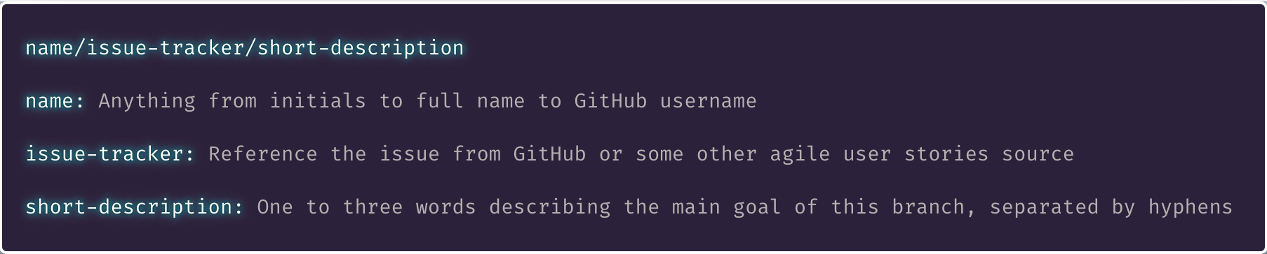
Branch Naming
Notes:
One of first methods for keeping a consistent tracking system of Issues, pull requests, and git history.
The important factor here is consistency.

Slide 10
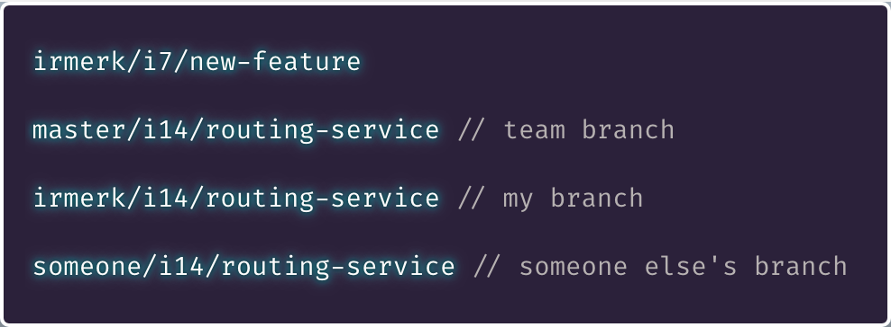
Branch Naming

Slide 11
Rebase
vs
Merge

Slide 12
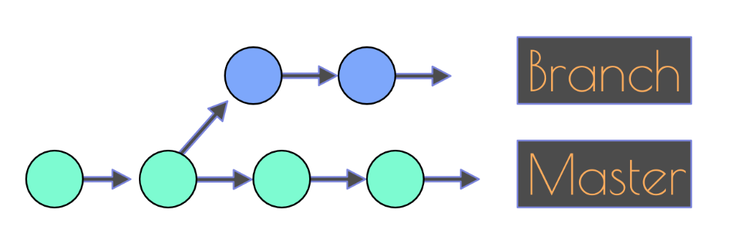
Rebase v Merge
Notes:
A feature or fix branch comes off the master code base

Slide 13
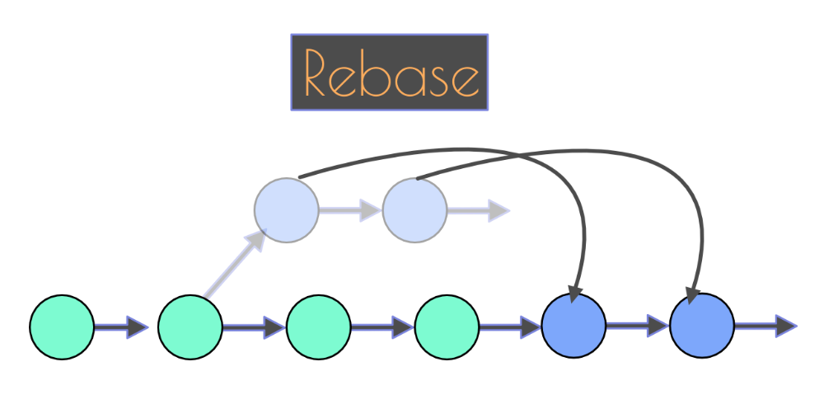
Rebase v Merge
Notes:
Ports a branch (master) into your current branch
Applying all of your commits on top of that branch (master),
Replacing your branch with the revised version.
Catches you up to a branch (master) by rewriting git history in your local git.
Think of it as moving your branch to the tip of master instead of having branched off from an earlier version of master.

Slide 14
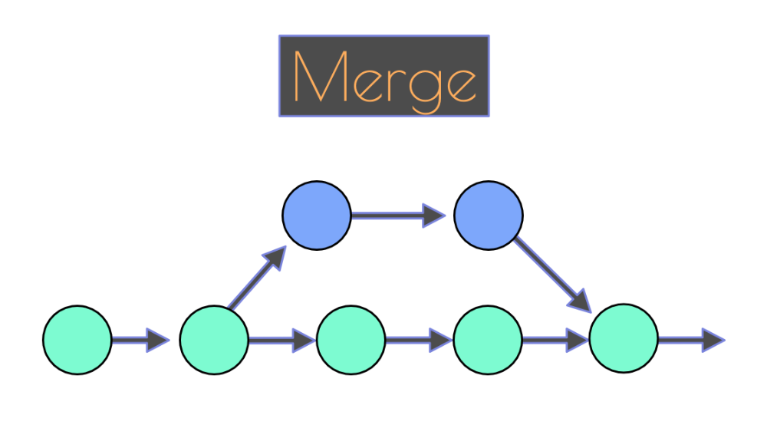
Rebase v Merge
Notes:
Creates a new commit specifically for the merge
Can clutter git log - more on this later

Slide 15
Squash
Reduces clutter
Maintains readable log
Notes:
Common practice to condense long commit message chains into one or a few commits
Useful when committing frequently
Can remove clutter from a commit just to remove `console.log`

Slide 16
Squash
✅ Rebase locally
✅ Squash in GitHub
Notes:
Rebase locally to ensure everything is in order
Squash in GitHub once everything is confirmed to be in order
Keeps merge commits in GitHub very clear (for investigation)

Slide 17
Squash
🚫 Squash locally
🚫 Rebase after
Notes:
Squashing before rebasing reduces conflicts
But changes history, not accurate representation

Slide 18
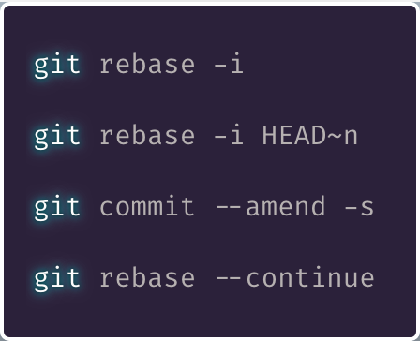
Interactive Rebase
Notes:
Useful when needing to remove multiple commits
Or resolve confusing conflicts
Otherwise overkill

Slide 19
Interactive Rebase
Notes:
Accord Project requires a Developer Certificate of Origin sign-off
May need to rapidly change messages on series of commits

Slide 20
Force Push
🚫 CAUTION 🚫
Notes:
Force pushing can have dire consequences if not used properly, consult others if unsure how to use this.
This is if previously pushed code to a remote branch
Pushing ammendments

Slide 21
Rewriting History
🚫 CAUTION 🚫
Notes:
Rebase for rewriting is useful
Still needs caution
Don’t interrupt others’ history
Caution: Avoid force pushing to a remote branch other people are working on.

Slide 22
Rebase Your Fears
Commit ongoing work
Practice practice practice
Think of the history!
Notes:
I still fear rebase and squash.
Merge conflicts can be more frequent and seem more difficult.
Commit frequently = Complications infrequent
Merge commit made with conflicts - important part of history

Slide 23
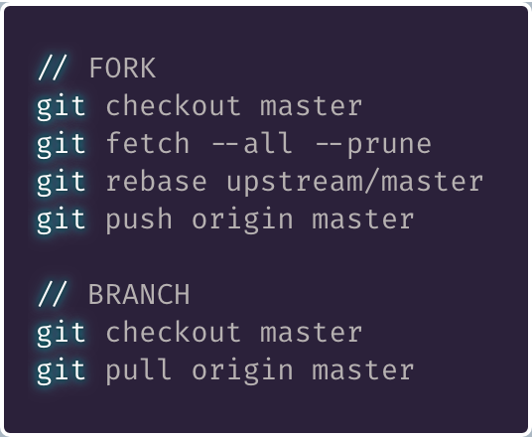
My Workflow
Notes:
My recommendation for a general workflow
Ensure you are currently in master →
If working in a fork, fetch
If working in a branch, pull

Slide 24
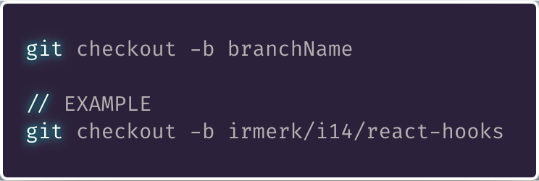
My Workflow
Notes:
Create a new branch for your feature or bug fix
Make changes with as many commits as necessary.
The final commit should build and pass tests.

Slide 25

My Workflow
Notes:
Ensure branch sits on top of master
(as opposed to branch off a branch).
This ensures reviewer minimal effort to integrate your work by fast-fowarding master

Slide 26
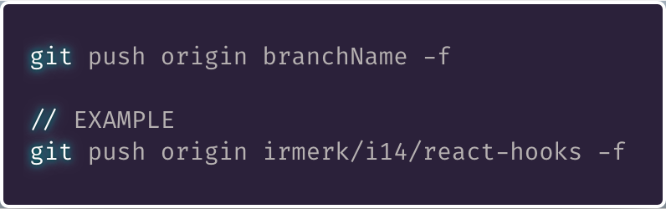
My Workflow
Notes:
If you have previously pushed your code to a remote branch, you will need to force push.
If not, omit the -f tag.
Open a pull request in GitHub from this forked branch.

Slide 27
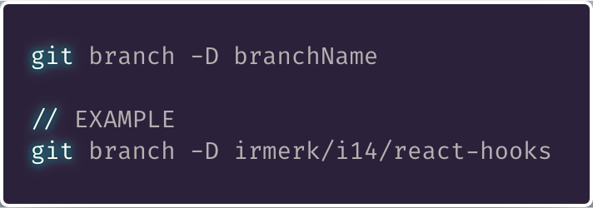
My Workflow
Notes:
Once merged to master - clear out your branch locally

Slide 28
🙅 Merge 🙅
Non-destructive
Easily pollutes log
Notes:
Non-destructive
but can pollute an active master
Many uncomfortable rebasing, just practice

Slide 29
Diff
Ensure Code is As Expected
Notes:
Adopt habit of `diff` prior to committing
Ensure code is as expected
No junk

Slide 30
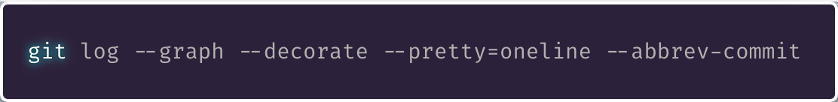
Log
Notes:
Reveal history of everything
This command builds ASCII graph for branch structure

Slide 31
Blame
Specific Lines
Whole Files
Date Ranges
Notes:
Method inspecting who changed what
VSCode? Use GitLens

Slide 32
Commit
Messages

Slide 33
Commits
Capture Single Logical Changes
Commit Often
Commit Working Order
Notes:
More than one change? Split
Small, incremental, self contained, chronological

Slide 34
Messages
Take Your Time
Include Issue References
Notes:
Don’t rush, document well
For future readers - including yourself
Vital accessibility of context

Slide 35
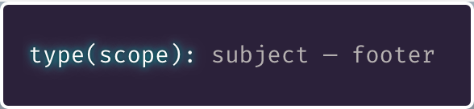
Commit Message Formatting

Slide 36
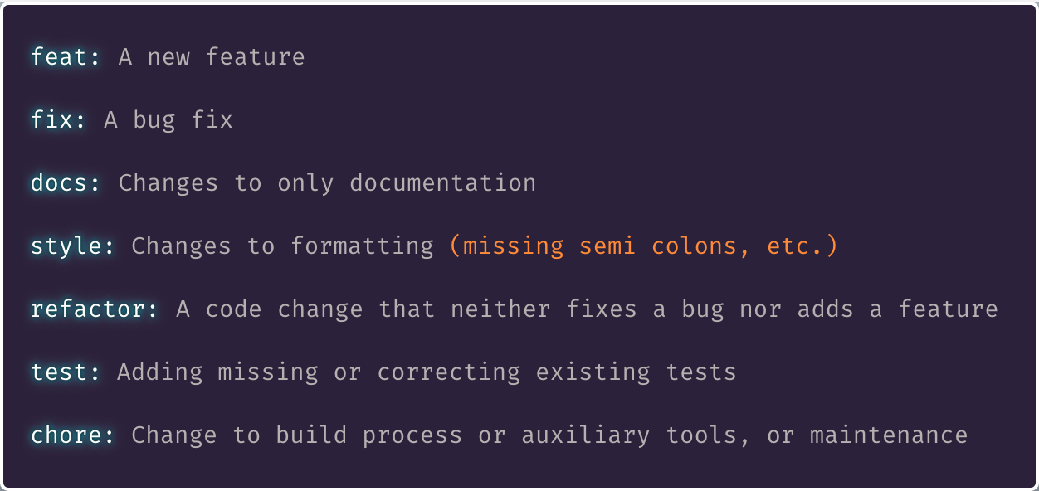
Commit Message Formatting
Types

Slide 37
Commit Message Formatting
Scope

Slide 38
Commit Message Formatting
Subject
Notes:
If applied, this commit will <SUBJECT LINE>

Slide 39

Commit Message Formatting
Footer

Slide 40
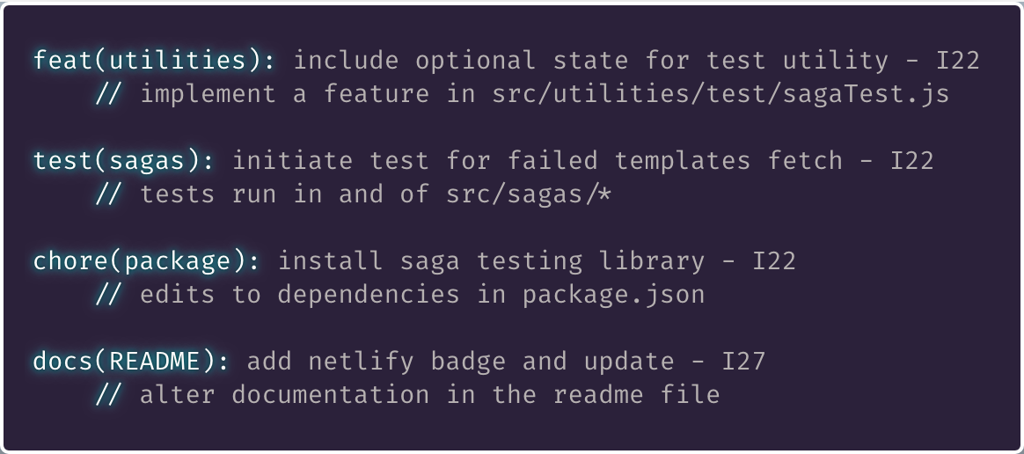
Commit Message Formatting
Examples
Notes:
If applied, this commit will:
INCLUDE OPTIONAL STATE FOR TEST UTILITY — in — UTILITIES
INITIATE TEST FOR FAILED TEMPLATES FETCH — in — SAGAS

Slide 41

GitHub

Slide 42
Pull
Requests
Notes:
Issue -> Feature or Bug
PR -> Code Changes
Done well = commits construct PR to tell story

Slide 43
Pull Requests
Share Information
Peer Reviews
Accountability

Slide 44
Pull Requests
Complete Code Addition
Title Format Follows Commits
Squash, Log Persists

Slide 45
PR ↔ Git
Title Maps to Git
Should be Small
Notes:
Similar to Git Commits
Small
Title = Commit message (format)

Slide 46
PR ↔ Issue
Cleanliness
Layers of Single Threaded Goals
Notes:
Merged PRs in GitHub:
Read like git log, chronological order

Slide 47
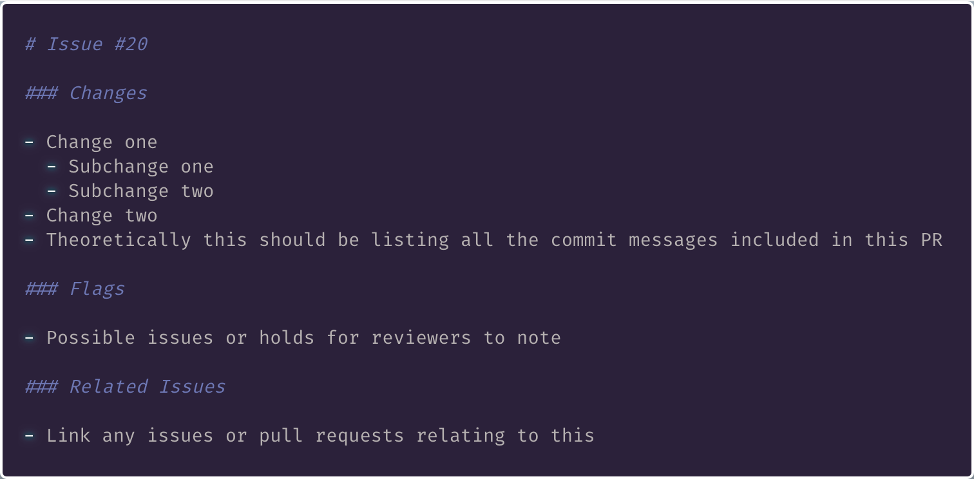
Pull Request Formatting
Notes:
Changes map to git commit messages

Slide 48
Pull Request
What Changes Address Issue?
What Side Effects?
Why is it Necessary?
Notes:
Preempt reviewer needing to ask questions
Be thorough

Slide 49
PR Reviews
Be Thorough
Guardian of Git History
Keeper of Code Quality

Slide 50
PR Reviews
Obvious Now ≠ Obvious Later
Pristine Code > Finishing Feature
… But Don’t Block

Slide 51
PR Reviews
Changes Necessary?
Contributors ≠ Reviewers

Slide 52
GitHub Issues
Easily Maintained
Use Liberally
Foundations for Conversations
Notes:
This goes into search engines,
Provides record for searches and links
Search first to reduce duplicates

Slide 53
GitHub Noise
Is Your Presentation Worth It?
Avoid Rushed Answers/Responses
Provide Context!
Notes:
Be mindful
Is this worth someone’s time?
Gentle bump to reviewers.

Slide 54
Open Source Software
Notes:
Or OSS

Slide 55
Open Source Software
Notes:
Thread for accessibility / documentation:
Commits -> PRs -> Issues -> labels -> projects
Foster collaborative and open atmosphere

Slide 56
github.com/accordproject
accordproject.org
Notes:
Join us @
Participating in Hacktoberfest

