Slide 1
Computational Science Project
Computational analysis of the functionality of proteins,
and generation of functional proteins
Joseph Touzet

Slide 2
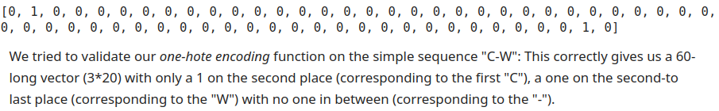
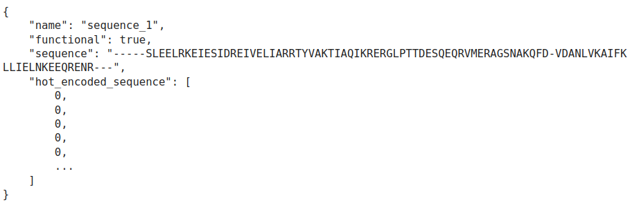
Task 1 - Reading and formatting the data
A - One-hot encoding sequences:
B - Reading all sequences:

Slide 3
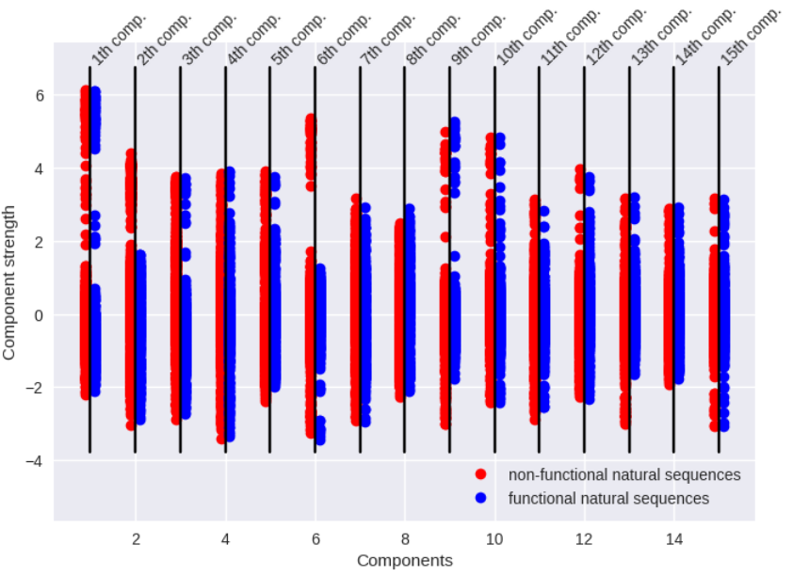
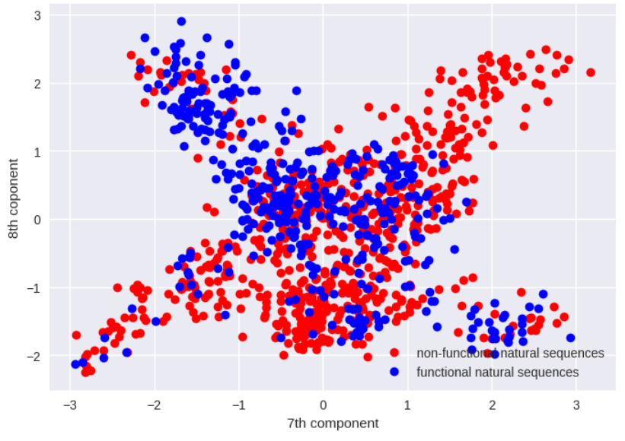
Task 2 - Principal Component Analysis

Slide 4
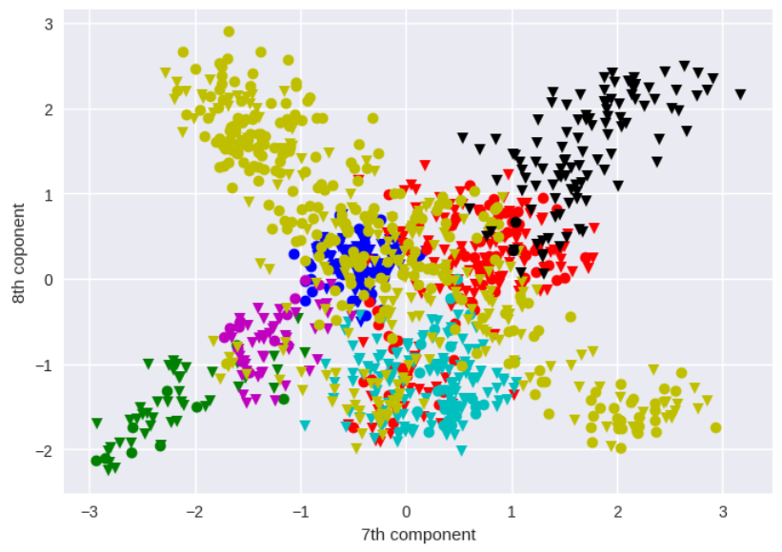
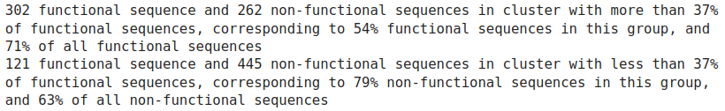
Task 3 - First analysis: clustering
3.1 - Clustering in natural space: functionality

Slide 5
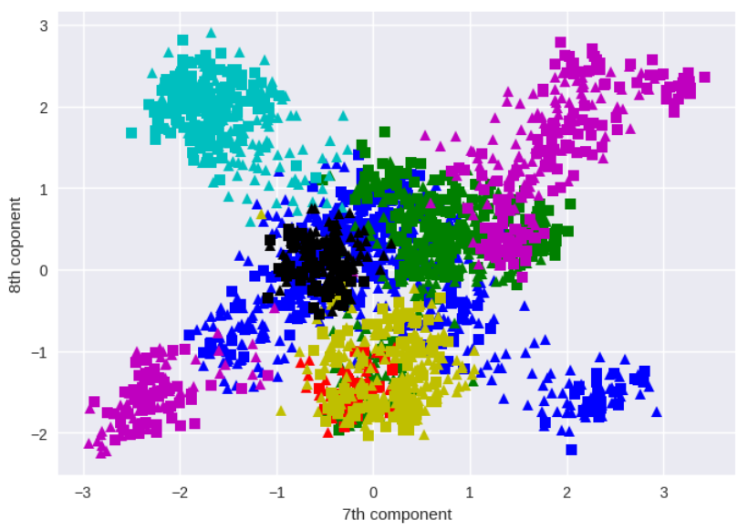
Task 3 - First analysis: clustering
3.1 - Clustering in natural space: natural vs artificial

Slide 6
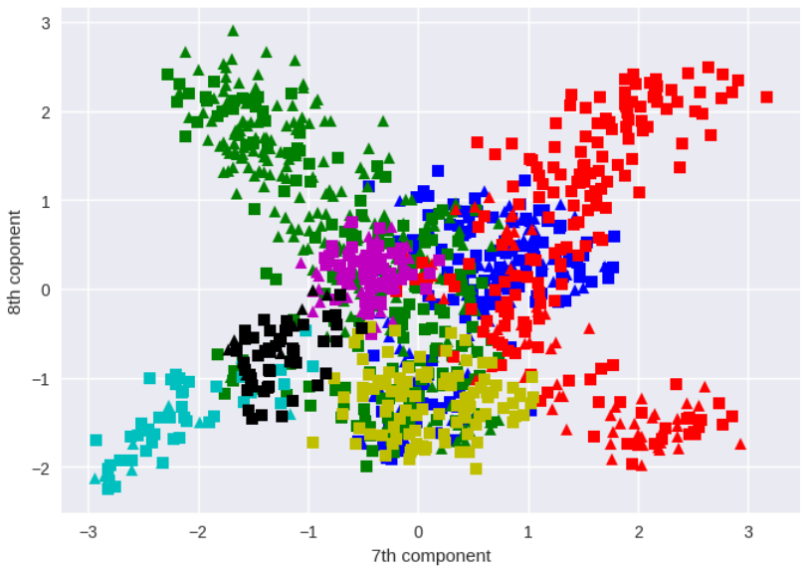
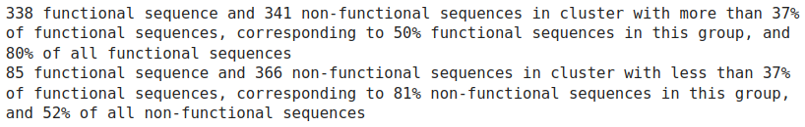
Task 3 - First analysis: clustering
3.2 - Clustering in PC space: functionality

Slide 7
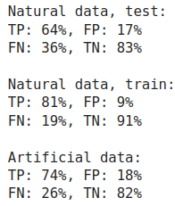
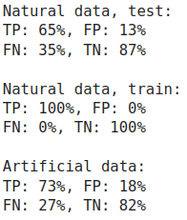
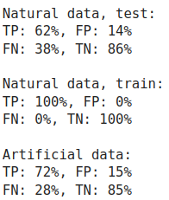
Task 4 - Further analysis: training better models
4.a - decision tree:
4.b - logistic regression:
4.c - neural network:

Slide 8
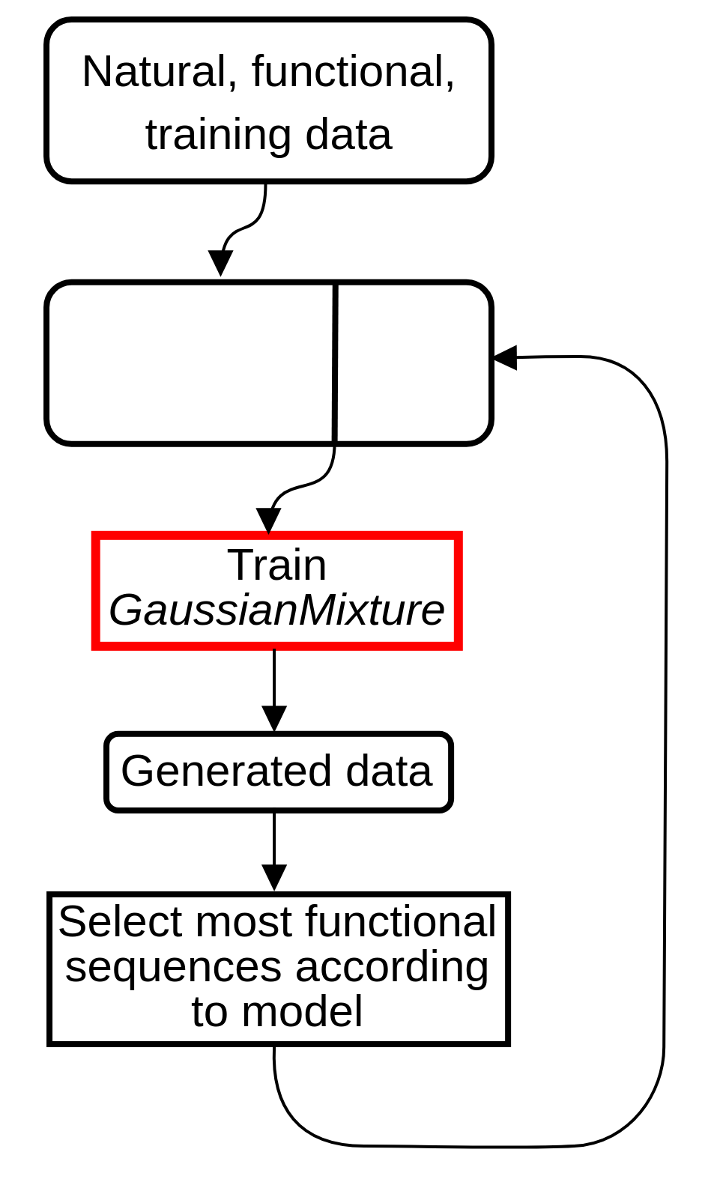
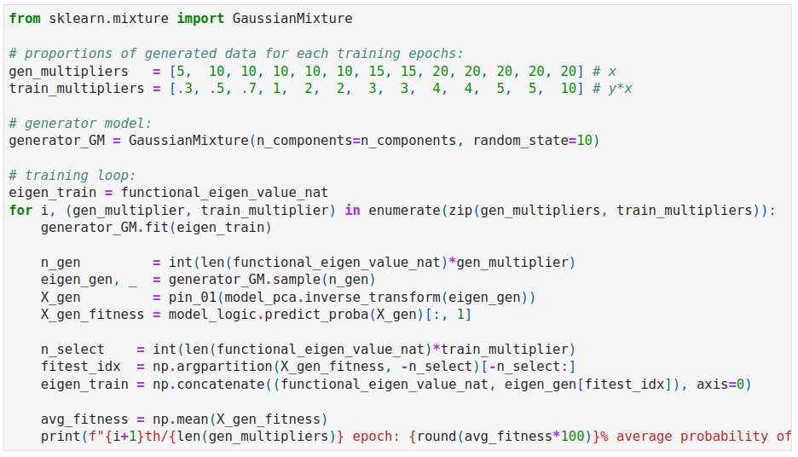
Task 5 - Generating artificial functional sequences

Slide 9
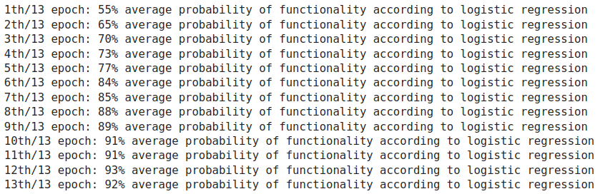
Task 5 - Generating artificial functional sequences
Training:

Slide 10
Task 5 - Generating artificial functional sequences
Intersection with training data:
5.1 - Clustering:
5.2 - Decision Tree:
5.3 - Neural network:

Slide 11
Conclusion
Good separation of functional/non-functional sequences
Efficient generation of supposedly functional sequences
Generated sequences functional according to all different models

