Slide 1
Quantum information presentation
Quantum teleportation is a universal computational primitive
Joseph Touzet

Slide 2
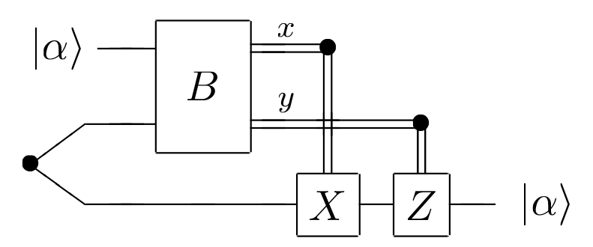
Quantum teleportation
1 - The teleportation setup

Slide 3
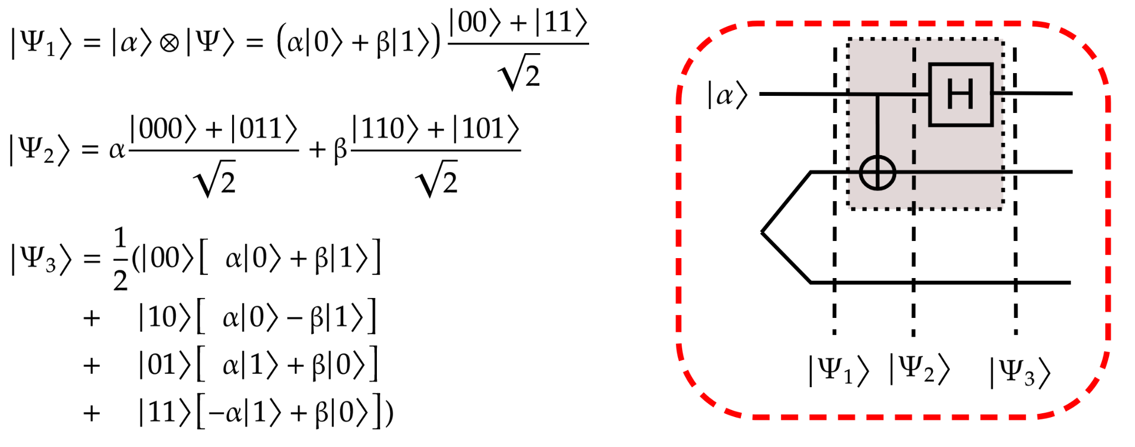
Quantum teleportation
1 - The teleportation setup: first proof

Slide 4
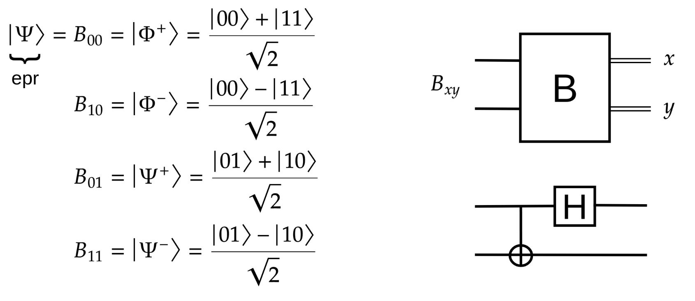
Quantum teleportation
1 - The teleportation setup: Bell states

Slide 5
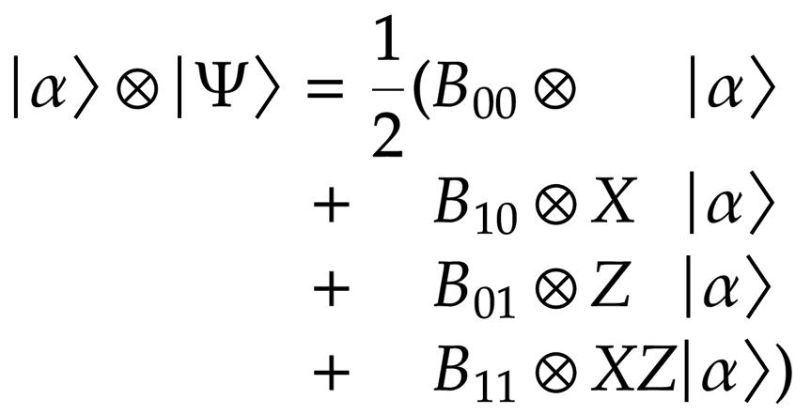
Quantum teleportation
1 - The teleportation setup: better proof

Slide 6
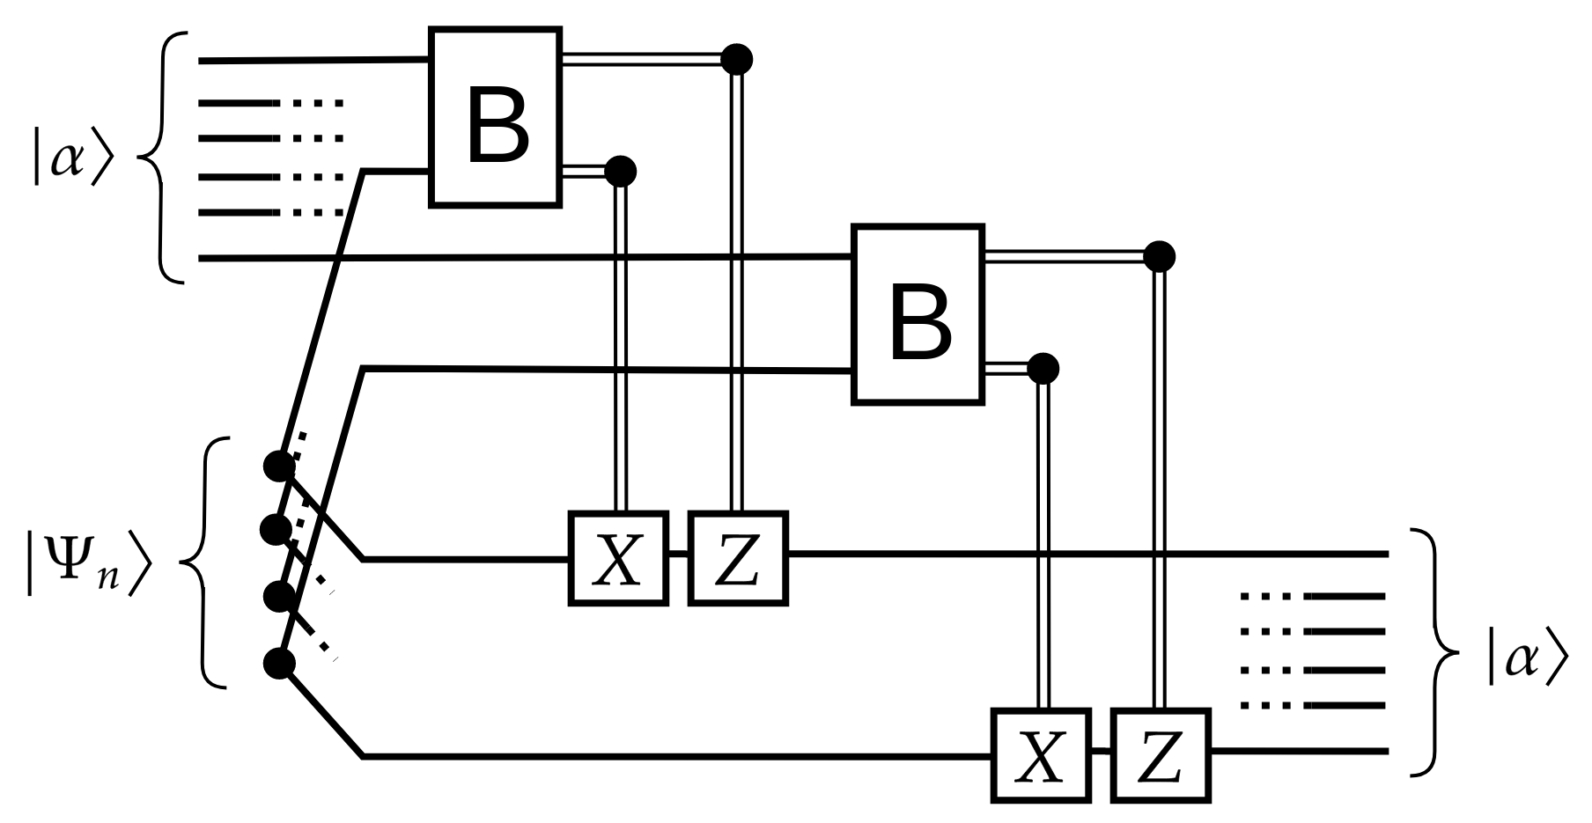
Quantum teleportation
1 - Multiple qubit teleportation

Slide 7
Quantum teleportation
2 - Why use quantum teleportation ?
Use different types of qubit for computation and storage
Long range qubit transportation

Slide 8
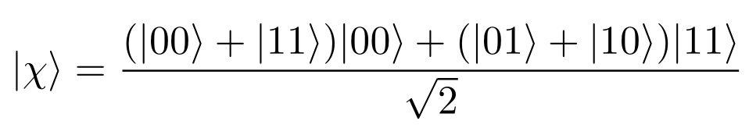
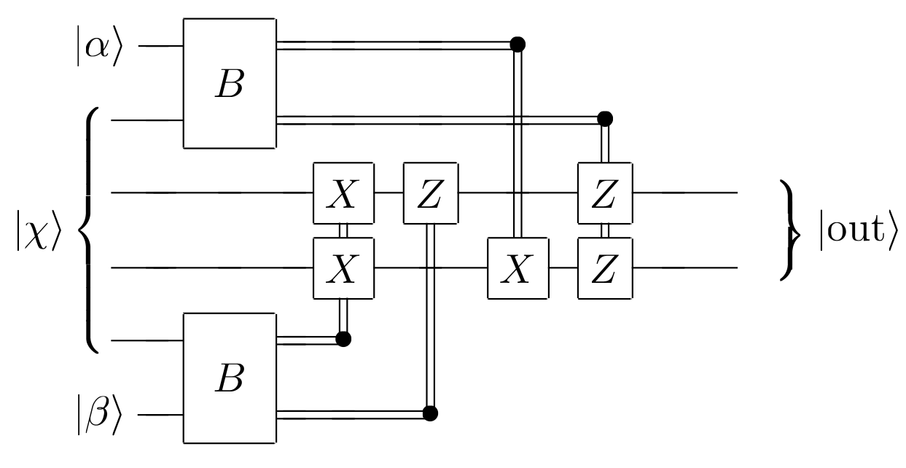
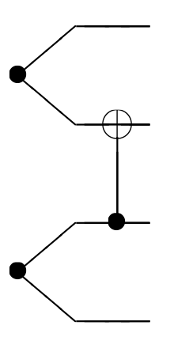
Using quantum teleportation to build quantum gates
3 - From a quantum teleporter to the CNOT gate:

Slide 9
Using quantum teleportation to build quantum gates
3 - From a quantum teleporter to the CNOT gate:
Using the CNOT gate we have built, and single-qubit gates we have a universal set of quantum gates !
Circuit functionality is proven later on

Slide 10
Fault tolerant quantum gates
4 - introducing fault tolerance
Redondance block to correct faults
-> Avoid operations within blocks to avoid error propagation
-> Prefere transversal operations

Slide 11
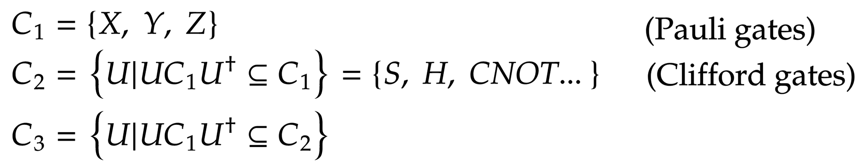
Fault tolerant quantum gates
4 - introducing fault tolerance: building gates from the C3 group
C1 and C2 gates can be applied transversely, while C3 gates cannot in general.

Slide 12
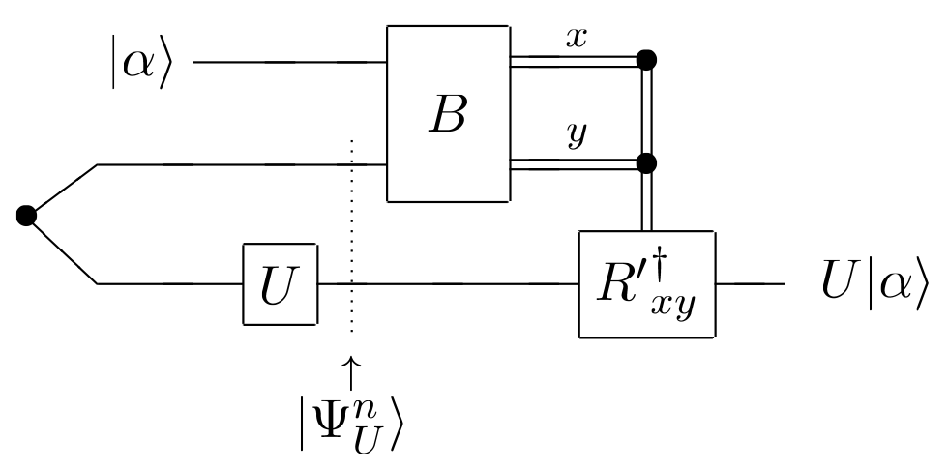


Fault tolerant quantum gates
4 - introducing fault tolerance: building gates from the C3 group

Slide 13
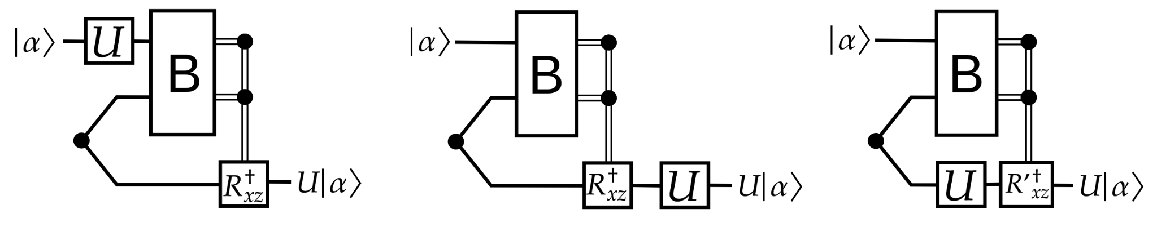
Fault tolerant quantum gates
4 - introducing fault tolerance: building gates from the C3 group

Slide 14
Fault tolerant quantum gates
4 - introducing fault tolerance: building gates from the C3 group
We can build gates from the C3 group (Cn) only by applying gates from the C2 group (Cn-1) to the actual Qubits !
Can also be used to prove the CNOT gate circuit

Slide 15
Conclusion
Advantages of this method:
Typical advantages of quantum teleportation:
  Apply gates on “volatile qubit”, while storing “stable qubit”
Use already existing quantum teleportation device
Apply “complex” gates (for fault tolerant comp.) using “simpler” gates

