Slide 1

Two Homes,
One County
A Data-Driven Home Search for William Rodriguez
King County Housing Market Analysis · Sales from May 2014 – May 2015
1 / 12

Slide 2


William Rodriguez — buyer, household of 2
Meet the Client
City Home
Country Home
Needs to move fast
Wants a central location
Best possible timing to buy
Prefers non-renovated homes
2 / 12
Notes:
William Rodriguez is buying two properties: For the country home, timing is the priority — he wants to buy at the best possible time, and prefers non-renovated properties. For the city home, the priority is a centrally located zip code where homes turn over often, giving him a faster, more realistic search.

Slide 3

BUSINESS QUESTION
What factors influence the price of homes in King County?
Every finding and recommendation in this deck traces back to this one question — answered specifically for William's two searches.
3 / 12
Notes:
The business question behind the analysis: what factors influence the price of homes in King County? We break it into three hypotheses. Then answer each one for William's two searches specifically.

Slide 4

What We Looked At
21,597
12 months
King County
home sales analyzed
May 2014 – May 2015
Seattle & surrounding area
Sale records were joined against county property details — size, condition, location, and renovation history — for every transaction in the window.
4 / 12
Notes:
We're working with a full year of King County home sales, just over 21,500 transactions, joined to the county's property detail records so we know the size, condition, location, and renovation history for every sale.

Slide 5



Three Hypotheses Tested
Hypothesis 1 — Does location drive price?
Hypothesis 2 — Does renovation status matter?
Hypothesis 3 — Is there a best time to buy?
5 / 12
Notes:
Three research questions guided the analysis: does a home's location drive its price, does renovation status change what buyers pay, and is there a seasonal pattern that points to a better or worse time to buy?

Slide 6
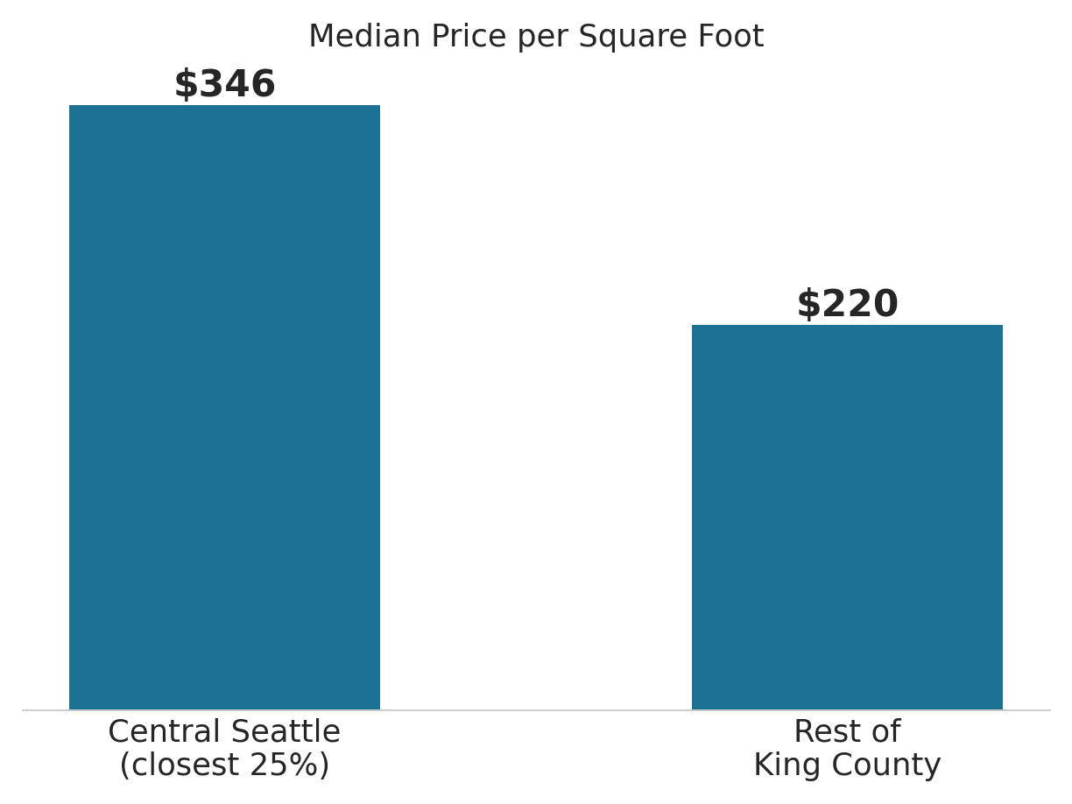
Location Commands a Premium
A home within ~6 miles of downtown Seattle costs about 57% more per square foot than homes farther out.
Large-lot “country” homes don’t sell for less overall — but they do cost less per square foot of living space, since the buyer is paying for land, not finished floor area.
6 / 12
Notes:
Homes in the closest quarter of the market to downtown Seattle sell for a median of $346 per square foot, versus $220 for the rest of the county — with a 57 percent premium. Large-lot homes don't sell for less in total, but they are cheaper per square foot, since more of the price is for land rather than house.

Slide 7
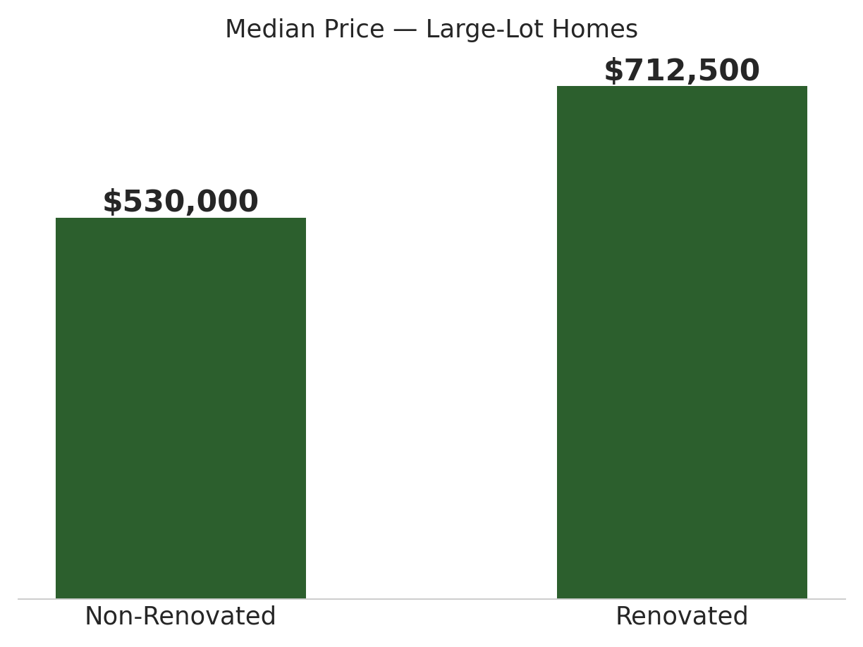
Non-Renovated Homes Cost Less
Non-renovated homes are both the norm (97% of listings) and the cheaper option — a ~34% savings among large-lot homes.
97% of King County homes have no renovation on record. Non-renovated isn’t a compromise here — it’s the typical listing, which lines up well with William’s stated preference.
7 / 12
Notes:
Among large-lot properties, renovated homes have a median price of $712,500 versus $530,000 for non-renovated ones, with a 34 percent premium. Ninety-seven percent of homes countywide have no renovation on record, so non-renovated is the typical listing and the cheaper one.

Slide 8
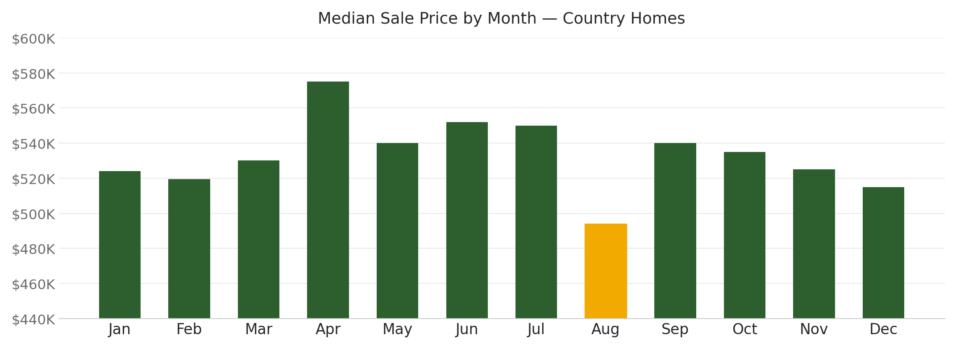
When You Buy Determines What You Pay
For country homes, August is the cheapest month to close (median $493,725) — worth timing around if savings matter most.
Country homes specifically — city homes follow a different, later-year pattern.
Aug – $493,725
May – 604 sales
cheapest median price for country homes
most country-home listings to choose from
8 / 12
Notes:
For country homes, median price is lowest in August and highest in April, while sales volume is lowest in January and peaks in May. City homes follow a different pattern — their median price is lowest in November and highest in March. Since timing matters most for the country home, August is the window we recommend targeting.

Slide 9
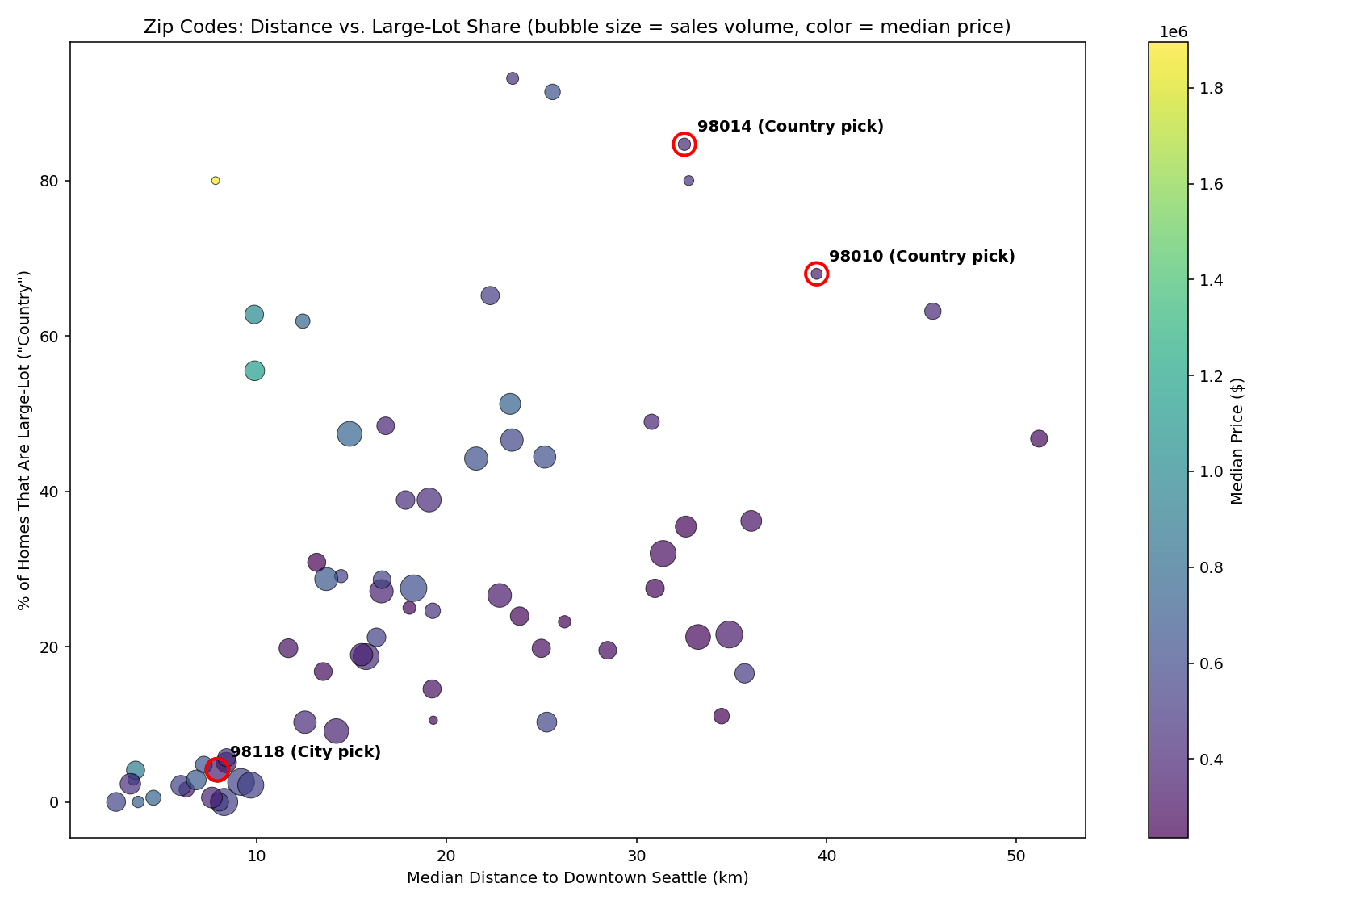
For the City Home → Zip 98118
98118 is the closest high-turnover, affordable zip to downtown — the strongest match for “fast and central.”
7.9 km
from downtown Seattle — the closest of the high-turnover zips
507 sales
in the 12-month window — highest turnover among affordable central zips
$367,500
median price — the most affordable of that group
Distance vs. large-lot share, sized by sales, colored by price — 98118 circled.
98103, 98115, and 98117 are strong second choices. Filter to 1–3 bedrooms — plenty for a household of 2, avoiding a ~41% size premium.
9 / 12
Notes:
For the city home, 98118 stands out as the strongest option near downtown - with the closest high-turnover ZIP code at 7.9 km away. It has the most sales among affordable central ZIP codes (507 during the period), and has the group's lowest median price at $367,500. ZIP codes 98103, 98115, and 98117 are also solid alternatives. For a two-person household, focusing on one- to three-bedroom homes captures 59% of available listings while avoiding an estimated 41% premium for extra bedrooms that are unlikely to be used.

Slide 10
For the Country Home → Zip 98010 or 98014
98010 and 98014 are genuinely rural, affordable, with enough active listings and sales to suit William's timeline and preference for non-renovated homes.
30+ km
from downtown — genuinely rural, not just “outside city limits”
68–85%
of homes in these zips are large-lot — real country character
$360K–$415K
median price — well below the county median
Distance vs. large-lot share, sized by sales, colored by price — 98010 & 98014 circled.
Lean into non-renovated listings here — they’re the majority of homes and meaningfully cheaper.
10 / 12
Notes:
For the country home, zip codes 98010 and 98014 stand out as large-lot areas at 30+ kilometers from downtown, where 68 to 85 percent of homes qualify as large-lot versus a 25 percent countywide, and affordable medians of $360,000 and $415,000. Non-renovated listings are both the norm and the better deal here.

Slide 11
Final Recommendations
City home
Target zip 98118 — closest high-turnover, affordable zip to downtown. Filter to 1–3 bedrooms.
Country home
Target zip 98010 or 98014 — genuinely rural and affordable. Lean into non-renovated listings.
Timing
Country home: close in August for the lowest price ($493,725), or May for ~18% more inventory at only a ~9% premium. City home: timing matters less since speed comes first, but November is the cheapest month ($537,500) if there's flexibility — the two searches don't share one seasonal pattern.
11 / 12
Notes:
Final recommendations: a 1-3 bedroom city home in zip 98118, and a non-renovated country home in zip 98010 or 98014. If timing matters for the country search, August for the lowest price or May for more inventory at a small premium.

Slide 12

Thank You
Questions & discussion
12 / 12
Notes:
That's the full picture — happy to open it up for questions.

